Slide 1
Cross-Hedging Castor Meal Price Risk Using NCDEX Castor Seed Futures
Nandan Lunawat| M.A. Applied Quantitative Finance
The question
Asset A: Castor meal
Asset B: Castor Seed futures
A holder of castor meal faces price risk, but NCDEX has no castor meal futures contract.
NCDEX does trade castor seed futures, the raw material that castor meal comes from.
Can castor seed futures hedge castor meal? How much risk do they remove, and does the hedge hold up on new data?
SEA daily quote
Ex-Kandla
Rs per tonne
Castor seed futures
NCDEX, symbol CASTOR
Deesa, monthly expiry
Rs per quintal
Linked because castor seed is crushed into castor oil and castor meal, but they are different products. This makes it a cross-hedge.
1 / 4
Notes:
I chose castor meal as the asset to hedge because there is no castor meal futures contract on NCDEX, so a direct hedge is not possible. NCDEX does trade castor seed futures, and castor meal is what is left after oil is extracted from castor seed, so the two prices are economically linked. Because the futures are on a related commodity and not on castor meal itself, this is a cross-hedge. My aim was to estimate the hedge ratio, measure how much price risk it removes in the estimation period, and then test the same hedge on a later period it had not seen.

Slide 2
Data and how it was treated
Daily data, 25 Sep 2023 to 28 Sep 2026
 | Castor meal (spot) | Castor seed (futures)
Source | SEA (Solvent Extractors' Association of India) daily quotes | NCDEX daily bhavcopy files
Price | Published quote, Rs/tonne | Closing price of each contract, Rs/quintal
Collected | 647 daily posts | 744 trading days, 3,467 contract-days
Usable | 546 prices | All days; contract chosen by roll rule
1
Collect
Downloaded every daily NCDEX file and every SEA quote post; each file checked against its date.
2
Clean
SEA posts set aside only for fixed reasons: date mismatch, duplicate post or obvious typing error.
3
Align
A return is formed only when two consecutive trading days both have published prices. Nothing is filled in or carried forward.
Returns: r = ln(Pt / Pt-1). For futures, the same contract is used on both days.
4
Result
496 matched daily returns: 275 to estimate the hedge (to 26 Sep 2025), 221 to test it (1 Oct 2025 to 28 Sep 2026).
2 / 4
Notes:
The futures data come from NCDEX's daily bhavcopy files, which list every contract's closing price, volume and open interest. The castor meal price comes from the Solvent Extractors' Association of India, because NCDEX does not publish a castor meal price. I collected 744 trading days of futures data and 647 SEA posts, and 546 of those posts gave a usable price. Posts were set aside only for fixed reasons such as a wrong date, a duplicate or an obvious typing error. I then matched the two series: a daily return is used only when two consecutive trading days both have published prices, and I never filled in or estimated a price. That gave 496 daily log returns, which I split by date into 275 for estimating the hedge and 221 for testing it.

Slide 3
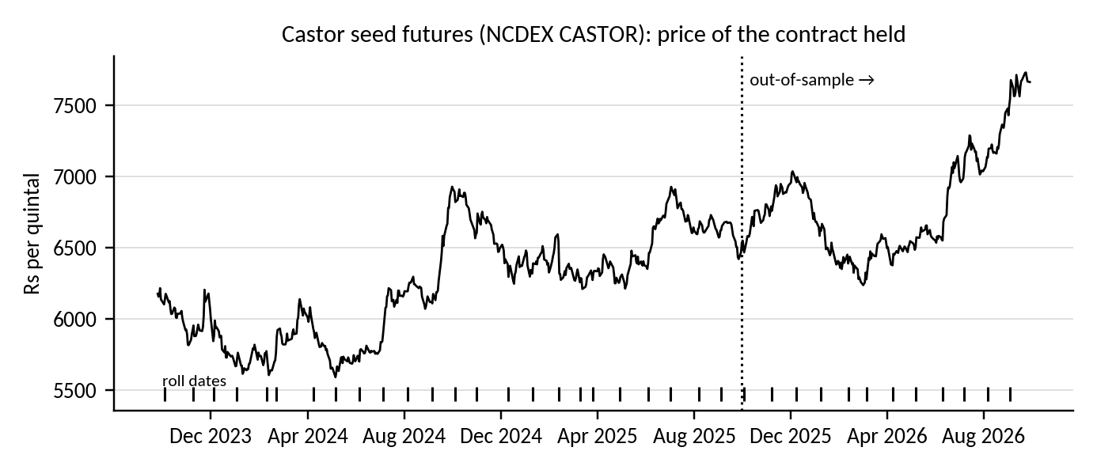
Building a continuous futures price
The problem
Each contract expires, so 3 years needs 36 contracts joined together.
Joining creates artificial price jumps at each switch (paper p.6-7).
Holding to expiry means thin trading and delivery risk (p.1).
What I did
Switch when the next contract's open interest is larger (paper p.2).
My additions: act the next day (no future information) and switch anyway with 7 trading days left (NCDEX delivery period).
Every return uses one contract, so switch gaps never count as returns.
Price of the contract held each day (Rs/quintal). Ticks mark the 36 contract switches; the dotted line marks the start of the test period.
Check: holding each contract to expiry instead cut out-of-sample effectiveness to 3.0%.
3 / 4
Notes:
A futures contract expires every month, so to get three years of data I had to join 36 contracts. The course reading Continuous Contracts Explained points out two problems. If you switch only at expiry, you hold a contract when trading is thin and delivery can be forced. And when you join contracts, the price difference between the old and new contract looks like a jump that never happened in the market. I switched to the next contract when its open interest became larger, which is the method in the paper. I added two things myself: open interest is only published after the close, so I switch the next day, and if the switch has not happened with seven trading days left, I switch anyway, because NCDEX castor seed goes into compulsory delivery in the last three trading days. This safety limit was used for 4 of the 36 switches. Most importantly, every daily futures return uses the same contract on both days, so the price gap at a switch is never counted as a return. As a check, holding each contract until expiry gave much weaker results, 3.0% out of sample.

Slide 4
The hedge and the results
Buyukkara, Kucukozmen and Uysal (2022)
Hedged return: rH = rS - h × rF
OLS: slope of rS on rF (fixed h)
Naive: h = 1
GARCH: new h each day (diagonal VECH)
HE = 1 - Var(hedged) / Var(unhedged)
0.614
OLS hedge ratio (t = 4.46): sell about Rs 61 of futures per Rs 100 of castor meal
What it shows
The link is real but weak: returns correlate at 0.26, and the hedge removes under 7% of the risk.
Results are almost the same out of sample, so the hedge holds up on new data.
GARCH adds under half a percentage point, which is not enough to prefer it over OLS.
Limits: SEA prices are reported rates, not trades; costs, margins and 5-tonne lots are ignored.
4 / 4
Notes:
For the hedge I followed Buyukkara, Kucukozmen and Uysal. The hedged return is the castor meal return minus h times the futures return. I estimated h in three ways: OLS gives one fixed ratio, the naive hedge simply uses 1, and a diagonal VECH GARCH model gives a new ratio each day. Hedge effectiveness is the share of variance removed. The OLS hedge ratio is 0.614 and it is statistically significant, so for every 100 rupees of castor meal you would sell about 61 rupees of castor seed futures. But the hedge only removes about 6.8 percent of the risk in sample and 6.6 percent out of sample. The naive hedge does worse because one-for-one is too much for such a loose link, and GARCH is only slightly better than OLS, not enough to justify the extra complexity. My conclusion is that castor seed futures give only a small but stable hedge for castor meal: a cross-hedge can only remove the risk the two commodities share, and here that shared part is small.

Slide 5
Thank You.

