Slide 1

Green MLOps
A Framework for Energy-Efficient Machine Learning Operations Pipelines
Nandan Muruli
Master's in Applied Computer Science -- SRH University Heidelberg
Supervisor: Prof. Dr. Kamellia Reshadi
September 2026

Slide 2



The Problem
MLOps pipelines optimize accuracy and latency -- and ignore carbon
Deep learning's growing compute demand carries a real carbon cost. Traditional MLOps pipelines have no built-in way to see it, let alone optimize for it.
This project's goal
Design, implement, and evaluate a pipeline that treats energy efficiency as a first-class metric -- alongside accuracy -- using a real, end-to-end ML workload.
Accuracy, latency, throughput
tracked automatically
Case study workload:
Energy & carbon footprint
DistilBERT fine-tuned for sentiment classification on IMDb reviews
almost never tracked
CI/CD pipelines
have no telemetry hook for sustainability
Green MLOps -- Case Study Presentation
2

Slide 3


Research Questions
RQ1
RQ2
RQ3
How can power-consumption tracking be integrated non-intrusively into automated ML training and deployment loops?
What is the quantitative trade-off between model performance (F1) and energy consumption under model compression?
Can data-driven scheduling and execution-level resource capping cut emissions without breaching latency SLAs?
Green MLOps -- Case Study Presentation
3

Slide 4



Architecture & Tech Stack
A working, reproducible pipeline -- not a simulation
→
→
→
→
DVC
MLflow
CodeCarbon
Docker
GitHub Actions
Data & pipeline versioning
Experiment tracking
Energy / emissions telemetry
Containerized execution
CI/CD: lint + smoke tests
configs/config.yaml is the single source of truth
Dataset sizes, model choice, training hyperparameters, compression settings, SLA threshold, and thread caps all live in one config file -- every pipeline stage (dvc.yaml) reads from it, so nothing is hardcoded per script.
Green MLOps -- Case Study Presentation
4

Slide 5

Documented Scope Adaptation
A hardware constraint, not a shortcut
The available hardware has no Intel RAPL interface and no NVIDIA GPU -- so two components specified in the expose were substituted, and the substitution is reported as a limitation, not hidden.
PROPOSED (expose)
IMPLEMENTED (this project)
Scaphandre (Intel RAPL / Kubernetes)
CodeCarbon-only telemetry
GPU power-capping (nvidia-smi)
CPU-thread-count cap (torch.set_num_threads)
Grafana + Kubernetes dashboard
MLflow UI + static HTML dashboard
Green MLOps -- Case Study Presentation
5

Slide 6
RQ1 -- Non-Intrusive Telemetry
One context manager, zero changes to the training loop
Real baseline training runs
with GreenTracker(project_name="imdb_baseline_run"):
trainer.train()
Run date | Duration (s) | Emissions (mg CO2e) | Energy (Wh)
2026-08-06 | 41.18 | 60.96 | 0.134
2026-08-27 | 41.47 | 83.23 | 0.135
Wrapping existing training code in a single context manager logs CodeCarbon's emissions estimate straight into the same MLflow run as accuracy and loss -- no separate dashboard, no training-loop changes.
Source: logs/emissions.csv, captured automatically -- no manual measurement.
Green MLOps -- Case Study Presentation
6

Slide 7
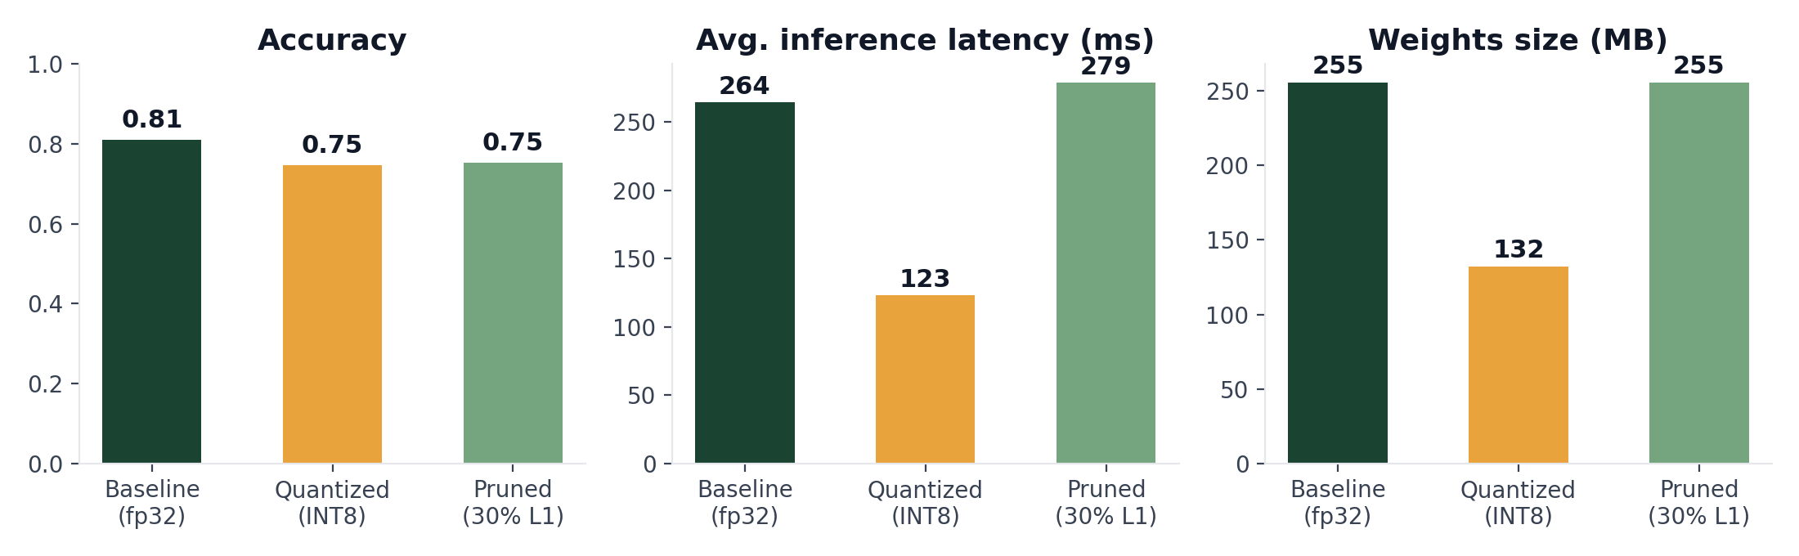
RQ2 -- Compression Trade-off
Quantization wins; unstructured pruning doesn't pay off here
-48%
-53%
-6.3 pp
model size
inference latency
accuracy (quantized)
Green MLOps -- Case Study Presentation
7

Slide 8
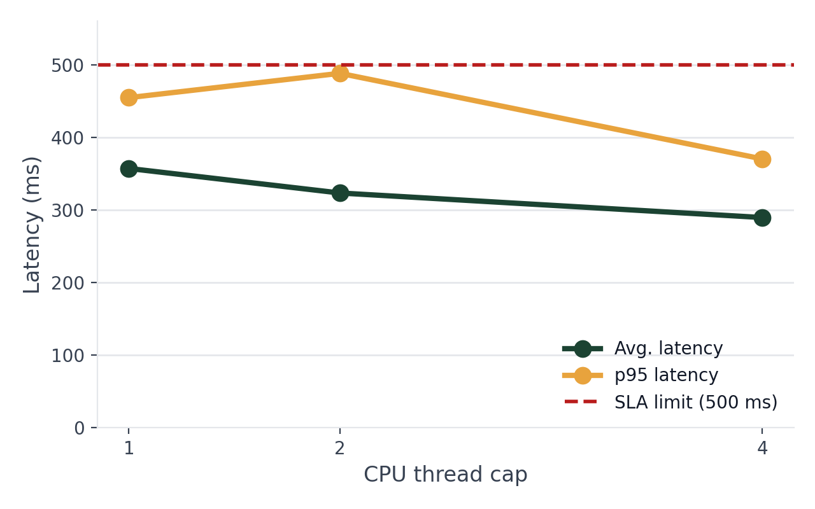
RQ3a -- Resource Capping vs. Latency SLA
CPU-thread cap as a proxy for GPU power-capping
Key findings
No thread cap violated the 500ms SLA.
1 thread: 37% lower measured emissions than 4 threads -- but p95 latency used 91% of the SLA budget (vs. 74% at 4 threads).
Trade-off confirmed: capping resources lowers energy draw at the cost of a thinner latency safety margin.
Green MLOps -- Case Study Presentation
8

Slide 9
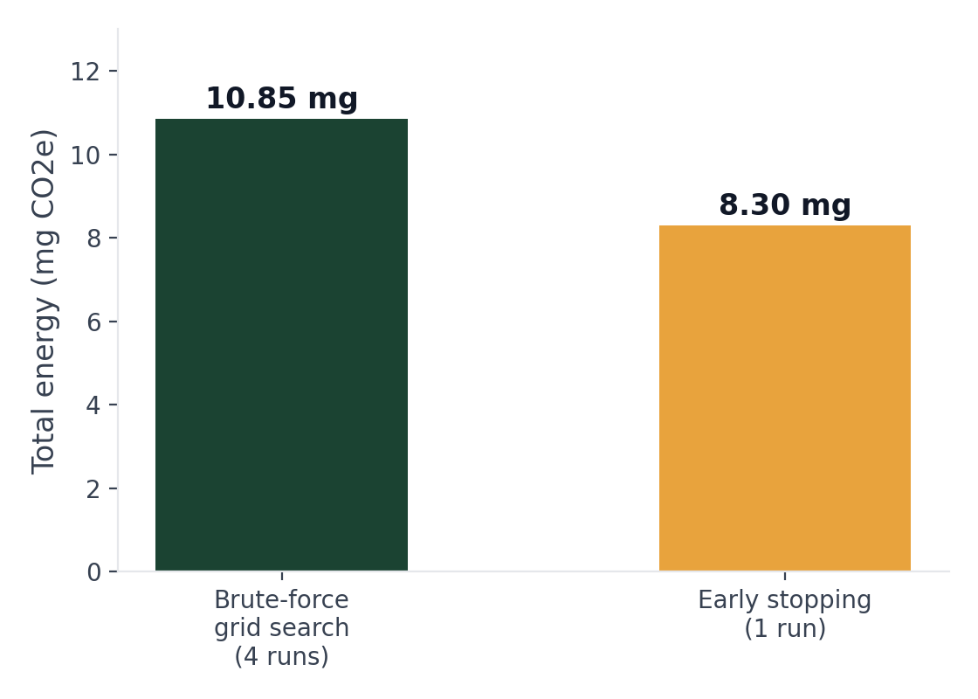
RQ3b -- Scheduling: Grid Search vs. Early Stopping
Adaptive scheduling wins on both energy and quality
23.5%
less energy than brute-force grid search
Grid search: 4 configs x 1 epoch, best eval loss 0.680
Early stopping: 1 run, stopped after 3 epochs, eval loss 0.514
Caveat: grid search explored breadth (4 configs) while early stopping explored depth (1 config, more epochs) -- not a perfectly controlled comparison, but a real result in this setting.
Green MLOps -- Case Study Presentation
9

Slide 10
Limitations & Future Work
LIMITATIONS
FUTURE WORK
No Intel RAPL / NVIDIA GPU -- Scaphandre and true GPU capping untested
Small fine-tuning scale (500 train examples) for time-budget reasons
CodeCarbon readings noisy at sub-5-second evaluation timescales
Unstructured pruning shows no speedup without a sparse-compute runtime
Grid search vs. early stopping conflates search breadth and depth
Validate the CPU-cap proxy against real Scaphandre + GPU power-capping
Scale to the full IMDb training set
Try structured pruning / knowledge distillation for real speedups
Repeat benchmarks across seeds to report variance
Green MLOps -- Case Study Presentation
10

Slide 11

Conclusion
RQ1
A single context-manager wrapper integrates carbon telemetry non-intrusively, unified with existing MLflow tracking.
RQ2
INT8 quantization is the clear win (-48% size, -53% latency, -6.3pp accuracy); unstructured pruning is not, on this hardware.
RQ3
Resource capping trades latency margin for lower energy; adaptive early stopping beat brute-force search on both energy and quality.
Thank you -- Questions?

