Slide 1
Brain Computer Interface -Authentication
Store and execute the transactions using brain waves
Prasanth Nandanuru
Engineering Manager , VP
WellsFargo

Slide 2
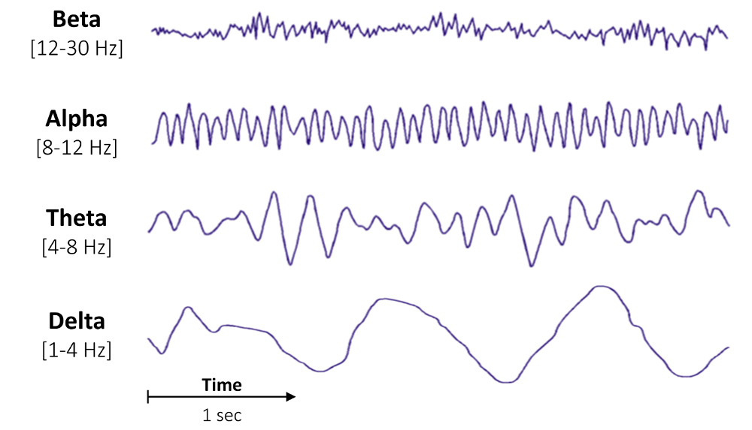
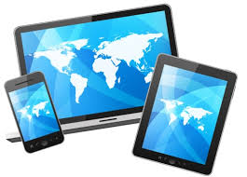
Interaction between human neural system and machines
Attention
Meditation

Slide 3


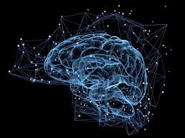


Biometrics
FingerPrint Recognition
**Brainwaves Recognition
Face Recognition
Retina Recognition
Voice Recognition

Slide 4
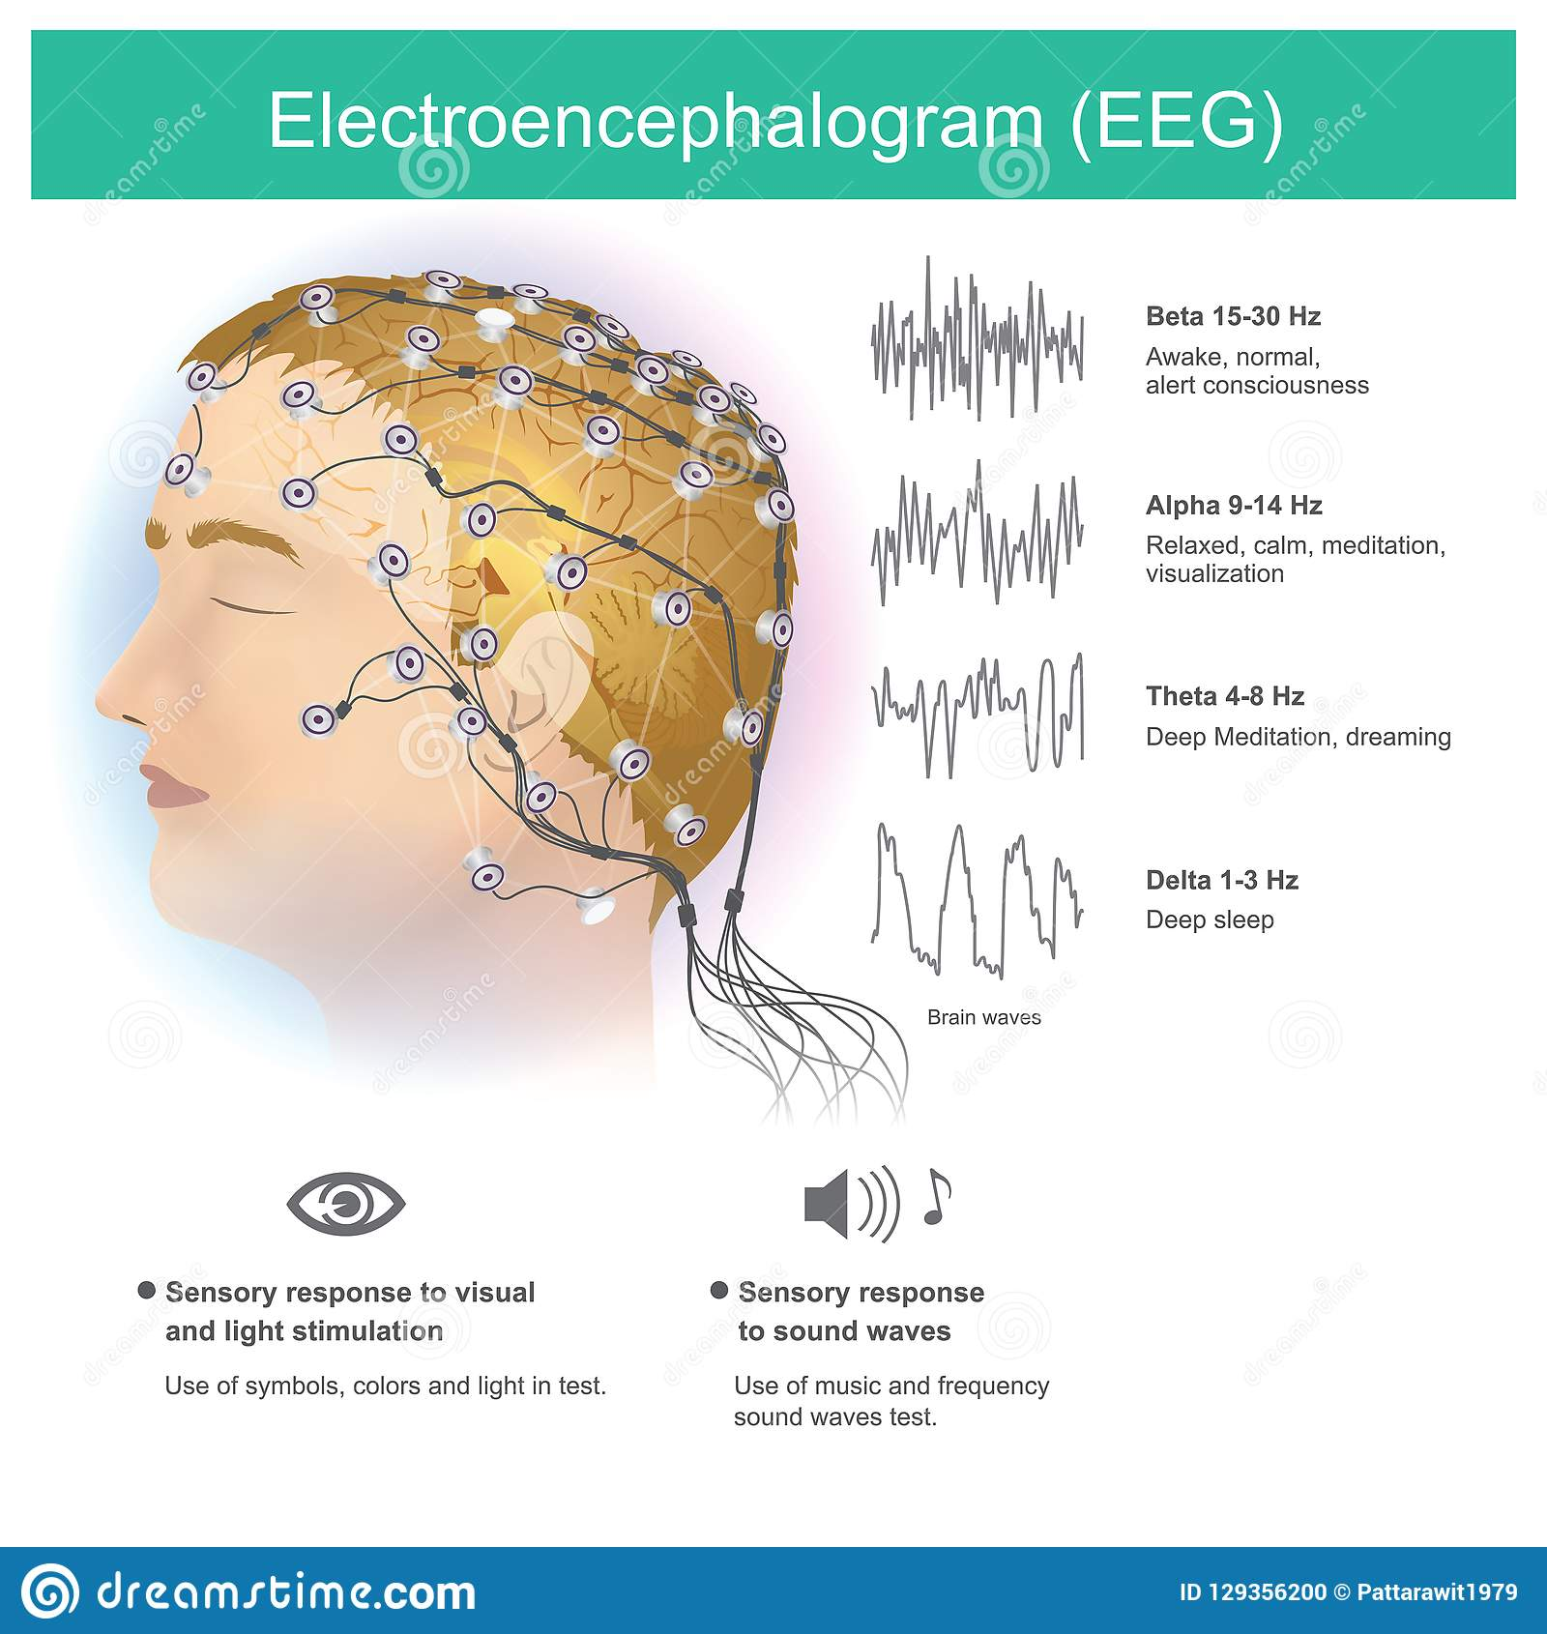
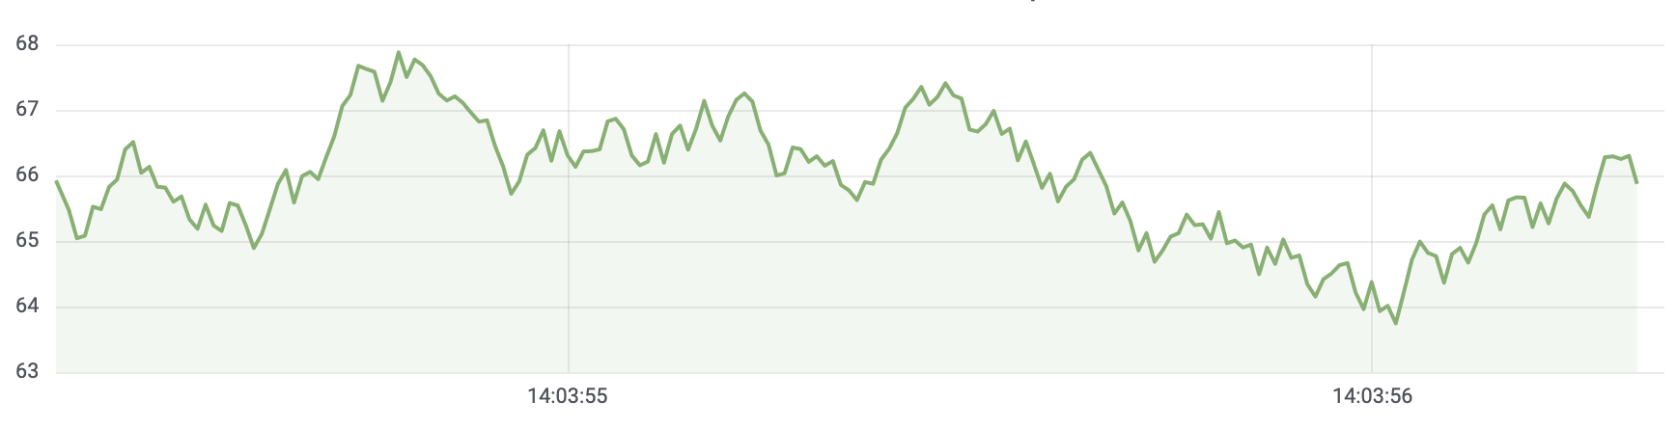
Visualise EEG waves captured into Timeseries DB
Smart Phone
Graphana Visualisation on Timeseries DB

Slide 5
Architecture
Bank API
Gateway
Store
Service
Time
Series DB
Retrieve
Service
Compare
Service
(Model)

Slide 6
ML Pipeline flow connected with end user
publishes
feature transformation and apply ML model
Extracted Features
Kafka Topic
Kafka Topic
KStreams
Feature
Transformation
posts
Apply ML Model
Store features for continuous model refinement
Timeseries DB
Notification on result

Slide 7
ML Pipeline flow -Model building and Versioning
publishes
Start Model building pipeline -Model creation and versioning
Kafka Consumer
Cloud Storage
AI Platform
Feature Scaling and Transformation
reads
TimeSeries DB
Create and Apply Model Architecture
Save Model with versioning

Slide 8
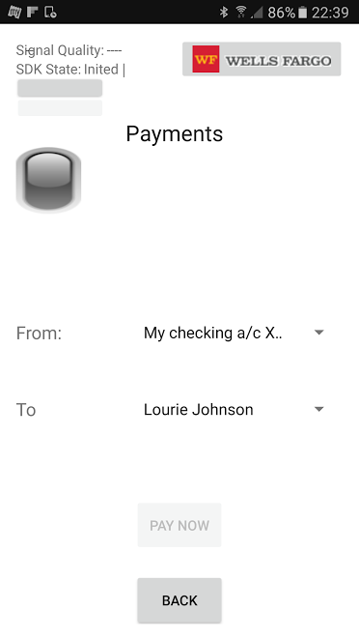
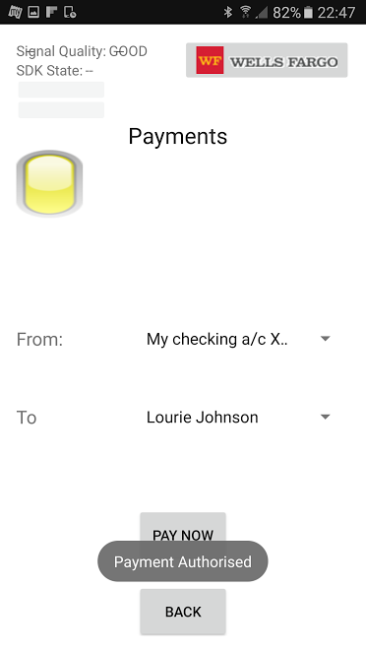
Demo: Payment authorised by eye blink
Bank
Bank
Blink -Brain waves
** Note: Can extend to store the brain waves and execute the transactions

Slide 9
Technique 1 :Pattern Searching Technique

Slide 10
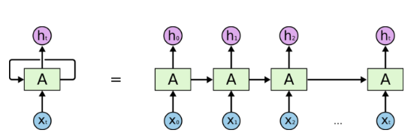
Technique 2: Apply Deep Neural Networks - LSTM Model

Slide 11
Questions
Demo

