Slide 1
Machine Learning
Supervised – Input and output of each example specified
Regression – Continuous output
Classification – Discrete output
Unsupervised – Algorithm finds structures among dataset - clusters

Slide 2
Supervised Machine Learning
Classification

Slide 3
Am I a cat or a dog?
Dataset consists of 100 pictures of 4 different animals
Algorithm learns the features of the animals from the training set
It can then classify the a random picture as one of the animals
Called multiclass classification
Discrete output

Slide 4
Supervised Machine Learning
Regression

Slide 5
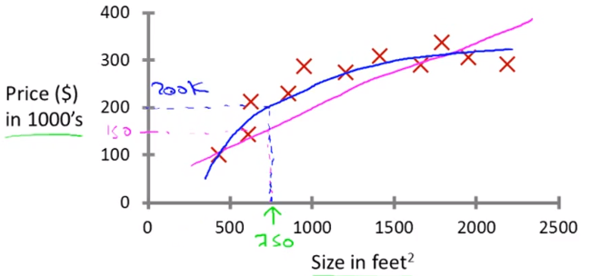
What’s the price of the house?
Learning algorithm maps the size of the house to the price
Predicts the price for the given input house size

Slide 6
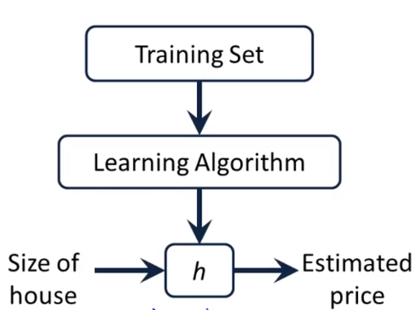
Linear Regression – Univariate
m –> training examples
x -> input variables / features
y -> output features
h -> Hypothesis function
→ X
← Y

Slide 7


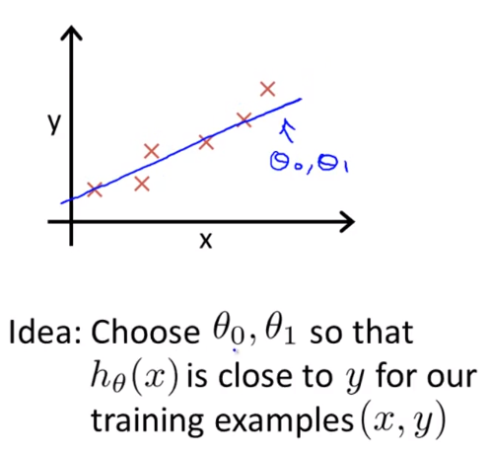

BIAS – Offset all
predictions made
SLOPE of the line depicted by hypothesis function

Slide 8

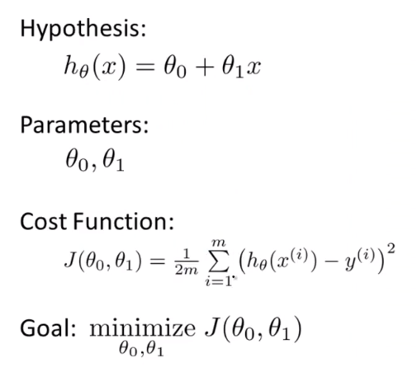
COST FUNCTION
Error – [h(x) - y]
Aim – Minimize the cost J
Mean Squared Error cost function

Slide 9
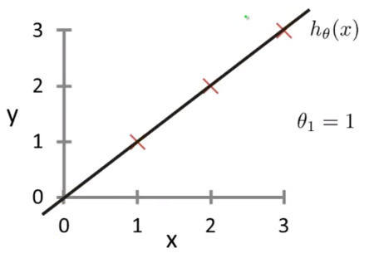
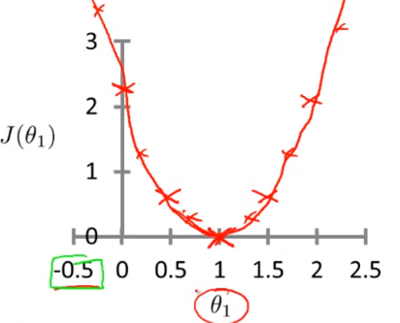
Simplified Model
h(x) = θ₁x … (θ₀ = 0)
When θ₁ = 0
When θ₁ = 0.5
When θ₁ = 1
Find the value of J(θ) for each value of θ₁

Slide 10
Examples
Lemonade business – Revenue is dependent on temperature
Amazon – recommends items to users based on user behavior
Predict number of shoppers passing in front of billboard – predict maximum to bid for advertisement

Slide 11
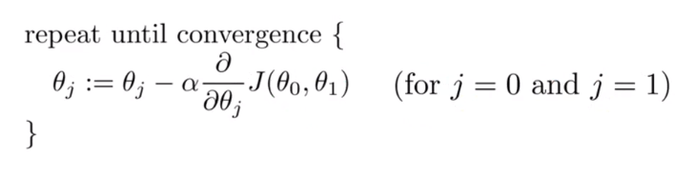
Gradient Descent - algorithm to minimize cost function
Start with some parameter values (θ₀, θ₁)
Change values to reduce J(θ₀, θ₁) until minimum
α - learning rate (controls how big a step is taken downhill)
Simultaneous Update – Compute the RHS for both and assign to new (θ₀, θ₁)
Converges even with a fixed rate α - the derivative approaches zero as we approach the bottom of the function – gradient descent will take smaller steps

Slide 12
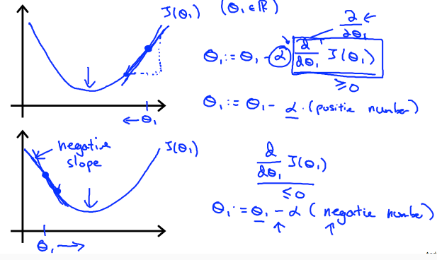

Slide 13
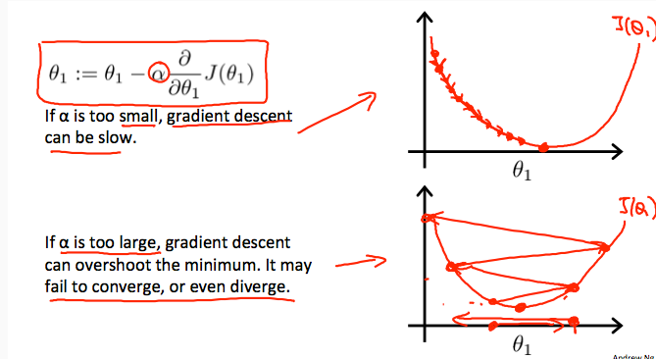

Slide 14
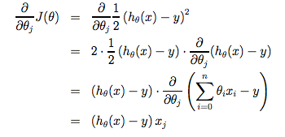
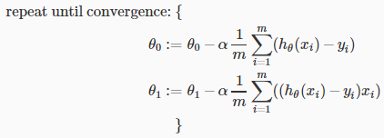

Slide 15


Multivariate Linear Regression
x_{1,} x_{1,} x₁……….. x_{n} -> input
Y -> output
E.g. size, number of rooms, age of home, number of floors -> price
Convenience – introduce x₀ = 1, such that ‘x’ and ‘θ’ have ‘n+1’ elements each

Slide 16
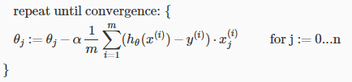
Gradient Descent - Multivariate

Slide 17
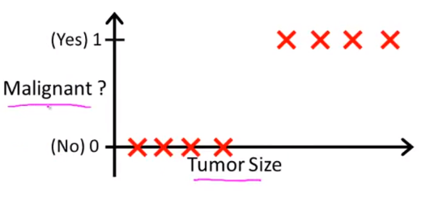
Logistic Regression
Method for classifying data into discrete outcomes
Classification, not regression
Purpose of logistic regression – because linear regression is not useful for classification problems.
y = 0 or y = 1, but using Linear Regression, h(x) can be > 1 or < 0 too.
Using log regression, 0 <= h(x) < 1
Threshold the hypothesis output at 0.5 – if h(x) > 0.5, y = 1; if h(x) < 0.5, y = 0

Slide 18
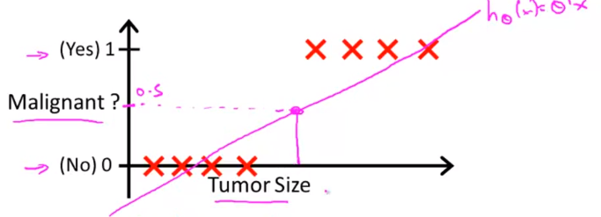
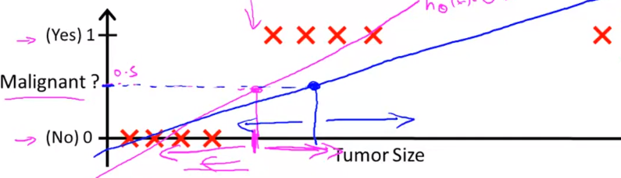

Slide 19
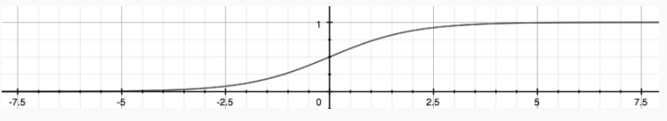
h(x) -> θ^{T}x … linear regression
h(x) -> g(θ^{T}x) … logistic regression
g(z) = 1 / (1 + e^{-z})
This is the sigmoid or the logistic function
Therefore, h(x) -> 1 / (1 + e^{-θTx})
This function maps any real number to interval (0,1)
h(x) – probability that output is 1 – example,

Slide 20


Decision Boundary
Sigmoid function –
When input (z) is greater or equal to 0, output of function i.e. h(x) is greater than 0.5
If input to ‘g’ is θ^{T}x →
Decision Boundary – Line separating area where y = 0 and y = 1. Created by our hypothesis function

Slide 21

Cost Function – Logistic regression
It is the penalty the learning algorithm has to pay if it outputs h(x) and actual label is y.
If we use the same cost function as linear regression, the cost function will be a non-convex function (gradient descent won’t work as it will have many local optimums) as h(x) is non linear.

Slide 22
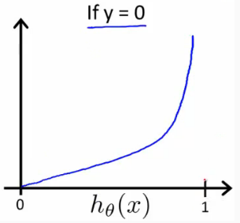
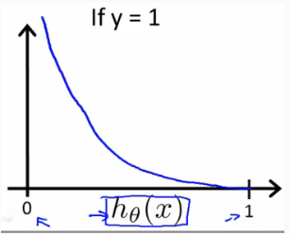

If y = 1, cost -> $∞$ if prediction is h(x) = 0 (high penalty) and minimum cost if h(x) = 1.
If y = 0, cost -> $∞$ if prediction is h(x) = 1 (high penalty) and minimum cost if h(x) = 0.

