Slide 1
A Tale of two cities
Comparison between New York and Mumbai

Slide 2
Mumbai Vs NewYork for Students
Mumbai as well as New York is have one of the best educational institutes with respect to their countries.
Students look for a comparison between the cities all over the world when it comes to spending money on education and its overall worth after completion of it.
They look for segmentation of neighborhoods, population, desirability rank, number of ranked universities, employer activity rank, affordability rank etc.
In this project we will segment the neighborhoods as well as compare the cities on parameters mentioned above.

Slide 3
Data acquisition and cleaning
Forsquare APIs will be used for location of neighborhoods and getting the venues in radius of 1 Kms.
The data for Mumbai is taken from the Wikipedia. The data is scrapped using “pandas” and taken into dataframe and analysed further.
The data for population, desirability rank, student affordability rank, number of ranked universities, employer activity rank etc. has been taken from QS best student cities page for Mumbai and Newyork.

Slide 4
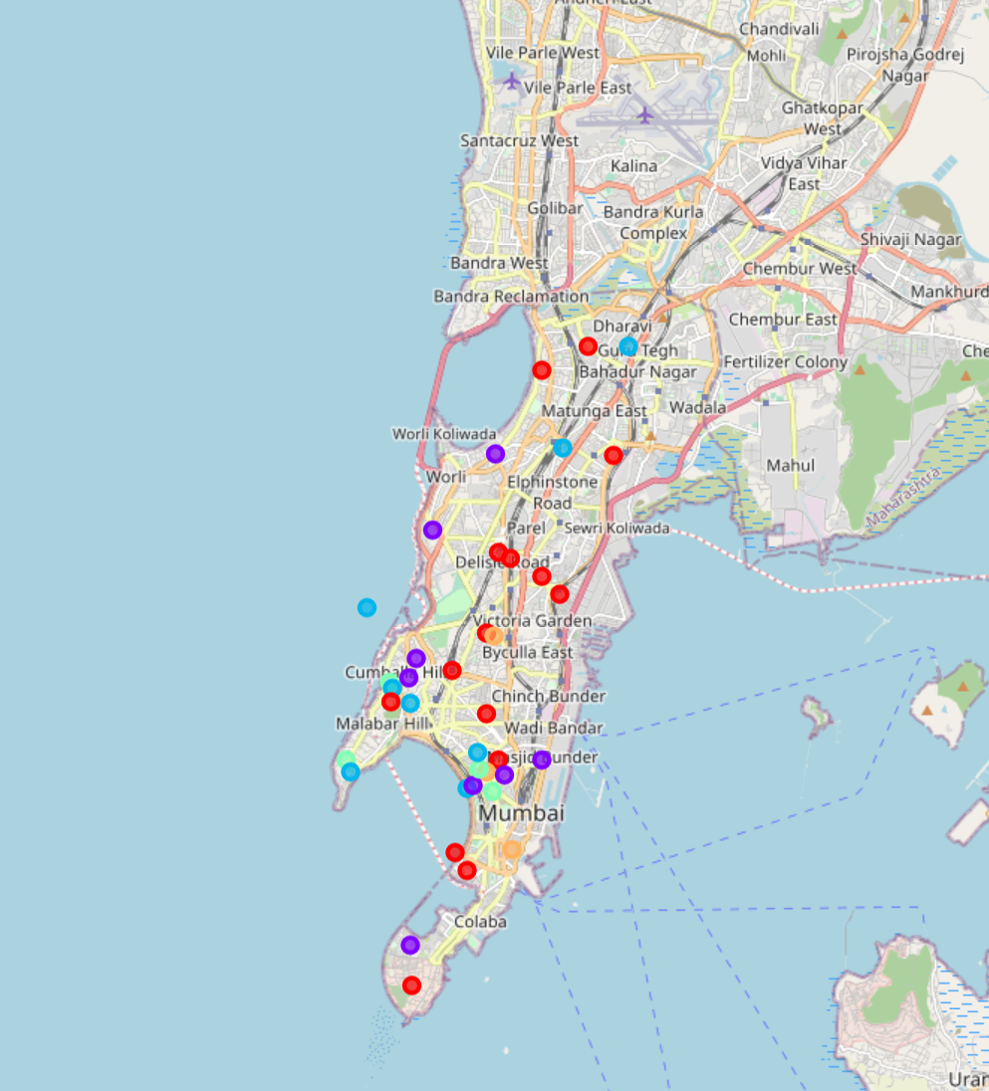
Mumbai Neighborhoods

Slide 5
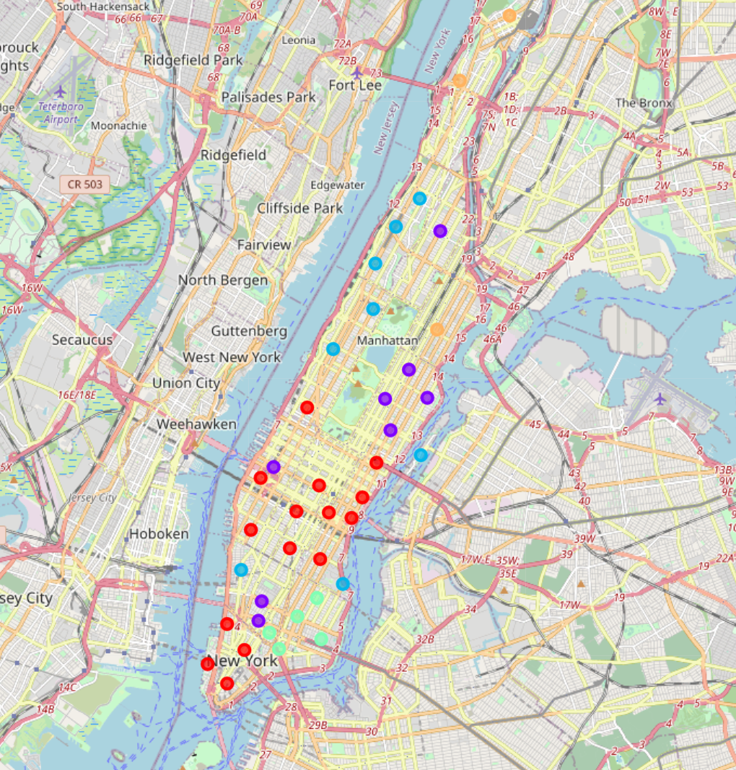
Manhattan, NewYork Neighborhoods

Slide 6
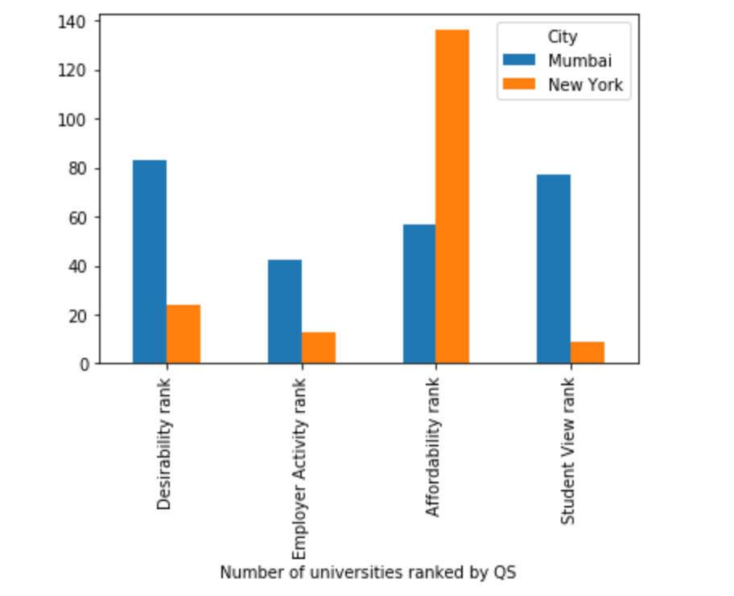
Mumbai & NewYork Comparison on University Front

Slide 7
Conclusion
Mumbai being more diverse place than New York on base of venue segmentation.
Students prefer mostly New York when it comes to choosing which university they want to study in.
Education in Mumbai is way cheaper than New York.

