Slide 1
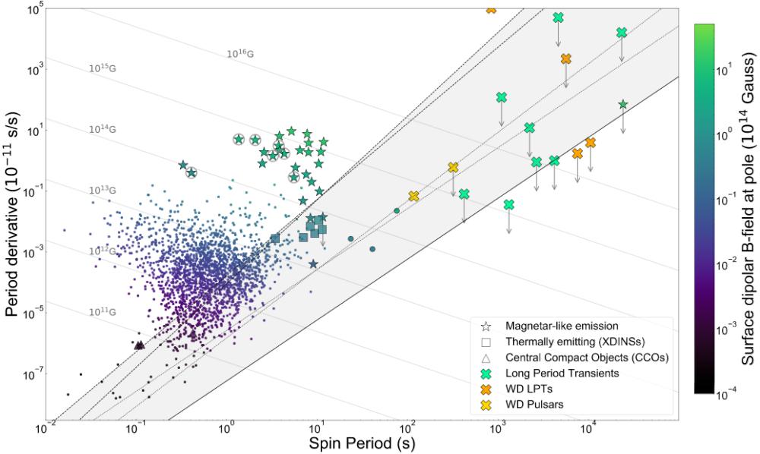
ASKAPJ1839-0756
GCRTJ1745-3009
CHIME J1634+44
ASKAP J1448-6856
GLEAM-XJ1627-5235
ASKAPJ1935+2148
GLEAM-X J0704-36
ASKAP J1755-2527
ILT J1101+5521
eRASSU J1912-4410
ASKAPJ1832-0911
AR Sco
CHIMEJ0630+25
GPMJ1839-10

