Slide 1
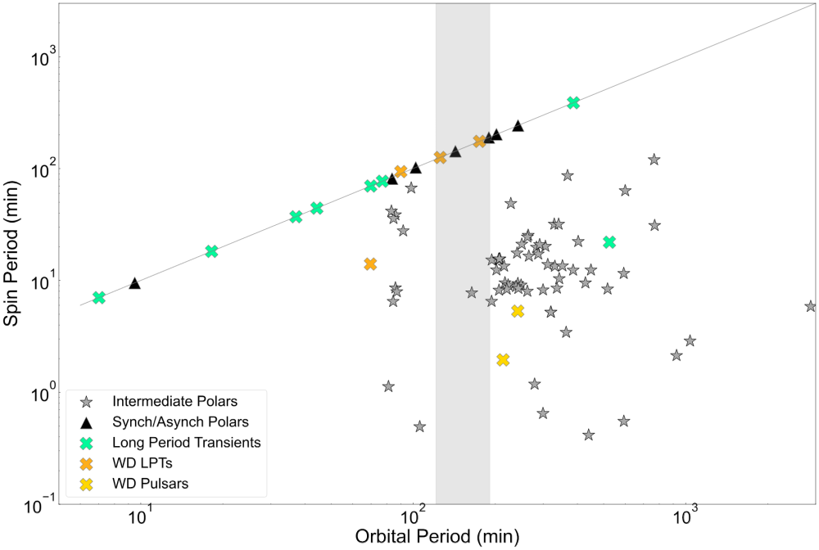
GLEAM-X J0704-37
ILTJ1101+5521
ASKAPJ1448-6856
ASKAPJ1839-0756
GCRT J1745-3009
ASKAPJ1755-2527
GLEAMJ1627-5235
CHIMEJ0630+25
GPMJ1839-10
ASKAPJ1832-0911
ASKAPJ1935+2148
CHIME J1634+44
eRASSU J1912-4410
AR Sco

