Slide 1
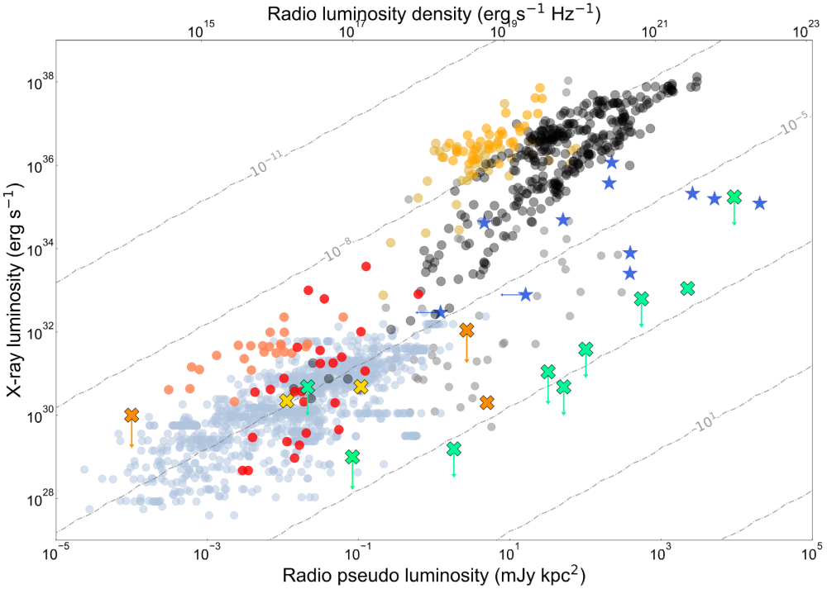
BH X-RAY BINARIES
NS X-RAY BINARIES
AMXPs
MAGNETARS
LONG PERIOD TRANSIENTS
PULSARS
MAGNETIC CVs
CVs
WD LPTs
WD PULSARS
STARS

