Slide 1
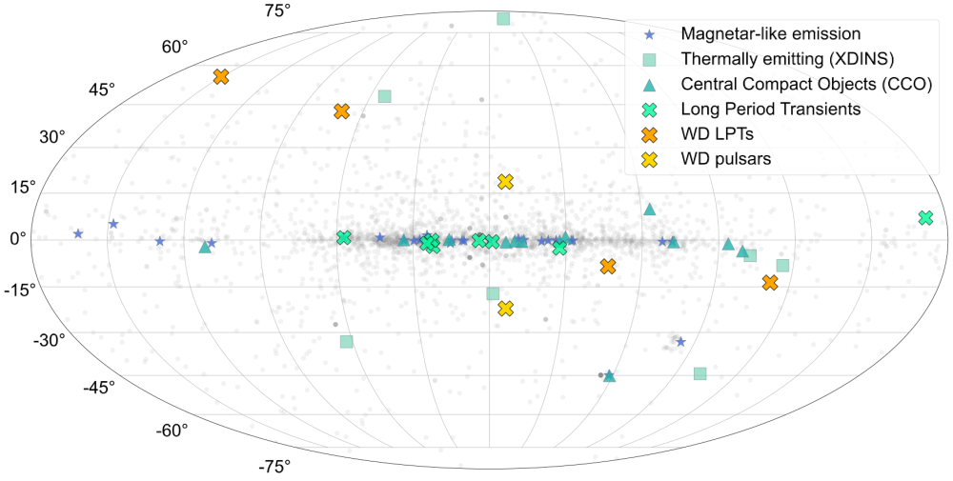
ILTJ1101+5521
CHIMEJ1634+44
AR Sco
GPMJ1839-10
ASKAPJ1832-0911
CHIMEJ0630+25
ASKAPJ1839-0756
ASKAPJ1935+2148
GLEAM-XJ1627-5235
GCRTJ1745-3009
ASKAPJ1755-2527
ASKAPJ1448-6856
GLEAM-XJ0704-36
eRASSU J1912-4410
LMC
SMC

