Slide 1
Hybrid-ELIZA
Rule-Based Dialogue with Deep Learning Emotion Detection
GROUP - IV
22 March, 2026

Slide 2


Presentation Outline
Data Collection
Burmese Language Script Architecture
Model Training
Testing the Emotion Model
Model Evaluation Metric
Findings & Factors to be considered
Challenges & Constraints
LET’S GET STARTED

Slide 3
Group Members
AUNG CHAN NYEIN
PHYU PYAR CHAN MYAE KYAW
MYAT THIN THIN KYI
HTET HTET WIN NAUNG
MYO AUNG
KHIN NYEIN CHAN THU
SU LARB MON
HSU SAN LIN
LIN LAT EAIN
THANT HTUT AUNG

Slide 4
Data Collection
Collected Myanmar (Burmese) language text data from various sources (social media, articles, and Tiktok and Facebook content)
Ensured the dataset includes six emotional expressions and make sure to balance for model training
Initial text collecting and organization performed using Notepad++
Removed duplicates, shuffles, structured and labeled the data in Microsoft Excel
Categorized text based on emotion classes ( Sadness, Joy, Love, Anger, Fear and Surprise)
Converted the finalized Excel dataset into CSV format for compatibility with machine learning models
Total Data =1390 texts
There are 256 data classified as Sadness, 248 as Joy, 243 as Love, 227 as Anger, 218 as Fear, and 200 as Surprise
N E X T

Slide 5
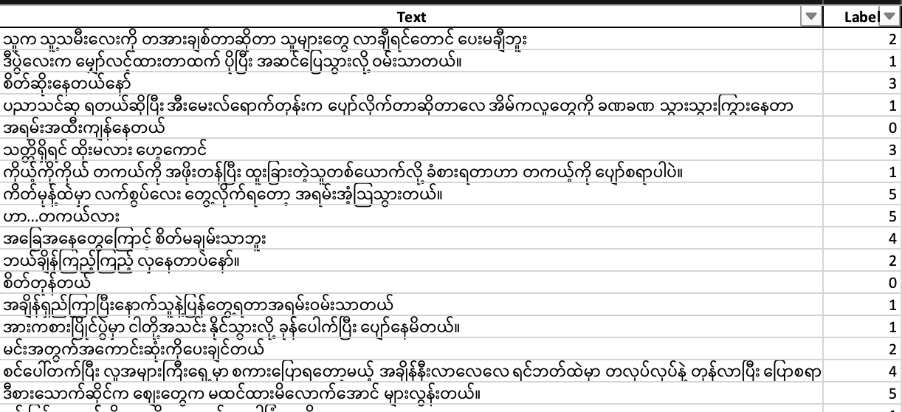
Dataset Structure

Slide 6

It is a syllabic writing system (each character represents a syllable rather than a single letter)
1.
Each syllable is typically composed of:
Consonant base (main character)
Vowel signs (placed around the consonant)
Medials (modify consonant sounds)
Tone markers (indicate pitch and meaning)
Burmese Language Script Architecture
2.
Text encoding is done using Unicode, which is essential for processing Burmese text in NLP models
3.
4.
Words are usually not separated by spaces, making tokenization more challenging in text processing

Slide 7
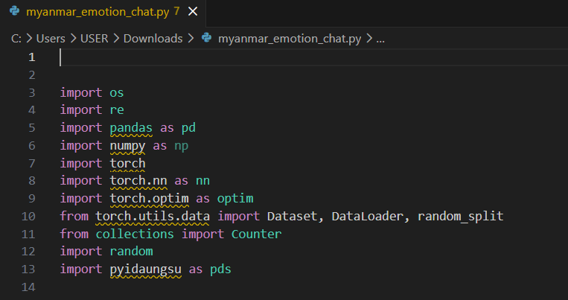
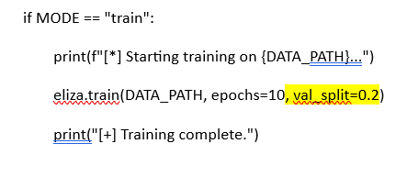

Model Training Processes
2.
1.
Split the dataset into Training and Testing .
Training data is 80% and testing data is 20%.
Install & Import necessary Libraries
*Important*
!pip install pyidaungsu openpyxlc

Slide 8
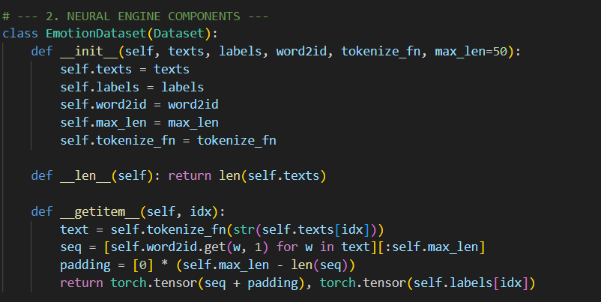
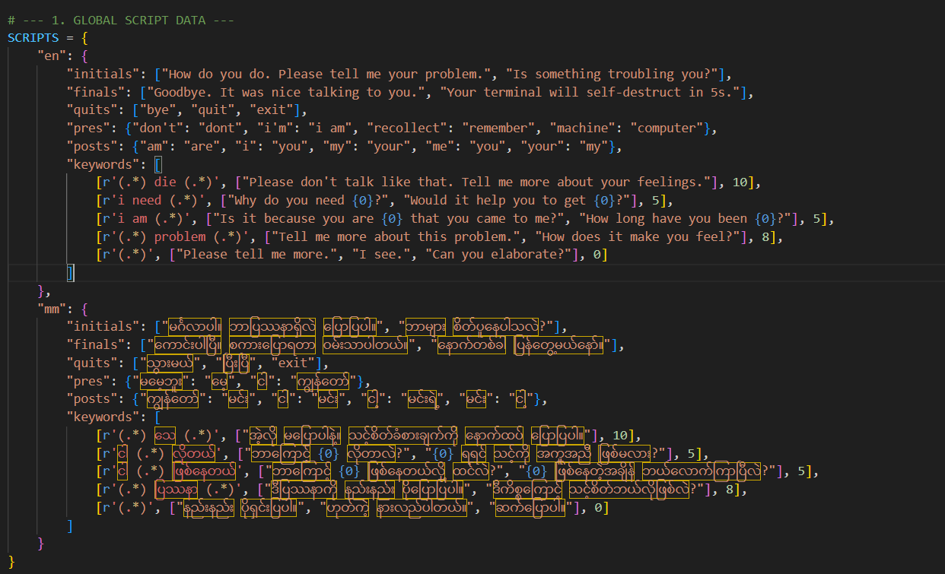
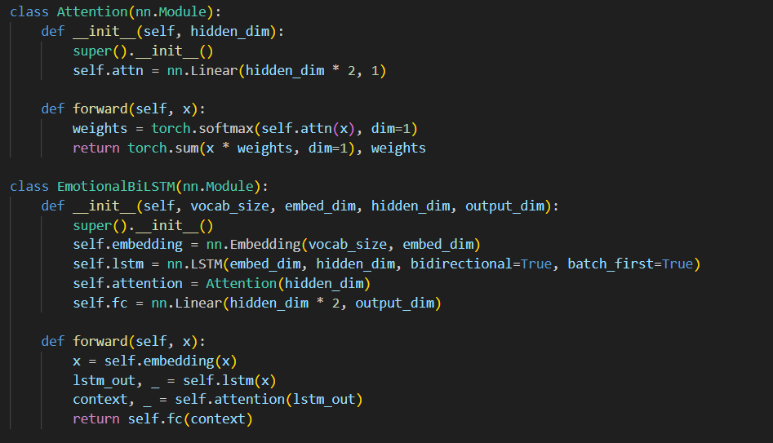
Code Blocks
for training process

Slide 9
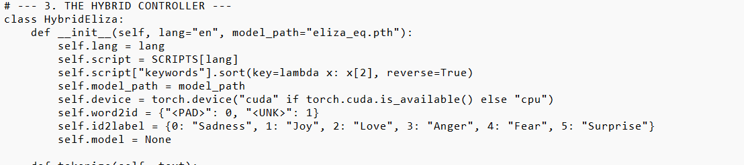
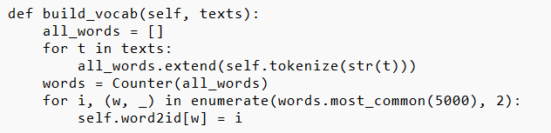
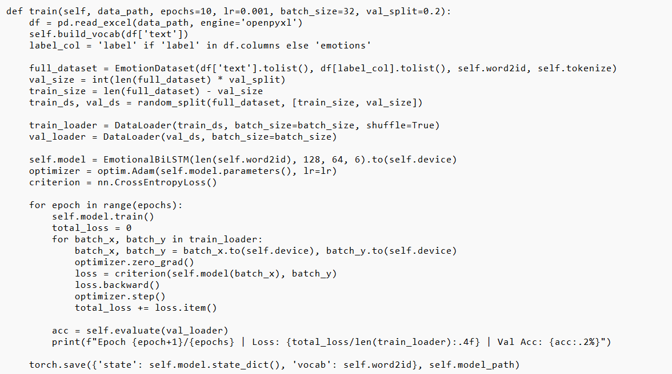
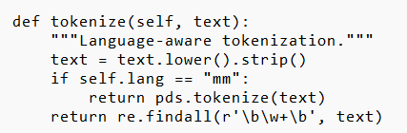
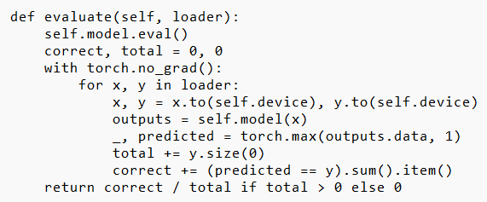

Code Blocks
for training process

Slide 10

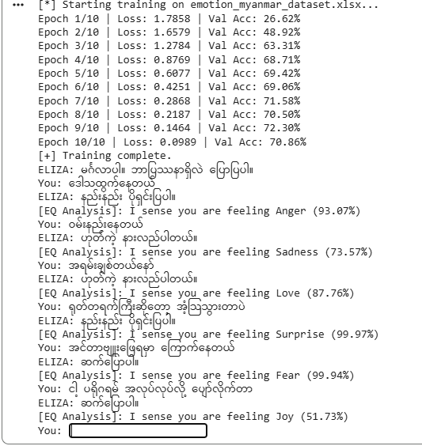
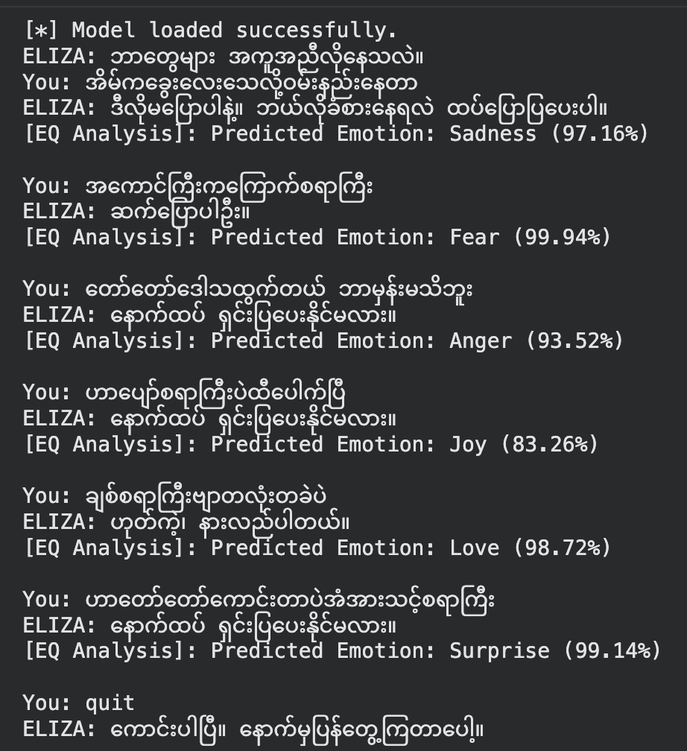
Testing Results

Slide 11
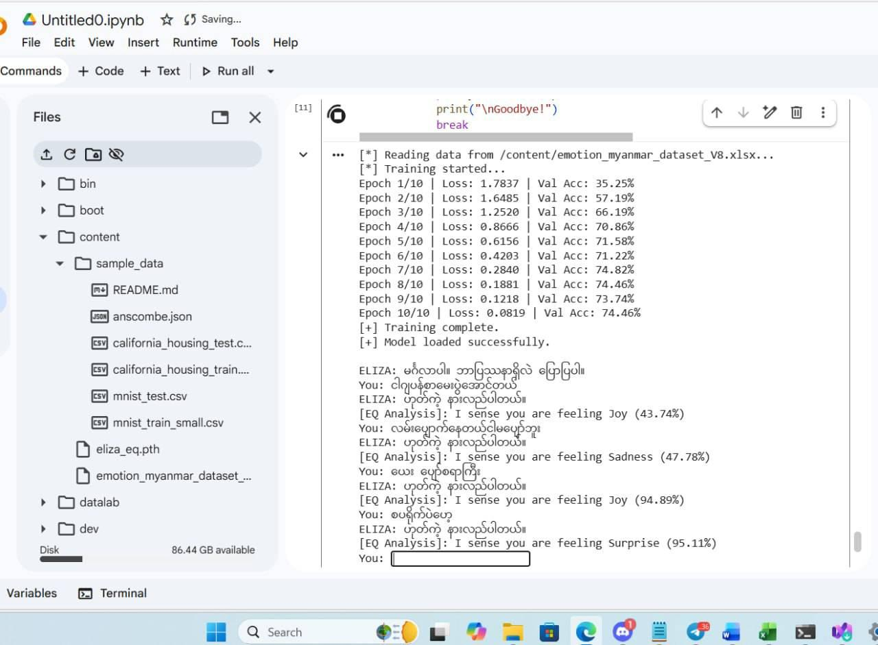
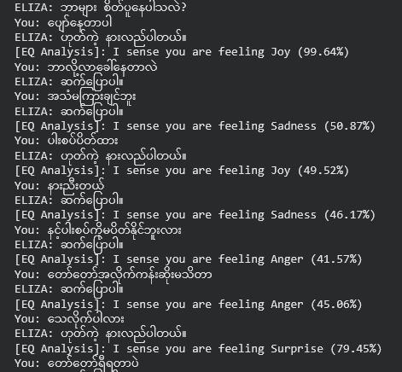
Testing Results
Key Metrics:
Peak Accuracy: 74.5%
Top Confidence: 99.9% (Fear/Surprise)
Processing Time: < 1s (if applicable)
As you may see in the testing results slides, we’ve captured the transition from raw training data to a live, empathetic conversation in Burmese. Thank you

Slide 12
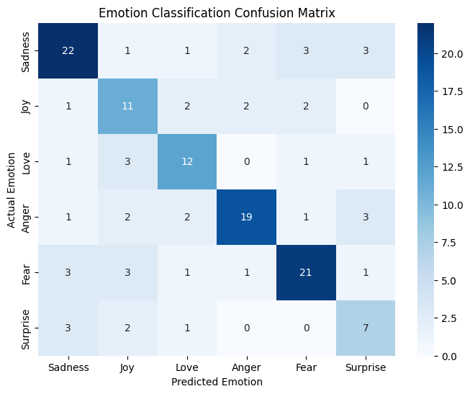
Performance Metrics
=== MODEL PERFORMANCE ON UNSEEN TEST DATA ===
precision recall f1-score support
Sadness 0.71 0.69 0.70 32
Joy 0.50 0.61 0.55 18
Love 0.63 0.67 0.65 18
Anger 0.79 0.68 0.73 28
Fear 0.75 0.70 0.72 30
Surprise 0.47 0.54 0.50 13
accuracy 0.66 139
macro avg 0.64 0.65 0.64 139
weighted avg 0.67 0.66 0.67 139

Slide 13
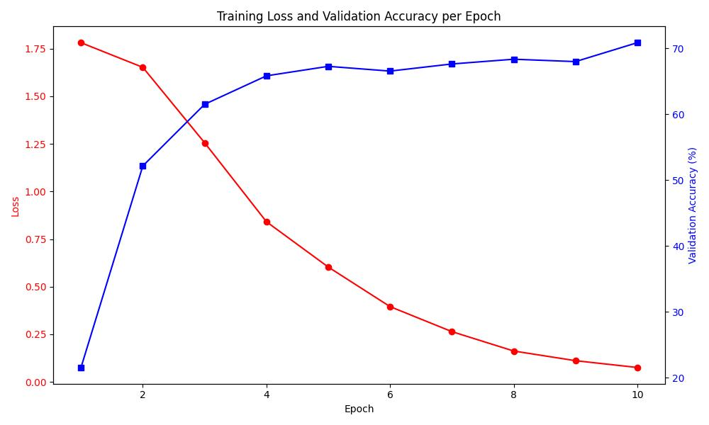
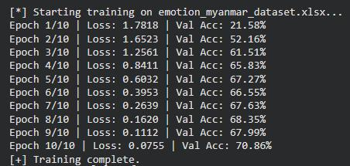
Performance Metrics

Slide 14
Findings & Factor to be Considered
ဘာကြောင့် ကို Tokenization သုံးတာလဲ ဆိုရင် မြန်မာစာဟာ English လို space မခြားတဲ့အတွက် split() ကို သုံးရင် တစ်ကြောင်းလုံးကို စကားလုံးတစ်လုံးတည်းအနေနဲ့ model က မှတ်သွားတတ်ပါတယ်။ pyidaungsu ကို သုံးလိုက်ခြင်းအားဖြင့် - "ကျွန်တော်စိတ်ညစ်တယ်" ကို ["ကျွန်တော်", "စိတ်ညစ်", "တယ်"] ဆိုပြီး ခွဲခြားနိုင်သွားပါတယ်။ ဒါမှသာ Model က "စိတ်ညစ်" ဆိုတဲ့ စကားလုံးကိုတွေ့ရင် Sadness (ဝမ်းနည်းခြင်း) လို့ ပိုမိုတိကျစွာ ခန့်မှန်းနိုင်မှာဖြစ်ပါတယ်။
Pyidaungsu Font Installation က လဲ အရေးပါတဲ့ အချက်တခုဖြစ်ပါတယ်။
Data တွေကို ပြန်လည်စုစည်းပြီး ရှင်းလင်းတဲ့ အဆင့်မှာ သေချာဂရုစိုက်ပြီး လုပ်ဆောင်ထားမှ ရလဒ် တွေကပိုမိုကောင်းမွန်တောတွေ့ရပါတယ်
Epoch ကို ၃၀-၅၀ အထိ ပြောင်းလဲပြီးစမ်းကြည့်တာမှာ ပုံမှန်ထက်ပိုမိုကောင်းမွန်တဲ့ Loss & Validation Accuracy ကိုမတွေ့ရပါဘူး။ အကောင်းဆုံး အခြေအနေက Epoch 13-15 လောက်မှာပဲ​ရှိတာကို တွေ့ရှိရပါတယ်။

Slide 15
Challenges & Limitations
Our group built a complete, validated pipeline combining rule-based architecture.
Data constraints: it would be better to expand the dataset to overcome the limitation.
Burmese texts/sentences has no spaces, the model initially treated the whole sentence as a single, unknown words.
Tokenization has been utilized to allow the deep learning model to accurately build a vocabulary and recognize critical words without flaw.
Pyidaungsu Font cannot use in the Python version higher than 3.1.11

Slide 16

Thank You for your Attention!

