Slide 1

PROJECT SCOPE
SCRDR Rule-Based Classification
Performance Evaluation and Model
Interpretation for Herpetological Data
DATASET SUMMARY
18 Unique Species Records
MODEL FRAMEWORK
Single Cascade Ripple Down Rules (SCRDR)
An Analysis of Snake Species Identification
GROUP 3
Assignment 4

Slide 2


Dataset Composition and Characteristics
TAXONOMIC SAMPLE
18 Unique Species
Categorical Features
The dataset provides a broad taxonomic overview, encompassing 18 distinct snake species from diverse families.
Species Name
TARGET VARIABLE
DATA DISTRIBUTION
Venom Status
BOOLEAN
Perfectly Balanced
Head Shape
CATEGORICAL
Each species is represented by exactly one record, creating a balanced but small-scale foundational dataset.
Eye Pupil
CATEGORICAL
Body Pattern
CATEGORICAL
Habitat
CATEGORICAL

Slide 3

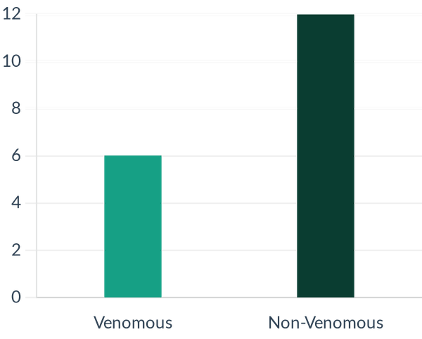
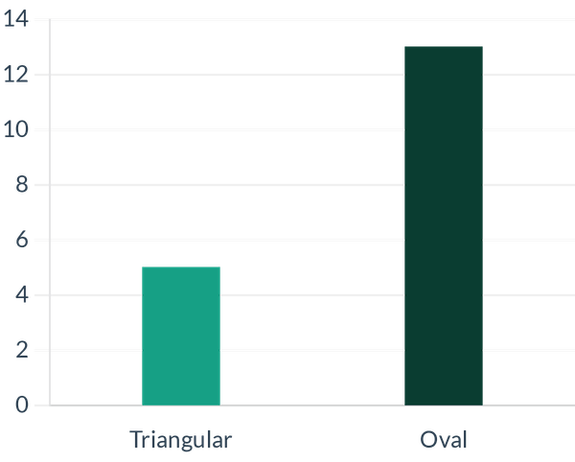
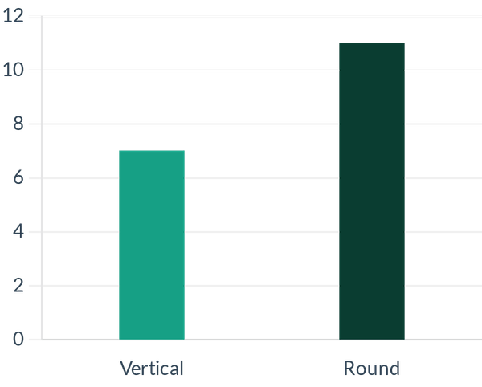
Morphological Feature Distribution
Venom Status
Head Shape
Ocular Characteristics
33% of sampled species are venomous (6/18), while 67% are non-venomous.
Oval heads are the dominant morphology (13/18), compared to triangular shapes (5/18).
Round pupils are more prevalent (11/18) than vertical slit pupils (7/18).

Slide 4
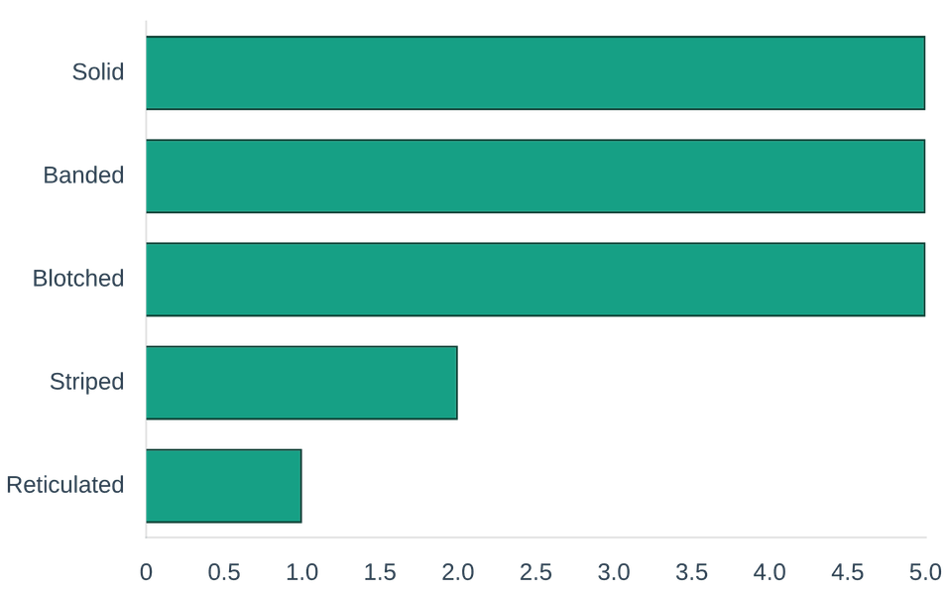
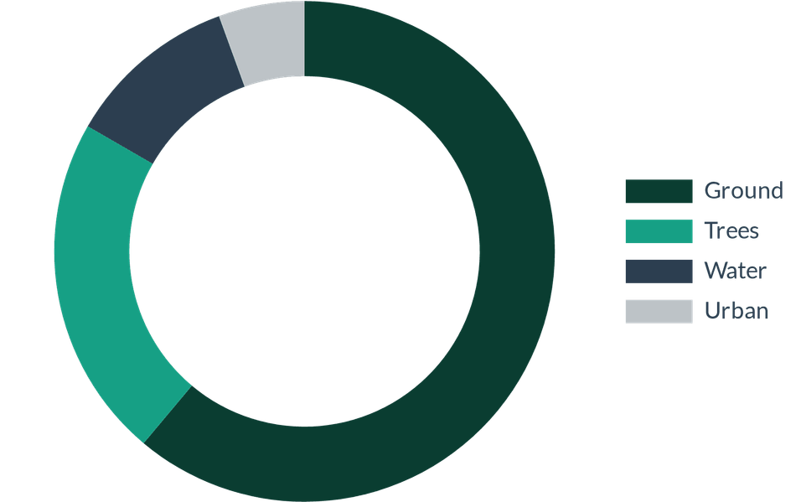
Ecological and Pattern Analysis
Body Pattern Diversity
Habitat Distribution
Solid, banded, and blotched patterns are equally represented as the most common traits in this sample.
61% of species are ground-dwelling, reflecting common sampling biases in herpetological surveys.

Slide 5

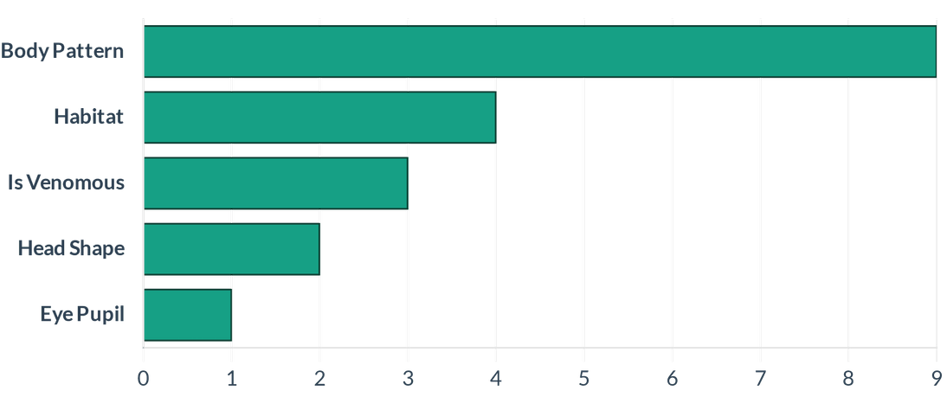
SCRDR Model Architecture and Feature Importance
MODEL FRAMEWORK
SCRDR Classifier
Feature Importance Ranking
STRUCTURAL COMPLEXITY
20 Rule Nodes
MAXIMUM TREE DEPTH
4 Hierarchical Levels
The rule-based SCRDR architecture ensures full transparency, allowing for direct interpretation of the classification logic applied to each species.
Primary Predictor: Body pattern is the most influential feature, utilized in 9 separate rule conditions.

Slide 6

Quantitative Performance Metrics
94.4%
0.93
17/18
OVERALL ACCURACY
MACRO F1-SCORE
CORRECT PREDICTIONS
Metric Category
Macro Average
Weighted Average
Performance Status
Precision
0.92
0.92
HIGH RELIABILITY
Recall
0.94
0.94
HIGH SENSITIVITY
F1-Score
0.93
0.93
OPTIMAL BALANCE

Slide 7

Analysis of Classification Error
ACTUAL CLASSIFICATION
MODEL PREDICTION
Sunbeam Snake
Oriental Rat Snake
Venom Status
False
Venom Status
False
Head Shape
Oval
Head Shape
Oval
Eye Pupil
Round
Eye Pupil
Round
Body Pattern
Solid
Body Pattern
Solid
Habitat
Ground
Habitat
Ground
Causal Analysis: Morphological Convergence
The identification failure stems from categorical ambiguity. Both species share identical values across the primary morphological and ecological features used by the model, making them indistinguishable under the current rule set.

Slide 8





Strategic Improvements and Model Scalability
Sample Augmentation
Feature Refinement
Increasing the number of samples per species is essential to validate real-world generalization and reduce overfitting on the current limited dataset.
Incorporating finer-grained morphological or geographic data is necessary to resolve identification conflicts between convergent species.
Validation Strategy
Model Scalability
Implementing a dedicated hold-out test set will provide an unbiased performance estimate and ensure model robustness against unseen data.
Transitioning from a single tree to a multi-cascade architecture to accommodate a larger taxonomic scope and more complex decision boundaries.
STRATEGIC ROADMAP FOR RESEARCH PHASE II

Slide 9

"The SCRDR model provides a robust and interpretable framework for herpetological classification, balancing high accuracy with the transparency required for scientific inquiry."
Conclusion and Summary
Internal Validity
Future Outlook
The model demonstrates high internal validity for species identification within the current taxonomic scope, achieving 94.4% accuracy.
Future iterations will prioritize resolving morphological ambiguities through expanded data collection and refined feature granularity.
Decision Transparency
END OF PRESENTATION
The rule-based nature of the SCRDR framework ensures full transparency in the decision-making process, essential for academic and professional applications.

