Slide 1
SCRDR Tutorial - Experiment
Two New Datasets
and
an Interactive Knowledge-Acquisition Experiment
GROUP IV
Dr. Ye Kyaw Thu - (LU Lab., Myanmar)
AI Engineering (Fundamental)
May 03, 2026

Slide 2
Outline of this Presentation
Background
Details of this Experiment
Datasets Applied
Experiment Workflow
Auto Induction SCRDR (Learner)
Interactive SCRDR
Conclusion

Slide 3
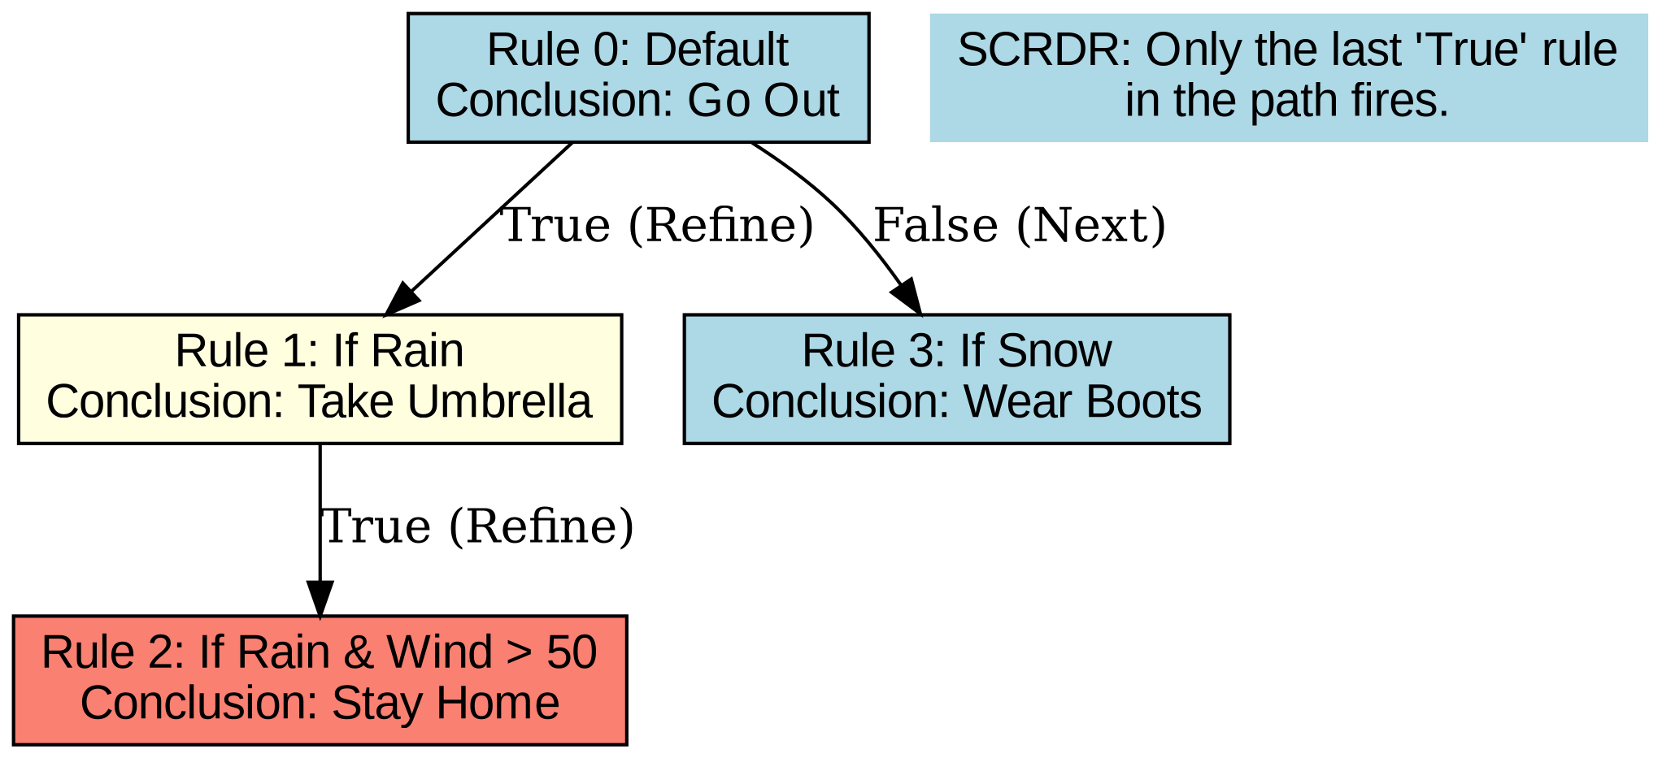
Background - What is SCRDR?
Single Classification Ripple-Down Rules
A binary tree of rules where each rule is added because the system failed on a real case.
Key principles:
Case-driven rule creation
Cornerstone cases prevent regressions
No retraction — rules only refined
Last True rule in path fires

Slide 4
Details of this Experiment
The original tutorial compare five datasets with ML and SCRDR.
Thisi work is the extended the origin with two new datasets
1 Add Two New Datasets
Heart Disease (UCI)
Adult Income (UCI)
Run both ML baseline (5 methods) and SCRDR auto-induction
2 Try Interactive SCRDR
Build rules
Compare to auto-induction
Test RDR’s main strength: Explainable knowledge from a human expert opinion.

Slide 5
Datasets Applied
Dataset | Type | Rows | Target | Source
Iris | Numeric | 150 | class (3 species) | UCI
Wine | Numeric | 178 | Class (3) | UCI
Mushroom | Categorical | 8124 | edible / poisonous | UCI
WDBC (Breast Cancer) | Numeric | 569 | Diagnosis (M/B) | UCI
Titanic | Mixed | 891 | Survived (0/1) | Kaggle
Heart Disease (NEW) | Mixed | 303 | target (0/1) | UCI
Adult Income (NEW) | Mixed | 32,561 | income (>50K) | UCI
New datasets: a small medical dataset (Heart) and a large categorical-heavy dataset (Adult).

Slide 6

Experiment Workflow
storage
1. Data & Preprocessing
Acquisition and cleaning of primary data sources.
Heart Datasets
Adult Datasets
analytics
2. ML Baseline
Establishing performance benchmarks.
Five ML Methods evaluated on new datasets
auto_awesome
3. SCRDR Auto
Automated induction process.
Run scrdr_learner.py on both datasets
psychology
4. SCRDR Interactive
Human-in-the-loop refinement.
Manual Rule setting and expert validation

Slide 7
Heart Disease - Features & Target
Feature | Type | Meaning | Remark
age | numeric | Age in years | >55 increases risk
sex | 0/1 | 0=female, 1=male | Males higher risk
cp | 0–3 | Chest pain type | 0=typical angina, 3=asymptomatic
trestbps | numeric | Resting BP (mmHg) | >140 is hypertensive
chol | numeric | Cholesterol (mg/dl) | >240 is high
fbs | 0/1 | Fasting blood sugar >120 | 1=diabetic-range
restecg | 0–2 | Resting ECG | 1,2 = abnormal
thalach | numeric | Max heart rate achieved | >150 is good
exang | 0/1 | Exercise-induced angina | 1=positive (bad)
oldpeak | numeric | ST depression | >2 strong disease signal
slope | 0–2 | ST slope | 2 = downsloping (bad)
ca | 0–4 | # major vessels colored | >0 = blockage
thal | 0–3 | Thalassemia | 2=fixed, 3=reversible defect
target | 0/1 | 0 = no disease, 1 = disease

Slide 8
Adult Income Dataset - Features & Target
Feature | Type | Signal to Target
education-num | numeric (1–16) | Very strong: higher = more income
age | numeric | Strong: middle-age peak earnings
hours-per-week | numeric | Strong: >40 = often high earner
capital-gain | numeric | Extreme signal: >0 almost always >50K
capital-loss | numeric | Moderate
marital-status | categorical | Strong: "Married-civ-spouse" much more often >50K
occupation | categorical | Strong: "Exec-managerial", "Prof-specialty"
relationship | categorical | Strong (overlaps marital)
sex | M/F | Moderate
workclass | categorical | Weak
race | categorical | Weak
native-country | categorical | Weak
fnlwgt | numeric | Don't use — sampling weight, not predictive

Slide 9
Auto Induction SCRDR (Learner)

Slide 10
ML Baseline (Weighted F1)
Dataset | DT | RF | SVM | NB | LR
Iris | 1.00 | 1.00 | 1.00 | 1.00 | 1.00
Wine | 0.94 | 1.00 | 1.00 | 1.00 | 1.00
Mushroom | 1.00 | 1.00 | 1.00 | 0.95 | 1.00
WDBC | 0.95 | 0.96 | 0.97 | 0.96 | 0.97
Titanic | 0.78 | 0.80 | 0.82 | 0.78 | 0.80
Adult (new) | 0.81 | 0.85 | 0.84 | 0.34 | 0.84
Heart (new) | 0.75 | 0.87 | 0.90 | 0.85 | 0.89
Observations
Adult: NB collapses (0.34) due to feature correlation.
•Heart: SVM strongest (0.90); DT lowest (0.75).
•DT score is a useful proxy for SCRDR's ceiling.

Slide 11
SCRDR Auto-Induction Results
Dataset | Best ML | DT | SCRDR | Gap (vs DT)
Iris | 1.00 | 1.00 | 0.97 | −0.03
Wine | 1.00 | 0.94 | 0.72 | −0.22
Mushroom | 1.00 | 1.00 | 1.00 | 0.00
WDBC | 0.97 | 0.95 | 0.84 | −0.11
Titanic | 0.82 | 0.78 | 0.82 | +0.04
Adult | 0.85 | 0.81 | 0.74 | −0.07
Heart | 0.90 | 0.75 | 0.56 | −0.19
Patterns
Matches ML when data has clean rule structure.
Underperforms on continuous medical/chemical data.
Heart shows the biggest gap — motivates Stage 3.

Slide 12
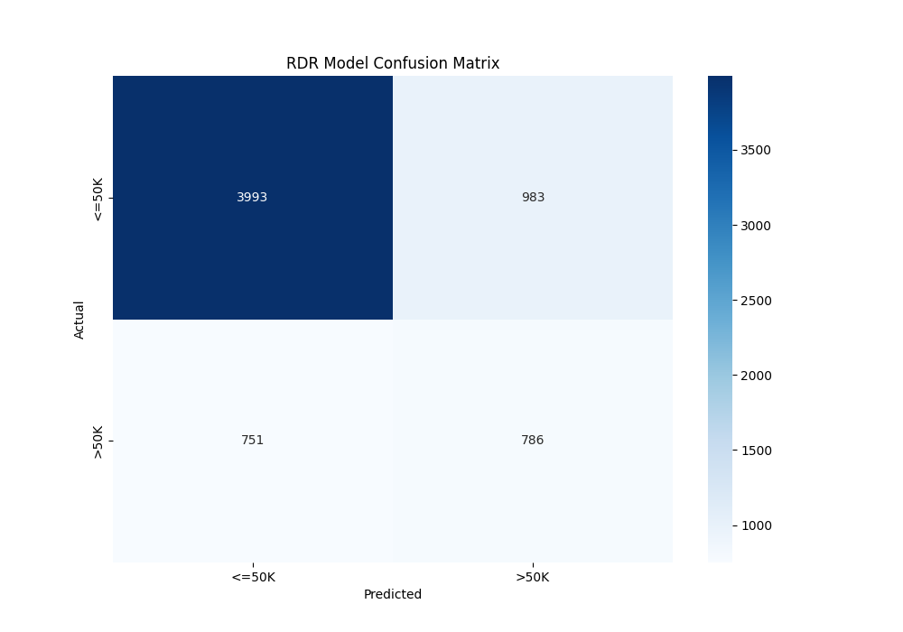
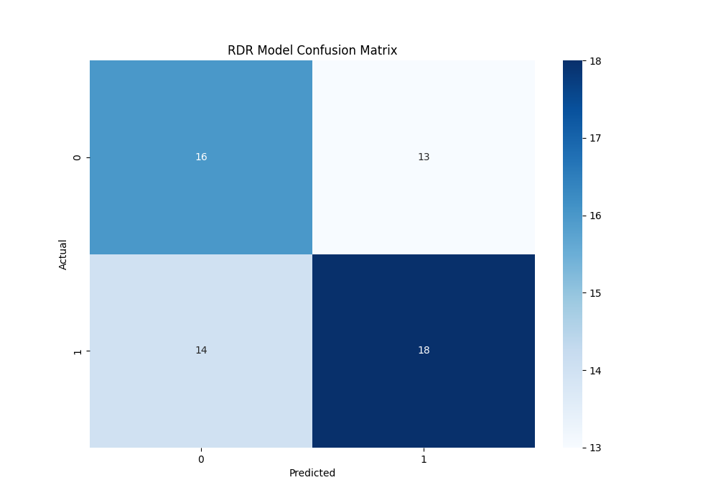
SCRDR Auto: Confusion Matrices
Adult - Confusion Matrix
Heart Disease - Confusion Matrix

Slide 13
SCRDR Auto-Induction Benchmark with 5 ML Baselines
Dataset | DT | RF | SVM | NB | LR | SCRDR
Iris | 1 | 1 | 1 | 1 | 1 | 0.97
Wine | 0.94 | 1 | 1 | 1 | 1 | 0.72
Mushroom | 1 | 1 | 1 | 0.95 | 1 | 1
WDBC | 0.95 | 0.96 | 0.97 | 0.96 | 0.97 | 0.84
Titanic | 0.78 | 0.8 | 0.82 | 0.78 | 0.8 | 0.82
Adult | 0.81 | 0.85 | 0.84 | 0.34 | 0.84 | 0.74
Heart | 0.75 | 0.87 | 0.9 | 0.85 | 0.89 | 0.56

Slide 14
Interactive SCRDR

Slide 15
Interactive SCRDR
Build Mode
Script reads each row. On error, prompts: feature, operator, value
Save & Resume
Tree saved to JSON after every rule
Test Mode
Re-run on same dataset to get classification report.
Practical Limit: Dataset size, Heart (~300 rows) is fine; Adult (~32k) needs sampling.

Slide 16
Heart Disease — Rules Built Interactively
# | Rule | Predicts | Medical Reasoning
1 | oldpeak > 1.5 | Disease | ST depression — strong ischemia signal
2 | thal == 3 (refinement) | Disease | Reversible defect
3 | thalach > 160 (refinement) | Disease | High peak HR override
4 | ca > 0 | Disease | Any blocked vessel
5 | exang == 1 | No disease | Note: rule conclusion may need review
6 | cp == 0 | No disease | Note: cp=0 is asymptomatic — usually high risk
7 | age < 45 | No disease | Younger patients lower baseline risk
8 | thalach > 150 | No disease | Good cardiac response
9 | cp > 0 | Disease | Symptomatic chest pain refinement

Slide 17
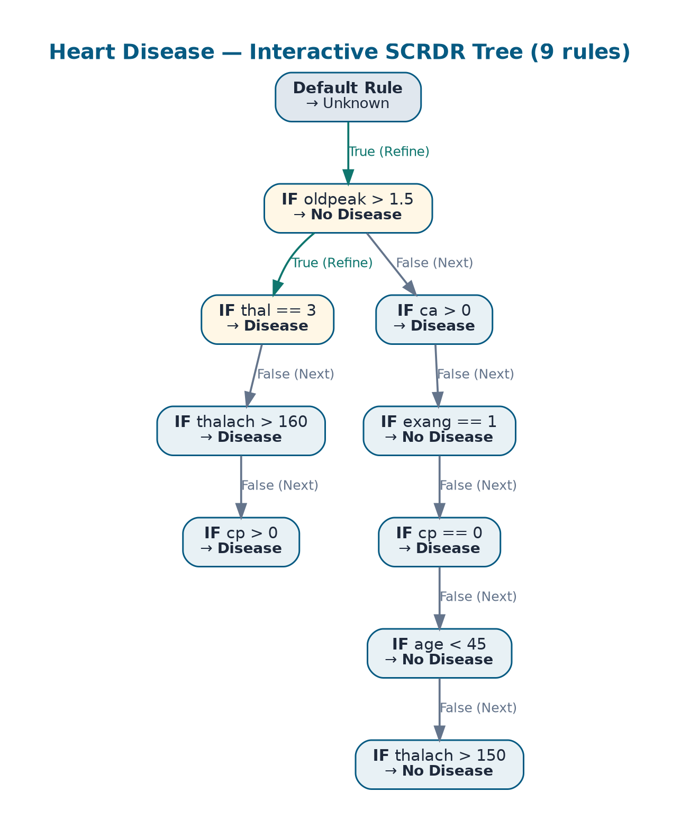
Heart Disease - Interactive Tree Structure
Tree Statistics
Total rules:
9
Max depth:
6
Conclusion balance:
5 × No disease / 4 × Disease

Slide 18
Adult Dataset - Interactive Build Approach
Adult has ~ 32,000 rows, too many for one-by-one prompts
Solution: balanced sample
Built tree on adult_small.csv — 200 rows of each class (400 total).
Tested on the full 32,561-row dataset to check generalization.
Rule Entered | Conclusion | Reasoning
capital.gain > 5000 | >50K | Capital gains nearly always = high earner
education.num > 12 | >50K | Bachelor's degree and above
marital.status == Married-civ-spouse | <=50K | (Note: this conclusion needs review)
hours.per.week > 45 | <=50K | Refinement under marital path
age < 28 / age > 60 | <=50K | Young or near-retirement earners

Slide 19
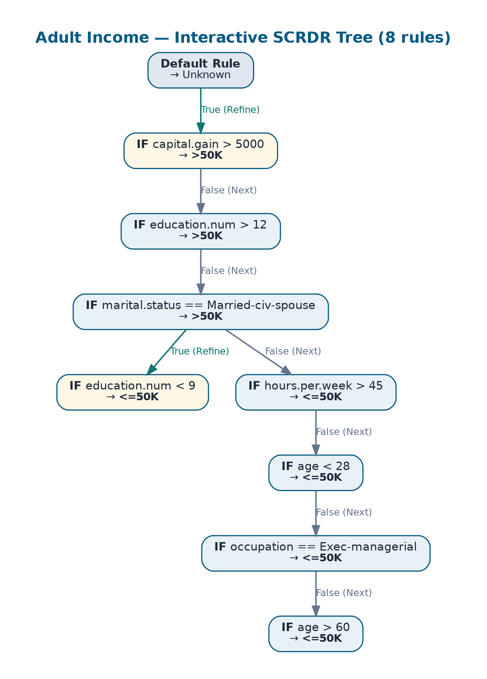
Adult Tree Structure
Setting the rules (8 rules) for adult dataset was done by using balanced sampled dataset.
Take 200 rows for each class to create a balanced 400 rows sample subset
sample sample = pd.concat([ df[df['income'] == '<=50K'].sample(n=200, random_state=42), df[df['income'] == '>50K'].sample(n=200, random_state=42) ]).sample(frac=1, random_state=42).reset_index(drop=True)

Slide 20
Final Comparison — All Three Approaches
Dataset | Best ML | SCRDR Auto | SCRDR Interactive
Heart | 0.90 (SVM) | 0.56 | 0.73
Adult | 0.85 (RF) | 0.74 | 0.73 (on sample set) 0.56 (on complete set)
Key Insight from the Experiment
Interactive RDR is sensitive to rule-entry mistakes: when prompted on one row, the user may pick a conclusion that fits that single row but inverts the rule's general meaning. Two such cases were found in this project (cp == 0 in Heart, marital == Married-civ-spouse in Adult). This is a teaching point: pure case-by-case knowledge acquisition needs cross-checking against general domain priors.

Slide 21
Conclusion
insights
Performance Patterns
SCRDR shows clear performance characteristics across different types of datasets:
Matches ML: Rule-friendly data like Iris, Mushroom, and Titanic.
Lags: Continuous medical/chemical data such as Wine, WDBC, and Heart.
psychology
Expert Rule Boosting
Expert-defined rules can significantly improve weak auto-induction results:
A stronger initial rule (e.g., oldpeak > 1.5) for Heart dataset...
...resulted in a 9-rule tree, compared to the 24-rule auto version.
warning
Real-World Risks
Interactive RDR processes introduce specific human-centric risks:
Single-row prompts may lead to inverted rule conclusions.
Mitigation: Domain priors must be used to cross-check each rule entry.

Slide 22
References
Adult Income Dataset (CCO Public Domain)-
https://www.kaggle.com/datasets/uciml/adult-census-income
Heart Disease Dataset (CCO Public Domain)-
https://www.kaggle.com/datasets/johnsmith88/heart-disease-dataset

Slide 23
Thank You!

