Slide 1
PROJECT TITLE & TEAM
Flood Forecast and Prevention
Team Members:
Purushottam - CSE, 3rd Year
Nanda vikas - CSE, 3rd Year
Bhargav - CSE, 3rd Year
Ambedkar - CSE, 3rd Year
Kirandeep - CSE, 3rd Year

Slide 2
PROBLEM STATEMENT
Water-related events such as floods cost billions of dollars of damages every year and force millions of people to defend their homes, their lives and their livelihoods
Depending on the region, these phenomena can occur with little to no warning, putting communities under extreme stress to respond and repair in a short time period.

Slide 3
SOLUTION
Forecasting of floods
Getting data from sensors
Comparing with previous statistical data
prevention of floods
Sending Alerts

Slide 4
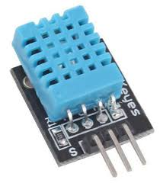

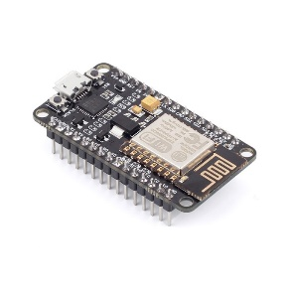
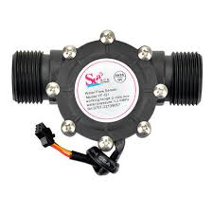
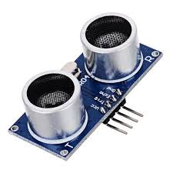
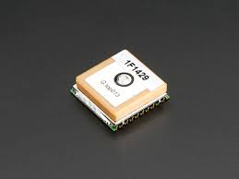
PROTOTYPE BLOCK DIAGRAM
Humidity
Temperature
Water-Flow Rate
Water-Level
Location

Slide 5



PROTOTYPE BLOCK DIAGRAM
Sensor
Data
Management
Citizens

Slide 6

TECHNOLOGY STACK
Sensors Technology
IBM Cloud
Machine Learning Algorithms
Firebase
Android Studio

Slide 7
CHALLENGES
More Statistical data for better prediction
Sensors giving more accurate value
Maintenance of Technology
High load on server

Slide 8
CONTACT US
Name:Purushottam Yadav Battula
Mobile No:9652161022
Email ID: purushottamyadavbattula@gmail.com
Name:K.Nanda Vikas
Mobile No:8019790948
Email ID:nandavikas858@gmail.com
Name:Ambedkar Gangula
Mobile No:9490377521
Email ID: gangulaambedkar@gmail.com
Name:M.Kirandeep
Mobile No:9030522664
Email ID:mungarakirandeep@gmail.com
Name:T.Siva Bhargav
Mobile No:9515473068
Email ID:thati9698@gmail.com

