Slide 1

DAYANANDA SAGAR UNIVERSITY
SCHOOL OF ENGINEERING
DEPARTMENT OF COMPUTER SCIENCE AND TECHNOLOGY
SPECIAL TOPIC
REVIEW-2
Feel good or Feel bad: A sentiment Analysis
Under the supervision of
Prof. Arjun Krishnamurthy
Team 34
Presented by:
Nandeesh P Math ENG21CS0263
N Rishi Rohan ENG21CS0256
Sree Vibha G ENG21CS0412
Sri Vishnavi Ananya Gollapalli ENG21CS0414
Dept of CSE., SOE-Dayananda Sagar University

Slide 2
Abstract
Text Classification has become a crucial because of the increasing amount of data being generated and used to improve the product or service is used based on identifying the sentiment behind the text. In this project, we are implementing sentiment analysis on the IMDB dataset using a Multi-Layer Perceptron (MLP) model implemented with TensorFlow and Keras after which training and testing the model is done and the accuracy of the model is evaluated. It also provides functionality to take user input, preprocess it, and make sentiment predictions using the trained model. Overall, the project demonstrates the complete pipeline of sentiment analysis, including data preprocessing, model building, training, evaluation, visualization, and user interaction.

Slide 3
Problem Statement
Performing sentiment analysis using suitable machine learning model to accurately predict the sentiment of movie reviews as positive or negative after performing pre processing of data

Slide 4
Solution to be achieved
Trying to create a neural network model using TensorFlow and Keras libraries that can accurately predict the sentiment of movie reviews as positive or negative.
Pre-process the IMDB dataset, then create a neural network model.
The model is compiled with the binary cross-entropy loss function and the Adam optimizer and trained on the training set for two epochs with a batch size of 128, using the validation set to evaluate the model's performance after each epoch. The model's accuracy is evaluated on the testing set, and the final model should achieve high accuracy in predicting the sentiment of movie reviews.

Slide 5
Objective
1. It aims to determine whether a piece of text expresses a positive, negative, or neutral sentiment, and to what degree.
2. It takes in a user input and processes the data and gives the result if it is a positive review or a negative review using Deep Learning Algorithm(Linear Regression)
3. Used in sentiment analysis to The model uses the deep learning technique of Recurrent Neural Network which learns to associate the words in the text with the sentiment expressed.
4. LSTM is used to process the sequential text data and capture the context and dependencies between words

Slide 6
Scope of the project
6
The project is limited to using the IMDB dataset for sentiment analysis of movie reviews, and the model is only evaluated based on its accuracy in predicting the sentiment of movie reviews as positive or negative.
The scope of the project can be expanded by using different datasets for sentiment analysis, evaluating the model's performance on different metrics, and exploring various techniques for improving the model's performance, such as using more complex neural network architectures or incorporating additional features into the model.

Slide 7
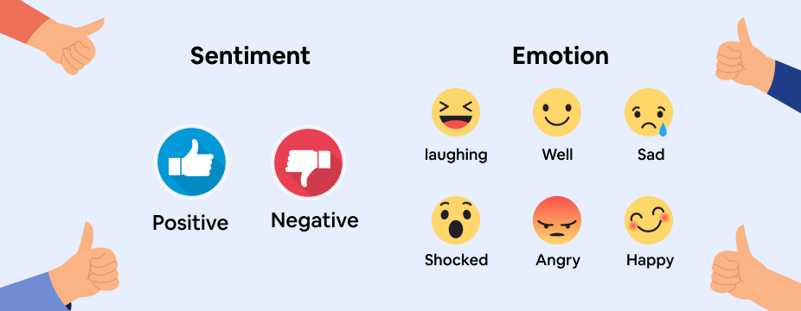
Sentiment Analysis
Sentiment analysis, also known as opinion mining, is a type of natural language processing (NLP) that involves identifying and extracting subjective information from text data, such as opinions, emotions, attitudes, and feelings expressed by individuals towards a particular topic, product, service, or entity.
Sentiment analysis has numerous applications in various domains, including social media monitoring, customer feedback analysis, brand reputation management, market research, and political analysis.

Slide 8
State of the Art Work: Literature Reviews

Slide 9
Literature review-1
Author’s Name/ Paper Title | Conference/Journal Name and year | Technology/ Design | Results shared by author | What you infer
Kian Long Tan, Chin Poo Lee and Kian Ming Lim "A Survey of Sentiment Analysis: Approaches, Datasets, and Future Research” | Citation: Tan, K.L.; Lee, C.P.; Lim, K.M. A Survey of Sentiment Analysis: Approaches, Datasets, and Future Research. Appl. Sci. 2023, 13, 4550 Published: 3 April 2023 | machine learning, deep learning, or ensemble learning. | Need for more trustworthy language models. Focus toward deep learning techniques where, text is first encoded into pretrained word embeddings such as GloVe, word2vec, or fastText which are fed into deep learning models such as CNN, LSTM, GRU, etc. | The paper talks about Sentiment analysis and the steps done throughout to achieve the necessary output. It covers the deep learning, machine learning, ensemble learning approaches, datasets, limitations and future research prospects 1.The focus has been shifted to mainly to the deep learning approach 2. Future study should concentrate on fine-grained and elaborate sentiment analysis that includes classes with various emotional tensors like very positive, positive, neutral, negative, and extremely negative

Slide 10
Literature review-2
Author’s Name/ Paper Title | Conference/Journal Name and year | Technology/ Design | Results shared by author | What you infer
Yingqi Wang & Hongyu Han & Xin He & Rui Zhai A two-stage unsupervised sentiment analysis method | Multimedia Tools and Applications Received: 20 March 2022 / Revised: 29 June 2022 / Accepted: 6 February 2023 | SASC (Sentiment Analysis based on Sentiment Clustering) | Un-labelled reviews are taken as research object, and sentiment analysis method is developed based on topic model LDA and K-means algorithm. Firstly, the status of unsupervised learning sentiment analysis is briefly analysed, and then the application of clustering algorithm in sentiment analysis is introduced in detail. Secondly, a two-stage sentiment analysis method is proposed. | In order to address the issues of low accuracy and unstable review sentiment clustering methodologies, the SASC (Sentiment Analysis based on Sentiment Clustering) method is put forth. To increase the precision and stability of the findings, two-stage sentiment clustering is used to extract the latent sentiment information from the review texts.

Slide 11
Literature review-3
Author’s Name/ Paper Title | Conference/Journal Name and year | Technology/ Design | Results shared by author | What you infer
Tapasy Rabeya and Ismail Jabiullah A Rule-Based Approach for Sentiment Analysis of Products Review | Elixir Inform. Tech. 164 (2022) 56147-5615113, 4550 Received: 12 January 2022; Received in revised form: 17 March 2022; Accepted: 27 March 2022; | Machine learning, Deep learning, Ensemble learning. | Analyses the expressions from the textual reviews of a product for predicting sentiment and assigns scores for our predefined features to present a net sentiment profile of a product of all parameters and attributes that seem to be really beneficial to the customer and manufacturer. | The main aim of the paper is to make product buying efficient and easy by sorting the reviews into negative and positive with respective to the assigned words about the product about which the decision is taken on the expression given or commented. With the rising popularity of E-Commerce trade, sentiment analysis in this domain will prove very helpful in filtering out the products by the customer.

Slide 12
Literature review-4
Author’s Name/ Paper Title | Conference/Journal Name and year | Technology/ Design | Results shared by author | What you infer
Prof. R Y Totare , Aishwarya Ahergawli , Abhijeet Girase , Ishwari Tale , Ayushi Khanbard A Review on Twitter Sentiment Analysis Using ML | International Journal for Research in Applied Science & Engineering Technology (IJRASET) ISSN: 2321-9653; IC Value: 45.98; SJ Impact Factor: 7.538 Volume 10 Issue XII Dec 2022- | Sentiment reversal prediction model | This research focuses on how to merge the textual content of Twitter tweets and sentiment propagation models. examines the spread of feelings by researching a phenomena known as inversion of feelings and identifies several intriguing characteristics of reversal of feelings. | Due to the distinctive qualities of Twitter messages, the majority of existing Twitter sentiment analysis systems simply take into account the textual information of Twitter messages and are unable to deliver sufficient performance.. Existing methods ignore the dispersion of emotional information The need to study Sentiment analysis by taking in account the concepts of other domains, fuse the knowledge and integrate textual data with distributing emotions and enhance twitter sentiment analysis

Slide 13

13
Dept of CSE., SOE-Dayananda Sagar University

Slide 14
Functional requirements
The system can take in an input and the model can predict if the given input review from the user is positive or negative.
The system can perform the classifier training process and display the model in the form of feature sets of the term data from the training data,
The system can display the test data result and display confusion matrix generated from the classifier testing,
The system can display sentiment analysis result derived from reviews submitted by users.
Dept of CSE., SOE-Dayananda Sagar University

Slide 15
Non-functional requirements
Performance: The model should be able to process a large number of movie reviews in a reasonable amount of time, with minimal delay or lag.
Accuracy: The model should have a high degree of accuracy in predicting the sentiment of movie reviews, with a low rate of false positives or false negatives.
Scalability: The model should be able to handle increasing amounts of data and users, without compromising performance or accuracy.
Reliability: The model should be reliable and robust, with minimal downtime or errors.

Slide 16
Non-functional requirements
Security: The model should be secure, with appropriate measures in place to prevent unauthorized access or data breaches.
Usability: The model should be easy to use, with a simple and intuitive user interface that requires minimal training or technical expertise.
Accessibility: The model should be accessible to users with disabilities or special needs, with appropriate accommodations such as screen readers or keyboard navigation.
Portability: The model should be portable, with the ability to run on different platforms and operating systems.
Maintainability: The model should be easy to maintain and update, with clear and well-documented code and processes.
Privacy: The model should respect the privacy of users and their data, with appropriate measures in place to protect sensitive information

Slide 17

Software & Hardware Requirements

Slide 18
Software Requirements
Python programming language
TensorFlow or Keras framework for building and training the model
Scikit-learn or other libraries for data pre-processing and analysis
Jupyter Notebook or other IDE for developing and testing the code
Flask or Django for developing a web application to interact with the model
Database management system such as MySQL or MongoDB for storing and managing data

Slide 19
Hardware Requirements
A computer or server with a multi-core CPU and a high-end GPU to speed up model training and processing
Sufficient RAM to handle the size of the data being processed
Sufficient storage space to store the data and the model files
Internet connectivity for accessing and processing data from external sources

Slide 20
System architecture
The model depends on various platforms, systems, services, and processes to function effectively. Here are the key dependencies:
1.Python: The model is implemented using the Python programming language.
2. TensorFlow and Keras: The model uses TensorFlow and Keras API for building and training neural networks.
3. NumPy: NumPy is a package with Python which is used for numerical operations and array manipulations in the model.
4. Matplotlib : Used for data visualization, plotting the review length distribution and generating heatmaps for the confusion matrix.
5. IMDB Dataset: The model relies on the IMDB dataset, which provides a collection of movie reviews with sentiment labels (positive or negative). The dataset is accessed through the Keras API.

Slide 21
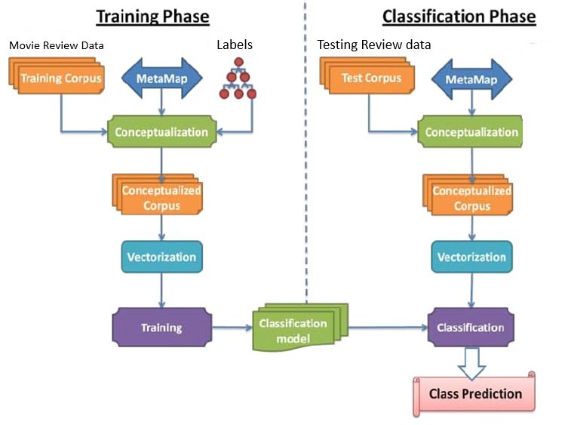
System Architecture

Slide 22
Methodology
1. Problem Understanding: Clearly defining the problem at hand, in this case is sentiment analysis on movie reviews. Determine the goal, such as predicting whether a review is positive or negative based on its text.
2. Data Acquisition: Obtain the necessary dataset for training and testing the model. In this project, the IMDB dataset containing labelled movie reviews is used.
3. Data Pre-processing: Clean and pre-process the dataset to make it suitable for model training. This includes steps like tokenization, removing stop words or noise, handling missing values, and converting text data into numerical sequences.

Slide 23
Methodology
4. Model Selection and Architecture: Choose an appropriate model for sentiment analysis. In this case, a Multi-Layer Perceptron (MLP) model is used. Define the architecture of the model, including the number and type of layers, activation functions, and other relevant parameters.
5. Train-Test Split: Split the pre-processed dataset into training and testing sets. The training set is used to train the model, while the testing set is used for evaluating its performance.
6. Model Training: Train the selected model on the training data. This involves feeding the input data into the model, adjusting the model's parameters (weights and biases) iteratively using an optimization algorithm ( Adam optimizer), and minimizing a chosen loss function ( binary cross-entropy).

Slide 24
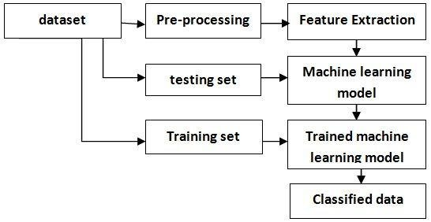
Methodology

Slide 25
Methodology
7. Model Evaluation: Evaluate the trained model on the testing data to assess its performance.
8. Prediction and Inference: Deploy the trained model for prediction on new, unseen data. In this project, it involves taking user input (movie reviews), pre-processing it, and feeding it into the model to classify the sentiment.
9. Performance Analysis and Iteration: Analyse the model's performance, identify areas for improvement, and iterate on the methodology, such as trying different models, pre-processing techniques and training with new datasets.

Slide 26
Methodology
The sentiment analysis project utilizes several data structures. Here are the key data structures used in the project:
1. NumPy Arrays
2. Python Lists
3. Dictionaries
4. Tokenizer
5. Sequences
6. Pad Sequences
7. Model Architecture
8. Confusion

Slide 27
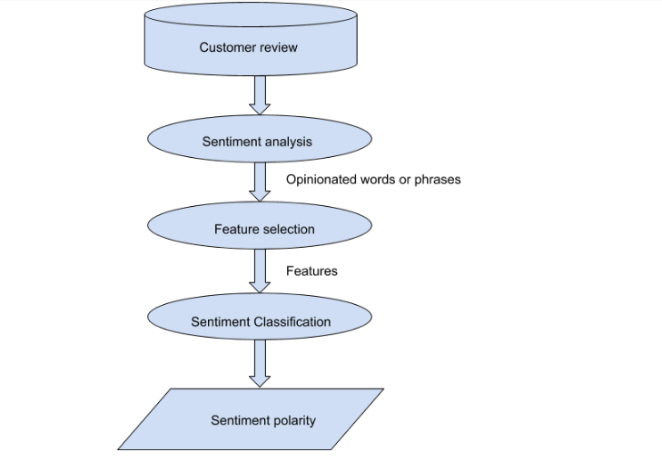
Experimentation
Dept of CSE., SOE-Dayananda Sagar University

Slide 28

Experimentation
Dataset used:
IMDB Dataset
Type of Network used:
RNN(LSTM)

Slide 29
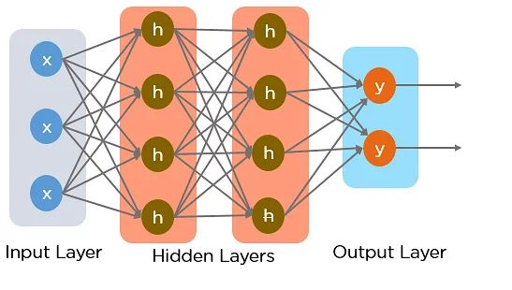
Recurrent Neural Network
It’s a type of neural network architecture specifically designed to process sequential data, RNNs process the text input word by word, updating their hidden state at each step, and producing an output prediction at the final step.
The RNN can learn to associate certain patterns and sequences of words with specific sentiment labels during training, and then use this learned knowledge to predict sentiment for new, unseen text.

Slide 30
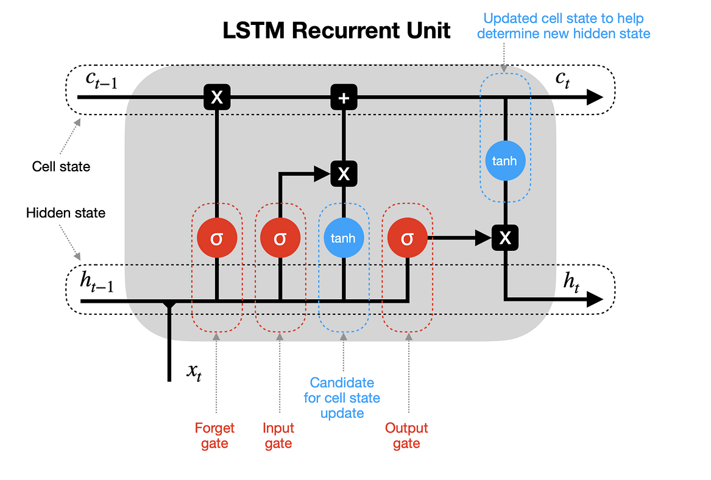
LONG SHORT-TERM MEMORY CELL
LSTM is a specific variant of the recurrent neural network (RNN) architecture that addresses the issue of capturing long-term dependencies in sequential data.
LSTM networks are effective in understanding and classifying the sentiment expressed in text. LSTM cells are designed to retain and update information over long sequences, making them well-suited for tasks that require capturing context and dependencies between words.

Slide 31
Experimentation
Once the prepared dataset is fed and loaded into the sentiment analysis model, the actual work of sentiment analysis involves several steps to classify and analyze the sentiment of the text.
1.Text preprocessing: The input text is preprocessed to make sure the format corresponds to what was taught. This entails eliminating any extraneous characters, changing the text's case to lowercase, tokenizing the text into distinct words and making any other necessary adjustments.
2. Encoding: In order to feed the preprocessed text into the sentiment analysis model, it is then encoded into numerical representations. In this part of the encoding process, words are often translated into numerical vectors using word embedding techniques (such as Word2Vec, GloVe)

Slide 32
Experimentation
3.Padding and batching: Encoded text is frequently padded or truncated to a predetermined length in order to analyze the data as quickly as possible. This guarantees that the form of every input is the same. The data is additionally split up into batches, enabling parallel processing and quicker computing.
4.Forward Propagation: The sentiment analysis model is then applied to the batched and padded data. The input is analyzed and altered layer by layer based on the model's RNN architecture. The model's hidden layers develop representations for the text's sentiment-related attributes.
5. Sentiment Classification: Once the forward propagation is complete, the model generates a prediction for each input instance. This prediction represents the sentiment label associated with the input text, such as positive, negative.

Slide 33
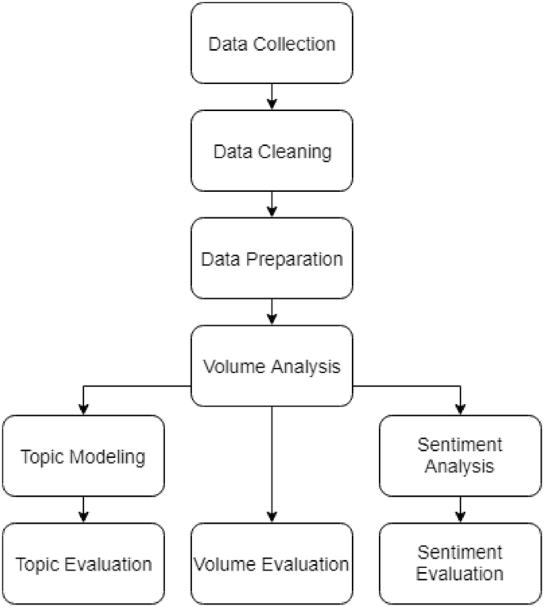
Experimentation
6. Evaluation and Analysis: After sentiment classification, the accuracy and performance of the sentiment analysis model are evaluated using appropriate evaluation metrics such as accuracy, precision.

Slide 34

Experimentation
Python is the language used

Slide 35
Result We Are Obtaining
The model is giving the overall sentiment of the loaded dataset along with the percentage of negative or positive reviews.
The model has been trained on the IMDb dataset, which consists of movie reviews labeled as positive or negative, and is able to accurately classify new, unseen movie reviews as positive or negative based on these learned patterns and features.
The model is able to take in a user input of the review and predict the sentiment of it accurately.
A confusion matrix has been plotted to better represent the accuracy of the classification.

Slide 36
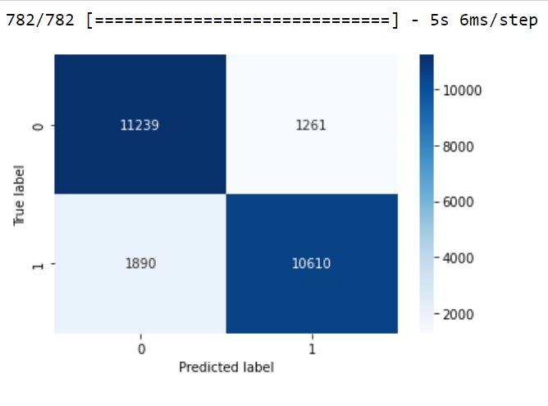
Confusion Matrix

Slide 37
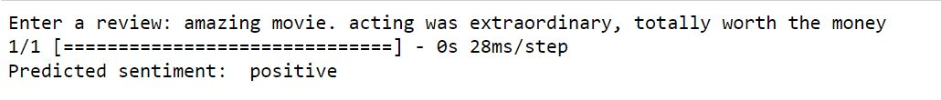
Positive Review Test Case
Negative Review Test Case

Slide 38
References
https://machinelearningmastery.com/prepare-movie-review-data-sentiment-analysis/
https://builtin.com/data-science/how-build-neural-network-keras
https://machinelearningmastery.com/predict-sentiment-movie-reviews-using-deep-learning/
https://datamahadev.com/lstm-sentimental-analysis-using-keras-with-imdb-dataset/
https://towardsdatascience.com/sentiment-analysis-using-lstm-step-by-step-50d074f09948
https://www.geeksforgeeks.org/confusion-matrix-machine-learning/
https://www.w3schools.com/python/python_ml_confusion_matrix.asp
https://www.tutorialspoint.com/keras/keras_model_compilation.htm
https://www.kaggle.com/datasets/atulanandjha/imdb-50k-movie-reviews-test-your-bert/code?datasetId=447516
https://www.geeksforgeeks.org/what-is-sentiment-analysis/
https://monkeylearn.com/sentiment-analysis/
https://towardsdatascience.com/sentiment-analysis-concept-analysis-and-applications-6c94d6f58c17

