Slide 1
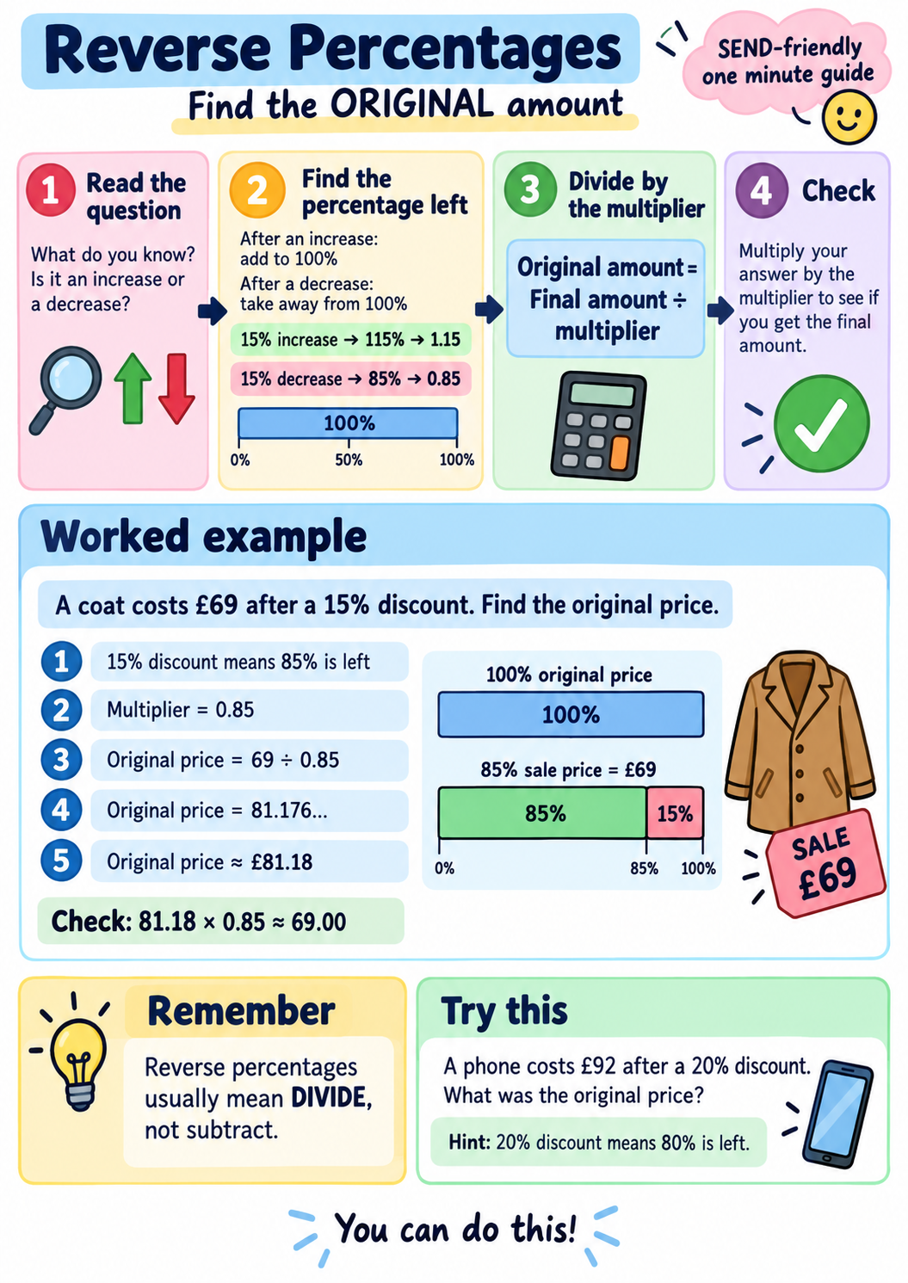
Notes:
Reverse Percentages one minute guide. Key message: reverse percentages usually mean divide by the multiplier, not subtract.

