Slide 1

Iris Flower Species
Classification
Name: ____________________
Date: 2026-10-30

Slide 2

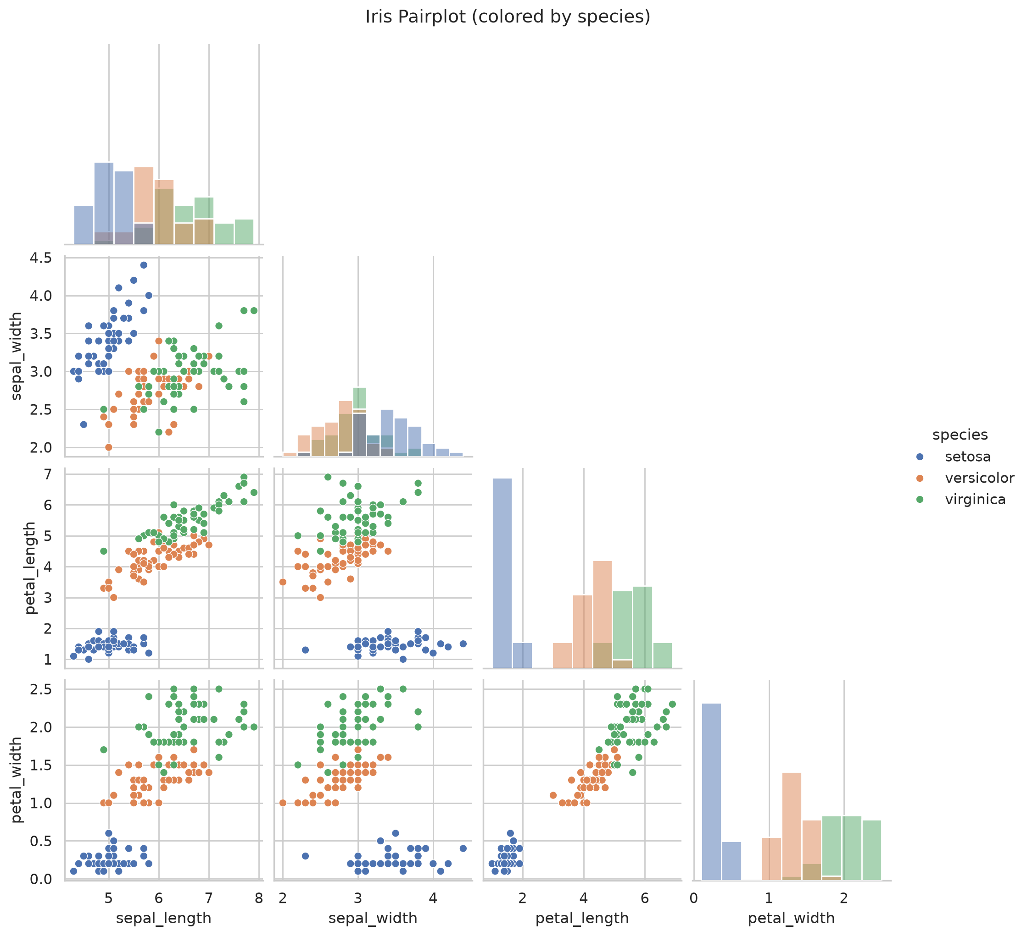
Problem
Predict Iris species from 4 flower measurements.
A classic multi-class classification task (3 classes).
Dataset
Source: sklearn Iris dataset (150 rows).
Features: sepal length/width, petal length/width.
Classes: setosa, versicolor, virginica.

Slide 3

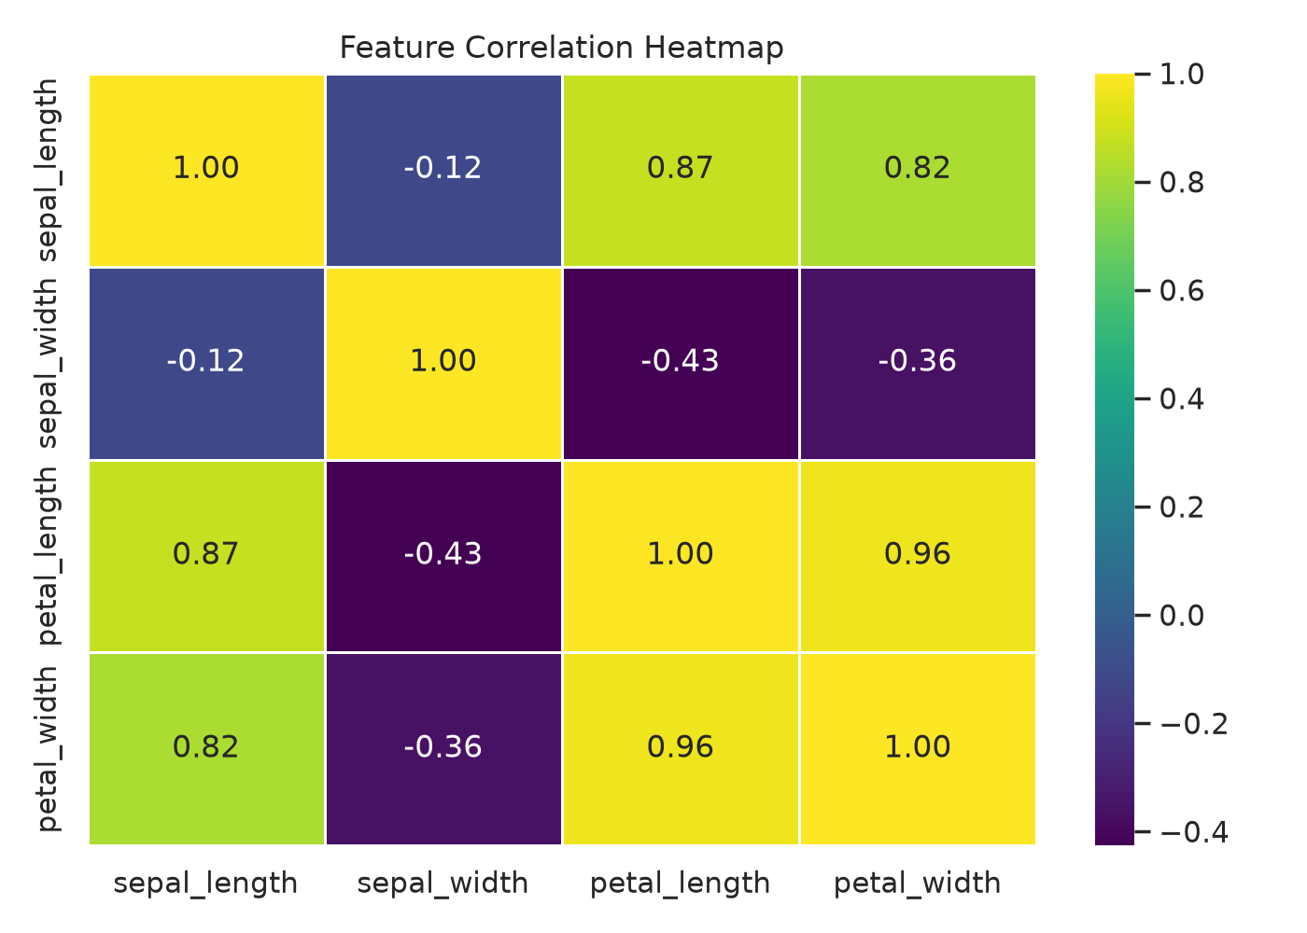
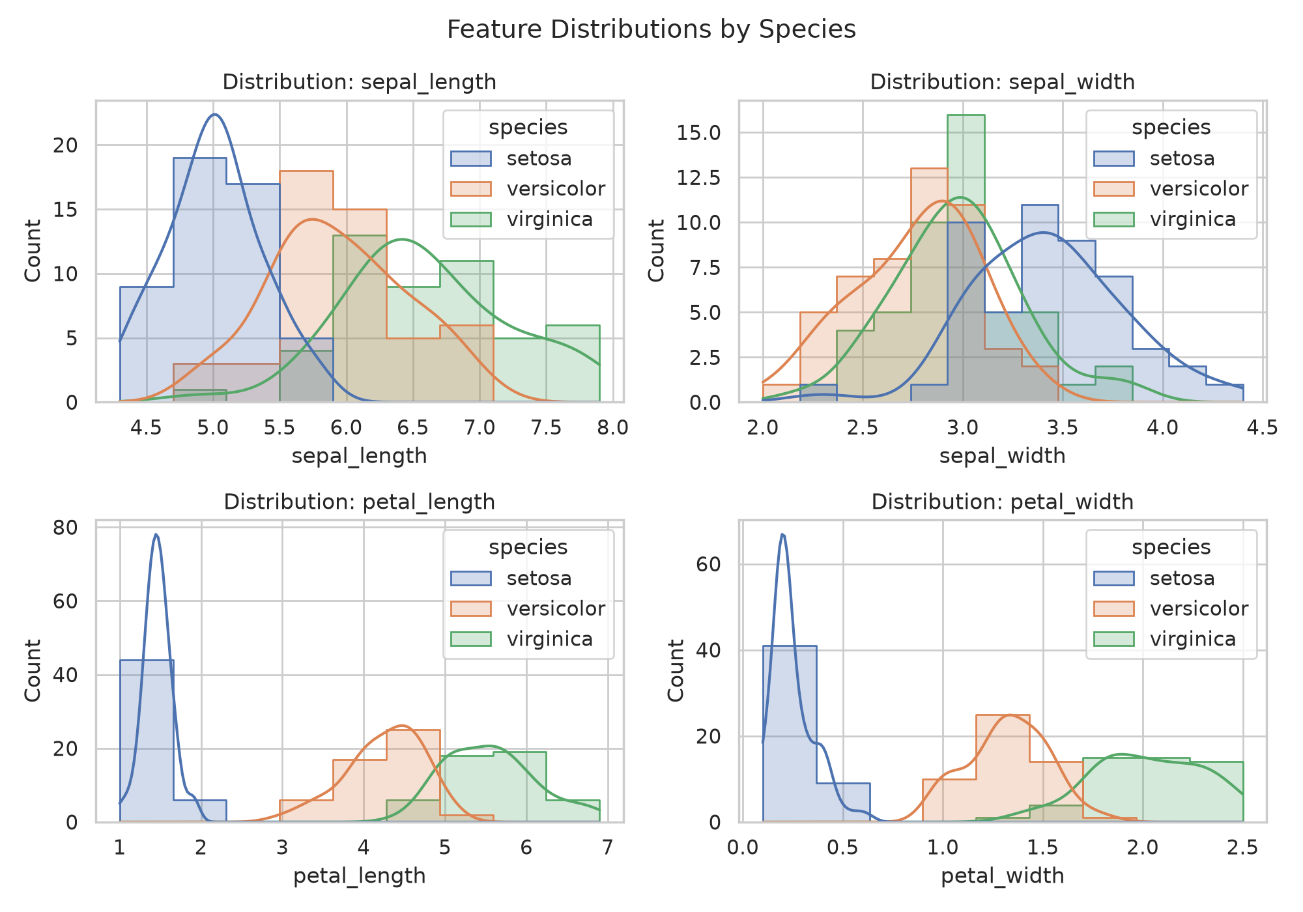
EDA + Preprocessing
Validated numeric features, removed duplicates, ensured clean labels.
All 4 standard features retained (high signal on petal measures).
Train-test split with stratification for fair evaluation.

Slide 4

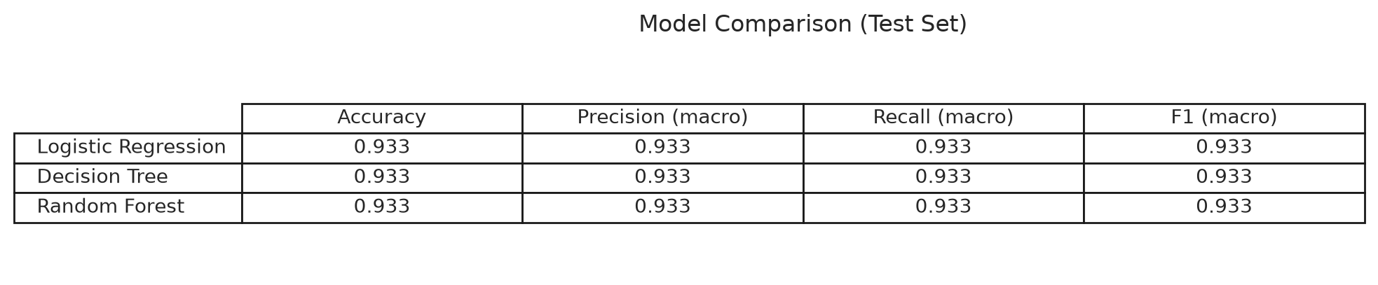
Modeling + Metrics
Models: Logistic Regression, Decision Tree, Random Forest.
Compared with Accuracy / Precision / Recall / F1 (macro).
Best model: Logistic Regression (F1=0.933, Acc=0.933).

Slide 5

Conclusion
Key takeaways
Achieved >90% accuracy (best test accuracy: 0.933).
Petal measurements are the strongest separators between classes.
Deployed the trained model via an interactive Streamlit app.
Future scope
Add input validation + model confidence/probabilities.
Track experiments with MLflow and add CI checks.
Extend to other flower datasets or add SHAP explanations.

