Slide 1
CricBid: Real-Time Multi-Laptop Cricket Player Auction System
Java Swing Dark Broadcast Arena • MySQL 8 JDBC • Multi-Laptop TCP Socket Server (Port 5050)
Member 1 — [Enter Name & Register Number] (Data Layer & JDBC)
Member 2 — [Enter Name & Register Number] (Bidding Engine, Rules & AI Bots)
Member 3 — [Enter Name & Register Number] (TCP Socket Networking & Live Sync)
Member 4 — [Enter Name & Register Number] (Broadcast UI, Audio & Analytics)

Slide 2
Final Review (Review 3)
Overall Implementation Status: 91%
✔ Complete 3-Tier Architecture: 10 Java Packages, 70 Classes, 6 MySQL Relational Tables, and 48 Seeded Cricket Players.
✔ Real-Time 3-Laptop LAN Deployment: Laptop 1 (Admin Host + MySQL + TCP Port 5050) & Laptops 2–3 (Live Franchise Owners).
✔ Review 3 Dark Broadcast UI: Full FlatDarkLaf Navy & Gold Stadium Theme, Top 6-Team Purse Strip, Circular Timer & Rating Bars.
✔ Review 3 Interactive Features: Synthesized Gavel/Bid Audio Engine (javax.sound.sampled) + Live Multi-Laptop Chat & Banter Bar.
✔ Full Post-Auction Suite: Player Trade Desk, Custom Graphics2D Spending & Role Charts, Rules Compliance Audit & CSV Export.

Slide 3
CricBid Project Implementation Status (Modules 1 – 5)
Sno | Module Name | Planned Features | Features Completed | % Completion | Challenges Faced
1 | User Auth & LAN Portal (AuthService, LoginPanel) | Role login (ADMIN / TEAM_OWNER), SHA-256 hashing, Host IP config, quick-role fill | SHA-256 auth, live Hotspot IP auto-detection, 1-click role preset buttons | 95% | Resolved 5s MySQL reverse-DNS lag on Hotspot via skip-name-resolve & bind-address=0.0.0.0
2 | Player Pool & Franchises (DAO Layer, Pool/Teams UI) | 48 players across 4 roles, 6 franchises (100 Cr purse), live search & role/status filters | 6 DAO interfaces + JDBC impls, OOP role subclasses, live searchable pool & squad cards | 95% | Deferred initial JDBC queries until after Login so client laptops use Host IP instead of localhost
3 | Live Bidding & IPL Rules (AuctionService, RuleValidator) | Thread-safe bidding, 5 IPL rules (Purse, Overseas<=8, Squad<=25, Reserve, Step), ACID sale | ReentrantLock bidding, 6 custom CricBidExceptions, 4-table JDBC commit()/rollback() | 90% | Prevented race conditions between round timer expiry and late network bids using ReentrantLock
4 | Multi-Laptop TCP Sync & Chat (AuctionServer, AuctionClient) | TCP port 5050 broadcast, mid-round SYNC_STATE, BID_REJECTED, live multi-laptop chat | Multi-threaded ServerSocket, CopyOnWriteArrayList, 2s auto-reconnect, live chat & banter bar | 90% | Fixed ObjectInputStream handshake deadlock by flushing ObjectOutputStream first on both sides
5 | AI Bots & Auto-Suggest (BiddingStrategy, BotControl) | Aggressive, Balanced & Moneyball bots, live bot speed/toggle, AI max-bid advisor | Polymorphic EnumMap bot engine on ScheduledExecutorService + 1-click AI Auto-Suggest | 85% | Added 3s bot cooldown & human-priority lock so bots do not instantly outbid human laptops

Slide 4
Sno | Module Name | Planned Features | Features Completed | % Completion | Challenges Faced
6 | IPL Broadcast UI & Audio (FlatDarkLaf, SoundService) | Full Dark Navy/Gold theme, circular timer dial, rating/valuation bars, purse strip, sound | FlatDarkLaf UI, Graphics2D circular timer & stat bars, SOLD stamp dialog, PCM audio synthesizer | 90% | Synthesized zero-dependency 44.1kHz PCM audio on daemon threads without blocking Swing EDT
7 | Post-Auction Trade Desk (TradeService, TradeWindow) | Franchise-to-franchise player swap with purse differential & overseas limit validation | Transactional JDBC player trade execution with live purse update and auction_log entry | 85% | Validating two-way purse differences and overseas caps simultaneously before trade commit
8 | Visual Analytics & CSV Export (ReportsPanel, SummaryPanel) | Custom 2D Spending Bar Chart, Role Pie Chart, Top 10 Buys, Rules Compliance & CSV export | Graphics2D bar/pie charts, franchise compliance audit table, JFileChooser CSV export | 95% | Dynamically scaling bar chart heights & pie angles cleanly during early auction rounds
9 | MySQL Schema & Audit Log (schema.sql, seed.sql, LogDAO) | 6 normalized tables (teams, users, players, squads, bids, auction_log) with FK constraints | Full relational schema, 48 seeded players, singleton DBConnection & live audit logging | 100% | Ensuring 1-click auction reset clears squads/bids/logs cleanly without FK constraint errors
10 | Multi-OS Deployment (Maven Shade, jlink Bundles) | Standalone shaded JAR + zero-Java-install portable bundles for macOS & Windows 11 | 5.2 MB Uber-JAR + custom jlink JRE 17 bundles tested live across 3 laptops on Hotspot | 95% | Handled macOS Gatekeeper quarantine (xattr) & Windows 11 Smart App Control via signed JRE
Overall Project Completion: 91% | Deployed & Verified Live Across 3 Laptops (1 Host Mac + 2 Client Laptops over Mobile Hotspot LAN)

Slide 5
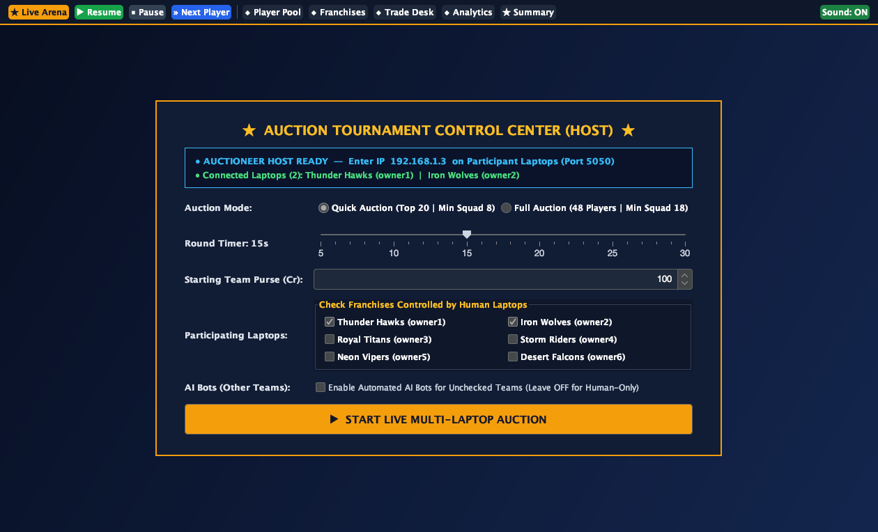
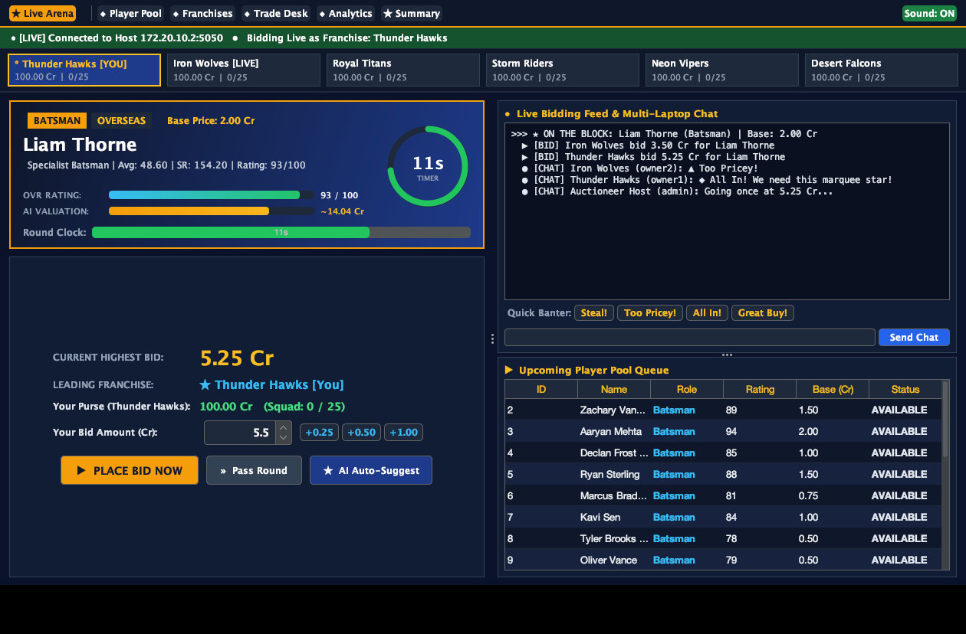
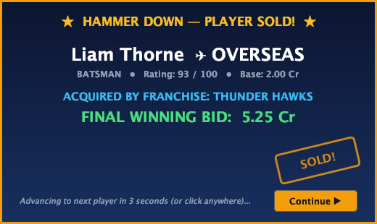
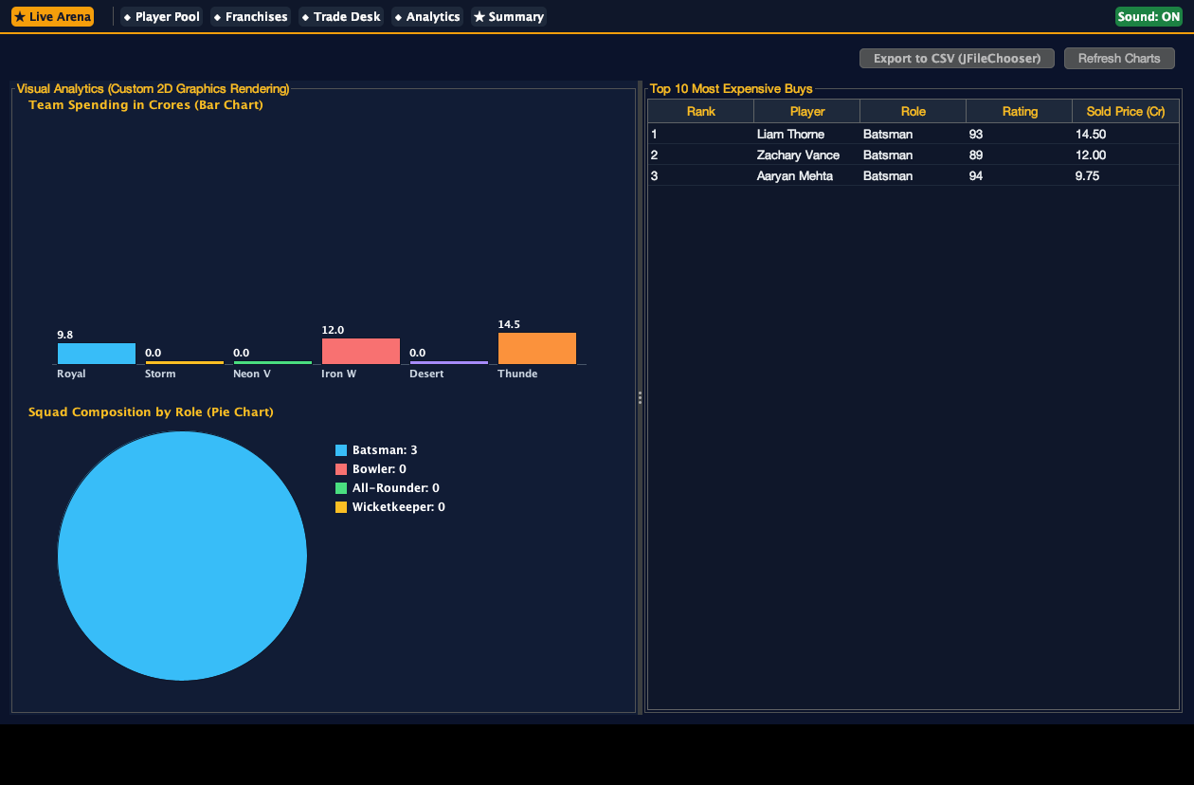
CricBid Review 3 — Full Dark Navy & Gold Broadcast UI Screenshots

Slide 6
Thank You!
Live 3-Laptop Auction Demonstration Ready

