Slide 1
Vehicle Showcase AR App
Team Members:
Nandhakumar. S [ 711715104043]
Sajan. S [711715104051]
Vigneshwar .D.K [711715104069]
Industrial Guide:
Ms. Shanmuga Priya .A
Faculty Guide:
Ms. Aruna .T.N
Department of CSE, KGiSL Institute of Technology, Coimbatore

Slide 2
Abstract
The aim of this project is to develop AR vehicle showcase android app using Unity 3D and Vuforia. A voice controlled cloud based machine learning AI bot is integrated with wit.ai API. This app will project 3D model of vehicle in the real world which makes the user to experience the view of real car showcase. Then by using our voice commands, the integrated bot will react to perform particular operation like open the car doors, change the colours, start the engine.
Department of CSE, KGiSL Institute of Technology, Coimbatore

Slide 3
Existing system
In existing application it is used to view the 3D model of the car using 2D Object recognition were in 2D Object recognition App ground plane detection is not possible.
Department of CSE, KGiSL Institute of Technology, Coimbatore

Slide 4
Proposed System
AR is all about superimposing computer-generated images on top of your view of reality, thus creating a composite view that augments the real world. In our App we are implementing 3D Object recognition and Ground plane detection is also possible.
Advantages over existing methods:
The AR car showroom app allows user to view the car in the manner they want and can alter the parts in imaginary that will project in real world.
Future enhancement:
Future work holds how engine works and damaged parts replacement with image recognition.
Department of CSE, KGiSL Institute of Technology, Coimbatore

Slide 5
Literature Review
Drawbacks of existing methods
In previous versions of AR applications 2D Object recognition were used which won’t give complete user experience. To overcome this we have implemented 3D Object recognition with Ground plane detection.
References
https://www.ibmbigdatahub.com/podcast/making-data- simple-2d-3d-augmented-reality-data-visualization.
wit.ai Docs
Unity Docs
Department of CSE, KGiSL Institute of Technology, Coimbatore

Slide 6
Data Flow Diagram – Level 0
0
LEVEL -
Upload the car models
Response the
queries
AR Application
Vehicle Showcase Dealer
Customer
Select the car
Department of CSE, KGiSL Institute of Technology, Coimbatore

Slide 7
Data Flow Diagram-Level 1
Response the queries
Update the car models
AR Application
Vehicle Showcase Dealer
Customer
Select the car
Requests of available cars
Update the cars
Car Designing Unit
Update 3D car models
Manufacturing unit

Slide 8
Module Splitup
Module 1
Creation of intro scene.
Adding of 3D car models.
Module 2
Adding the windows, chassis and base of the car.
Module 3
Integration of voice AI controlled bot.
Communication code using C#.
Module 4
Improving the code.
Fixing the audio ascents and video quality.
Department of CSE, KGiSL Institute of Technology, Coimbatore

Slide 9
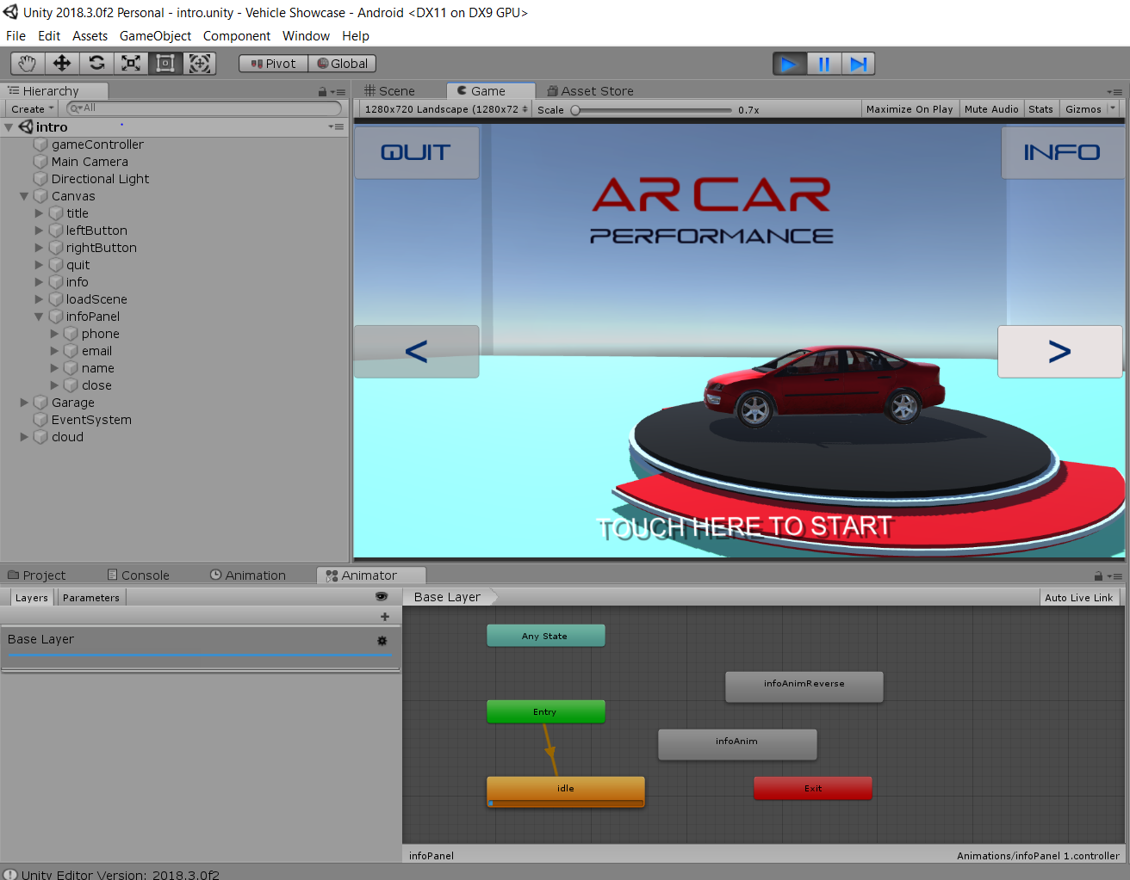
Snapshot

Slide 10
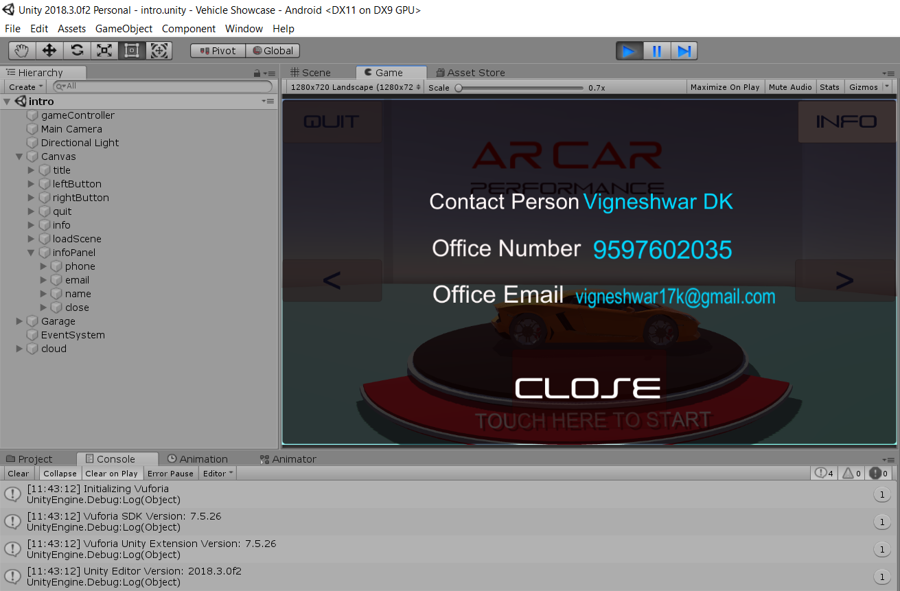
Continued…

Slide 11
THANK YOU !!

