Slide 1
Chapter 3
OSI
Model
The model
Functions of the layers
My notes for DataCom :: @nkur
_

Slide 2
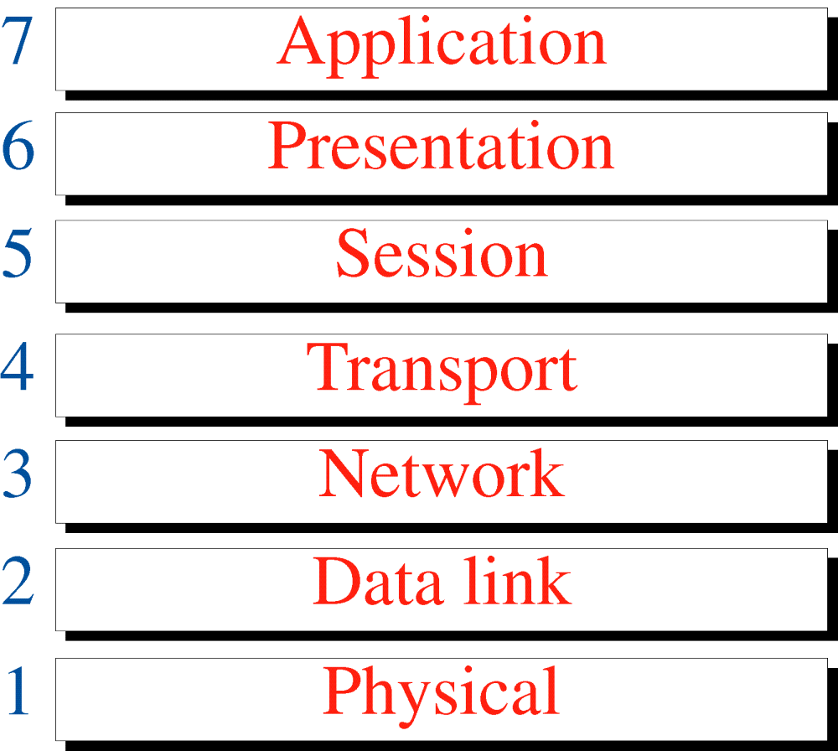
Figure 3-1
OSI Model
My notes for DataCom :: @nkur
_

Slide 3
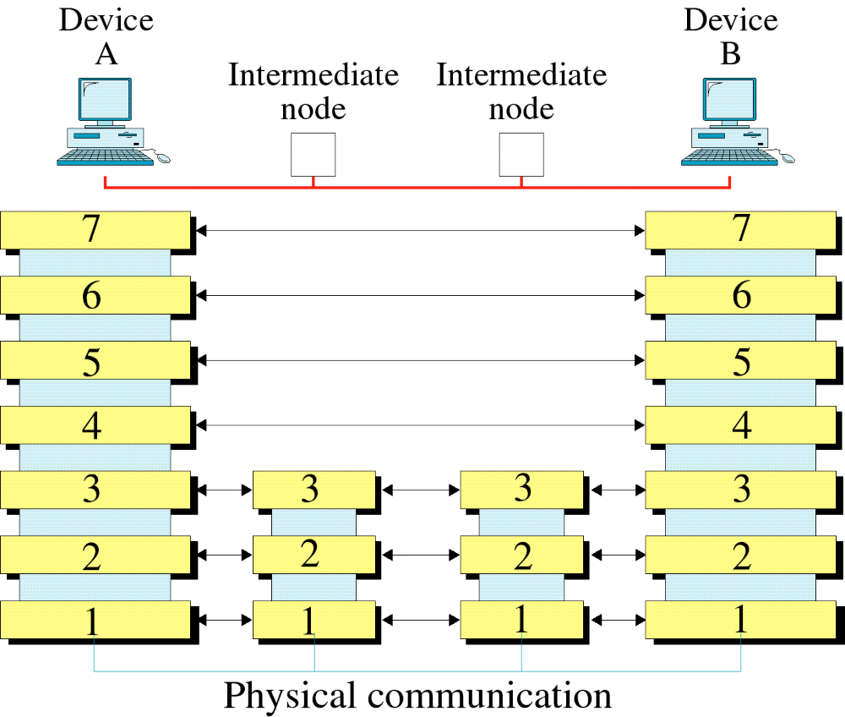
Figure 3-2
OSI Layers
My notes for DataCom :: @nkur
_

Slide 4
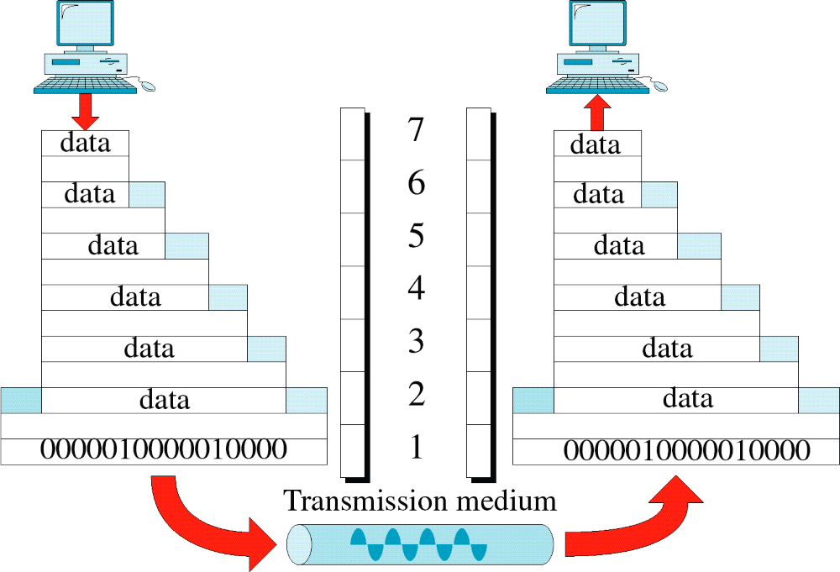
Figure 3-3
An Exchange Using the OSI Model
My notes for DataCom :: @nkur
_

Slide 5
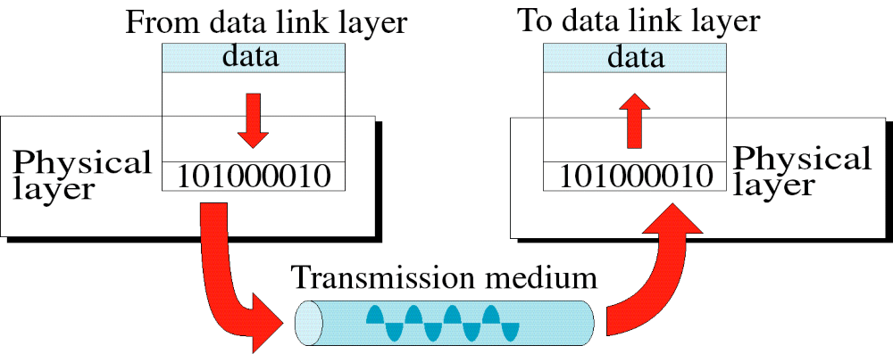
Figure 3-4
Physical Layer
My notes for DataCom :: @nkur
_

Slide 6
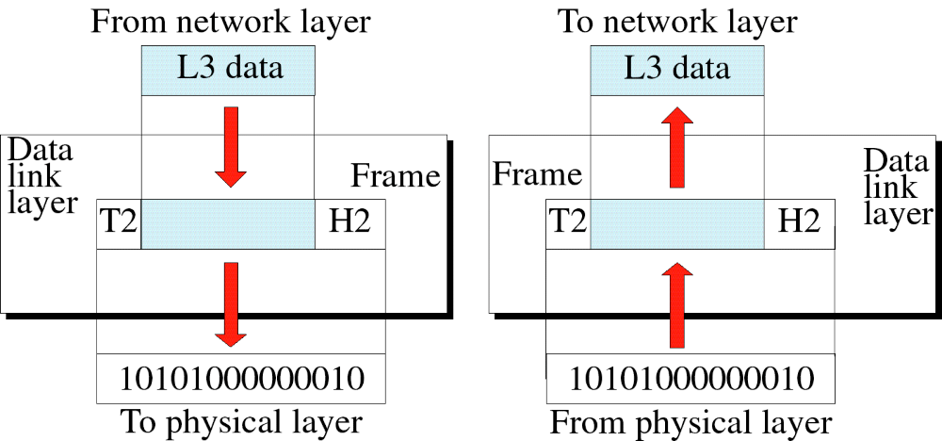
Figure 3-5
Data Link Layer
My notes for DataCom :: @nkur
_

Slide 7
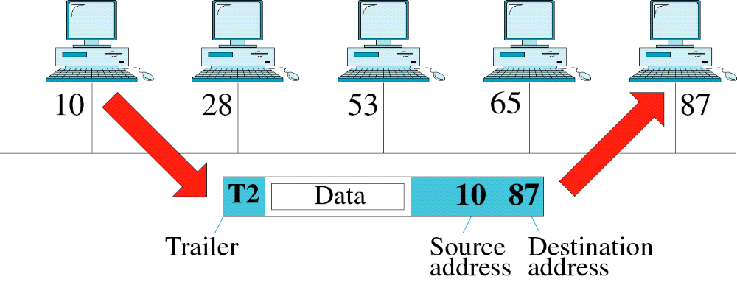
Figure 3-6
Data Link Layer Example
My notes for DataCom :: @nkur
_

Slide 8
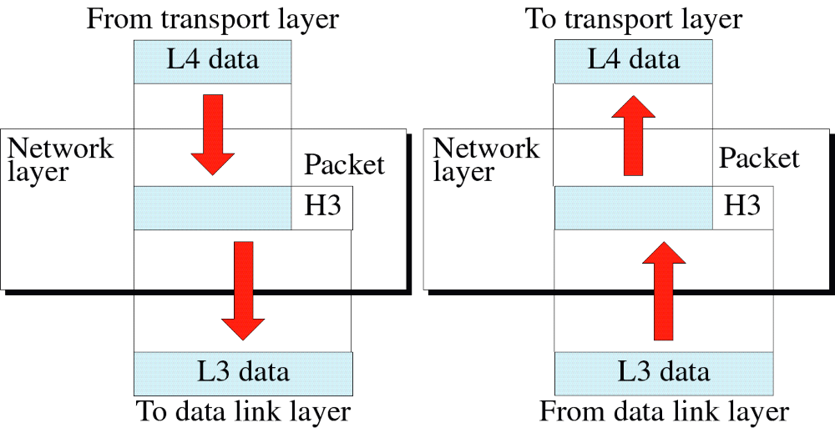
Figure 3-7
Network Layer
My notes for DataCom :: @nkur
_

