Slide 1

Mushroom Yield Forecast using Machine Learning
AI Data Analyst Capstone
Presented by Nandhana B
"An end-to-end machine learning pipeline for precision agriculture."

Slide 2

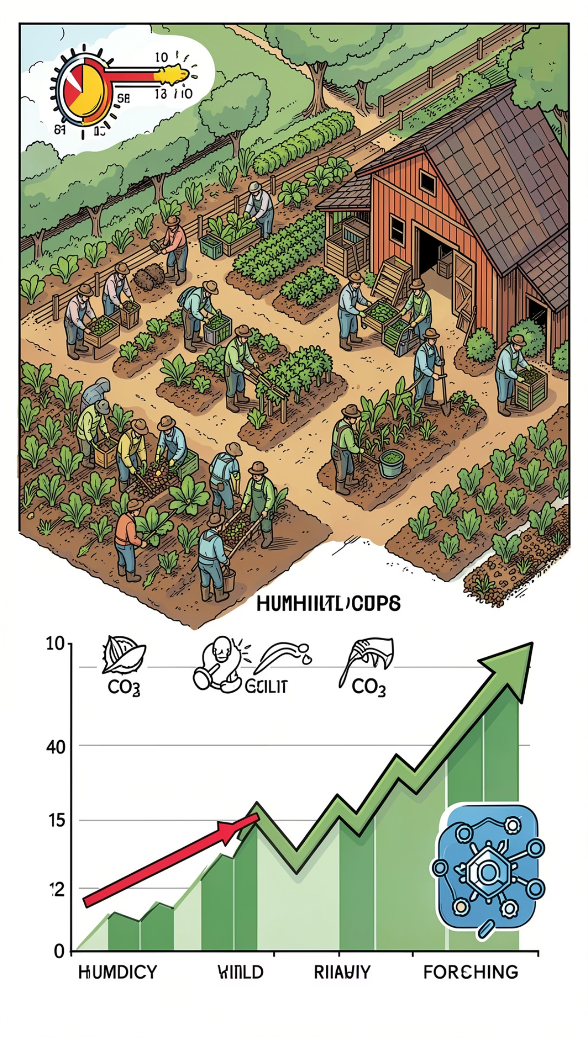
Why this project matters
Environmental volatility
Small changes in temperature, humidity and CO₂ create large yield unpredictability.
Financial impact
Yield uncertainty leads to planning errors, wasted inputs and lost revenue.
Machine learning opportunity
Prediction enables proactive environmental control, reduced waste and better scheduling.
Business Impact
✓ Better harvest planning
✓ Reduced crop waste
✓ Improved environmental control
✓ Data-driven farm decisions

Slide 3
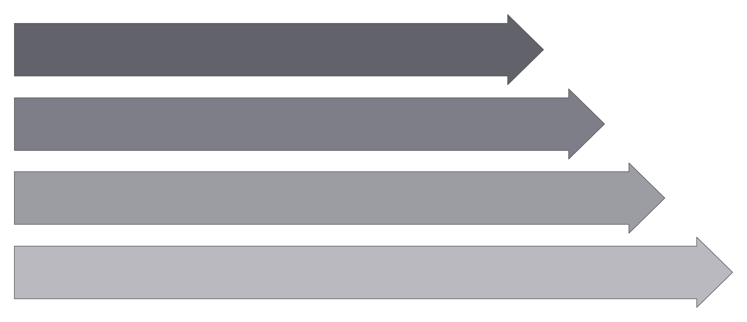
End-to-end workflow
Data Ingestion
Data Cleaning
Exploratory Data Analysis
Feature Engineering
Tools: Python • PanTools Used: Python • Pandas • NumPy • Scikit-learn • Joblib • Streamlit • Git • GitHub
This project follows a complete machine learning workflow from data ingestion and preprocessing to model training, deployment, and prediction monitoring.

Slide 4
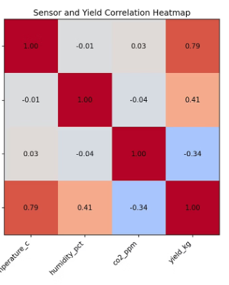
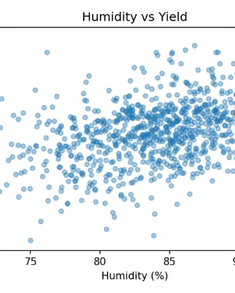
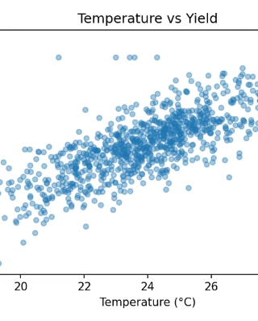
Dataset Overview
Dataset Size
Input features
Target
Initial Records: 1,025
Cleaned Records: 926
Daily sensor observations
🌡 Temperature (°C)
💧 Humidity (%)
🌫 CO₂ (ppm)
🍄 Daily Mushroom Yield (kg)
Key insight: Humidity showed the strongest positive relationship with mushroom yield, while temperature also contributed meaningfully.

Slide 5
Building the prediction model
1
01
Training → Validation → Testing
Linear Regression
Models were trained on historical data, validated using cross-validation, and evaluated on an unseen test dataset.
Baseline model with high interpretability and excellent performance on the dataset.
02
2
TimeSeriesSplit
Chronological splitting preserved the order of observations and prevented data leakage, ensuring realistic model evaluation.
Random Forest
Ensemble model capable of capturing nonlinear relationships between environmental variables.
03
Evaluation Metrics
3
• MAE (Mean Absolute Error)
• RMSE (Root Mean Squared Error)
• R² Score
Tuned Random Forest
Hyperparameters optimized using GridSearchCV with TimeSeriesSplit cross-validation.

Slide 6
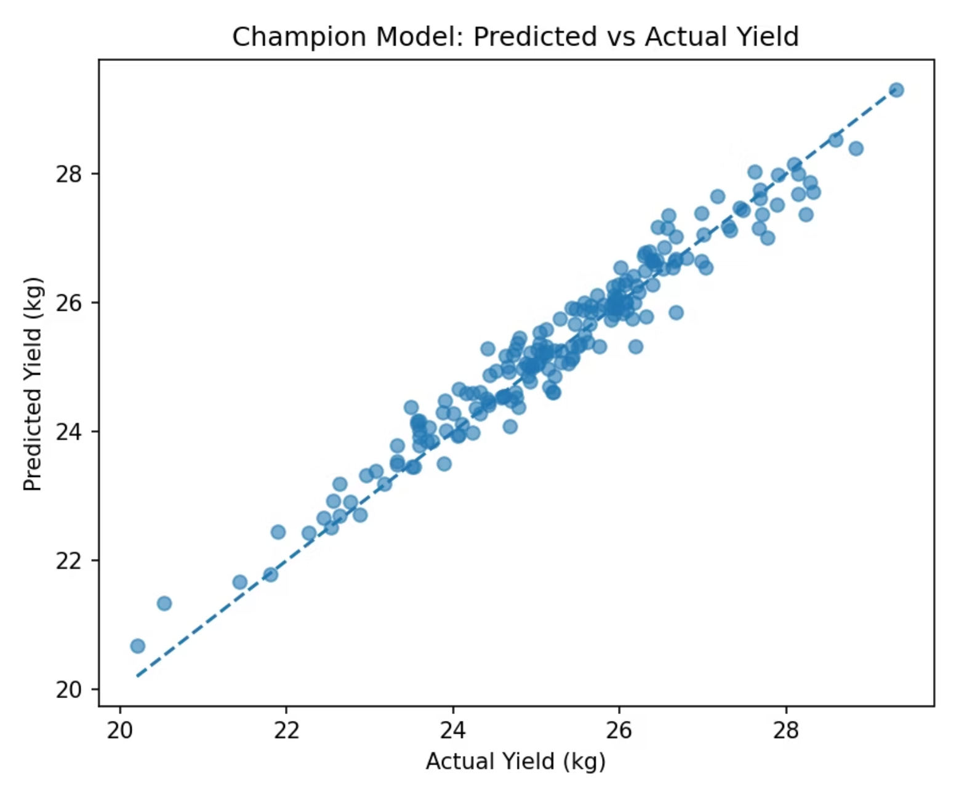
Model performance
Champion model highlighted: Linear Regression
Model
MAE
RMSE
R²
Linear Regression — Champion Model
0.2812
0.3532
0.9496
Random Forest
0.3597
0.4639
0.9131
Tuned Random Forest
0.3592
0.4550
0.9164
Predicted vs Actual values for the champion Linear Regression model.

Slide 7

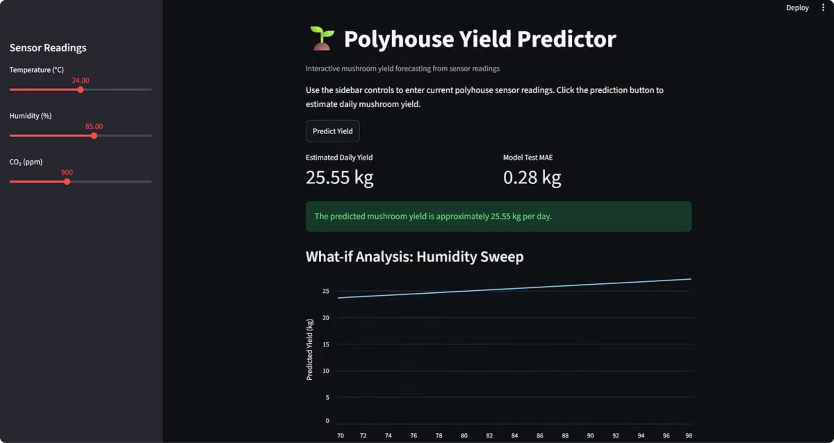
Streamlit Web Application
Controls
Temperature • Humidity • CO₂ sliders for on-the-fly scenario testing.
Prediction output
Instant yield forecast (kg) with confidence band and model metadata.
Deployment
Streamlit Community Cloud • GitHub repository for code and reproducibility.
Callouts: Temperature Slider • Humidity Slider • CO₂ Slider • Prediction Output • Model Info

Slide 8
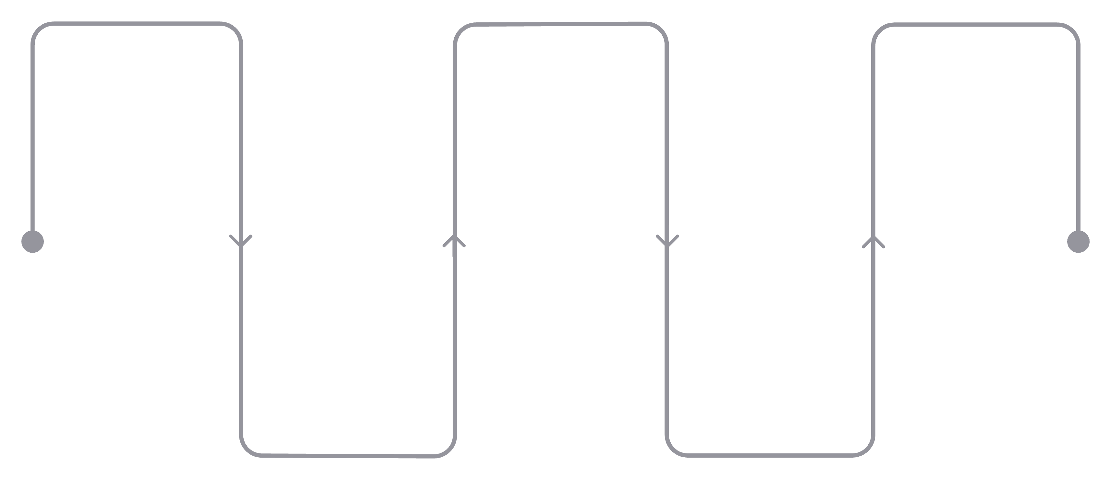
Monitoring & production thinking
User Input
Logging
Retraining
Collect features in cloud
Prediction logging for audit
Detect drift, trigger retraining
Prediction
Monitoring
Generate model output
Model monitoring and alerts
Prediction logging
Drift detection
Retraining
Stores timestamp, sensor inputs and predicted yield for future analysis and model monitoring.
Detects changes in environmental sensor patterns that may reduce prediction accuracy over time.
The model should be retrained when new production data becomes available or when model performance declines.s.

Slide 9
Project Achievements & Future Improvements
Project achievements
Future improvements
✔ Developed an end-to-end machine learning pipeline
✔ Cleaned and validated 926 sensor observations
✔ Compared three regression models
✔ Selected and deployed the champion model
✔ Built a live Streamlit application
✔ Designed a monitoring and logging strategy
Collect Real sensor data
Integrate high‑frequency IoT readings for finer resolution.
IoT integration
Edge-to-cloud pipeline for real-time control feedback loops.
Automatic retraining
Scheduled or event-driven retraining when drift is detected.
Dashboard analytics
Operational dashboards for planners and growers.
This project demonstrates the complete lifecycle of a machine learning solution—from data preparation to deployment and monitoring.

Slide 10

Conclusion & Questions
Key takeaways
✔ Built an end-to-end machine learning pipeline
✔ Developed and compared multiple regression models
✔ Selected Linear Regression as the champion model
✔ Successfully deployed the application using Streamlit Community Cloud
✔ Implemented a monitoring and logging strategy
Project Deliverables
• GitHub Repository
• Technical Report
• Streamlit Web Application
• Monitoring Plan
• Final Presentation
Future Vision
• Integrate real-world farm sensor data
• Expand environmental features
• Automate retraining
• Develop a real-time analytics dashboardc retraining and expand analytics for operational decisioning.
Thank you

