Slide 1
Finding Time Dependent Shortest Paths over Large Graphs
Presented by
Nandhana Sakthivel

Slide 2
Problem Scenario

Slide 3
Scenario
In this paper, we study how to answer queries of finding the best departure time that minimizes the total travel time from a place to another, over a road network, where the traffic conditions dynamically change from time to time.
Due to the increasing interest in dynamic management of transportation system, there are needs to find out shortest path over larger graphs. E.g.: Road networks.
When traffic information is known for a longer time period, we can provide the user with how fast one can travel from one place to another as fast as possible.

Slide 4
Time Dependent Graph (Data Structure)

Slide 5
Time dependent graph
A time dependent graph is defined as GT(V,E,W): V = {vi} is a set of nodes; E ⊆ V × V is a set of edges; W is a set of positive- valued edge delay functions. For every edge (vi,vj) ∈ E, there is a function wi,j(t) ∈ W, where t is a time variable in a time domain T . An edge-delay function wi,j(t) specifies how much time it takes to travel from vi to vj , if departing vi at time t.
We concentrate on finding the least total travel time (LTT) from source node (vs) to destination node (ve) when the starting time t (departure time from the source), can be selected in a user- given starting-time interval T = [ts , te ] ⊆ T . Such a query is called an LTT query, denoted as LTT(vs , ve , T ).

Slide 6
Time dependent graph
Note: Travel time = Arrival time - Starting time
In order to find LTT, we allow waiting time, denoted as w(vi), at each node vi. That is, when arriving at node vi, we can wait for a time period w(vi) if LTT can be minimized.
For each node vi, we have depart(vi) = arrive(vi) + w(vi)
arrive(vk) = depart(vk−1 ) + w k−1,k (depart(vk−1 ))
gp(t) = arrive(vk )
gp(t) above is the arrival-time function representing the arrival time from v1 to vk along path p, possibly waiting at some nodes on this path, if departing from v1 at starting time t. The travel-time function along path p is thus gp(t) − t [arrival time – starting time].

Slide 7
Problem Definition

Slide 8
Definition
TDSP Problem: Given a time-dependent graph GT(V,E,W)and an LTT Query LTT(vs,ve,T),where vs,ve ∈ V , and T ⊆ T is a starting-time interval.
The Time-Dependent Shortest-Path (TDSP) problem is to minimize LTT: gp∗(t∗)−t∗ = min {gp(t)−t}
p,w(∗),t
Finding a vs to ve path p∗ with waiting time w∗(vi) at vi[all nodes from vs to ve], along which the best starting time t∗ results in the minimum travel time gp (t) − t among all starting times t ∈ T and over all vs-ve paths p’s.

Slide 9
Existing Solutions

Slide 10
Discrete Time Algorithm
They find approximate LTT by globally discretizing time interval into time points. In brief, given a graph GT (V, E, W ), a discrete-time approach discretizes the starting-time interval T = [ts , te ] into k time points evenly, and constructs a static graph G′T (V ′ , E ′ , W ′ ) by making k copies of each node and each edge, respectively.
Thus, |V ′| = k|V |, |E′| = k|E|, and edge delay function W ′ is static. For each edge (vi′,vj′) ∈ E′, edge delay function wi′,j is equal to the value of wi,j(t) on a time point.

Slide 11
Drawbacks
The difference between LTT obtained using this approach and the optimal LTT (i.e. min LTT) is called LTT error is very sensitive to the value of k and it is unbounded.
This is because the optimal starting time t∗ for LTT(vs , ve , T ) can be always between any two of the k time points, and the LTT error is generated in an accumulative way along vs to ve paths. Hence, the LTT error is unbounded.

Slide 12
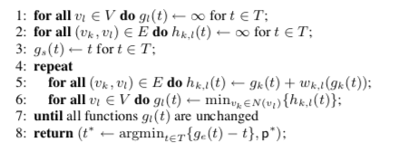
Bellman-Ford based Algorithm
gl(t) be the earliest arrival time at node vl, from source vs, for starting time t, and let function hk,l(t) be the earliest arrival time at vl, from source vs via edge (vk,vl), for starting time t.

Slide 13
Drawbacks
OR algorithm – Orda and Rom proposed generalized version of Bellman -Ford algorithm.
The high complexity makes it infeasible to use it for larger graphs.
OR takes a strategy of determining path toward destination (ve) while refining the arrival time functions, gi(t), in the whole interval T. We call such an algorithm a path selection and time refinement approach
After some iterations, gi(t) might have converged in a subinterval of T, but algorithm OR cannot recognize this, and still needs to recalculate gi(t) and hk,j(t) in the whole interval T.

Slide 14
A* Algorithm
The main idea is to maintain a priority queue Q of all paths to be expanded.
Let pk be a path from source vs to a node vk. Note: there are possibly multiple paths from vs to vk in GT , and all of them may be maintained in Q at the same time.
Each distinct vs-vk path pk is associated with a function,
fpk (t) = gpk (t) + dk,e − t.
Here, gpk (t) is the arrival time from source vs to vk along path pk for starting time t; dk,e is a lower bound estimation of the travel time from vk to destination ve; fpk (t) is the estimated travel time from source vs to destination ve along path pk for starting time t.
Note: Here, we are finding a point k in-between the source and destination.

Slide 15
A* Algorithm
In each iteration, it picks the path pi from the priority queue Q to expand, such that min{fpi (t)} is the minimum among all paths pk’s in Q.
This is also a path-selection and time-refinement approach. The path-selection is done explicitly in the path extension from pk to pl, followed by the time-refinement done in the computation of gpl (t) and fpl (t). The path-selection and the time-refinement here are coupled even more closely than those in OR.

Slide 16
Drawbacks
Algorithm A* is efficient only when estimation can assist pruning the search space effectively, and vs and ve are closed to each other in graph GT .
It is difficult to find such estimation dk,e in general graphs, and it is infeasible to use A* to handle large time-dependent graphs, where ve may be far away from vs.

Slide 17
New Dijkstra based algorithm (Solution)

Slide 18
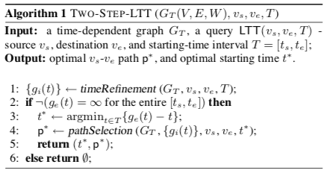
Outline

Slide 19
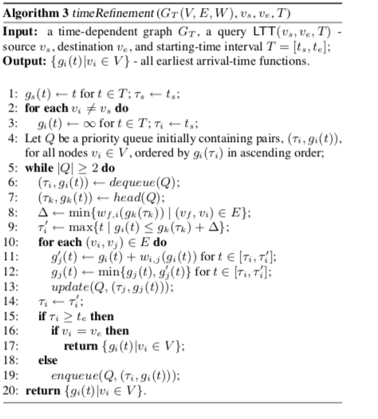
Dijkstra-Based Time-Refinement algorithm
Time complexity: O((n log n + m)α(T ))

Slide 20
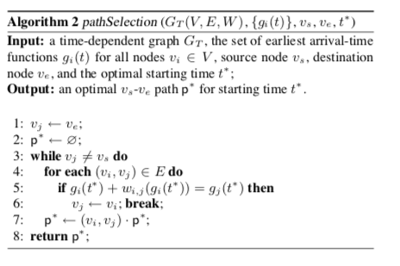
Fast Path Selection Algorithm
Time complexity:O(mα(T))

Slide 21
FIFO graphs

Slide 22
FIFO graphs
FIFO : Time-dependent graph GT (V, E, W ) is a FIFO graph, iff every edge (vi,vj) has FIFO property.
FIFO Property: An edge (vi, vj ) has FIFO property,
iff wi,j (t0) ≤ t∆ + wi,j (t0 + t∆) for t∆ ≥0, or
t1 +wi,j(t1) ≤ t2 +wi,j(t2) for t1 ≤t2.
No Waiting in FIFO Graphs: For a given query LTT(vs , ve , T ) on a FIFO time-dependent graph GT , there exists an optimal vs to ve path p∗ along which the optimal waiting time w∗(vi) = 0 for every vi on p∗.

Slide 23
Time Refinement for FIFO Graphs

Slide 24
Time Refinement for FIFO graphs
Here, by time-refinement we mean two things: arrival-time function refinement of gi(t) and starting-time interval refinement of the starting-time subinterval Ii = [ts , τi ], for every node vi in GT .
Our algorithm uses a priority queue, Q, which initially contains pairs (τi , gi (t))’s for all nodes vi ∈ GT in the ascending order of gi (τi ). The top pair in Q is (τs , gs (t)) initially.
In every iteration in the while loop, the starting-time interval refinement is conducted in line 6-9 and line 14, and the arrival-time function refinement is conducted in line 10-13.
Starting time interval is the departure time.

Slide 25
Starting Time Refinement (departure time)
In every iteration, it first dequeues the top pair from Q, denoted as (τi, gi(t)) (line 6).
After dequeuing, it will use the current top pair in Q, denoted as (τk , gk (t)), as the basis for starting-time interval refinement (line 7 - The operation head(Q) retrieves the top pair but does not dequeue it from Q).
Therefore, gi(τi) is the earliest arrival time from source node vs, followed by gk(τk), among all pairs (τl,gl(t))’s in Q.

Slide 26
Arrival Time Refinement
The arrival- time function gi (t), for node vi , is well-refined as the earliest vs -vi arrival-time function in both the original starting-time subinterval, Ii = [ts , τi ], and the enlarged one, Ii′ = [ts , τi′ ], in the previous and the current iterations, respectively.
It can then be used to refine arrival-time functions, gj (t), in starting-time subinterval [τi , τi′ ] for all of vi’s outgoing neighbors vj ((vi,vj) ∈ E). It is done in line 10-13.
After arrival-time function refinement, τi is set as τi′ (line 14). If in the entire interval T = [ts,te], for node vi, gi(t) has been well-refined, as specified in the condition “τi ≥ te” (line 15), the algorithm further checks whether vi is the destination. If true, it terminates in line 17. If gi(t) has not been well-refined in the entire starting-time interval, pair (τi,gi(t)) is enqueued back into Q (line 19) for further time refinement.

Slide 27
O((n log n + m)α(T ))
Time Complexity

Slide 28
O((n + m)α(T ))
Space Complexity

Slide 29
Storage and Implementation
A time-dependent graph GT (V, E, W ) is maintained using an edge representation, where an edge is stored as a triple (vi,vj,wi,j(t)). The edges can be stored in a table.
The first column (vi) and the second column (vj) are fixed-size whereas the third column (edge-delay function) is variable-size. Two B+-trees are built on the top of the table. One is built on the first column (vi), and the other is built on the second column (vj). They can efficiently support all the necessary operations w.r.t. GT .
The priority queue Q sorts (τi,gi(t)) in the ascending order of gi(τi). Every element of Q in our storage model is a pointer pointing to the corresponding pair (τi , gi (τi )) which is maintained in I - Table.
Since N-Index and priority queue Q are not large, they can be maintained in memory. When GT is too large to be stored in the main memory, we maintain AT-Table, I-Table, and GT on disk.

Slide 30
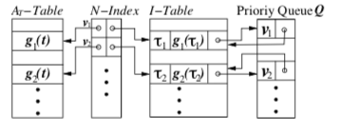
Runtime Data Structure
AT–Table: Arrival time
I-Table: Departure /Starting time

Slide 31
Non-FIFO graphs

Slide 32

Solution
For each edge-delay function wi′,j (t) in the non-FIFO graph G′T , we define wi,j (t) to construct a FIFO graph GT .
∆i,j (t) is the optimal waiting time to traverse edge (vi , vj ), if arriving at vi at time t. If there are multiple possible values of t∆ to minimize wi′,j(t + t∆) + t∆, we select any of them as ∆i,j(t).

Slide 33
Solution
We show in the figure above, that we can transform such a non-FIFO graph G′T (V, E, W ′) into a FIFO graph GT (V, E, W ) where both V and E remain unchanged. Then we can process LTT(vs , ve , T ) on the FIFO graph GT using our proposed TWO-STEP-LTT algorithm.
The optimal path p∗ found in GT can be converted into an optimal path p′∗ in the original non- FIFO graph G′T , by inserting some waiting time on each node in path p∗.

Slide 34
Performance Studies

Slide 35
Experimental Setup
We use a real dataset with 16,326 nodes and 26,528 edges, representing the road-map in the Maryland State in US. The dataset is extracted from the US Census Bureau 2005 TIGER/Line4

Slide 36
Experiment 1(Graph-Scalability):
For query LTT(vs, ve,T), we fix starting-time interval T = [0, 500], and vary (i) the number of nodes, and (ii) the number of edges, in the time-dependent graph.
The average processing time of DOT is about 10 times larger than our TWO-STEP-LTT consistently.
TWO-STEP-LTT outperforms OR when the number of nodes is > 80.
A* algorithm is the fastest when there are less than 1K nodes, but it becomes slower than TWO-STEP-LTT when there are more than 1K nodes.
The average processing time of A* algorithm increases exponentially, and it cannot finish for most queries in this experiment when the number of nodes is > 4K, because its search space is exponentially w.r.t. the size of graph.

Slide 37
Experiment 1(Graph-Scalability):
TWO-STEP-LTT outperforms OR significantly when the graph is large in size. The average memory consumed by OR is 5 times larger than TWO-STEP-LTT, because OR maintains two sets of functions.
The memory consumed by DOT is 50 times larger than TWO-STEP-LTT consistently. A* algorithm consumes much more than TWO-STEP-LTT does when the number of nodes is > 1K.
Second, we vary the density of GT by fixing the number of nodes as 2K while changing the number of edges.
The average processing time increases when the number of edges increases. TWO-STEP-LTT significantly outperforms DOT and A*algorithm in all the cases and outperforms A*algorithm when the number of edges is > 2K.

Slide 38
Experiment 1(Graph-Scalability):
A* algorithm cannot find LTT in reasonable time for most queries tested when the number of edges is > 4K. In terms of memory consumption,
TWO-STEP-LTT performs the best followed by OR and then DOT. The amount of memory A* algorithm consumes is exponentially proportional to the number of edges.
The error becomes smaller when the number of edges increases, because with more edges, the average distance between two nodes becomes smaller, which decreases the LTT error.

Slide 39
Experiment-2 (Query-Scalability)
We use GT (with 2K nodes and 3K edges). For query LTT(vs,ve,T), (i) we vary the number of nodes on the shortest vs-ve path (ii) we change the length of starting- time interval T .
Time/memory consumed by DOT and OR are nearly unchanged, because they cannot terminate until the LTT from vs to every other node is determined. A* algorithm performs well if the vs-ve distance is < 15, but quickly deteriorates otherwise.
TWO-STEP-LTT constantly outperforms A*algorithm after the vs-ve distance is > 16 on both time and memory consumed, because the size of the search space in A* algorithm increases exponentially w.r.t. vs-ve distance.

Slide 40
Experiment-2 (Query-Scalability)
The average/max LTT error of DOT which becomes larger, while the number of nodes on the vs-ve shortest path increases.
Second, we vary the length of starting-time interval T from 50 to 1,000 and report the average of processing time and memory
It is shown that all algorithms need additional time/memory with the length of interval T increases, because the increment of |T| incurs both additional function-operation time and search space. TWO-STEP-LTT out- performs the others consistently as it already have the time subinterval enlargement in arrival time refinement.

Slide 41
Experiment-3 (Edge-Delay Function)
We test the effect of edge- delay functions on the processing time of TWO-STEP-LTT and OR, since both request larger numbers of function operations than the other two. We use GT, and fix T = [0, 500].
TWO-STEP- LTT outperforms OR.
When w∆ increases, both TWO-STEP-LTT and OR consume more time, because resulting functions gi(t)’s can be more complicated, and hence require more function-operation time in both. TWO-STEP-LTT again outperforms OR in this test.

Slide 42
Related work
Dynamic Shortest Path (DSP): The DSP problem is to recompute shortest-paths repeatedly, while the underneath graph with constant edge delays is allowed to be updated from time to time.
Hierarchy Based Method: Hierarchy-based methods partition the graph into small fragments and materialize the shortest-paths between border nodes in different fragments. The shortest-path between two nodes in the graph is obtained by combining the shortest-paths from different fragments.

Slide 43
References
Ding, J. X. Yu, and L. Qin. Finding time-dependent shortest paths over large graphs. Proceedings of the 11th international conference on Extending database technology Advances in database technology EDBT 08, page 205, 2008
X. Cai, T. Kloks, and C. K. Wong. Time-varying shortest path problems with constraints. Networks, 29(3):141–150, 1997.
I. Chabini. Discrete dynamic shortest path problems in transportation applications: Complexity and algorithms with optimal run time. Transportation Research Record, 1645:170–175, 1998

Slide 44
Thank you!

