Slide 1
Comparison of randomness in PRNG & QRNG
By
Nandhana Sakthivel

Slide 2
Introduction

Slide 3
Random Number Generation
A random number is a number chosen from a pool of limited or unlimited numbers that has no discernible pattern for prediction. The pool of numbers is almost always independent from each other. However, the pool of numbers may follow a specific distribution.
A random number generator is a device that can generate one or many random numbers within a defined scope. Random number generators can be hardware based or pseudo-random number generators.
E.g. : Pseudo RNG, Quantum RNG

Slide 4
Applications
Simulations
Statistical Sampling
Cryptography
Computer Programming
Numerical Analysis
Decision Making
Recreation
The important thing to remember is “No Random Number generator is good for every application!”

Slide 5
Pseudo Random Number Generator
A pseudo-random number generator is an algorithm for generating a sequence of numbers whose properties approximate the properties of sequences of random numbers.
Computer based random number generators are almost always pseudo-random number generators.
Yet, the numbers generated by pseudo-random number generators are not truly random.
E.g.: Linear Congruential Generators, Binary sequence random generators
Here, we will be using Binary sequence random generator for comparison purposes.

Slide 6
Why Hardware RNG?
Today, systems that rely on deterministic processes such as Pseudo Random Number Generators (PRNGs) to generate randomness are not secure because they rely on deterministic – thus predictable – algorithms.
A better solution is to use hardware random number generation.
However, not all of them are equally good.
Many still rely on classical physics processes that run in an uncontrolled and chaotic manner.
Additionally, they heavily rely on post-processing algorithms – that are deterministic thus vulnerable – to provide randomness as the quality of their entropy source is not consistent.

Slide 7
Quantum Random Number Generator
Quantum Random Number Generator (QRNG) generates perfectly unpredictable random numbers, derived from a quantum source and delivered at the speeds needed for commercial applications, to ensure the strongest level of encryption.
Quantum RNGs exploit elementary quantum optic processes that are fundamentally probabilistic to produce true randomness.
The method generates digital bits (1s and 0s) with photons, or particles of light. An intense laser hits a special crystal that converts laser light into pairs of photons that are entangled, a quantum phenomenon that links their properties. These photons are then measured to produce a string of truly random numbers.

Slide 8
Tests for Randomness

Slide 9
Introduction
When testing Random Number Generators (RNGs) for randomness you quickly run into the “is that really random” dilemma. As pattern seeking creatures, we naturally look for patterns on an ongoing basis.
Like many things, randomness varies. Most of the time, pseudo-random numbers generators (PRNGs) are basically creating randomness with lots of non-random processes.
There are two phases to test the random number generator process.
First you need a source of entropy that is impossible to guess like the weather.
Second you need a deterministic algorithm to expand the seed into a multitude of sequences for keys and the like.

Slide 10
Types of tests
There are of 2 types of tests
Empirical tests are conducted on a sequence generated by RNG and requires no knowledge of how the RNG works.
Theoretical tests are better when they exist, are a priori test in the sense that they require the knowledge of the structure of the RNG but the sequence doesn’t need to be generated.
But, here we focus on Empirical tests as we are comparing two different types of Random generators i.e. algorithmic and hardware oriented.
Before, we enter into empirical tests there are 2 tests which forms the foundation for this test: Chi-square test and Kolmogorov- Smirnov test

Slide 11
Chi- Square test
This test can be used in many situations and basically, when given an outcome of an experiment, can give an approximate probability as to how likely that outcome is.
A chi-square test for independence compares two variables in a contingency table to see if they are related. In a more general sense, it tests to see whether distributions of categorical variables differ from each another.
A very small chi square test statistic means that your observed data fits your expected data extremely well. In other words, there is a relationship.
A very large chi square test statistic means that the data does not fit very well. In other words, there isn’t a relationship.

Slide 12
Kolmogorov Smirnov Test
The Kolmogorov-Smirnov test is used to decide if a sample comes from a population with a specific distribution.
The Kolmogorov-Smirnov (K-S) test is based on the empirical distribution function (ECDF). Given N ordered data points Y₁, Y₂, ..., Y_{N}, the ECDF is defined as
EN=n(i)/N
where n(i) is the number of points less than Y_{i} and the Y_{i} are ordered from smallest to largest value.
It only applies to continuous distributions.

Slide 13
Empirical Tests

Slide 14
Frequency Test
This is the simplest of the empirical test.
We count the frequency of each categories present in the random number.
Then we apply chi-square test on it to see how the randomness is present based on chi- statistics and p-value
Then, based on the p-value we accept or reject the null hypothesis.
The null hypothesis states that there is no relationship between the two variables being studied (one variable does not affect the other). It states the results are due to chance and are not significant in terms of supporting the idea being investigated.
The alternative hypothesis is the one you would believe if the null hypothesis is concluded to be untrue.
The smaller the p-value, the stronger the evidence that you should reject the null hypothesis.

Slide 15
Serial test
The frequency test examines whether an individual element in a sequence comes up more often than it should, but we would also like pairs of successive numbers to be uniformly and independently distributed (for example, in a binary sequence, (0,0), (0,1), (1,0) and (1,1) should all be equally likely.
Instead of just pairs, this method can be generalized to triples, quadruples and so.
Then we apply chi-square test on it to see how the randomness is present based on chi- statistics and p-value
Then, based on the p-value we accept or reject the null hypothesis.

Slide 16
Information Entropy test
Random number generators focus a lot on producing large probable outcomes. This is where information entropy comes into play.
Information entropy is not just the average amount of information covered by an event, when considering all outcomes.
In randomness there is set number of outcomes, information entropy is the probability of each individual outcome.
The more possible variables there are in each bit of information, the more difficult it is to predict what the next bit will be based on the bits you have already seen.
You don’t want to have more probable outcomes for certain values, such as “A” 50%, probability, when what you really want is equal probability (see image below). In most cases high levels of information entropy indicate the data is random, and a low level indicates that data isn’t.

Slide 17
Algorithm

Slide 18
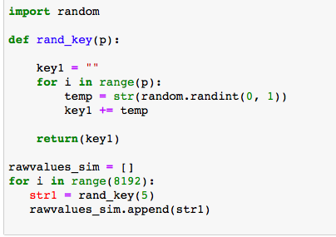
PRNG

Slide 19
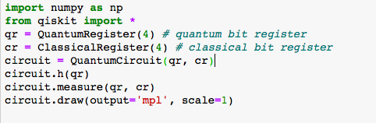
Quantum

Slide 20
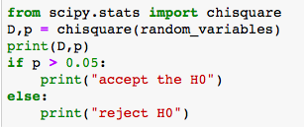
Chi-square test

Slide 21
1 bit RNG

Slide 22
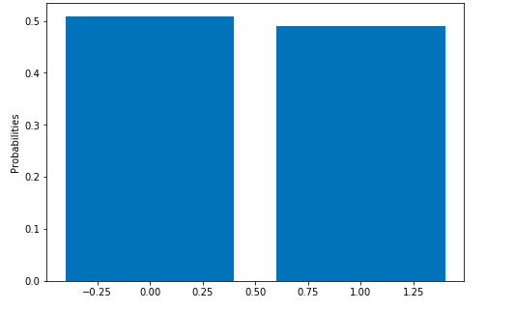
PRNG
Probabilities
0 : 0.509
1 : 0.49

Slide 23
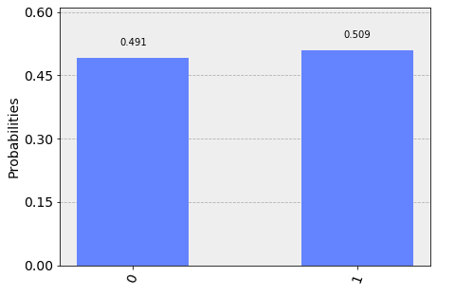
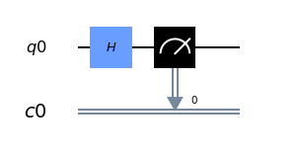
Quantum

Slide 24
2 bit RNG

Slide 25
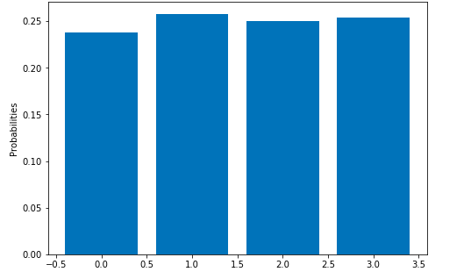
PRNG
Probabilities
0 : 0.237
1 : 0.258
2 : 0.25
3 : 0.254

Slide 26
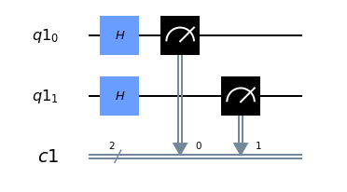
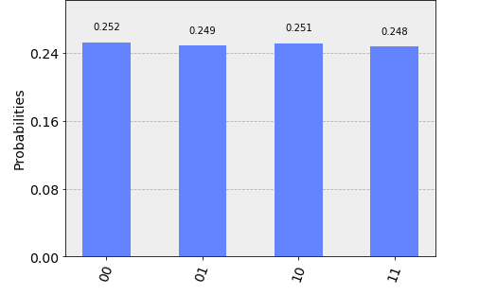
Quantum

Slide 27
3 bit RNG

Slide 28
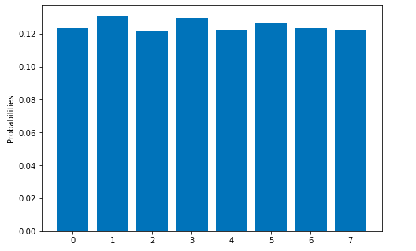
PRNG
Probabilities
0 : 0.123
1 : 0.131
2 : 0.121
3 : 0.129
4 : 0.122
5 : 0.126
6 : 0.123
7 : 0.122

Slide 29
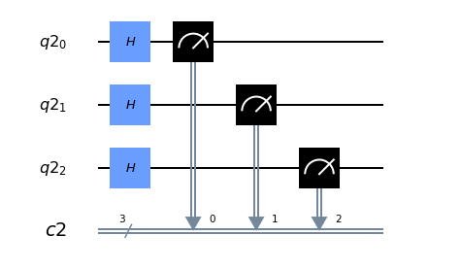
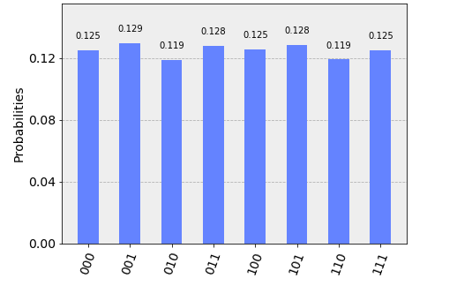
Quantum

Slide 30
4 bit RNG

Slide 31
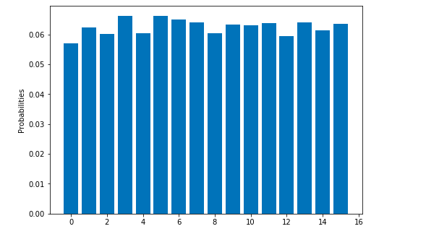
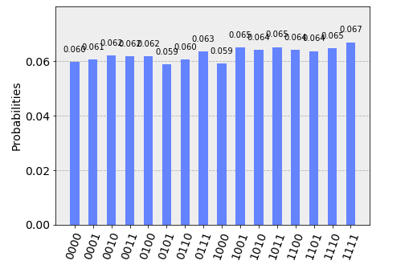
PRNG & Quantum

Slide 32
5 bit RNG

Slide 33
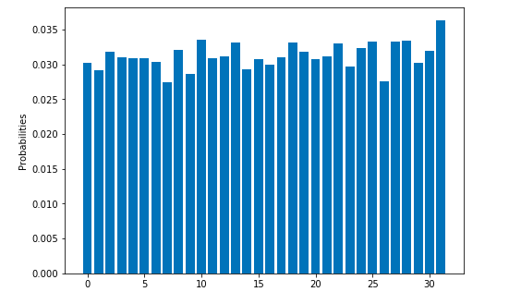
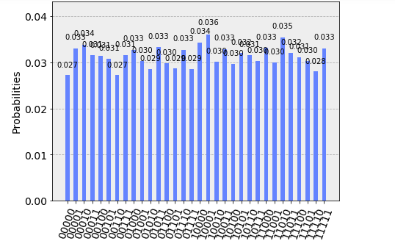
PRNG & Quantum

Slide 34
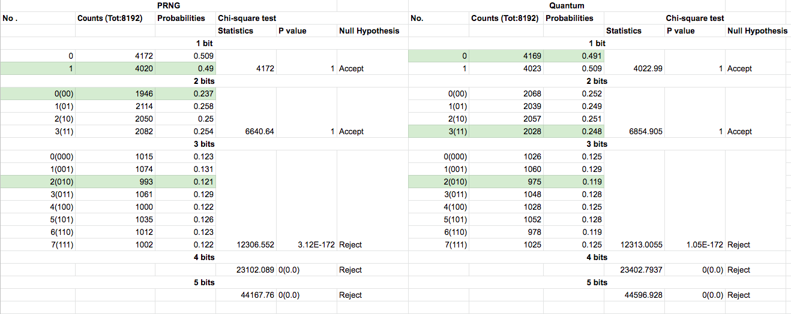
Observation

Slide 35
Observation
From the observation of the report, we can see that based on the frequency test, more or less all the categories of the bits are equally distributed.
Based on the information entropy test, the bits with low probability is mostly same on both classical and quantum RNGs.
Based on the serial test, once we increase the bit sequence repetition, the randomness of the system decreases. It decreases more in quantum due to the noise in the hardware.
Based on the chi-square test, we accept the null hypothesis for 1 and 2 bit sequence. But, we reject it when the no of bits are more than 3.
In 3 bit sequence and more, the probability of bits with 2 bit change is less when compared to the remaining bits.

Slide 36
References
https://medium.com/unitychain/provable-randomness-how-to-test-rngs-55ac6726c5a3
https://medium.com/faun/quantum-random-number-generator-qrng-c254335ef445
http://www-users.math.umn.edu/~garrett/students/reu/pRNGs.pdf
https://docs.scipy.org/doc/scipy/reference/generated/scipy.stats.chisquare.html

Slide 37
Thank you!

