Slide 1
Nandhika Rajmanikandan
Masters in Data Science
College of Computing
nrajmani@mtu.edu

Slide 2
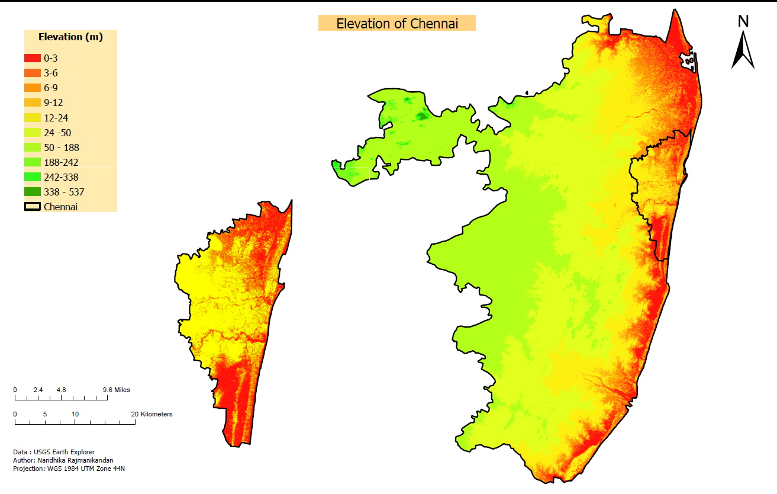
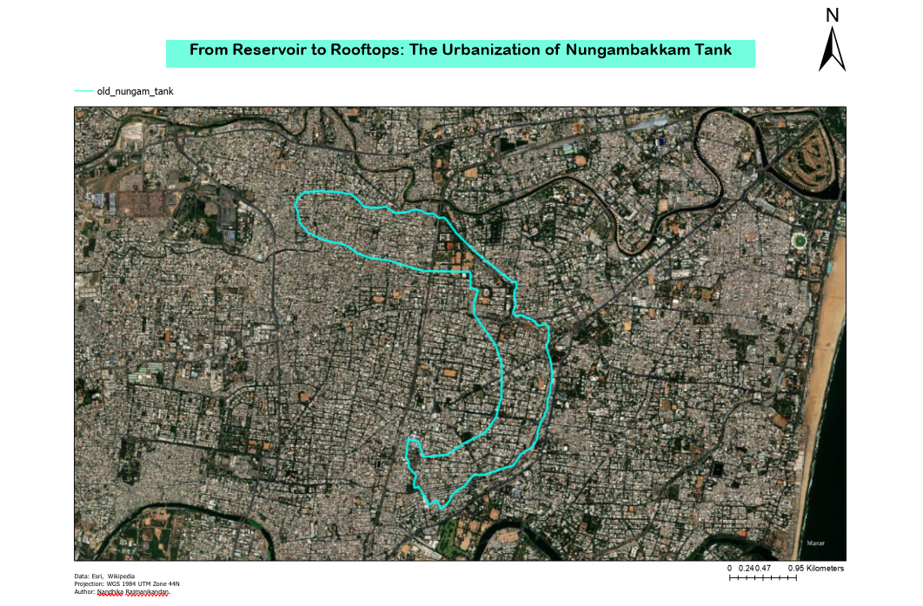
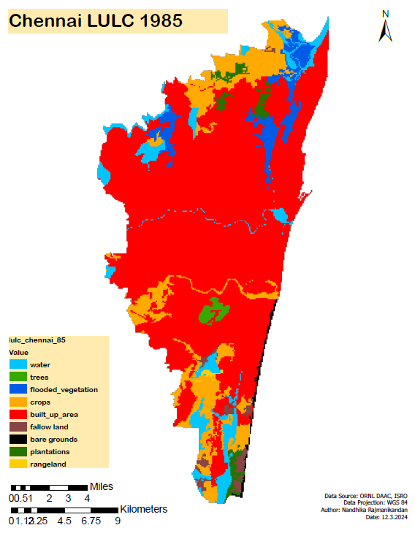
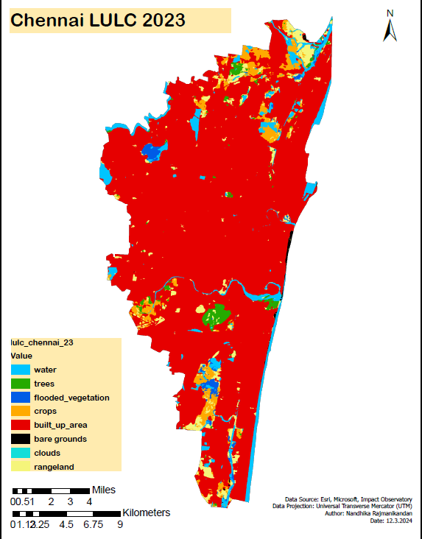
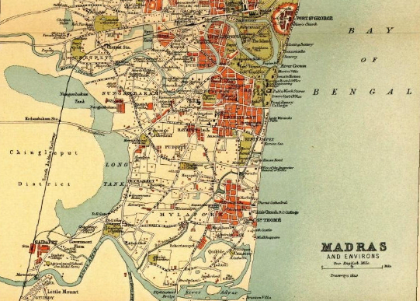
-Chennai -
a tale of Urbanization, Land Transformation, and Flood Risk.
Elevation and Vulnerability
From Reservoirs to Rooftops
Land Use Land Cover Changes
Historical Insights

Slide 3
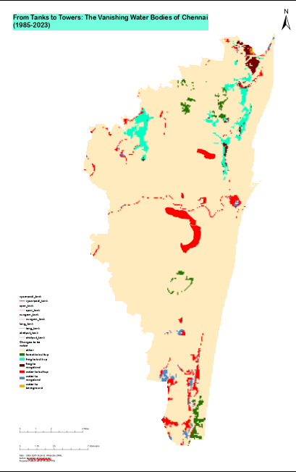
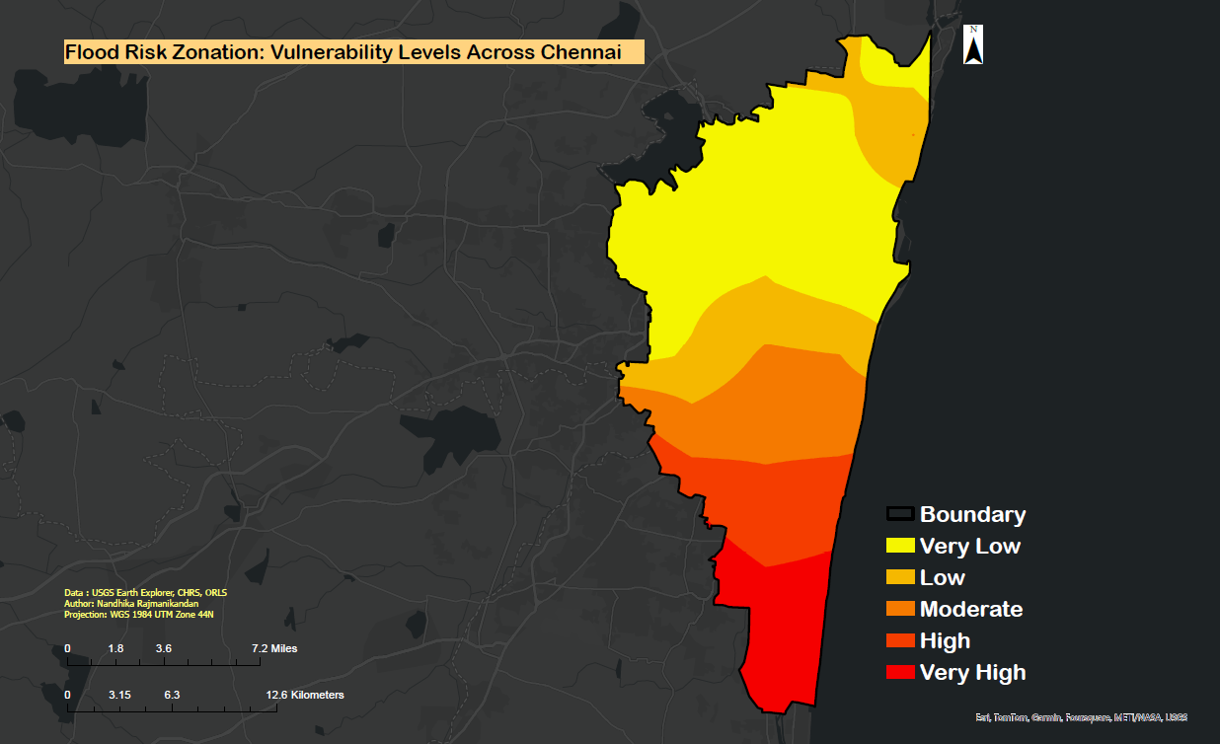
Chennai's Changing Face
a delicate balance between Growth and Vulnerability
When land forgets its water, water remembers its land

Slide 4
To add up: Try to do urban planning, include population data

