Slide 1
Predicting Lethal Outcomes in Myocardial Infarction
Presented by
Nandhika Rajmanikandan & Ganesh Vannam

Slide 2
Goal of Study
This study aims to predict lethal outcomes and causes for patients using their clinical data to improve early intervention and enhance patient management in critical care settings.

Slide 3
Data Set Structure
Sample Size: 1700
Number of Variables: 122
Continuous Variables: 14
Categorical Variables:108
Missing values: Yes

Slide 4
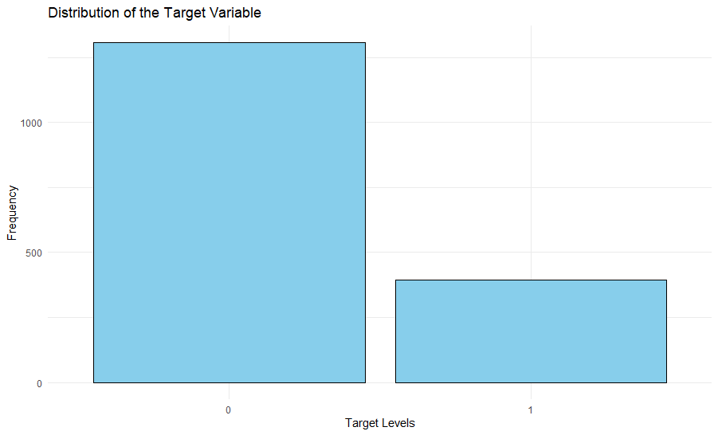
Response Variable
Lethal Outcome(cause)(LET_IS)

Slide 5
Data Preprocessing
  Categorical Variables:
Converting categorical variables into factors.
Remaining Numeric Variables:
Continuous features identified will be preserved for subsequent transformations and scaling.

Slide 6
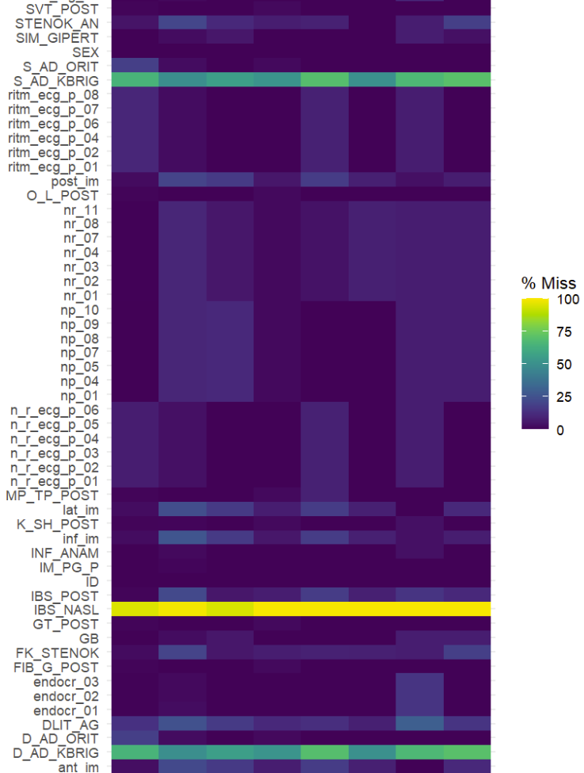
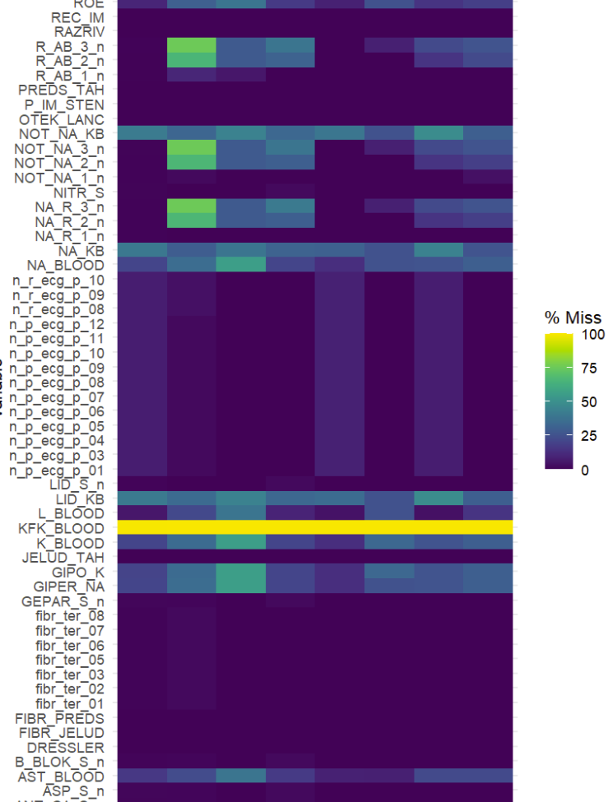
Missing Values
Target variable has no missing values
Total we have 15794 missing values
Proportion of missing values in dataset is 7.57779

Slide 7
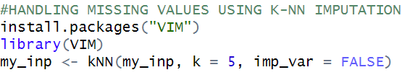
KNN IMPUTATION
Response variable is categorical
K = 5
Default value

Slide 8
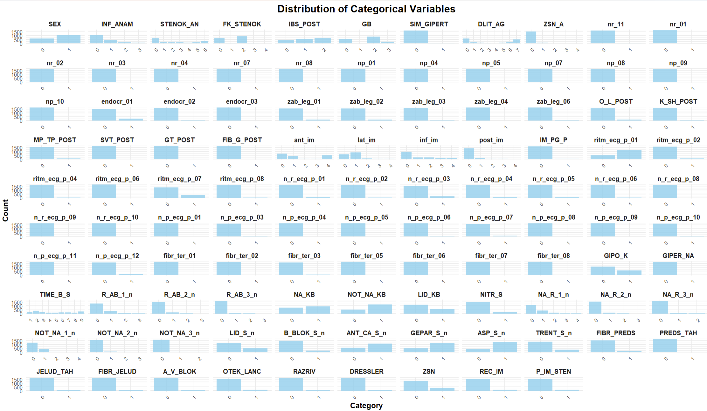
Distribution of Categorical Variables
Bar plots were used to show the frequency distribution of categorical variables, helping in understanding the class imbalance and prevalent values.

Slide 9
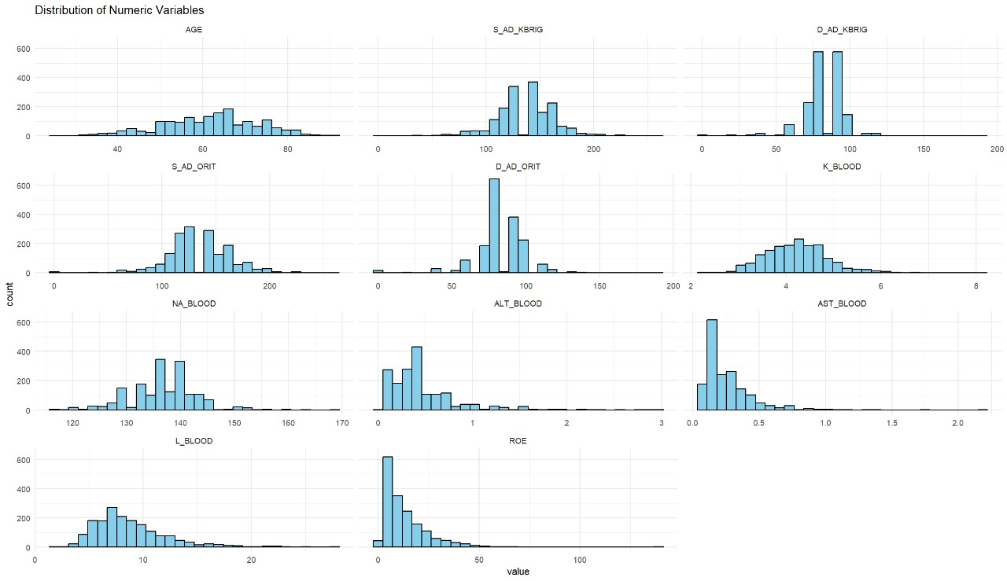
Distribution of continuous variables
ROE has Right Skewed
D_AD_KBRIG has Left Skewed
AGE has Normally Distributed

Slide 10
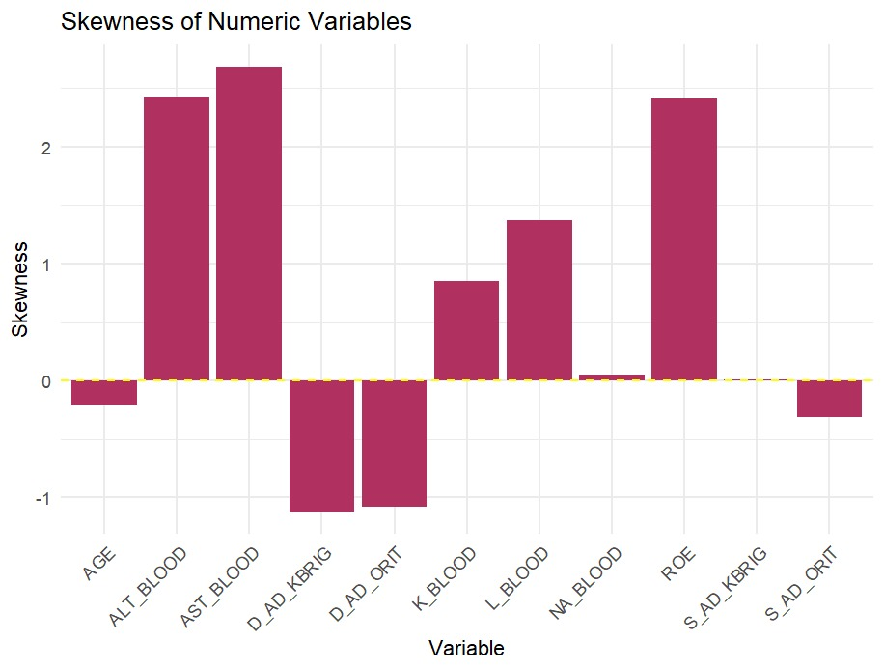
Skewness

Slide 11
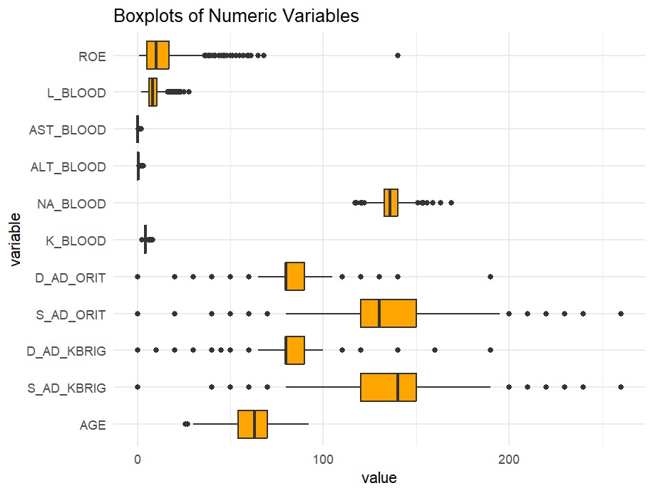
Outliers
ROE has most outliers

Slide 12
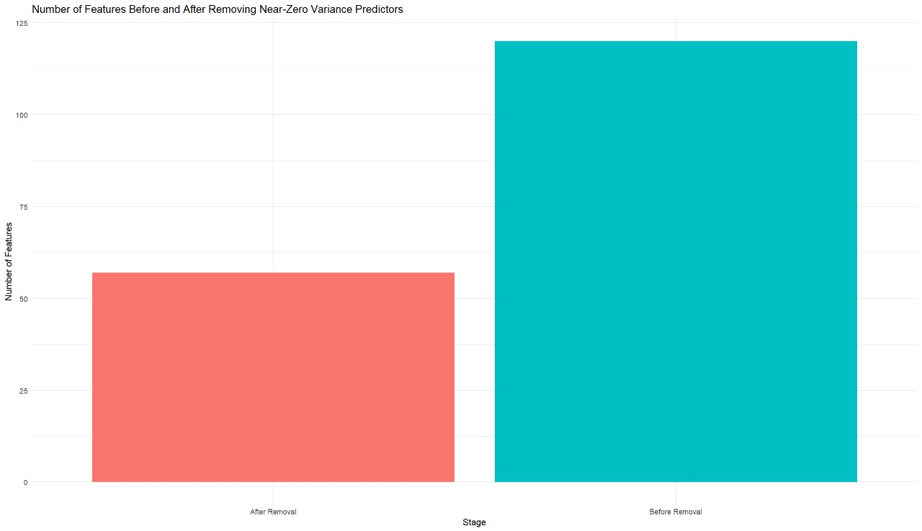
Near Zero Variance& Dummy variables
Number of feature after removing zero and near zero variance: 57
Number of features after adding dummy variables: 161

Slide 13
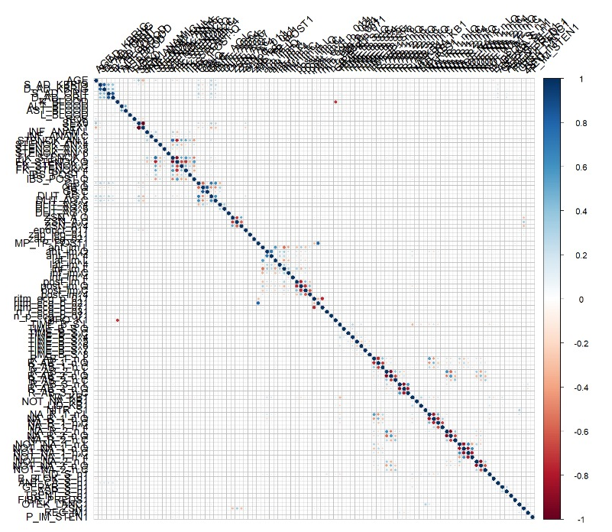
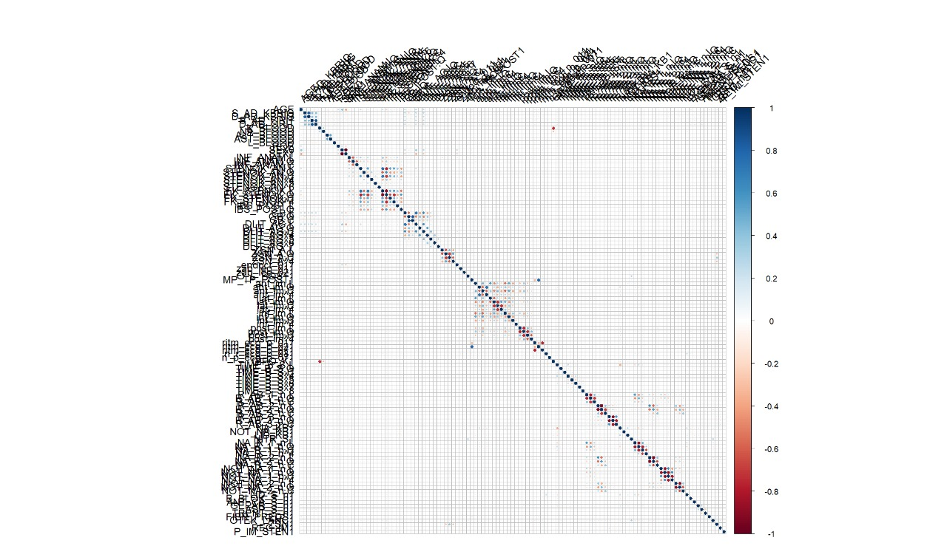
Correlation
Initial number of variables: 161;​
Cutoff = 0.75​
17 highly correlated were identified and removed.​
Remaining variables: 145
Before
After

Slide 14
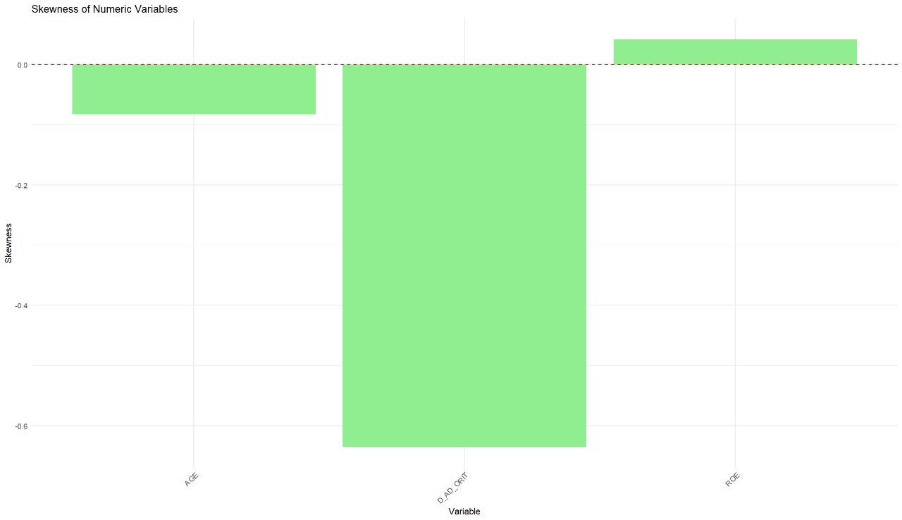
Box-Cox Transformation:
  Box-Cox transformation to handle the skewness in the continuous variables. This transformation is effective for normalizing data and is particularly useful when variables exhibit non-normal distributions.

Slide 15
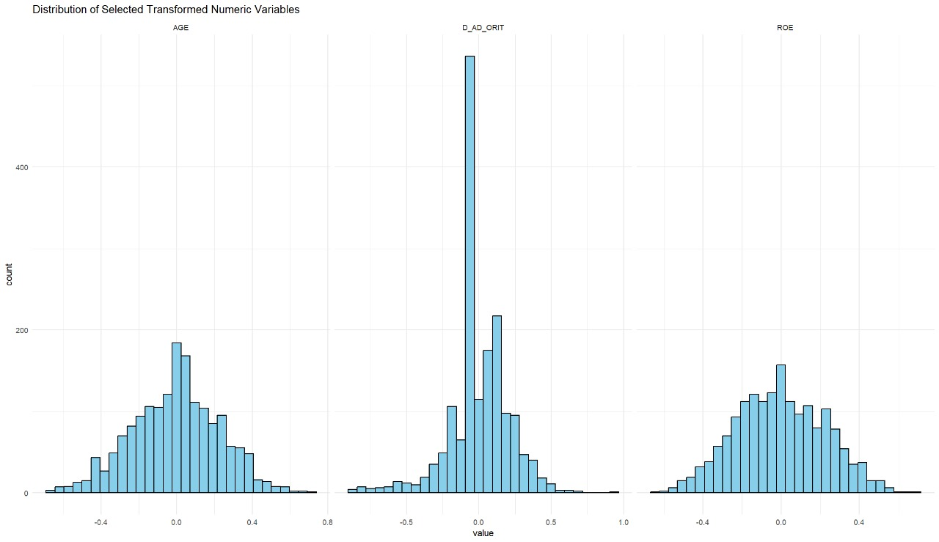
Distribution of Predictors

Slide 16
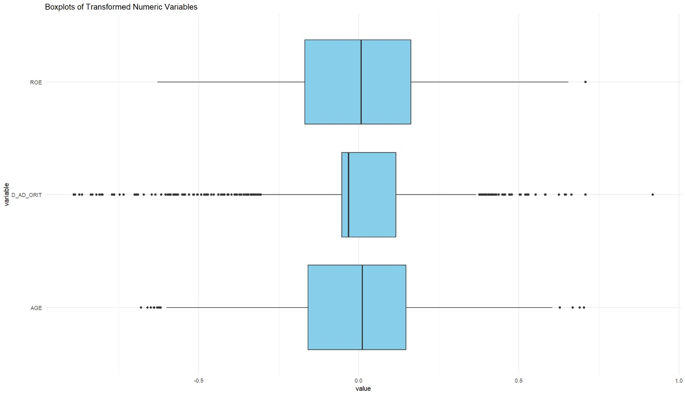
Spatial Sign Transformation
  D_AD_ORT has most of the Outliers

Slide 17
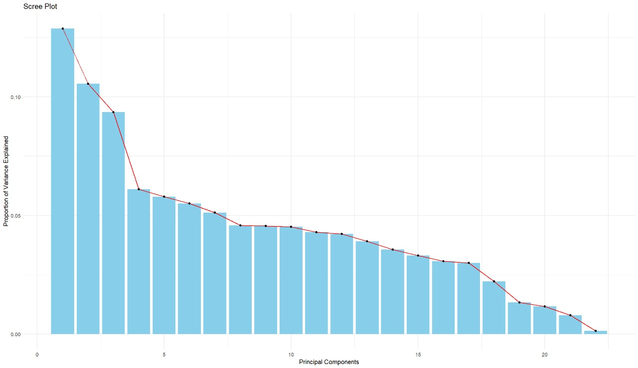
PCA
No of variables eliminated : 127
The scree plot helps in deciding how many components to retain by showing which components contribute meaningfully to the overall variance in the data.

Slide 18
Model Building:
We are using stratified random Sampling because dataset is imbalanced.
Splitting 80% of data for training and 20% for testing set.
10-fold cross validation
We are using Kappa metric to evaluate model performance, because our data set is imbalanced.

Slide 19
Models
Linear Models:
Logistic Regression
Linear Discriminant Analysis (LDA)
Partial Least Squares Discriminant Analysis (PLSDA)
Penalized Models
Non Linear Models:
Quadratic Discriminant Analysis (QDA)
Regularized Discriminant Analysis (RDA)
Mixture Discriminant Analysis (MDA)
Flexible Discriminant Analysis (FDA)
Neural Network
K-Nearest Neighbors (KNN)
Support Vector Machines (SVM)
Naïve Bayes

Slide 20
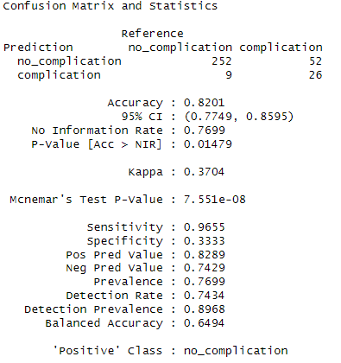
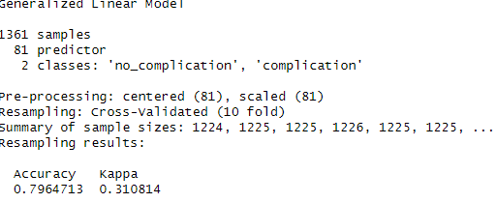
Logistic Regression Model

Slide 21
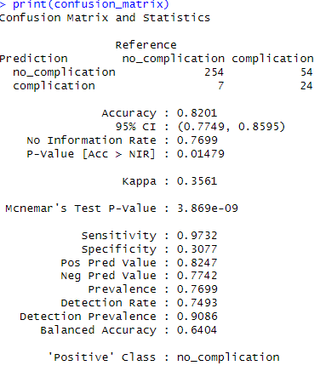
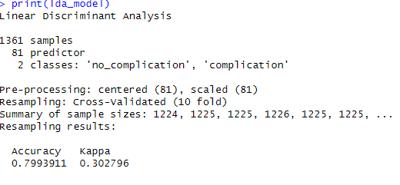
Linear Discriminant Analysis Model

Slide 22
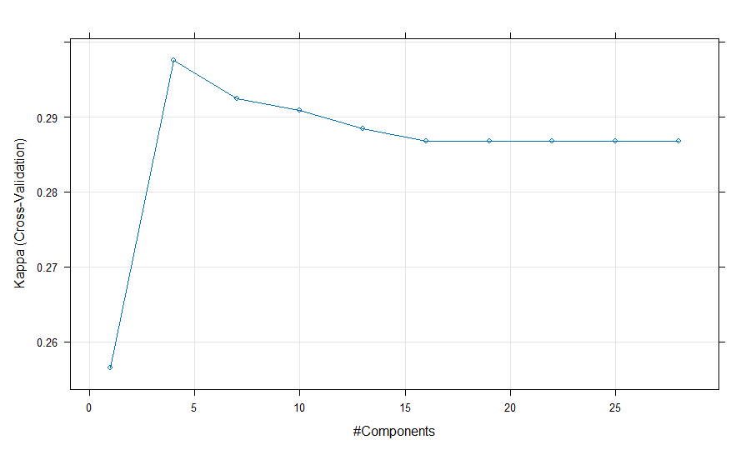
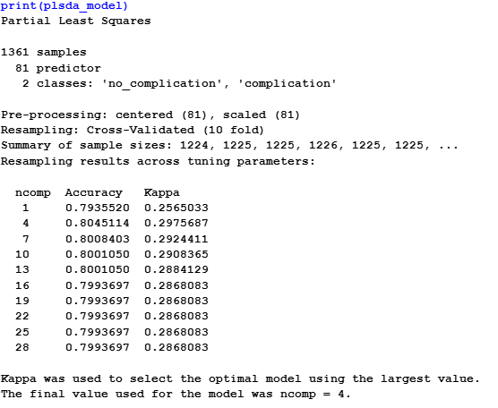
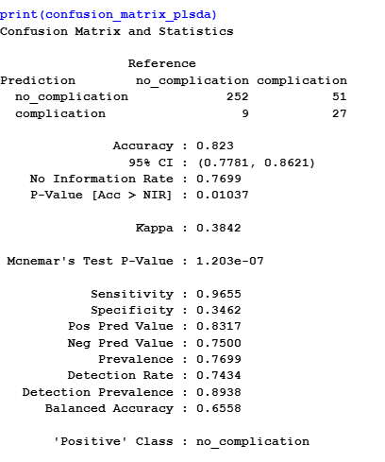
Partial Least Square Discriminative Analysis Model

Slide 23
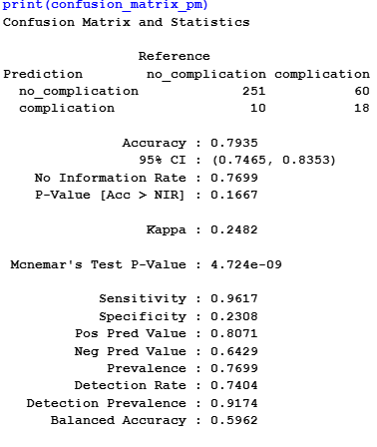
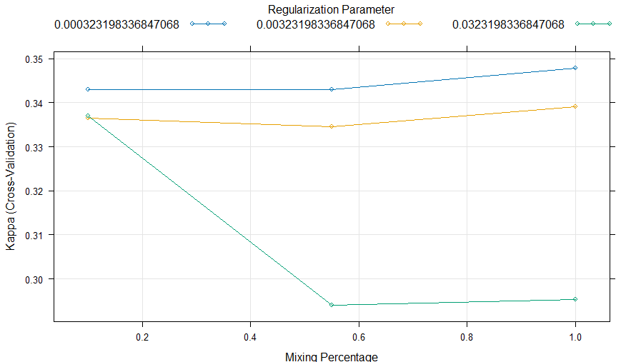
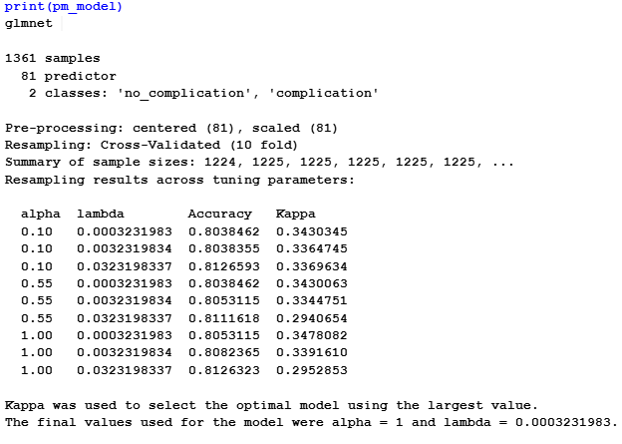
Penalized Model:

Slide 24
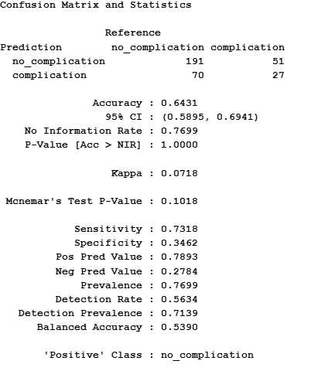
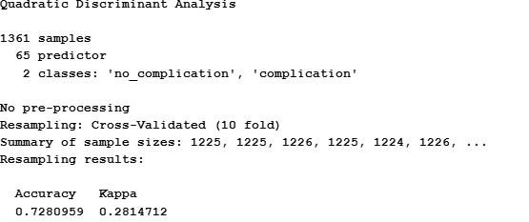
Quadratic Discriminant Analysis Model

Slide 25
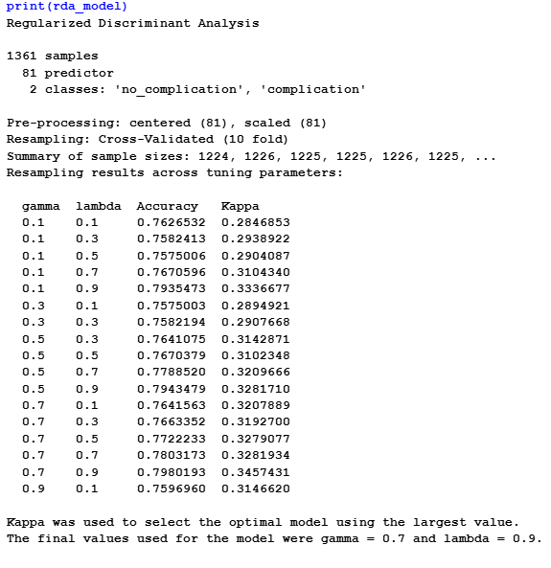
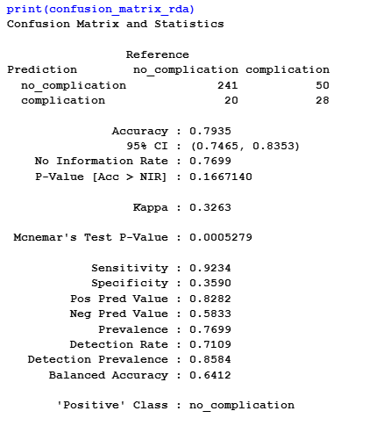
Regularized Discriminant Analysis Model

Slide 26
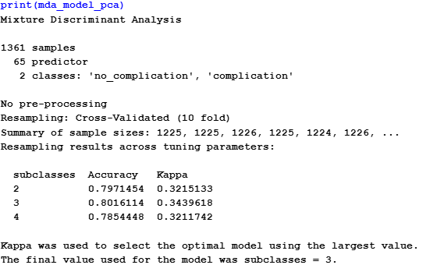
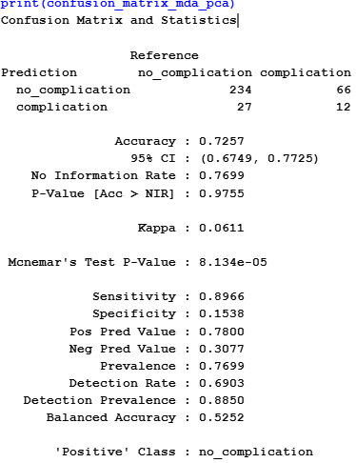
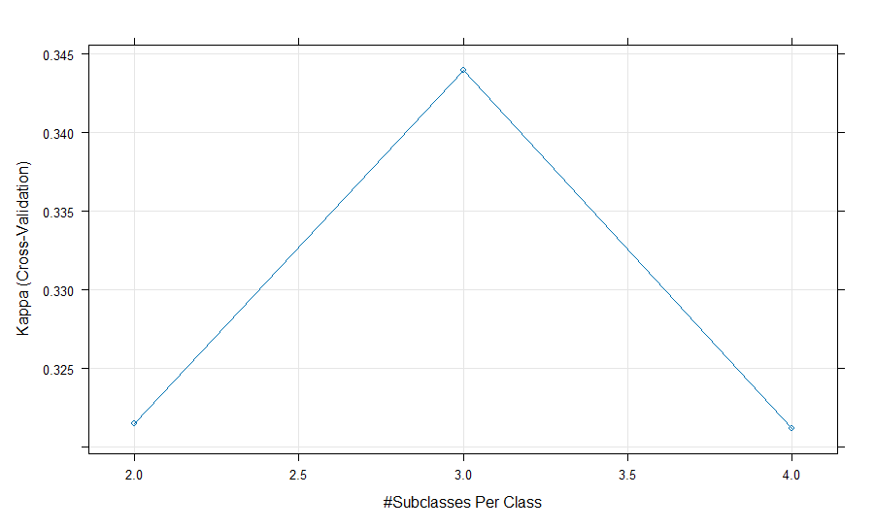
Mixture Discriminant Analysis Model

Slide 27
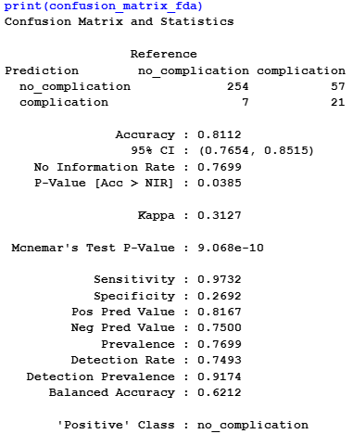
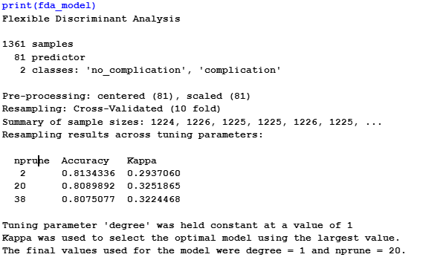
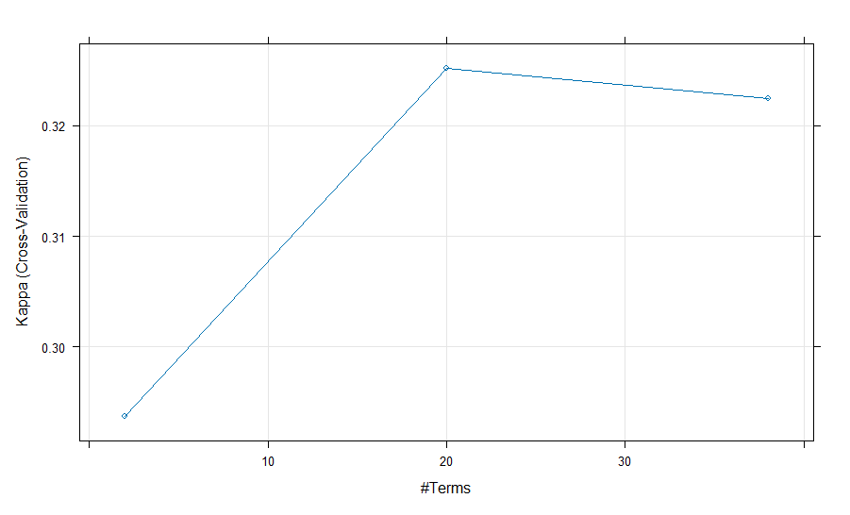
Flexible Discriminant Analysis Model

Slide 28
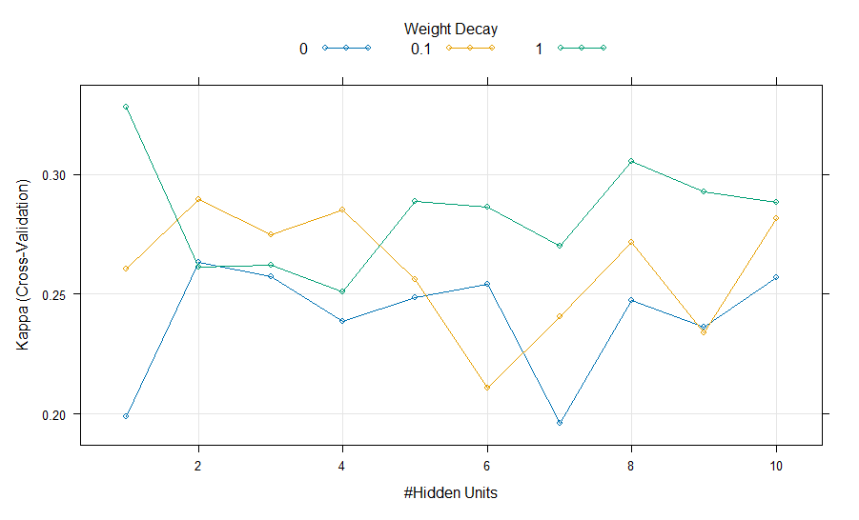
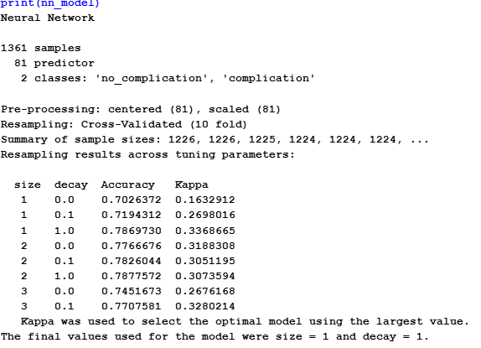
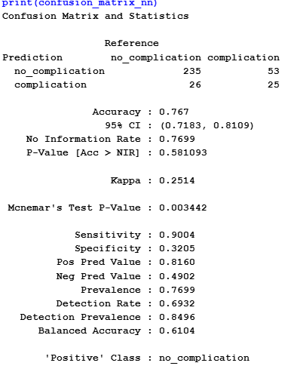
Neural Network Model

Slide 29
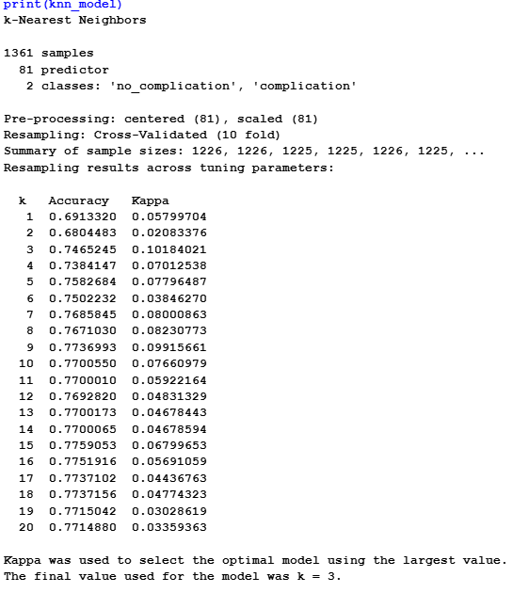
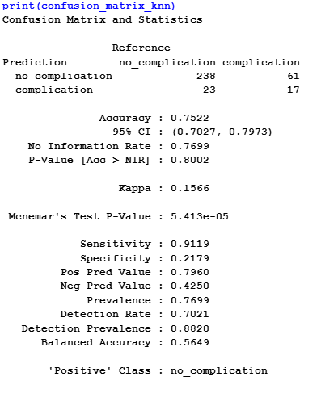
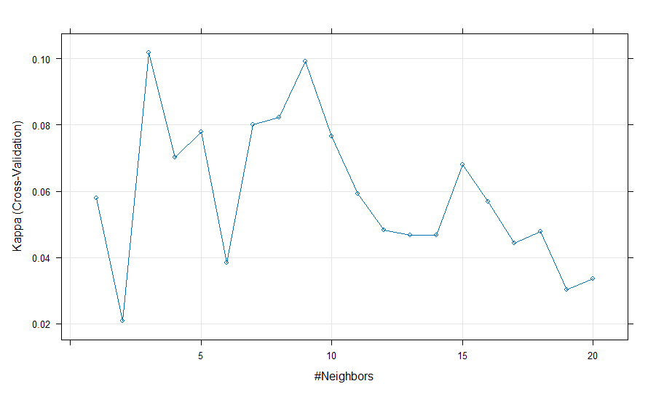
KNN Model

Slide 30
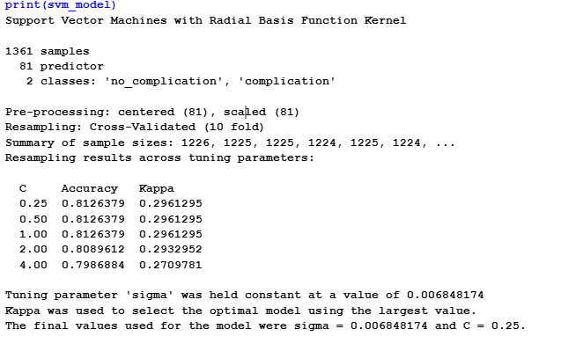
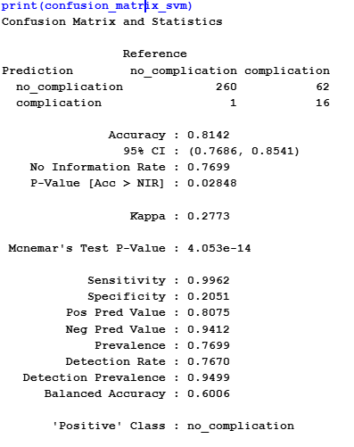
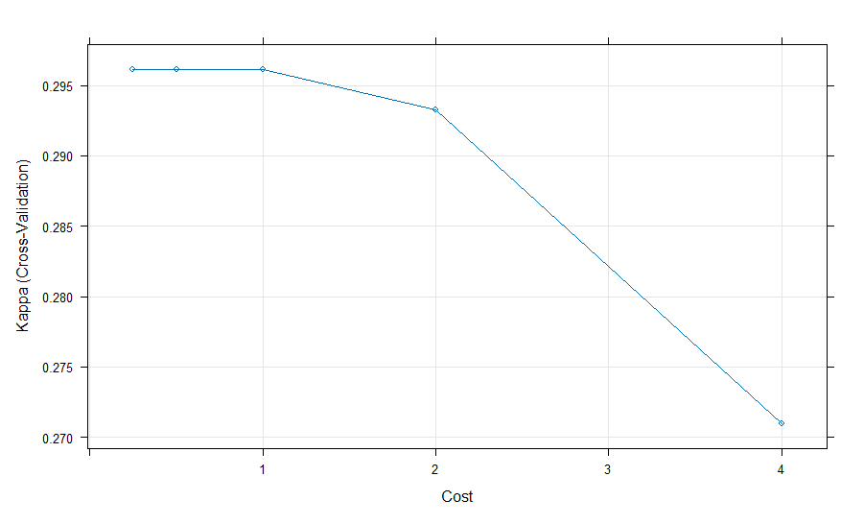
Support Vector Machine Model

Slide 31
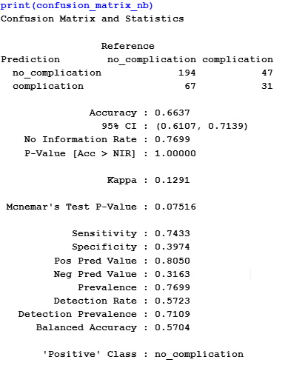
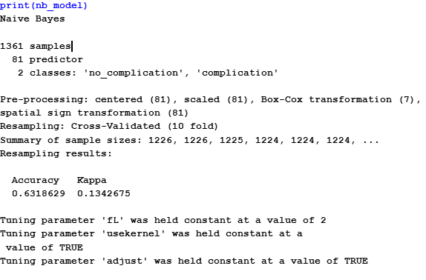
Naives Bayes Model

Slide 32
Summary of Linear Models
Models | Best Tuning Parameter | Training Kappa | Testing Kappa
LR | No | 0.3108 | 0.3704
LDA | No | 0.3027 | 0.3561
PLSDA | ncomp=4 | 0.2976 | 0.3842
Penalized | Alpha=1 & lambda=0.0003231 | 0.3478 | 0.2482

Slide 33
Summary of Non Linear Models
Models | Best Tuning Parameter | Training Kappa | Testing Kappa
QDA | No | 0.2814 | 0.0718
RDA | Gamma=0.7 & Lambda=0.9 | 0.3457 | 0.3263
MDA | Subclasses=3 | 0.3439 | 0.0611
FDA | Degree=1 & nprune=20 | 0.3251 | 0.3127
NN | Size=1 & decay=1 | 0.3368 | 0.2514
KNN | K=3 | 0.1018 | 0.1566
SVM | Sigma=0.0068 & c=0.25 | 0.2961 | 0.2773
NB | No | 0.1342 | 0.1291

