Slide 1
Adventure Works Sales Analysis Dashboard

Slide 2
Content:
Dataset: Adventure Works
Contains Customer, Date, Products, Product category, Product subcategory, Sales Table
Time period:(2010-2014)
Dataset Information
Table Used:
Dim Customer
Dim Date
Dim Product
Dim Product category
Dim Product sub category
Dim Sales territory
Sales Table(union of fact internet sales and fact internet sales new)

Slide 3
Tools and Technologies
Excel → Data cleaning & preprocessing
SQL → Data extraction & querying
Tableau → Visualization
Power BI → Dashboard Creation
Relationship → one to many
Overview:
This project analyzes sales performance of Adventure Works dataset
Focus on revenue, profit, and customer trends
Built interactive dashboards using BI tools

Slide 4
Excel – Data Cleaning
Removed duplicates and handled missing values
Standardized data formats (dates, numbers)
Used filters and sorting for quick analysis
Data Analysis:
Used Pivot Tables for summarizing data
Applied formulas (SUM,VLOOKUP/XLOOKUP)
Created calculated fields for insights
Found sales trends over time

Slide 5
SQL – Data Extraction
Retrieved data using SELECT statements
Filtered data using WHERE conditions
Sorted results using ORDER BY
Data Transformation:
Used JOINS (INNER, LEFT) to combine tables
Applied GROUP BY for aggregation
Used aggregate functions (SUM,COUNT.AVG)
Used subqueries for deeper analysis

Slide 6
Tableau -- Visualization
Created interactive charts(bar, line, tree)
Used color and labels for better understanding
Designed user – friendly dashboards
Dashboard Features:
Added filters (Region, Year, Product)
Enabled dashboard actions for interactivity
Used containers for proper layout
Analyzed trends using time – based charts

Slide 7
Power BI – Data Modeling
Created relationships between tables
Designed snow flake schema model
Used calculated columns and measures
DAX & KPIs:
Created measures using DAX
Built KPI cards (Sales, Profit, Orders)
Used time intelligence functions
Added slicers for filtering
Build interactive dashboards with visuals

Slide 8


KPI CARDS
Total Sales:
Shows overall revenue generated
Helps measure business performance
Total Sales = Sum of all sales amount
Used to track revenue growth over time ✅
Total Profit:
Indicates profitability after cost
Helps identify financial health
Total Profit = Sales – Cost
Helps in evaluating cost efficiency ✅

Slide 9


Total Orders:
Represents number of product sold
Useful for demand analysis
Helps identify high-demand products ✅
Total Orders = Count of Order IDs
Profit Margin(%):
Profitability ratio
Helps compare performance over time
Indicates efficiency of business operations ✅
Profit Margin = Profit / Sales

Slide 10
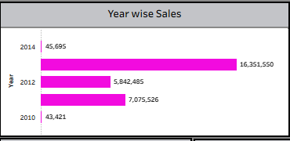
CHARTS EXPLANATION
📊 Year-wise Sales (Bar Chart)
This chart shows the total sales performance across different years
It helps identify growth trends and compare yearly performance
Sales significantly increased in one particular year (highest bar), indicating strong business growth
Some years show lower sales, which may indicate market or demand fluctuations.

Slide 11
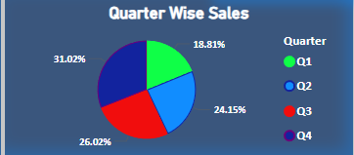
🟣 Quarter-wise Sales (Pie Chart)
This chart represents the distribution of sales across four quarter (Q1, Q2, Q3, Q4)
It helps identify which quarter contributes the most total sales
One or two quarters contribute higher sales, showing seasonal demand patterns
Useful for planning marketing and sales strategies
“Quarter-wise analysis helps identify seasonal trends and peak business periods.”

Slide 12
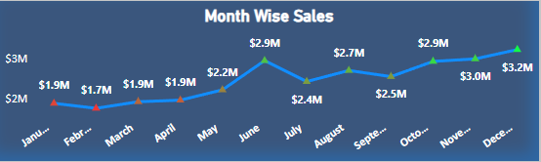
📈 Month-wise Sales (Line Chart)
This chart shows sales trends across months
It helps identify monthly growth patterns and fluctuations
Sales show a gradual increasing trend over time
Certain months have peak sales, indicating high demand periods
“Monthly trend analysis help in understanding short– term patterns and forecasting future sales.”

Slide 13
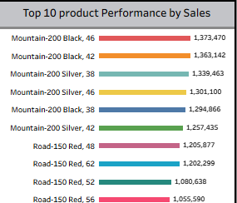
📊 Top 10 Product Performance by Sales
This chart displays the top 10 products based on total sales revenue
It helps to identify best-performing products in the business
Products like MOUNTAIN-200 series contribute the highest sales
Sales values are relatively close, showing consistent product demand
Road series products also contribute significantly to overall revenue

Slide 14
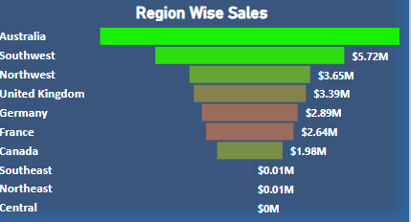
📊 Region Wise Sales
This chart shows sales performance across different regions
Australia has the highest sales contribution
Southwest and Northwest regions also perform strongly
Some regions like Central and Northeast show very low sales
Helps identify high and low performing regions
Low-performing regions indicate growth opportunities

Slide 15
🟣 Filters & Slicers (Dashboard Interactivity)
Filters and slicers are used to make the dashboard interactive
Allow users to analyze data dynamically based on selections
Enable quick filtering by:
Region
Year/date
Product Category
Improve user experience by providing customized views of data
Help in drill-down analysis and better decision -making

Slide 16
Conclusion:
Successfully analyzed sales data using multiple tools
Identified key trends, top products and high-performing regions
Build interactive dashboards for better decision-making
Demonstrated end-to-end data analytics workflow

Slide 17
Thank you

