Slide 1
Bank Loan Portfolio Analysis Project

Slide 2
PRESENTED BY
Group 6
Abhilash Dandya
Avinash Nesan M
Ayushi Pundir
Chetan Narayan Bachhav
Nandhini P
Yogesh Kumar
Pankaj Bhaskar Patil

Slide 3
Table of Contents
Introduction
Objectives of the study
KPIs List
Tools
Excel Dashboards
Power BI Dashboards
Tableau Dashboards
MySQL Queries
Key Takeaway

Slide 4
Introduction
Bank Loan Analytics Dashboard
Good morning/afternoon everyone.
Our project focuses on analyzing bank loan data to generate meaningful business insights that support better lending decisions and risk management. The banking industry processes thousands of loan applications every year, making it essential to monitor loan performance, customer behavior, and repayment trends effectively.
For this project, we worked with two finance datasets containing more than 39,000 customer loan records each. Using Excel, SQL, and Power BI, we transformed raw data into interactive dashboards and key performance indicators (KPIs) that help stakeholders understand loan distribution, payment behavior, customer profiles, and loan status trends.
The primary objective of this project is to provide a data-driven approach for evaluating loan performance, identifying risk patterns, and supporting strategic decision-making within the banking sector.
Through this analysis, we aim to answer critical business questions related to loan amounts, customer verification status, home ownership, loan grades, payment trends, and regional loan performance.

Slide 5
Objectives
Analyze loan performance and repayment trends.
Monitor customer payment behavior.
Evaluate risk using loan grades and balances.
Compare verified vs non-verified customer payments.
Track loan status across states and months.
Study the impact of home ownership on repayments.
Create interactive dashboards for business decision-making.
Generate actionable insights for better lending strategies.
Segment customers based on risk

Slide 6
KPI’s
Sr. No. | KPI | Business Purpose
1 | Year-wise Loan Amount Statistics | Analyze loan disbursement trends over different years.
2 | Grade and Sub-Grade Wise Revolving Balance (Revol_Bal) | Evaluate customer credit utilization and risk profile.
3 | Total Payment for Verified Status vs Non-Verified Status | Compare repayment behavior between verified and non-verified customers.
4 | State-wise Loan Status Analysis | Identify loan performance and risk across different states.
5 | Month-wise Loan Status Analysis | Track monthly trends in loan performance and repayment status.
6 | Home Ownership vs Last Payment Date Statistics | Understand the relationship between property ownership and repayment behavior.

Slide 7
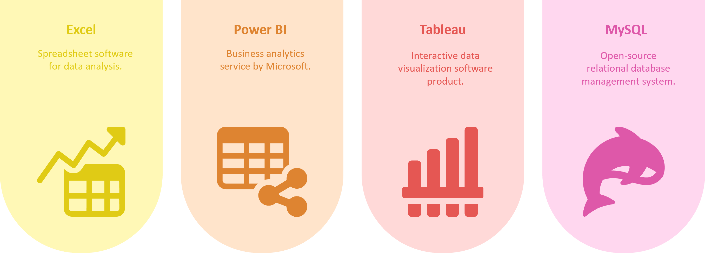
Tools

Slide 8
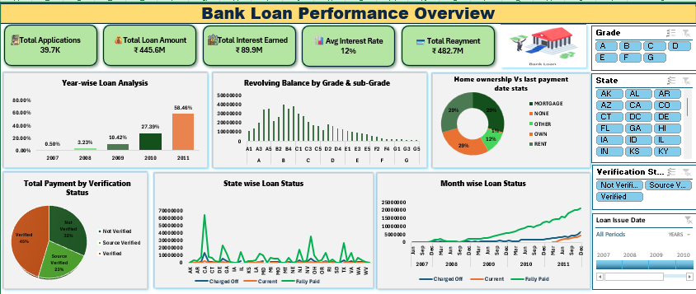
Excel Dashboard
“The dashboard highlights strong loan growth, healthy profitability, effective repayment collection, increasing customer demand, and well-managed credit risk across the loan portfolio."

Slide 9
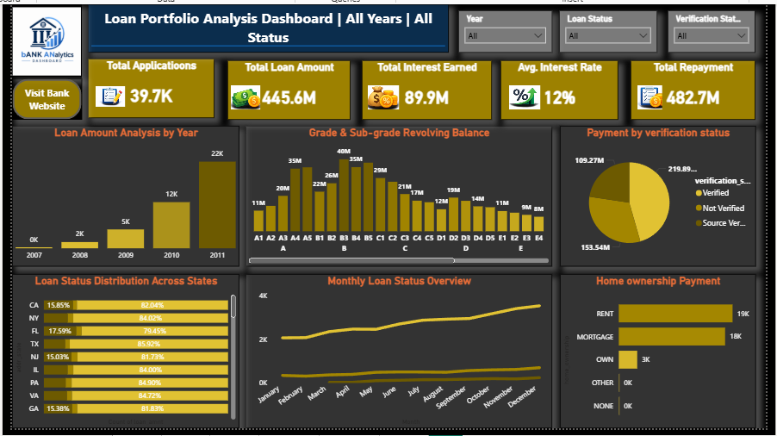
Power BI Dashboard
"This Power BI dashboard provides a comprehensive view of loan performance, customer repayment behavior, and portfolio health, helping stakeholders make data-driven lending decisions."

Slide 10
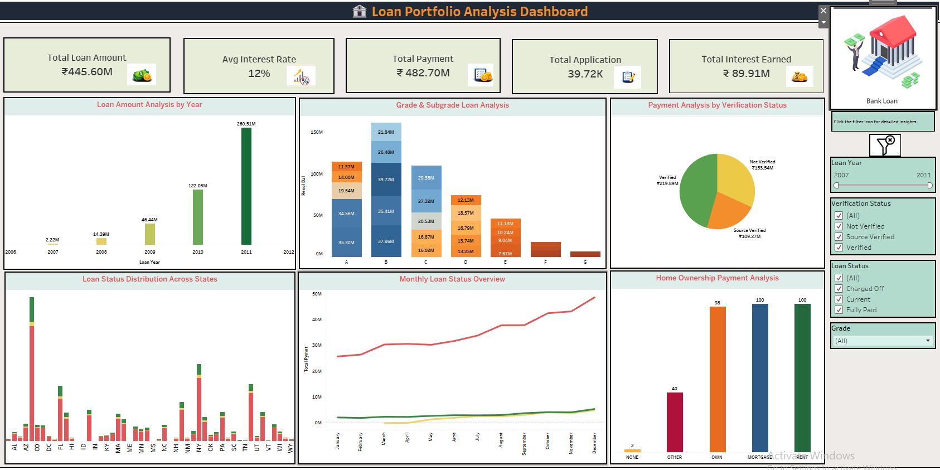
Tableau Dashboard
"This Tableau dashboard provides a comprehensive view of loan performance, customer behavior, and repayment trends, enabling stakeholders to make informed lending and portfolio management decisions."

Slide 11
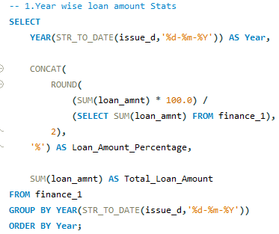
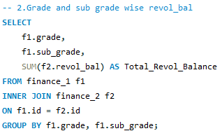
MYSQL Queries
"This query analyzes yearly loan disbursement trends by calculating total loan amounts and each year's percentage contribution to the overall loan portfolio."
"This query analyzes the total revolving balance across different loan grades and sub-grades to evaluate credit portfolio distribution and risk levels."

Slide 12
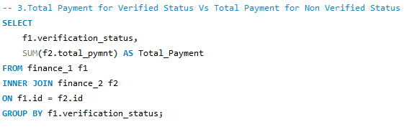
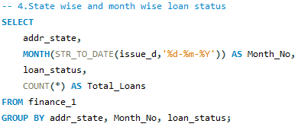
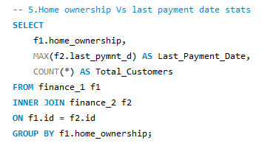
“This query compares total payments across different verification statuses to assess the impact of customer verification on loan repayment performance."
"This query analyzes loan status distribution across different states and months to identify regional and seasonal lending trends."
"This query analyzes customer home ownership categories by showing the latest payment date and total number of customers in each category."

Slide 13
Key Takeaways
Loan grades are strong indicators of repayment risk.
Verified customers generally show better payment performance.
Loan status varies across states and months.
Home ownership influences repayment behavior.
Revolving balance helps assess customer credit risk.
Interactive dashboards support data-driven banking decisions.
Analytics can improve lending efficiency and risk management.
"This project demonstrates how data analytics can help financial institutions monitor loan performance,
understand customer behavior, manage credit risk, and make informed business decisions through interactive
reporting and visualization."

Slide 14
THANK YOU

