Slide 1
Employee Data Analysis using Excel
NAME: NANDHINI.K
REGISTER NO:122200088
DEPARTMENT:B.COM(CS)
COLLEGE:PACHIYAPASS COLLEGE FOR WOMEN

Slide 2
PROJECT TITLE
Using pivot tables for employees
turnover analysis

Slide 3


AGENDA
Problem Statement
Project Overview
End Users
Our Solution and Proposition
Dataset Description
Modelling Approach
Results and Discussion
Conclusion
3/21/2024 Annual Review

Slide 4

* Problem Statement: The core issue or challenge the project aims to address.

Slide 5

PROJECT OVERVIEW
.
A high-level summary of the project's scope and goals.

Slide 6

WHO ARE THE END USERS?
The intended beneficiaries of the project's outcomes.

Slide 7

OUR SOLUTION AND ITS VALUE PROPOSITION
The proposed approach or solution to the problem.

Slide 8
Dataset Description
Details about the data used in the project.

Slide 9

THE "WOW" IN OUR SOLUTION
Allow users to quickly drill down into specific data points or segments.Pivot Tables: Provide flexible data summarization and analysis. Conditional Formatting: Highlight trends, outliers, or critical
3/21/2024 Annual Review
9

Slide 10
MODELLING
A
Deep Dive
Understanding Employee Attribution Employee attribution is the process of determining the factors that contribute to employee performance, turnover, or other outcomes. It's a critical aspect of human resource management, as it helps organizations identify areas for
improvement, optimize talent
strategies, and foster a positive work
environment.
10

Slide 11
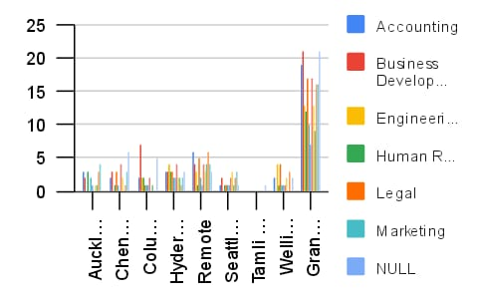
RESULTS
11

Slide 12
conclusion
The "Employee Performance Analysis Using Excel" project provides a robust and user-friendly solution for evaluating and managing employee performance. By leveraging Excel's powerful tools—such as filtering, pivot tables, charts, and conditional formatting—the project transforms raw performance data into actionable insights. The resulting interactive dashboards and customizable reports empower managers to make data-driven decisions, optimize workforce productivity, and foster continuous improvement across the organization. This solution not only streamlines performance management but also offers a cost-effective, scalable approach to enhancing overall organizational efficiency.

