Slide 1
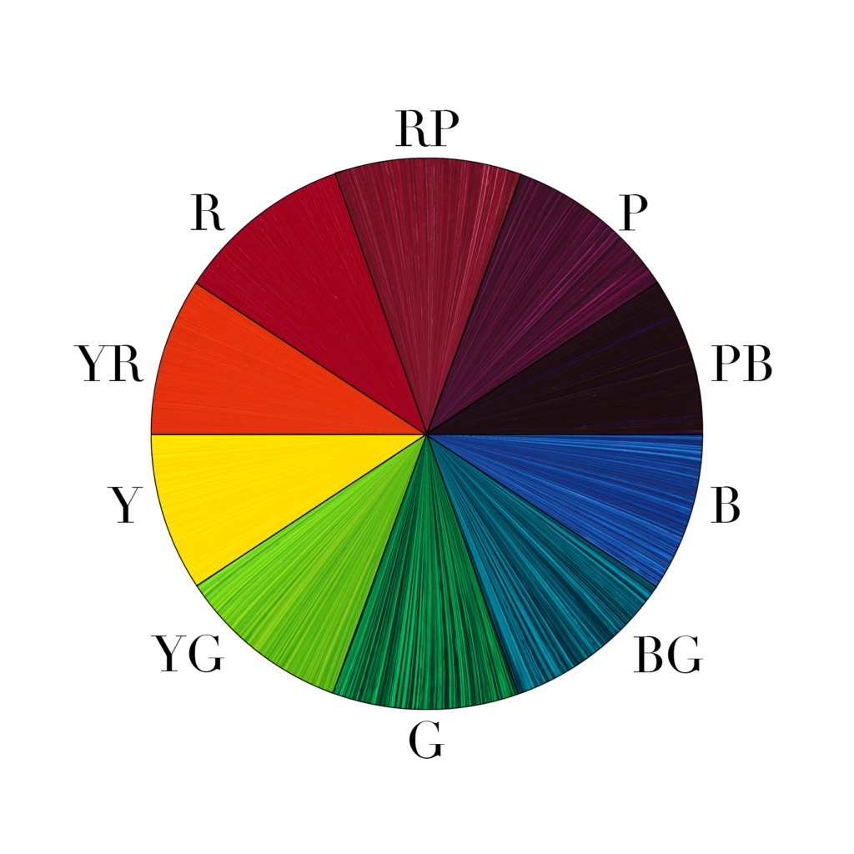
Cartoonify An Image
Using OpenCV
Mini project members:
Deepika . L
Nandhini . J . P

Slide 2
Introduction
~ Nowadays, social applications and it’s camera as well as filter features are booming in a drastic rate. And we cannot deny the technology being absolutely fun.
~ For the love of social media and filters, we’ve developed a fun application to cartoonify an image using the library OpenCV.

Slide 3
OpenCV
~Python is the pool of libraries. It has numerous libraries for real world applications. One such library is OpenCV.
~OpenCV is a cross-platform library used for Computer vision, as it includes applications like video and image capturing and processing.
~It is majorly used in image vision and other applications.

Slide 4
Project Abstract
~Chosen image or captured image is converted into a cartoon like image through OpenCV.
~The set of instructions include various steps to achieve the required change such as,
*Gray scale image
*Smoothening original image
*Smoothening gray scale image
*Retrieving the edges from gray scale image
*Cartoonification

Slide 5
Objectives.
To override certain limitations from the existing output .
Limitations
~Only existing images in the desktop can be chosen to to be edited.
~Lighter complexion images are relatively not as much as edged as bright complexion images.
Additional features
~Adding camera to click pictures and edit instantly.
~Improving the edging feature to get a better animated image.

Slide 6
Requirements.
Hardware Components
~Windows 9 and above.
~Compatible on all new devices.
Software Components
~Python 3.9 and above.
~Pycharm IDE

Slide 7
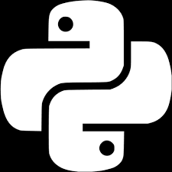
Thankyou.

