Slide 1
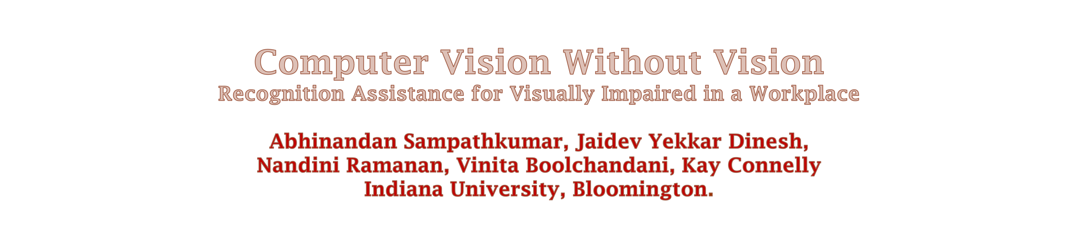
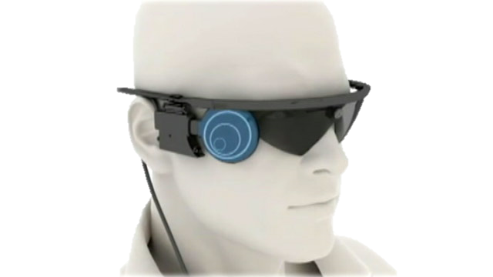

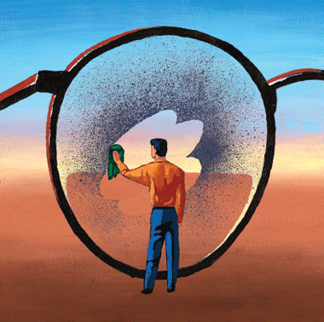
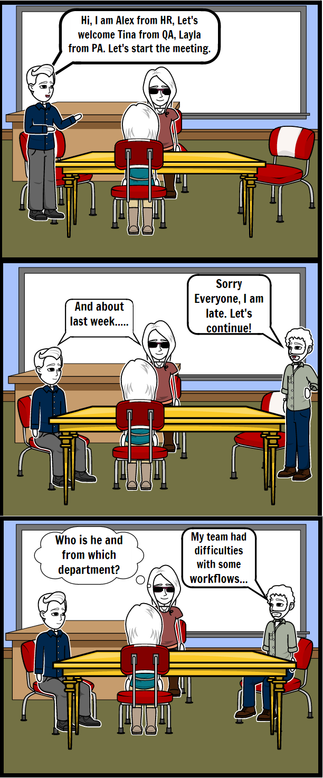
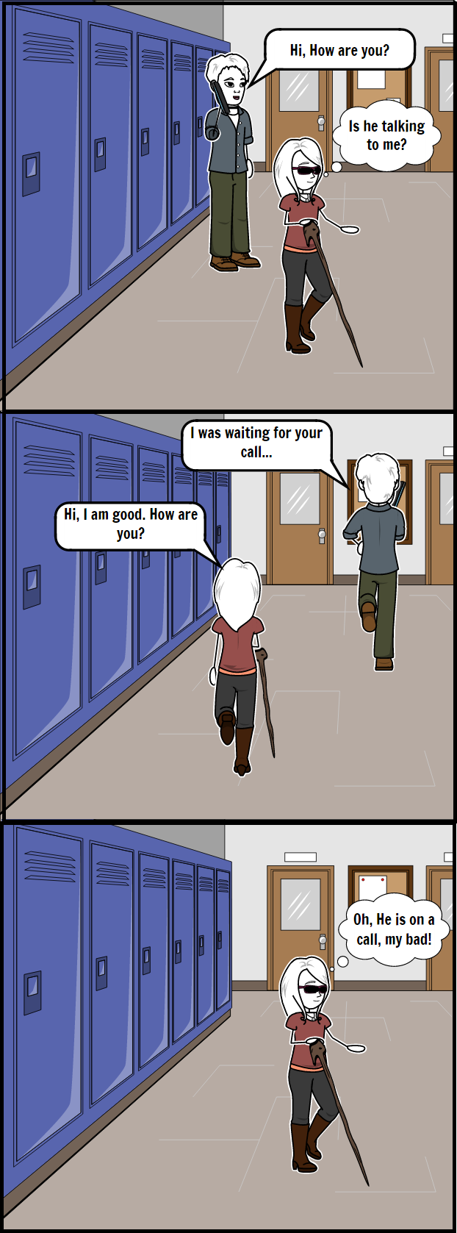





Abstract
Motivation
Our determination is to make OFFICE a better place for VISUALLY IMPAIRED, who experience serious difficulties in work place due to their reduced perception of the environment. Laying down a foundation of two embarrassing situations that each of our interviewee faced, with UBIQUITOUS COMPUTING, we have made an effort towards improving their perception of the surrounding reality.
Out of 285 million visually impaired people worldwide, 34 million are students and 75 million are employees and these numbers are predicted to increase every year [WHO].
Our interviewees raised concerns with problem of identifying individuals in office and responding to the conversations that are directed towards.
Our major interest is to contribute to the community.
Scenario 1
Objectives
Methods
Scenario 2
An assistive application for visually impaired in an office location should perform the following;
Help identify people in office.
Help avoid awkward situations, by informing them if a question was directed to them.
Mobile application to control the camera.
Concise/ clear audio feedback to the user.
Ensure privacy protocols are maintained in the application
Interviews:
  An expert
  Three completely blind
  1 partially blind person
Finalized the problem statement and the design.
Updates based on feedback.
Implementation:
  Image detection using dlib models
  Image matching and gesture recognition using Keras.
  Mobile application using Android Studio.
Our modus operandi
Click to capture
Select the option to recognize the person (or to know if he is on a call)
Audio feedback with the person’s name and designation (or notify if he is on a phone)
Snapshot
Conclusion
Future Work
Put screen shots of application and users using the application here
Our prototype informs the visually impaired user about surrounding employees’ identity.
It informs the user if a conversation is not directed to him/her.
It does not violate any privacy rights of people around the user as none of the captured images are stored.
Our mobile application is customizable .
We do not overwhelm the user with too details in the audio.
We intend to incorporate emotion recognition.
The camera functionality is envisioned to be upgraded to perform a wide angle image capture.
Our prototype can be extended to give user feedback on how many people are in his sight at any instance
We can incorporate gaze detection to identify if an individual is talking to the user.
Acknowledgements
Professor Kay Connelly, Thanmai Bindi and Akshay Manohar Reddy for the valuable guidance/feedback through each phase. Tousif Ahmed; our expert, who helped us narrow down to our problem statement and the target population. All our interviewees who helped us to understand the actual problems and identified solutions of their interests.
Done as a part of P-535 Pervasive Computing

