Slide 1

AUDIO STREAMING

Slide 2
STREAMING :
Why is it cool ???

Slide 3

AUDIO STREAMING:
It's a method of delivering an audio signal to your computer over a network and differs from the "normal" method of receiving Internet audio in one important way : instead of having to download a ".wav", ".au" or other type of file completely before being able to listen to it, you hear the sound as it arrives at your computer, and therefore do not have to wait for a complete download.
The sole purpose of our application enables a user to share and play music with the other person in the network.

Slide 4
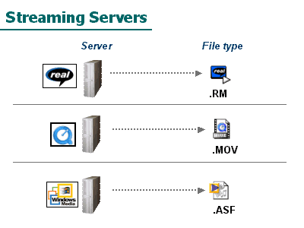
EXISTING SYSTEMS
The three major existing streaming technologies in market are RealMedia, QuickTime, and Windows Media technology

Slide 5

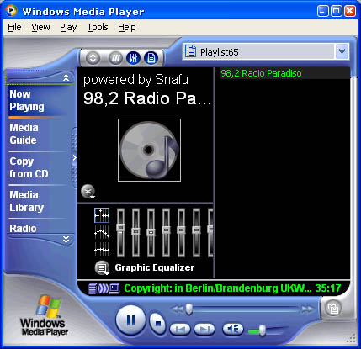
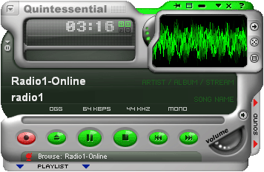

Slide 6
Our Project-
WHAT??

Slide 7
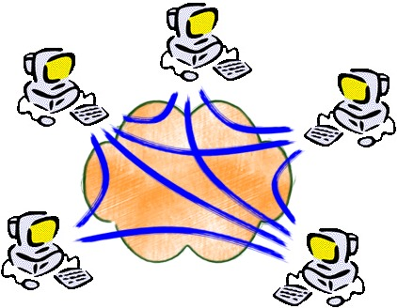
Two systems connected over a peer to peer network using NIC cards.
Both the systems should have the software developed by us, installed.
At least one of the two machines are required to contain music files in a specific folder which are to be shared over the network.
One of the users can search and locate the desired music files in the shared folder and download it.

Slide 8
Our project-
HOW??

Slide 9



Language used : C#
Framework : ASP . Net
IDE : Visual Studio 2005
Hardware involved :
Minimum memory-200MB to load our software.
Network interface cards
Other software involved : Audio players in both the machines

Slide 10
THANK YOU

