Slide 1
INTERNET OF THINGS(IOT) TRAFFIC MANAGEMENT BATCH MEMBERS: 1) ASHWATHI . A 2) MARI RAJAKUMARI .P 3) MUTHARASI MUKILA .G 4) MUTHU LAKSHMI .L 5) NANDHINI .S MENTOR: Dr.M.RUBAN GLADWIN M.E Ph.D.AP/ECE

Slide 2
BATCH MEMBERS:
SI.N0 | NAME | ROLE | REGISTER NUMBER | E-MAIL ID | CONTACT NUMBER
1 | M.Ruban Gladwin | Mentor | ----- | rubangladwin@gmail.com | 8300591990
2 | A. Ashwathi | Student | 951321106004 | ashwathi1105@gmail.com | 8248158255
3 | P. Mari Rajakumari | Student | 951321106026 | sandhanamariamman@gmail.com | 9047770719
4 | G. Mutharasi Mukila | Student | 951321106302 | varshaganesan680@gmail.com | 9786766486
5 | L .Muthu Lakshmi | Student | 951321106031 | muthulakshmi4889@gmail.com | 6384752335
6 | S. Nandhini | Student | 951321106033 | snandhini2909@gmail.com | 9345565764

Slide 3
PHASE-1

Slide 4
INTRODUCTION OF IOT
The Internet of Things (IoT) describes the network of physical objects-”things”-that are embedded with sensors, software and other technologies for the purpose of connecting and exchanging data with other devices and systems over the internet.

Slide 5
PROBLEM STATEMENT
The project involves using IOT devices and data analytics to monitor traffic flow and congestion in real-time, providing commuters with access to this information through a public platform or mobile apps. The objectives is to help commuters make informed decisions about their routes and alleviate traffic congestion. The project includes defining objectives, designing the IOT traffic monitoring system, developing the traffic information platform, and integrating them using IOT technology and python.

Slide 6
DESIGN THINKING:
Project Objectives: Define objectives such as real-time traffic monitoring, congestion detection, route optimization and improved commuting experience.
IOT Sensor Design: Plan the deployment of IOT devices to monitor traffic flow and congestion
Real-Time Transit Information Platform: Design a web-based platform and mobile apps to display real-time traffic information to the latform and mobile apps to display real-time information to the public.

Slide 7

Block diagram:
+12V
Arduino Mega 2560
Arduino nano
+5V
RFID Reader RC-522
+3.3V
BC SR04 01
BC SR04 02
BC SR04 03
BC SR04 04
Tag 1
Tag2
Tag3
Tag4

Slide 8
FLOW CHART
START
Read Distance
Calculate height from distance
If(height>= threshold)
Make call and update the web page
Update the web page
A

Slide 9
PHASE-2

Slide 10
HARDWARE COMPONENTS
1.ARDUINO MEGA 2560
2.ARDUINO NANO
3.RFID RC 522
4.RFID TAG
5.LED
6.RESISTORS(220ohm)
7.SIGNAL KIGHT MODULE PCB
8.POWER SUPPLY(12 volt)
9.ULTROSONIC SENSOR
10.BREADBOARD
11.CONNECTING WIRES

Slide 11
PROGRAMMING LANGUAGE
Python

Slide 12
COMPONENTS SPECIFICATION
ARDUINO MEGA 2560 - The ATmega 2560 has 256 KB of flash memory for storing code 8 KB of SRAM and 4 KB of EEPROM.
ARDUINO NANO – Arduino nano has 8 analogue pins. It has 6 PWM pins among the digital pins. It comes with 16 MHZ clock speed via a crystal oscillator.
RFID RC255-The RC255 reader module is designed to create a 13.56 MHZ electromagnetic field and communicate with RFID tags. The reader can communicate with a microcontroller over a 4-pin SPL with a maximum data rate of 10 Mbps.

Slide 13
RESISTORS – Resistance is the main specification for resistor element which indicates the single resistance value or range of resistance which the element provides.
POWER SUPPLY-The power rating describes the total system power that can be drawn from the unit before it overloads, usually expressed as watts. Modern PSUs commonly range 300W to over 1000W.
ULTRASONIC SENSOR- Ultrasonic transducers operate at frequencies in the range of 30-500 KHz for air-coupled applications.

Slide 14
INNOVATION TECHNOLOGIES
Automization of traffic control system for high density vehicle roads with priority of emergency vehicles. Let us see about the project , In this project we used Arduino mega 2560 as an art of the system with other interfacing devices like LED as signal light as ultrasonic sensors, hcsro4 four loaders to sense the density of the vehicle on the road.
And finally RFID reader rc522 along with RFID attacks for emergency vehicles additionally an Arduino nano is used at interface RFID reader. A 12volt, 5v, 3.3v power supply is used for Arduino mega, Arduino nano and RFID reader respectively.

Slide 15
A full road junction model or prototype is presented in frond of the demonstration the project . You can see the four ultrasonic sensor. Placed at side of used to sense the density of vehicle.
See of traffic signal light made of 10mm led Red, Yellow and Green are used with 230 ohm resistance to limit the current.
CASE -1
This helps us to reduce the traffic when there is large density traffic there will be a ultrasonic sensor to indicate a green signal automatically. By this innovation we can reduce the congested traffic .

Slide 16
CASE -2
In others case for emergency vehicles the corresponding RFID tag is bought near to the RFID reader the a green light is turn on to make the traffic free for the emergency vehicles.
When it is manned it will easy to communicate with them to clear the traffic . In order of it is unmanned then we are developing to communicate directly to the signal.
There will be a sensor placed in the road ways to sense the density volumes. For example there are four switches switch 1,2,3,4 and 5.

Slide 17
For every 30 secs the switch -1 is in ON condition (Green signal). After 30 secs the switch-1 is OFF and switch -2 is ON.
By that the vehicles traffic will be cleared.
In case there is an emergency vehicle or a politicans or an VIP is on road there will be a sound sensor or ultrasonic sensor or RFID reader will be fixed.
In this case the response will be sent to the signal and the traffic will be cleared before the vehicles is coming to that spot.

Slide 18
In future we will be removing the sensor and the cameras will be fixed.

Slide 19
SOURCE CODE
define RED 1
#define YELLOW 5
#define GREEN 9
void setup() {
pinMode(RED, OUTPUT);
pinMode(YELLOW, OUTPUT);
pinMode(GREEN, OUTPUT);
}
void loop() {
digitalWrite(red, HIGH);
delay(5000);
digitalWrite(red, LOW);
digitalWrite(yellow, HIGH);
delay(5000);
digitalWrite(yellow, LOW);
digitalWrite(green, HIGH);
delay(5000);
digitalWrite(green, LOW);
}

Slide 20
import network
import time
from machine import Pin
import dht
import ujson
from umqtt.simple import MQTTClient
# MQTT Server Parameters
MQTT_CLIENT_ID = "micropython-weather-demo"
MQTT_BROKER = "broker.mqttdashboard.com"
MQTT_USER = ""
MQTT_PASSWORD = ""
MQTT_TOPIC = "wokwi-traffic management"
sensor = dht.DHT22(Pin(15))
print("Connecting to WiFi", end="")
sta_if = network.WLAN(network.STA_IF)
sta_if.active(True)
sta_if.connect('Wokwi-GUEST', '')
while not sta_if.isconnected():
print(".", end="")
time.sleep(0.1)
print(" Connected!")
print("Connecting to MQTT server... ", end="")

Slide 21
client = MQTTClient(MQTT_CLIENT_ID, MQTT_BROKER, user=MQTT_USER, password=MQTT_PASSWORD)
client.connect()
print("Connected!")
prev_traffic management = ""
while True:
print("Measuring traffic management conditions... ", end="")
sensor.measure()
message = ujson.dumps({
“distance": hospital road(),
“distance": highway road(),
})
if message != prev_traffic management:
print("Updated!")
print("Reporting to MQTT topic {}: {}".format(MQTT_TOPIC, message))
client.publish(MQTT_TOPIC, message)
prev_traffic management = message
else:
print("No change")
time.sleep(1)

Slide 22
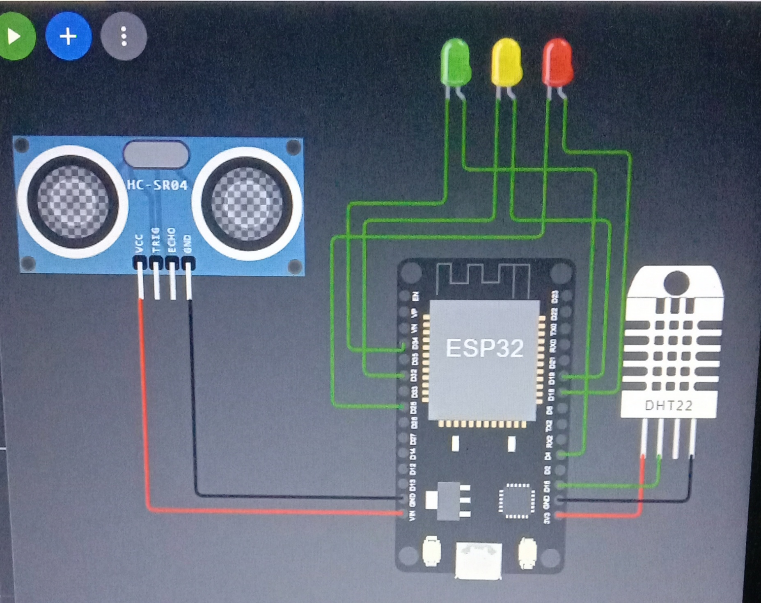
SIMULATION RESULTS

Slide 23
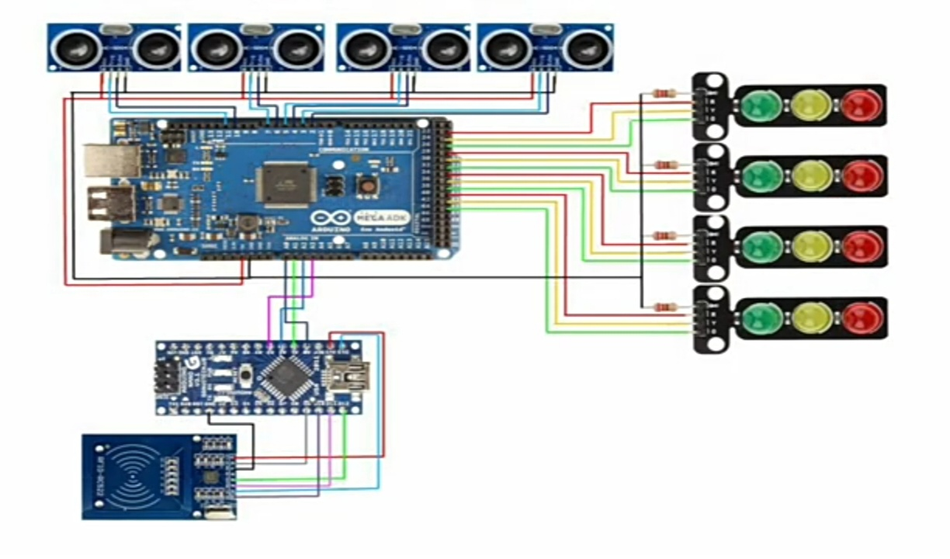

Slide 24
PHASE-3

Slide 25
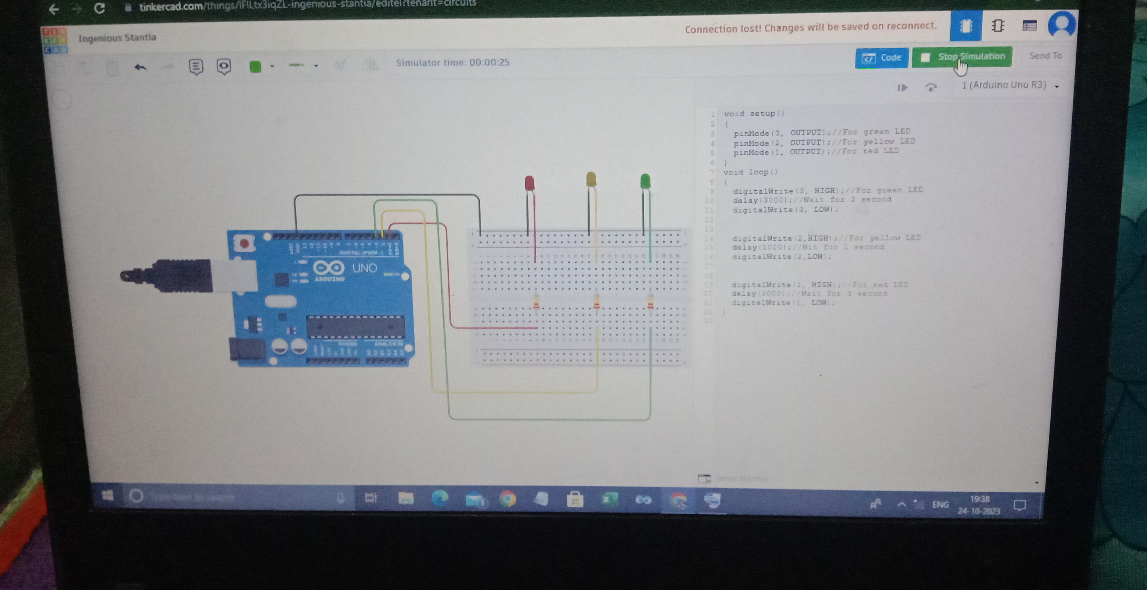

Slide 26
REFERENCES
Kessman, Wilshire, Quinn, Grochoske, Higinbotham based on Urban traffic control system and Traffic Engineering and control.

Slide 27
THANK YOU

