Slide 1
Digital Portfolio
STUDENT NAME:V.NANDHINI
REGISTER NO AND NMID: 36324U09054/astvu36336324u09054
DEPARTMENT: BACHLOR OF COMPUTER APPLICATION
COLLEGE: COLLEGE/ UNIVERSITY :SREE ABIRAAMI ARTS AND SCIENCE COLLEGE FOR WOMENS THIRUVALLUVAR UNIVERSITY

Slide 2
PROJECT TITLE
DIGITAL PORTFOLIO

Slide 3


AGEND
Problem Statement
Project Overview
End Users
Tools and Technologies
Portfolio design and Layout
Features and Functionality
Results and Screenshots
Conclusion
Github Link
3/21/2024 Annual Review

Slide 4

PROBLEM STATEMENT
Students need a professional way to present their skills, projects, and background.
Traditional resumes are static and lack interactivity.
A digital portfolio website helps students to showcase their work online in a more interactive and creative way.
The goal is to design and develop a personal portfolio website using HTML, CSS, and JavaScript.
A digital portfolio provides an interactive and accessible platform to present achivements,skills,and experiences

Slide 5
PROJECT OVERVIEW
Home Page:
A brief introduction about me:
name:V.Nandhini
Gmail:nandhinivijayakumar849@gmail.com
I am currently persuing 2 BCA in sree abiraami arts and science college
About Me Section:
About my background and interests
I completed 12th in government girls school and I am currently persuving
a bachelor of computer application
About my intrect I want to become a ips
And social servicer
A short paragraph about your background and interests.
Skills Section:
A list of your key skills (HTML, CSS, python,cpp)
Projects Section:
Display 2-3 projects with descriptions and links to Github or live demos.
Contact Form:
NAME:V.NANDHINI
Email:nandhinivijayakumar849@gmail.com
Message:
Dark Mode Toggle (Optional):
A button to switch between light and dark themes.

Slide 6
Project Title: My Digital Portfolio Technologies Used: HTML, CSS, JavaScript Student Name: [V.Nandhini] Project Duration: [e.g., 2 weeks]
Targent Audience :Teachers,Classmates,
Potential employers,or college admission
officers

Slide 7
END USERS
A student digital portfolio is a personal website created by a student to showcase their skills, projects, education, and achievements. When a student uses HTML, CSS, and JavaScript to build this website, they are acting as an end user of these technologies.
HTML is used to create the structure of the portfolio (like headings, paragraphs, and images).
CSS is used to style the website (like colors, fonts, and layout).
JavaScript is used to add interactive features (like buttons, forms, and animations).
As the end user, the student:
Builds and uses the portfolio for their own benefit
Controls the design, content, and purpose of the site
Uses it to apply for jobs, internships, or display school work
This process helps students improve their web development skills and create a professional online presence.

Slide 8
TOOLS AND TECHIQUES
A student uses HTML to create the structure of the portfolio website.
CSS is applied to style and design the website, making it visually appealing.
JavaScript adds interactive features such as clickable buttons and form validation.
The student uses tools like Visual Studio Code to write and edit code.
Web browsers like Google Chrome are used to test and preview the website.
Version control tools like Git and GitHub help manage the code and track changes.
Hosting platforms such as Netlify or GitHub Pages make the portfolio accessible online.
Through these tools and techniques, the student builds a professional digital portfolio to showcase skills and projects.
The student acts as the end user by creating and using this portfolio to present their work to others.

Slide 9
PORTOFOLIO DESIGN AND LAYOUT
The student uses HTML to organize the portfolio content into meaningful sections such as About Me, Projects, Skills, and Contact, ensuring semantic and accessible structure.
CSS is employed to style the website, including choosing a consistent color scheme, typography, and layout techniques like Flexbox and CSS Grid to create a clean, modern, and responsive design that adapts to desktops, tablets, and smartphones.
The student incorporates JavaScript to add interactivity, such as toggle buttons to show or hide detailed project descriptions, a mobile navigation menu that can open and close smoothly, and form validation to improve user input accuracy.
The layout includes a fixed navigation bar for easy access to different sections and uses spacing and alignment techniques to improve readability and visual appeal.
The portfolio design focuses on user experience (UX), making sure visitors can easily explore the student’s skills and projects without confusion or clutter.

Slide 10
FEATURES AND FUNCTIONALITY
Responsive Layout
Using CSS media queries and Flexbox/Grid to ensure the portfolio looks good on desktop, tablet, and mobile devices.
Navigation Menu
A fixed navigation bar created with HTML and CSS, enhanced with JavaScript to toggle a mobile-friendly menu.
Project Showcase Section
A grid of project cards made with HTML and CSS, where each card can expand to show more details using JavaScript toggles.
Contact Form
A form built with HTML that collects user input, styled with CSS, and validated with JavaScript to ensure all fields are properly filled before submission.
Downloadable Resume
A button or link that allows visitors to download the student’s resume PDF, implemented using simple HTML anchor tags.
Interactive Elements
Smooth scrolling between sections and animated hover effects on buttons and links using CSS transitions and JavaScript.
Dark Mode Toggle
A switch powered by JavaScript that allows users to toggle between light and dark themes for better accessibility and user preferenc

Slide 11
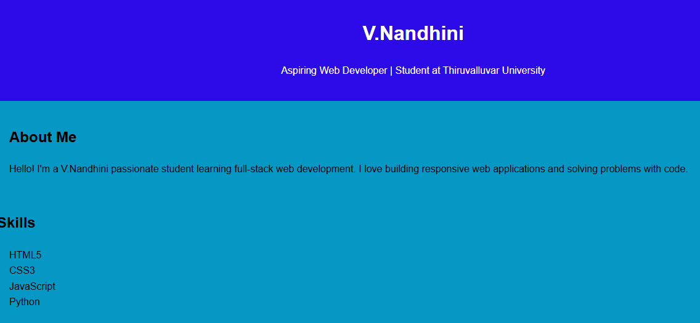
Results and screenshot

Slide 12
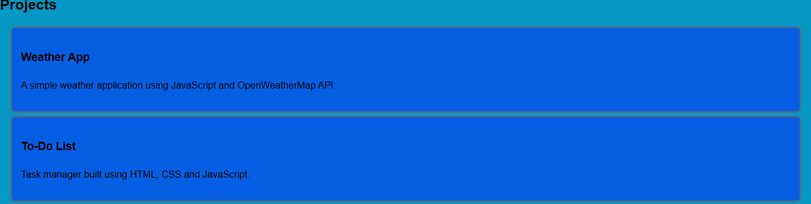

Slide 13


Slide 14
CONCUSION
I created a digital portfolio using HTML, CSS, and JavaScript to showcase my skills, projects, and personal information.
HTML was used to structure the content.
CSS added styling and design.
JavaScript made the page interactive (like showing project details).
This portfolio helps me present my work professionally and can be shared with teachers, employers, or online.

Slide 15
Githup link

