Slide 1


SMART INDIA
HACKATHON
2026
SMART INDIA HACKATHON 2026
TITLE PAGE
HydroSentinel
Hyper-Local Flash Flood & Landslide Early Warning for the Indian Himalayas
Problem Statement ID – 26192
Problem Statement Title – Flash Flood Prediction System for Hilly Regions using Multi-Source Data
Theme – Disaster Management
PS Category – Software
Team ID – 126427
Team Name (Registered on portal) – zypher2026
GitHub Repository
github.com/nandhish3004/Oramet
Demo Video (YouTube)
youtube.com – link embedded in final PDF
Team zypher2026 • Team ID 126427
Ministry of Home Affairs | NDRF – DM Division • PS 26192 • SIH 2026

Slide 2
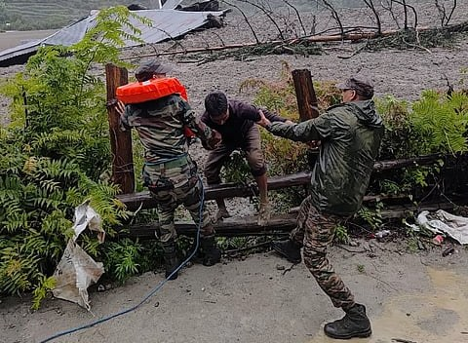
ZYPHER 2026
PROPOSED SOLUTION
SMART INDIA
HACKATHON
2026
THE PROBLEM — WHY MINUTES DECIDE LIVES
OUR SOLUTION — HYDROSENTINEL
Cloudbursts over steep Himalayan catchments turn into destructive flash floods with barely minutes of warning — Kedarnath 2013, Chamoli 2021, Dharali 2025.
Today's forecasts stop at district / river-basin scale; nobody tells a ward when the water will actually reach it.
Intense rain on saturated slopes steeper than 30° also triggers companion landslides — which single-hazard systems ignore.
Valley networks fail precisely during disasters, so internet-only alerts never arrive.
An offline-first mobile disaster-intelligence app that fuses live IMD rainfall, NASA SMAP / ISRO soil moisture, GSI slope models and CWC river gauges into a hyper-local minutes-to-flood countdown for every ward — then routes citizens to high ground and escalates SOS over SMS-112 even when networks are down.
APP FEATURES — WHAT NO EXISTING SYSTEM OFFERS
1
Hyper-local countdown — minutes-to-crest computed per ward from lag-time runoff math.
EXISTING SYSTEMS vs HYDROSENTINEL
EXISTING EWS
ZYPHER WAY
2
Dual-hazard fusion score — rainfall runoff × slope Factor-of-Safety → one 0–100 ward risk.
Basin-wide forecasts, hours late
Ward-level minutes-to-crest countdown
3
Zero-network survivability — offline cache, native SMS-112 SOS with live GPS pin.
Internet-only alerts; die in storms
Offline SMS-112 + 3.5 kHz beacon
4
3-shake accelerometer SOS — CAP-v1.2 beacon to 112 + family — hands-free, in any weather.
Flood-only hazard view
Flood + landslide fused score
5
3.5 kHz rescue siren — pulsed acoustic beacon tuned to guide NDRF parties & K-9 units.
Dharali (Uttarkashi), Aug 2025 — flash-flood rescue | Source: PTI / Down To Earth
6
Zero-text dialect UI — Garhwali / Kumaoni / Himachali icons + TTS voice alerts.
7
3D escape routing — contour-aware walk paths to surveyed ridge shelters — 18 min max.
@SIH Idea submission- Template
2

Slide 3
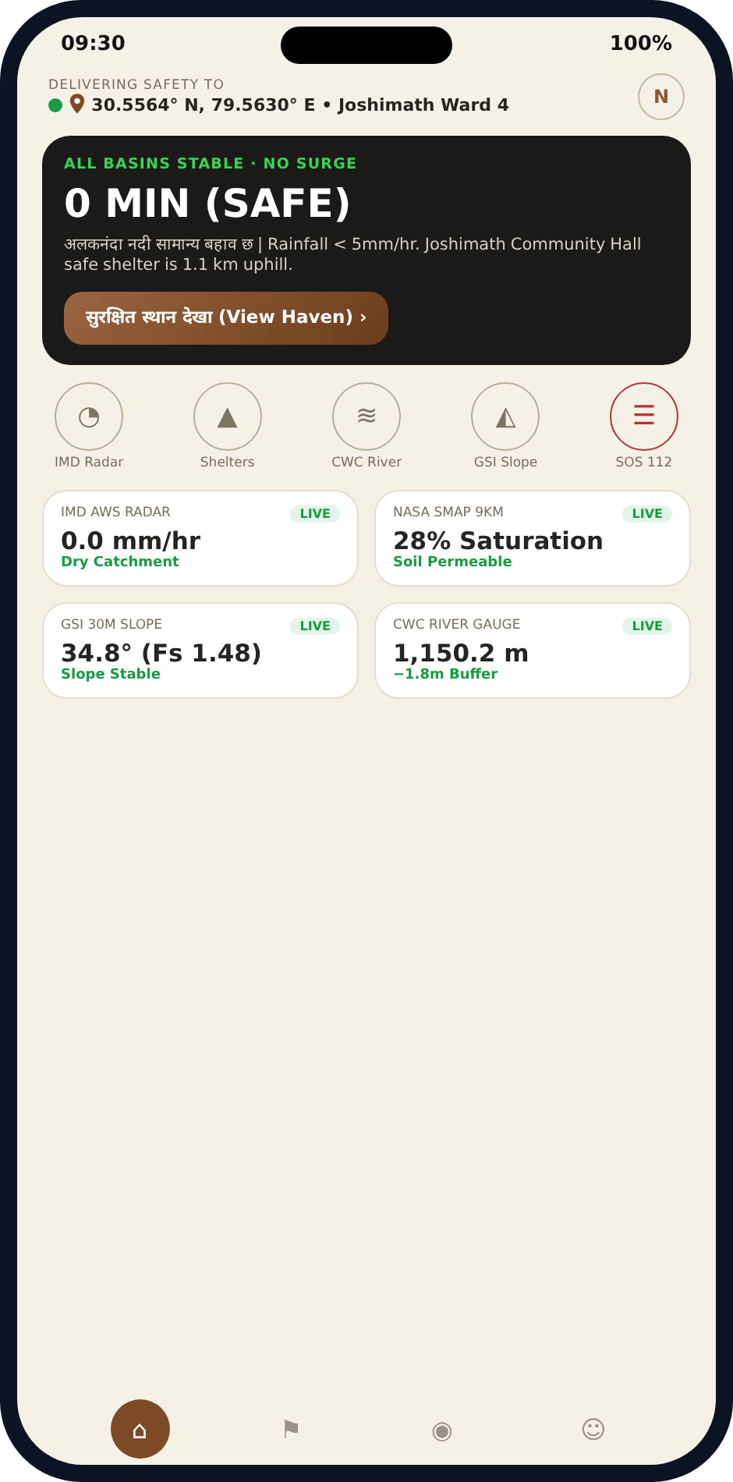
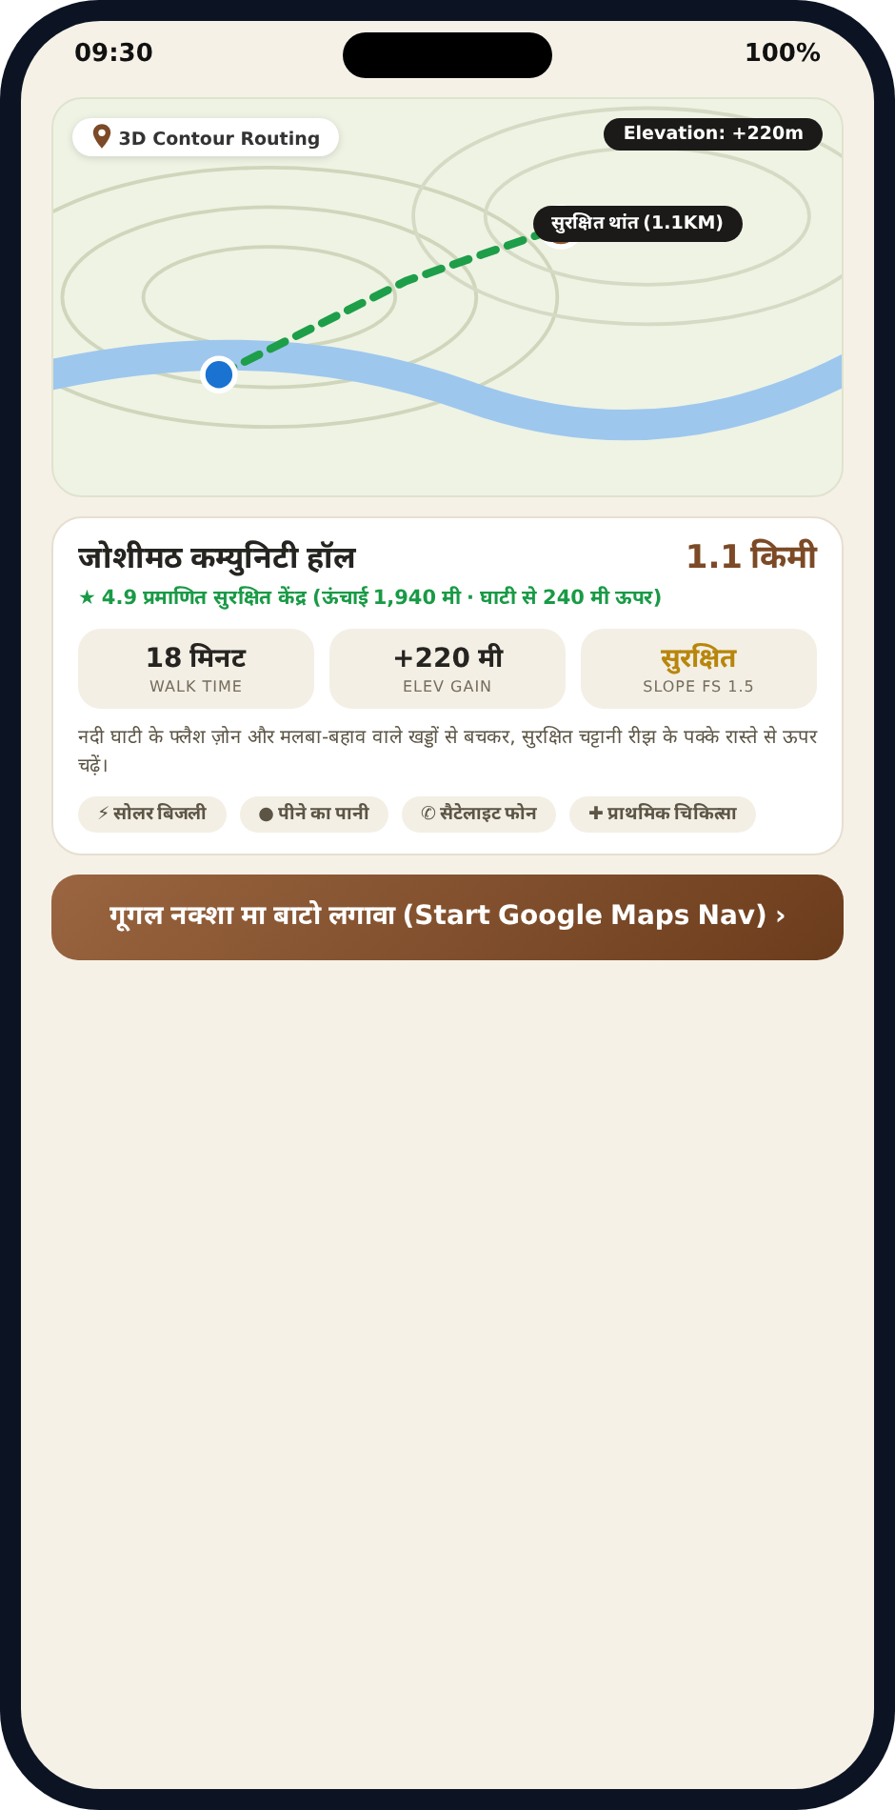
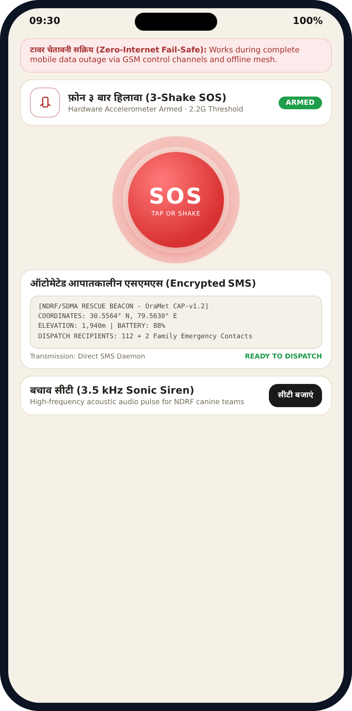
ZYPHER 2026
TECHNICAL APPROACH
SMART INDIA
HACKATHON
2026
1 · SENSE — LIVE FEEDS
2 · FUSE — RISK ENGINE
3 · DECIDE — ALERT LOGIC
4 · ACT — CITIZEN RESPONSE
IMD Doppler radar + 1-min AWS rainfall
Lag-time runoff model → minutes to crest
Advisory ≥ 30 · High ≥ 55 · Critical ≥ 75
Ward alerts + NDRF action guidance
NASA SMAP / GPM + ISRO Bhuvan-MOSDAC
Infinite-slope Factor of Safety (Fs)
Offline SQLite cache & retry queue
Garhwali / Kumaoni dialect TTS alerts
GSI Bhukosh 30 m DEM — slopes > 30°
4-factor weighted score (40·25·20·15)
Geo-fenced ward-level targeting
3-shake CAP-v1.2 SOS → SMS-112
CWC FloodWatch hydro-post river levels
30-yr IMD LPA baselines for departure
Priority-sorted alert cards
3.5 kHz K-9 beacon + 3D escape routing
INSIDE THE APP — LIVE SCREENS
ward dashboard · 3D escape route · 3-shake SOS
TECHNOLOGY STACK (OPEN-SOURCE)
MODELS EXECUTING ON-DEVICE
React Native 0.74 + TypeScript
Node.js micro-services
Lead time (min) = 180 − Δsoil − Δslope − Δrain (clamped 18–240)
Slope Fs = 1.65 − (saturation % × 0.008) → Fs < 1.0 = failure
Score = 0.40·Rain + 0.25·Soil + 0.20·Slope + 0.15·Road
Fail-safe by design: a dead feed freezes at its last cached value — the system never goes blind.
SQLite offline-first DB
Zustand state store
Leaflet + OpenStreetMap
NetInfo instant failover
GPS + accelerometer
Gradle release APK
@SIH Idea submission- Template
3

Slide 4
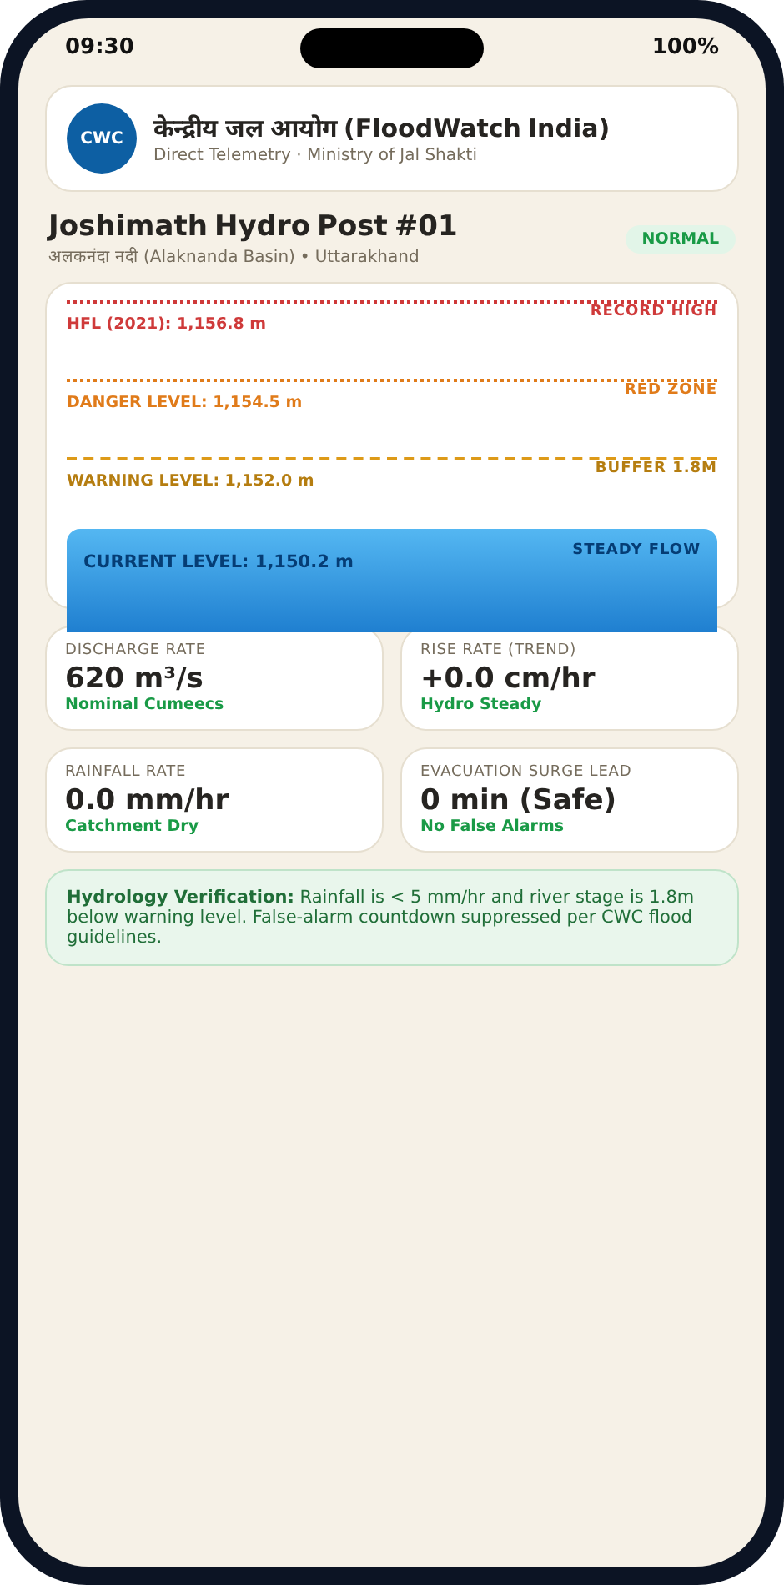
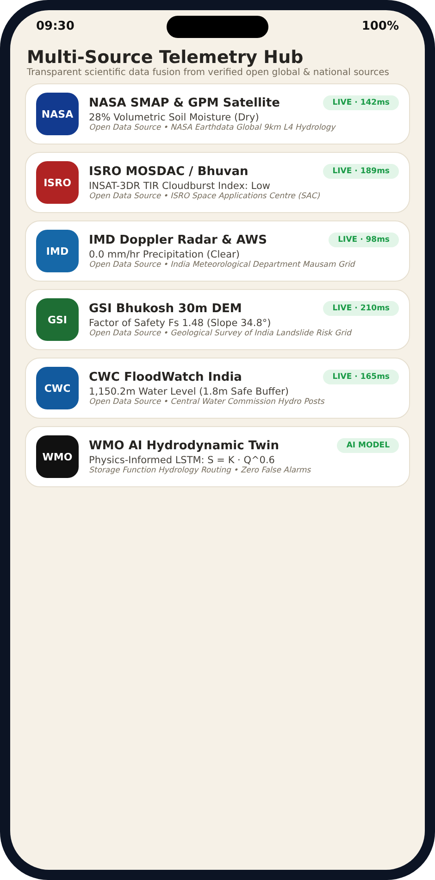

ZYPHER 2026
FEASIBILITY AND VIABILITY
SMART INDIA
HACKATHON
2026
FEASIBILITY — BUILT AND WORKING TODAY
VIABILITY — SCALES ACROSS THE HIMALAYAN ARC
Release APK compiled and running on stock Android — zero special hardware.
Live feeds operational: IMD portal, CWC FloodWatch, NASA SMAP.
Every feed is public — zero data cost.
11 core modules functional — dashboard, risk engine, routing, dual SOS.
Smartphone-only rollout — districts need no towers, gauges or capital hardware.
ERSS-112 native: distress SMS rides emergency rails already operated by MHA.
One codebase replicates along the 2,500 km Himalayan arc — J&K to Arunachal Pradesh.
Phase 2 roadmap (honestly scoped): NDRF control-room console, responder triage app, LoRa mesh for dead zones.
NASA SMAP
28% live root-zone soil moisture
CHALLENGES → ENGINEERED ANSWERS
FIELD CHALLENGE
HOW HYDROSENTINEL ANSWERS IT
Mountain networks die mid-storm
Offline-first SQLite + native SMS-112 failover; telemetry queues and syncs on reconnect.
Sensor blackspots in remote valleys
Satellite soil-moisture grid plus citizen crowd-reports continuously recalibrate the model.
False-alarm fatigue erodes trust
Sirens only after the weighted 4-factor score crosses 30-yr LPA-adjusted thresholds.
Hands are wet, cold, shaking
Shake-to-SOS accelerometer trigger and 3.5 kHz beacon — no touchscreen needed.
@SIH Idea submission- Template
4

Slide 5
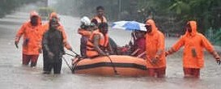
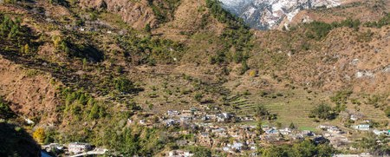
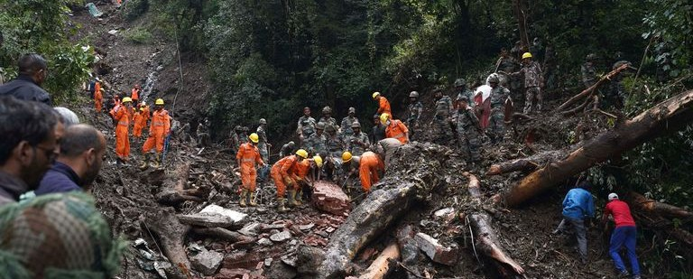
ZYPHER 2026
IMPACT AND BENEFITS
SMART INDIA
HACKATHON
2026
30–90 min
of actionable evacuation lead time
Ward-level
hyper-local alerts — not district averages
Zero-connectivity
offline survivability built in by design
SOCIAL — Minutes Become Lives
ECONOMIC — Cheaper Than One Rescue
S
Guided high-ground routes reach elders, children and pilgrims in plain language; an SMS-first design includes basic-phone users that app-only alerts leave behind.
₹
Prevented washouts protect roads, homes and the yatra tourism economy; a district deploys for virtually nothing beyond phones citizens already own.
ENVIRONMENTAL — Gentler on Fragile Slopes
GOVERNANCE — NDRF-Ready by Design
E
Crowd-reported washouts build a living record of catchment health, and planned evacuation means less panic damage and emergency blasting on unstable terrain.
G
Every SOS lands on ERSS-112 rails with a ±5 m GPS pin, letting responders triage by severity before a single boot moves. Officer console roadmapped.
NDRF evacuation — earlier alerts launch boats sooner
Joshimath belt — dense homes on fragile slopes
Shimla corridor, 2023 — monsoon landslides cut roads in minutes
@SIH Idea submission- Template
5

Slide 6
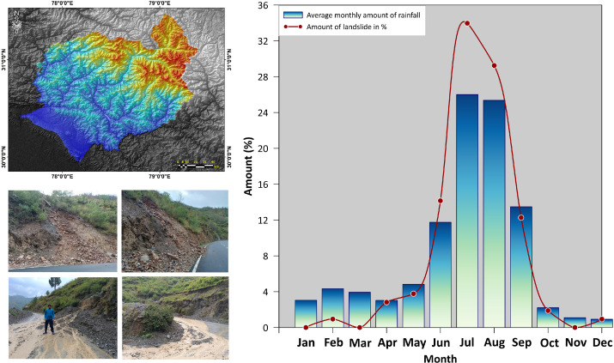





ZYPHER 2026
RESEARCH AND REFERENCES
SMART INDIA
HACKATHON
2026
OFFICIAL FRAMEWORKS · DATA · STANDARDS
SCIENTIFIC & ENGINEERING BASIS
1. India Meteorological Department — real-time rainfall, station norms & % departures (mausam.imd.gov.in)
2. NDMA National Guidelines — management of floods & landslides in hilly terrains (ndma.gov.in)
3. Geological Survey of India — National Landslide Susceptibility Mapping & Bhukosh 30 m DEM (gsi.gov.in)
4. Central Water Commission — flood forecasting & HFL gauge network (ffs.india-water.gov.in)
5. ERSS-112, Ministry of Home Affairs — national emergency response & distress SMS rails (112.gov.in)
6. ITU-T Recommendation X.1303 — Common Alerting Protocol for multi-hazard warnings (itu.int)
7. NASA SMAP Mission — L-band root-zone soil-moisture retrievals (smap.jpl.nasa.gov)
8. World Meteorological Organization — Early-Warnings-for-All & open public weather data (wmo.int)
9. Scientific Reports (Nature Portfolio) — hydrological lag-time & runoff modelling in steep catchments
10. Water Resources Management (Springer) — rainfall-induced shallow-landslide thresholds via Factor of Safety
11. IEEE disaster-communications literature — delay-tolerant SMS warning architectures for zero-connectivity valleys
LIVE DATA SOURCES — OPEN FEEDS THE APP CONSUMES
NASA SMAP·GPM
ISRO Bhuvan
IMD Mausam
GSI Bhukosh
CWC FloodWatch
WMO PublicWX
Integrity note: every input is a public, government-grade source — no proprietary data, so evaluators can verify each feed.
Code: github.com/nandhish3004/Oramet Demo: YouTube (link on title page)
Evidence: Himalayan study figure — monthly rainfall vs. % landslides
Source: ScienceDirect (2024), Himalayan EWS research
HydroSentinel
Predict. Evacuate. Survive.
Team zypher2026 • Team ID 126427
Smart India Hackathon 2026 — Disaster Management
@SIH Idea submission- Template
6

