Slide 1
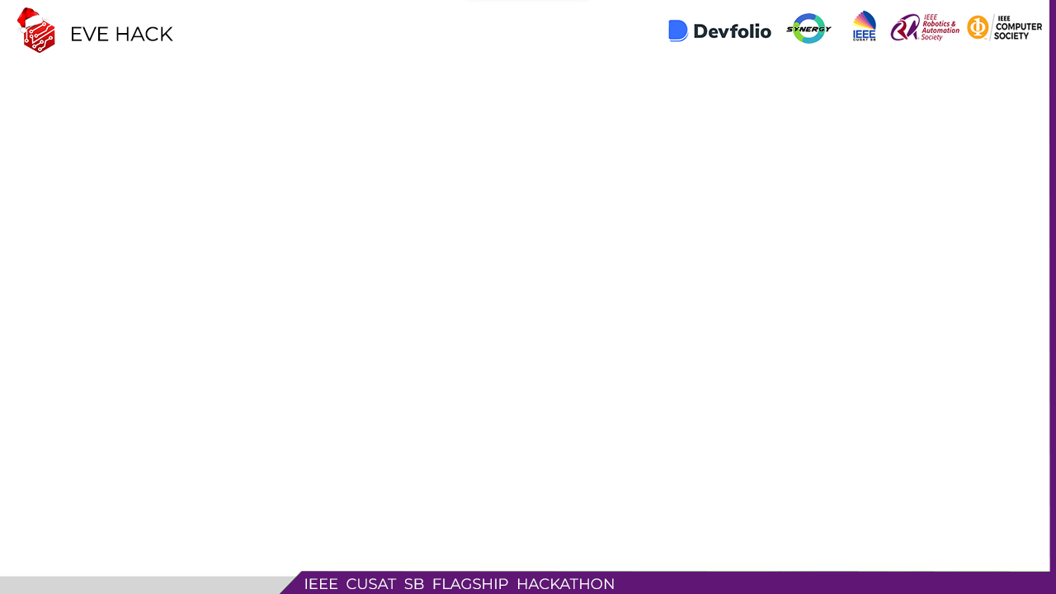
1
EVE HACK

Slide 2
TEAM DETAILS
2
TEAM NAME: Html Devs
TEAM MEMBER 1: MAILID: nandhukrishnana7@gmail.com CONTACT NO: 8086373905
TEAM MEMBER 2: MAILID: kjeldhose51@gmail.com CONTACT NO: 9747627110
TEAM MEMBER 3: MAILID: pruthvikanth007@gmail.com CONTACT NO: 8891369089
COLLEGE NAME: CUSAT

Slide 3
Improving Parental Visibility and Control in School Bus Transportation: A Real-time Tracking and Notification System
3
The problem statement "Improving Parental Visibility and Control in School Bus Transportation: A Real-time Tracking and Notification System" highlights the need for a solution that addresses the lack of visibility and control that parents have over their child's school bus transportation. The proposed solution is a real-time tracking and notification system that allows parents to track the location of their child's school bus in real-time and receive notifications when the bus arrives at the stop and when their child boards the bus. This would provide parents with the information they need to ensure their child's safety and peace of mind, and it would also give them the control they need to make informed decisions about their child's transportation.

Slide 4
EXISTING SOLUTIONS FOR THE PROBLEM
4
While there are a few solutions available to improve parental visibility and control in school bus transportation, such as GPS tracking systems, parent portals, and mobile apps, these solutions are not widely adopted and are not easily accessible in many parts of the world, including India. In many cases, schools and transportation departments in India lack the resources and infrastructure to implement these types of solutions. Additionally, in many cases the existing solutions are not integrated, and parents have to check different systems and platforms to get a complete picture of their child's transportation. The need for a more comprehensive and integrated solution that addresses the specific needs of the Indian market is becoming more pressing as the number of students and schools increase. There have been some implementations of GPS tracking and RFID systems in India but are still not widely adopted and lack of integration with other systems.

Slide 5
OBJECTIVES OF THE WORK
5
Create a real-time tracking system for parents to view the location of their child's school bus
Develop a notification system to inform parents about bus location and arrival time
Implement image scanning technology for student identification
Create a user-friendly interface for parents to access transportation information
Ensure privacy and security of student and parent data
Integrate the system with the school's management system
Provide a cost-effective solution for schools and transportation departments in India
Test and evaluate the system in a real-world setting.
Overall objective is to improve parental visibility and control over child's school bus transportation and ensuring student's safety.

Slide 6
IDEAS / SOLUTION / METHODS
7
Use GPS tracking devices for real-time bus location tracking
Implement notification system via email, SMS or mobile app
Use image scanning technology like facial recognition for student identification
Create user-friendly interface for parents to access transportation information
Implement security measures to ensure privacy and security of data
Integrate system with school management system for comprehensive view
Design cost-effective solution for easy adoption by schools and transportation departments in India
Test and evaluate system in real-world setting
Additional features like real-time video streaming, real-time chat communication with the driver and route optimization can also be considered.

Slide 7
UNIQUENESS OF THE IDEA?
8
The uniqueness of this idea lies in its comprehensive and integrated approach to addressing the problem of parental visibility and control in school bus transportation, with a focus on the Indian market. It incorporates innovative technologies like real-time bus tracking, notifications to parents, and image scanning for student identification. The integration of image scanning adds an extra layer of security and prevents outsiders from boarding. Additionally, the integration with the school management system provides a seamless and comprehensive view of the student's transportation and makes it more efficient for the school's administration. The system is designed to be cost-effective and easily adopted by schools and transportation departments in India, addressing the needs of this market specifically. It is tested and evaluated in a real-world setting to ensure effectiveness and usability.

Slide 8
TECH STACK / IMPLEMENTATION DETAILS
10
Backend: Node.js/Python for real-time tracking and notifications
Database: MongoDB/MySQL for storing data
GPS Tracking: Using devices installed on buses
Image scanning: OpenCV for facial recognition
Web/Mobile App: React/React Native for user-friendly interface

Slide 9
15
THANK YOU

