Slide 1

NETWORK VULNERABILITY SCANNER
STUDENT NAME
PROJECT GUIDE
Dr.K.SRINIVASAN
Assistant Professor and Head of the
Department Of Computer Science,
Govt.Art’s And Science College,
Pennagaram.
NANDHAUMAR .G
21PG171CSC010
II M.Sc.(CS)
Dept. of Computer Science
Govt.Art’s And Science College,
Pennagaram.

Slide 2
CONTENTS
Synopsis
Introduction
Exiting System
Proposed System
Module Description
Input / Output
Conclusion

Slide 3
SYNOPSIS
A vulnerability scanner is a computer program designed to assess computers, networks or applications for known weaknesses. These scanners are used to discover the weaknesses of a system. They are utilized in the identification and detection of vulnerabilities arising from mis-configurations or flawed programming within a network based asset such as a firewall, router, web server, application server, etc.

Slide 4
INTRODUCTION
As time passes, the world is becoming more connected due to internet and new networking technology. Due to open nature of Internet, security of network has hold attention. With the development of new technologies, organization is now moving its business functions to public network, and thus a huge amount of personal, commercial and organization’s information are available on networking infrastructures worldwide.
Network scanning is fundamental for gathering information about the real state of computer systems or networks
Vulnerability Assessment is a systematic analysis of security status of Information systems

Slide 5
SYSTEM SPECIFICATION
HARDWARE SPECIFICATION
System : AMD Pro (A4) – 2.5 GHz.
Hard Disk : 512GB.
Monitor : 15 VGA Color.
Mouse : Standard PS/2 Keyboard.
RAM : 4GB.

Slide 6
SOFTWARE SPECIFICATIOn
Operating System : Linux any version
Language - Front end : shell

Slide 7
EXISTING SYSTEM
Initially system administrators have to check the computer services and application code of every computer in person. Moreover they have to maintain information regarding the accounts and transaction of all the customers manually. Doing this manual transaction was really tedious job. This process is time consuming and it requires a great manual effort

Slide 8
DRAWBACKS
More time is consumed
More hard work

Slide 9
PROPOSED SYSTEM
This system tends to replace the drawbacks of existing system with the help of vulnerability scanning process which offers less timeconsuming, less interactive and less expensive. The main feature of this system is scanning various type of network based vulnerabilities and generates a report of scanned network.

Slide 10
ADVANTAGES
Less effort to complete scanning
Less time required and user friendly
Fastest Scanner

Slide 11
MODULE DESCRIPTION
A module is a collection of source files and build settings that allow you to divided your project into discrete units of functionality which provides a container for your apps source code, resource files, and app settings such as the module –level build file and computer manifest file.
This project includes 7 modules. They are

Slide 12
Ping Scan:
This module is mainly used to check whether the system is in ON or OFF mode through the internet.
Simple Port Scan:
This module helps to know the opened or closed status of all the ports.
Version Detection:
This module is mainly used to detect the version of running port in computer

Slide 13
Os scan:
This module helps to find or guess the operating system running on the network
Vuln scan using all ports:
This module helps to scan all the ports and states whether ports have vulnerabilities or not vulnerabilities

Slide 14
Aggressive Scan (or) Deep Scan:
This module is mainly used to scan the network in terms of deep scan or full scan.
EXIT:
This module helps to quit the application

Slide 15
SAMPLE CODE
#! /bin/bash
#echo " -------------------------------------------------------------------------------------------“
echo -e "\e[1;33m Miss(@&%*#+=)you ):- \e[0m"
#echo -e "\e Vulnerability Detection Tool \e “
#echo " "echo -e "\e[1;33m CREATEDBY: missyou()\e[0m
#INFINITE LOOP
for (( ; ; )) do
{ #STARTIN G
echo -e "\e[1;33m [0] Ping Scan (Check Whether Host is Up)\e[0m“
echo -e "\e[1;33m [1] Simple Port Scan \e[0m“
echo -e "\e[1;33m [2] Stealth Port Scan \e[0m
echo -e "\e[1;31m [3] Version Detection\e[0m“
echo -e "\e[1;33m [4] Whois Lookup \e[0m“
echo -e "\e[1;31m [11] Aggressive Scan (or) Deep Scan \e[0m“
echo -e "\e[1;35m [x] EXIT \e[0m"

Slide 16
echo "Enter your Option:"
read option
if [ "$option" = 0 ]; then
nmap -sn $iptarget fi
if [ "$option" = 1 ];
Then
sudo nmap -p 1-1000 $iptarget
if [ "$option" = 2 ];
Then
sudo nmap -sS $iptarget
fi
if [ "$option" = 3 ];
then nmap -sV -Pn -T4 $iptarget

Slide 17
if [ "$option" = "x" ];
then
echo "Quitting (OR) miss you):-"
break fi echo " " read -n 1 -s -r -p "Press any key to continue..."
Clear
}
done

Slide 18
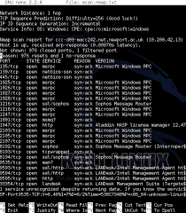
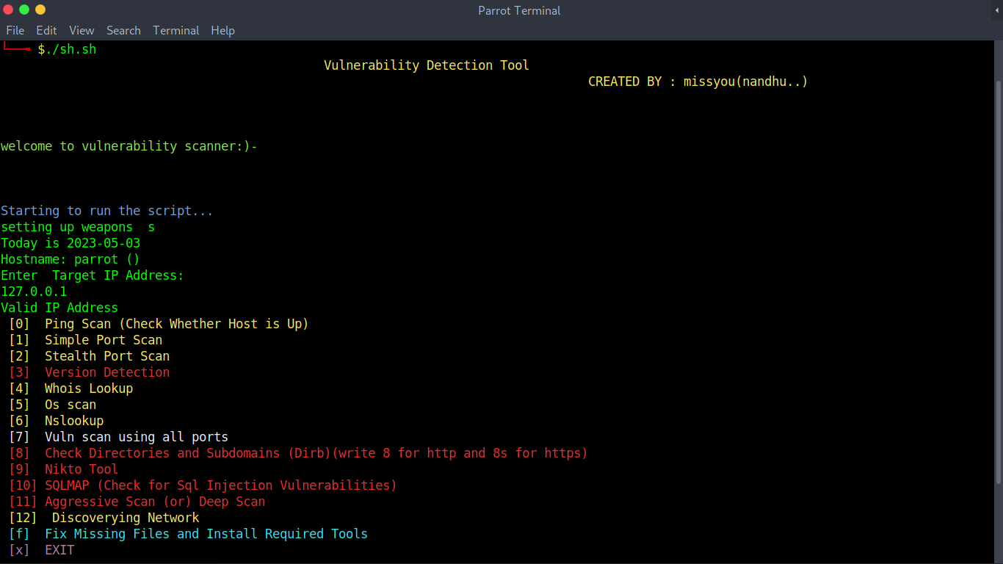
SAMPLE INPUT

Slide 19
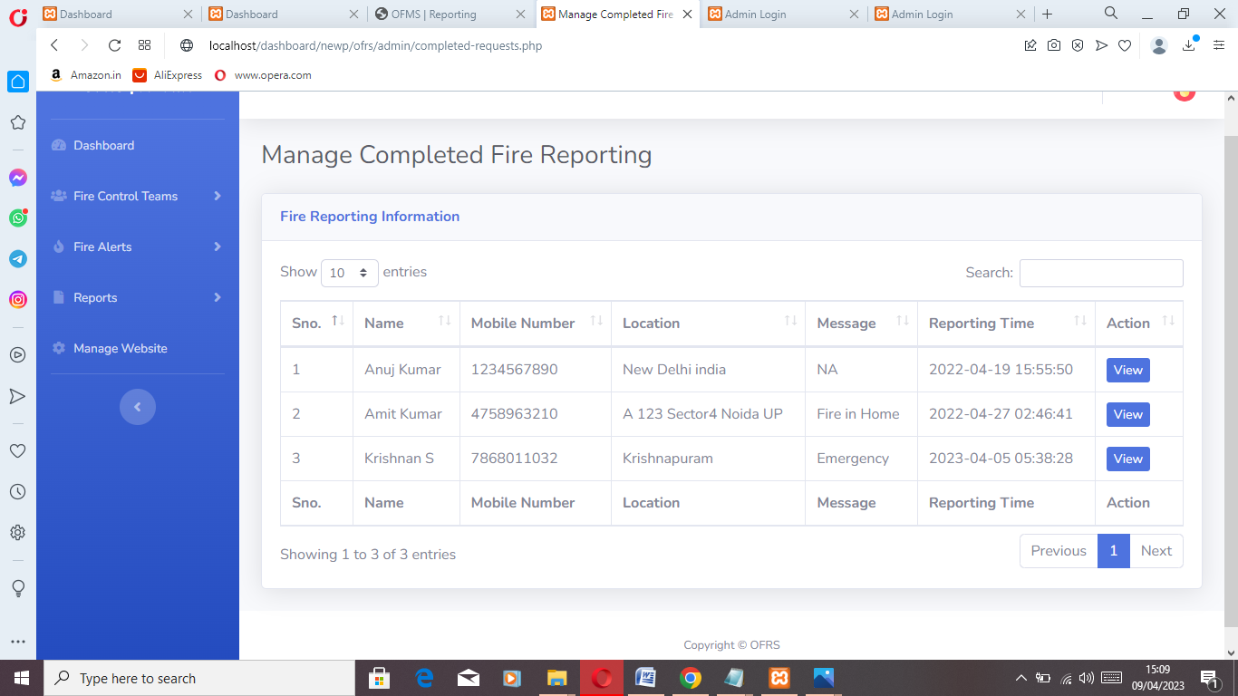
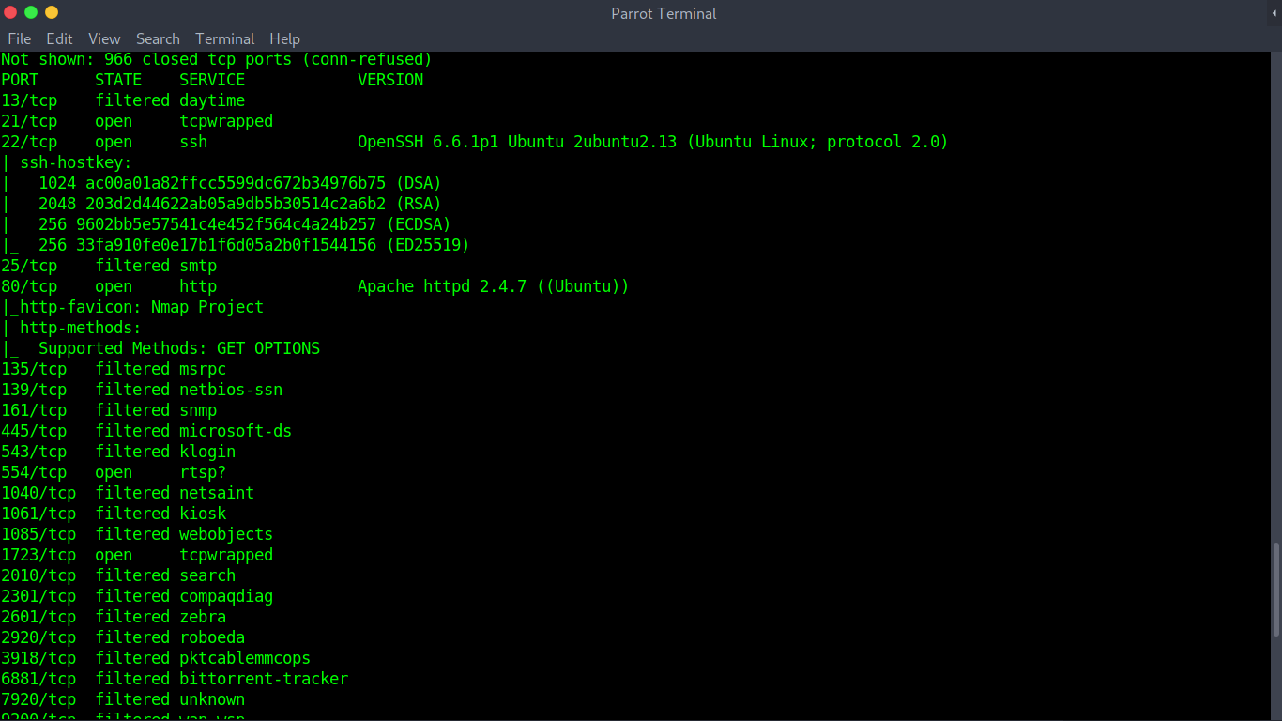
SAMPLE OUTPUT

Slide 20
CONCLUSION :
Every day, vulnerabilities are found in commonly used software products. A network scanner developed in this project is an application which is used to scan the network and report any identified vulnerabilities It is a web-based GUI which deals with two important aspect of network security are network scanning and vulnerability assessment

Slide 21
Future Scope
Improved accuracy and speed
Integration with other systems
Real-time monitoring
Community engagement
Data analysis

Slide 22
Thank you

