Slide 1
NAAN MUDHALVAN -GENERATIVE AI PROJECT AI CUSTOM DRAWINGS CLASSIFIER WITH PYTHON
Presented By:
Name: Nandini B Reg.No : 2021503321

Slide 2
Outline:
Problem Statement.
Objectives.
Proposed System.
System Approach.
Algorithm And Deployment.
Implementation.
Result.
Conclusion.

Slide 3
Problem Statement:
This project aims to build a python-based AI for classifying user drawings. It will use image processing and feature extraction to train a model (potentially a CNN) on user-defined categories (not just basic shapes).
The model will then predict categories for new drawings. Success will be measured by accuracy, precision, and recall.
This has applications in education, and creative assistance. The model will use this knowledge to predict categories for entirely new drawings. This has exciting possibilities for education, augmented reality, and even creative tools.

Slide 4
Objectives:
In Python builds a machine learning classifier for custom drawings.
It utilizes techniques like image preprocessing, feature extraction, and classification algorithms (e.g., CNNs) to categorize user-created drawings into predefined categories.
The goal is to create a user-friendly system that accurately interprets and classifies unseen drawings based on the learned patterns from training data.
The effectiveness will be evaluated using standard metrics like accuracy and precision.

Slide 5
Proposed system:
Define the classes for custom drawings.
Set up the project environment and dependencies.
Graphical User Interface (GUI): Create a GUI where users can draw and save samples for training the model.
Implement functionalities for drawing and saving images.
Training the Model: Preprocess the training data, including resizing, normalization, and augmentation.
Choose a suitable classification algorithm, like Convolutional Neural Networks (CNNs).
Train the model on the collected datasets to learn patterns and relationships.

Slide 6
Proposed system:
Making Predictions: Develop a prediction mechanism to categorize new, unseen drawings based on the trained model.
Evaluate the model's accuracy and performance in predicting custom drawings.
Saving and Loading: Implement functionality to save and load the trained model for future use.
Ensure the system can store and retrieve the necessary data for classification.

Slide 7
System Approach:
In this approach are:
System Overview.
Processing Pipeline.
Output and Applications.
System Overview:
Input: User-created drawings (varied styles, potentially unseen).
Goal: Interpret and categorize drawings.

Slide 8
System Approach:
Processing Pipeline:
Preprocessing: Clean and prepare drawings (resize, normalize).
Feature Extraction: Identify key characteristics (shapes, lines, etc.).
Classification: Analyze features and assign categories (e.g., CNN).
Output and Applications:
Output: Category label for the drawing.
Applications: Educational tools, AR experiences, creative assistants.

Slide 9
Algorithm And Deployment:
Data Collection & Labeling.
Preprocessing the Drawings.
Feature Extraction – Capturing.
Selecting & Training the Model.
Evaluating Testing & Refining.
Data Collection & Labeling:
Gather a variety of user drawings across predefined categories (beyond basic shapes).
Label each drawing with its corresponding category (e.g., animal, vehicle).

Slide 10
Algorithm And Deployment:
Preprocessing the Drawings:
Resize images to a uniform size, and convert them to a common format like grayscale.
Normalize pixel values to a consistent range (0-1) to improve numerical stability and feature scaling. For small details, consider additional preprocessing techniques to enhance model performance in computer vision tasks.
Feature Extraction – Capturing:
Shape recognition (identify and extract shapes like rectangle , circles).
Edge detection (capture edges and outlines).
Statistical features (calculate aspect ratio, number of closed shapes).

Slide 11
Algorithm And Deployment:
Selecting & Training the Model:
A classification algorithm suitable for image recognition:
Convolutional Neural Networks (powerful for complex recognition).
Support Vector Machines (efficient for smaller datasets).
Split your data into training and testing sets.
Train the chosen model on the training data, allowing it to learn the relationships between extracted features and category labels.

Slide 12
Algorithm And Deployment:
Evaluating Testing and Refining:
Use the testing set to assess the model's performance:
Accuracy (correctly classified drawings).
Precision (true positives among identified positives).
Recall (true positives identified by the model).
Analyze results and iterate on steps 2-4 (preprocessing, feature extraction, model training) if needed to improve performance.

Slide 13
Implementation:
Data Gathering and Labeling:
Define Categories: Create a Python list with predefined categories.
User Interface: Implement a basic window using tkinter for drawing submission.
Button/Dialog: Add a button or file selection dialog for drawing submission.
Category Selection: Provide dropdown or buttons for users to choose drawing categories.

Slide 14
Implementation:
Data Gathering and Labeling:
Define Categories: Create a Python list with predefined categories.
User Interface: Implement a basic window using tkinter for drawing submission.
Button/Dialog: Add a button or file selection dialog for drawing submission.
Category Selection: Provide dropdown or buttons for users to choose drawing categories.

Slide 15
Implementation:
Preprocessing the Data:
Resize Function: Write a function to resize images to a target size.
Load Image: Use PIL to open images from file paths.
Resize Image: Resize opened images to the target size.
Optional Grayscale: Include an option for converting images to grayscale.
Pixel Data Extraction: Convert resized images to flat lists of pixel values.

Slide 16
Implementation:
Feature Extraction:
Choose Feature Extraction Method: Decide on a method such as shape recognition.
Shape Recognition (Example): Utilize libraries like OpenCV for shape detection.
Shape Detection: Implement shape detection using cv2.findContours.
Feature Extraction (Example): Extract shape properties (size, position) as features.
Model Selection and Training:
Research Algorithm: Choose a classification algorithm (e.g., CNN with TensorFlow).
Data Splitting: Split labeled data into training and testing sets.

Slide 17
Implementation:
Basic Model Structure: Start building the model with chosen library (e.g., define CNN layers).
Train the Model: Train the model on training data to learn feature-category relationships.
Model Evaluation - Checking Performance:
Test the Model: Assess model performance on unseen data.
Accuracy Calculation: Calculate accuracy using libraries like scikit-learn.
Optional Metrics: Explore precision and recall metrics.
Analyze Results: Review accuracy and metrics for performance evaluation.

Slide 18
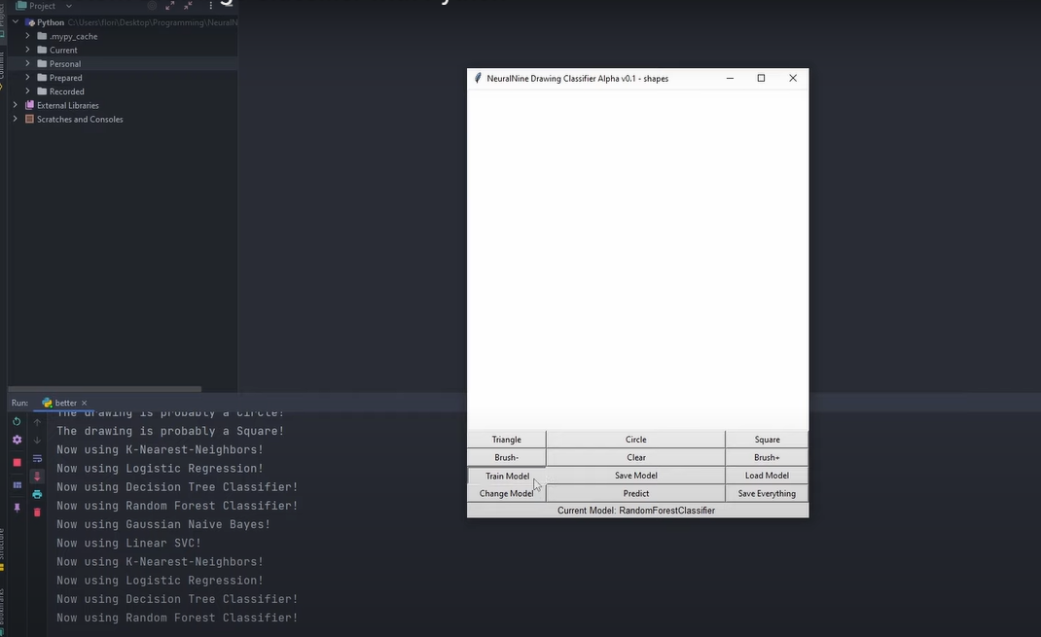
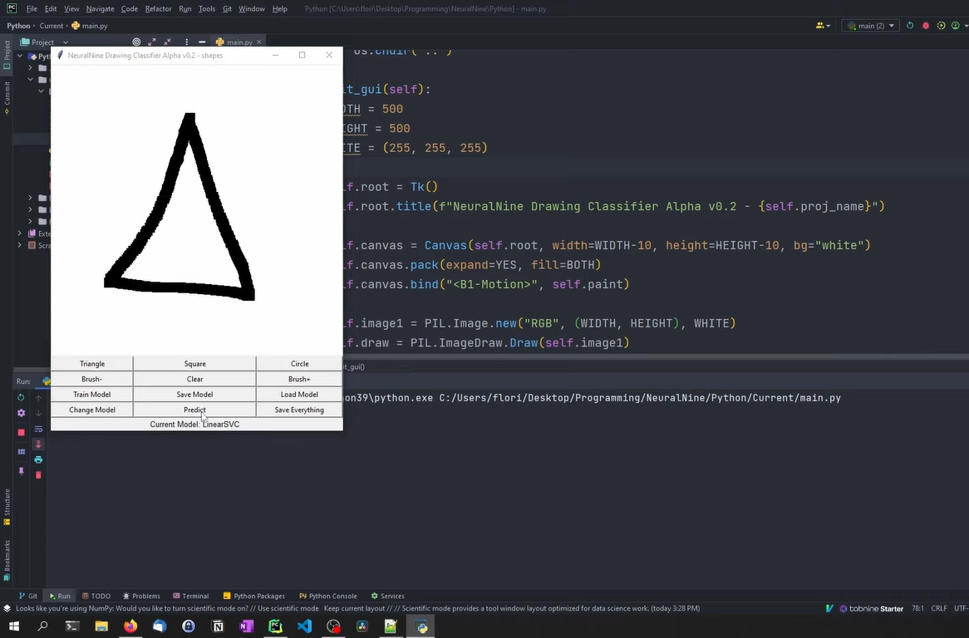
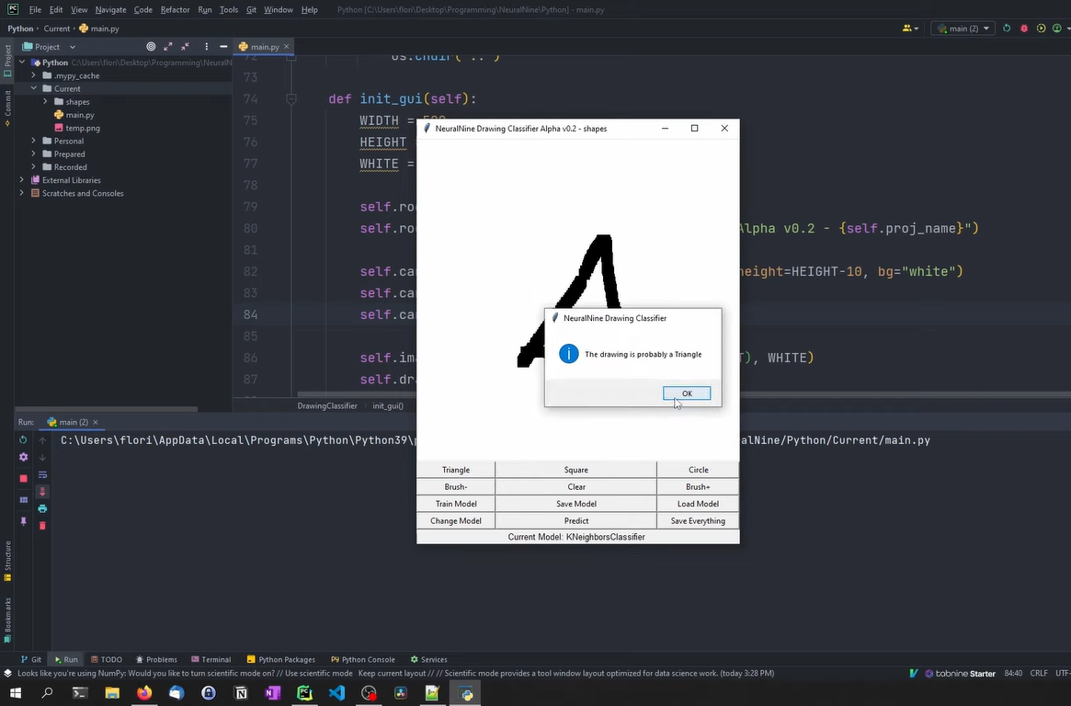
Results:

Slide 19
Conclusion:
The AI Custom Drawings Classifier, developed in Python, uses machine learning techniques such as preprocessing and Convolutional Neural Networks (CNNs) to accurately categorize user-created drawings. It employs evaluation metrics to ensure the model's reliability and can be applied to various fields, including education, augmented reality, and creative assistance. This project showcases the capability of machine learning in comprehending and interacting with visual data, offering promising applications across different areas.
Link:https://github.com/nandhu7-2003/Gen-AI/blob/main/Output%20NM%20Drawing_classifier.pdf

Slide 20
Thank you

