Slide 1
Who Gets a Chance at The Vaccine?
ISTE 600

Slide 2
Tanner Peterson, Nandhini Nagarathinam, and Sai Preetham Reddy Leburu
Agenda
Introduction/Problem Description
Data Exploration
Methodologies
Logic of Problem
Conclusion

Slide 3
Problem
Do socioeconomic indicators impact the number of people that are receiving the vaccine?
Motivation
COVID-19 has changed our lives significantly over the past year. Interested if we can use public data to tell us a story of who is receiving a vaccination.
Notes:
The COVID-19 global pandemic is a problem that has been impacting the world for over a year. A problem that started out trying to contain, test, minimize death, has now become an issue of how to create herd immunity. The problem is how many people are getting a vaccination to obtain immunity.
Key question is: With vaccines available to help resolve the COVID-19 global pandemic, the question now is what countries are receiving a vaccine. Do socioeconomic indicators have an impact on the number of vaccines countries are administering to their population
Purpose: The goal in reasoning this issue is to see on the global level which countries are administering vaccines to the public. Focus is to educate ourselves with publicly available data if socioeconomic factors do impact the vaccine rollout on the global level. Which countries are succeeding in administering the vaccine and do they have an advantage based on socioeconomic indicators.

Slide 4
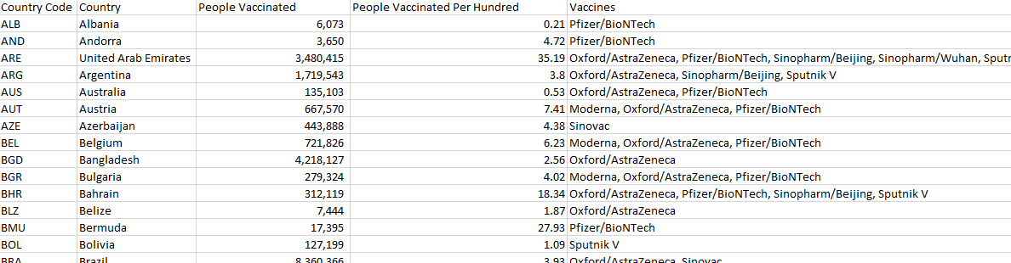
Data Exploration
Country Data
Notes:
https://www.kaggle.com/gpreda/covid-world-vaccination-progress?select=country_vaccinations.csv
Country data set for vaccinations was from Kaggle and collected from Our World in Data GitHub. The data was very messy with days that nothing were reported were blank and did not carry over grand totals. To get this to be usable we put this into SQL and grouped by max date that did not have null values.

Slide 5
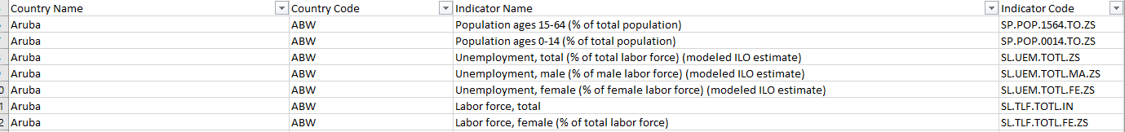
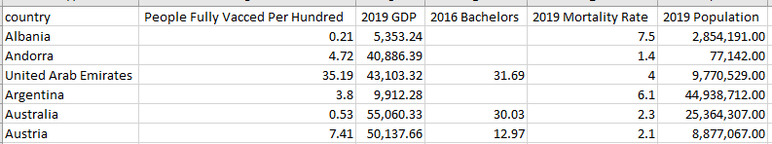
Data Exploration
Country Socioeconomic
Notes:
World Bank has great data for countries. Endless amounts of socioeconomic data points to choose from. We used an education dataset, economy, and population. Within each of these we had to filter for the indicator name that made most sense for what we were attempting to achieve. We then combined the most recent and complete into a dataset.

Slide 6
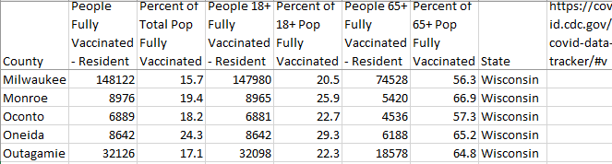
Data Exploration
County Vaccine
Notes:
The CDC has a great interactive map for tracking county level COVID details and included vaccination data. Only downside is that they only allow you to download one county at a time so aggregating this dataset took some time.

Slide 7
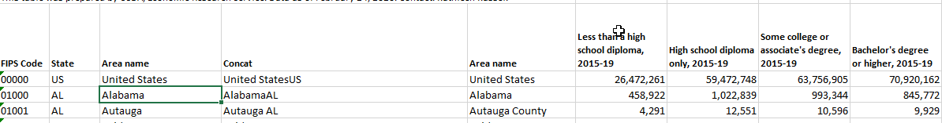
Data Exploration
County Socioeconomic
Notes:
Economic Research Service has similar socioeconomic datasets like what the World Bank publishes at the global level. Again, there are many attributes we needed to sift through to find like features that we wanted to test but were able to get it for all the counties in the country.
We aggregated these into one dataset that we could use for this project.

Slide 8
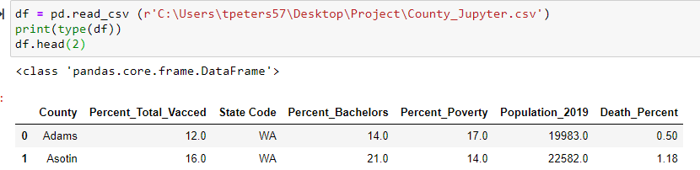
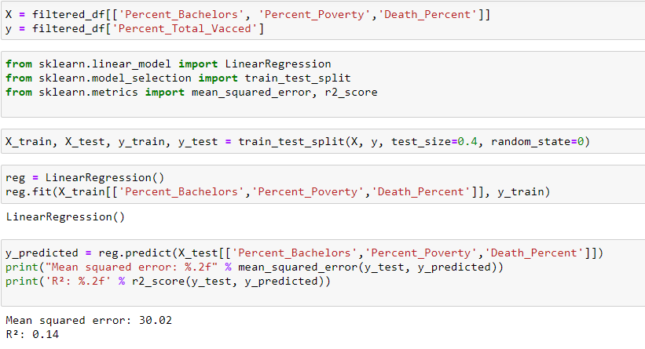
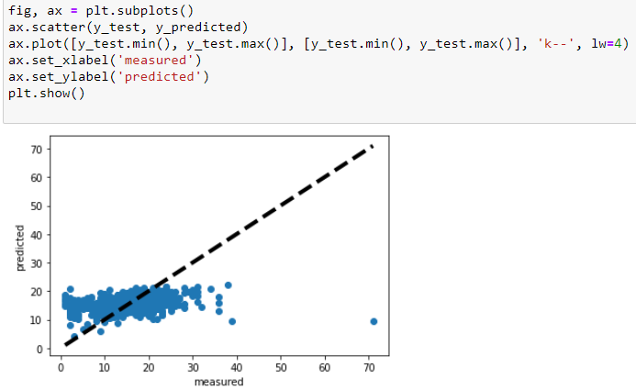
Methodology Linear Regression
Notes:
Imported pandas, numpy, scipy, and sklearn. Loaded the dataset into a pandas dataframe and dropped null values.
Labeled our target variable y and used the features from the dataset that are socioeconomic indicators.
Using the linear regression packages, test train split, and performance measures you can split the dataset to test/train like you can in weka. Random state is how many random cross validations you want to do on the dataset. Started out with 0. We ran this with many different iterations to see if we could increase the fit R^2 and decrease the MSE.
Visually you can see the fit is not particularly well. You want results to have a better linear relationship. Lets look at how the features are performing to see if there is some statistical significance to the model.

Slide 9
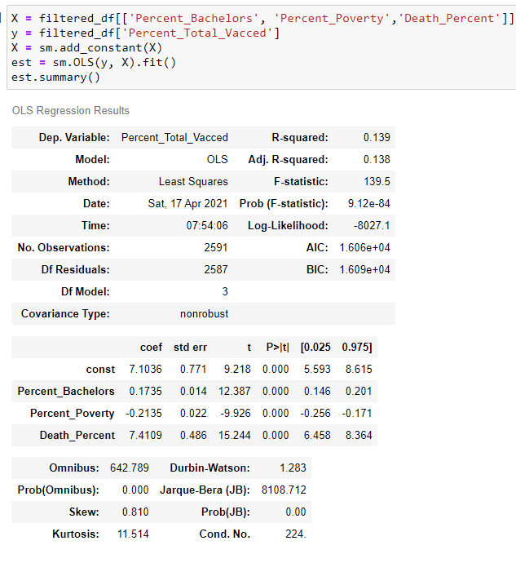
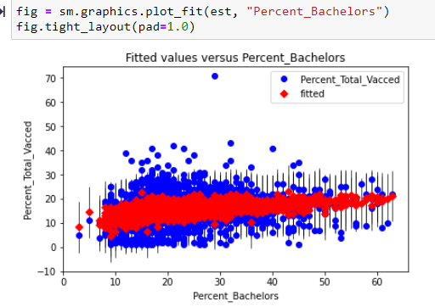
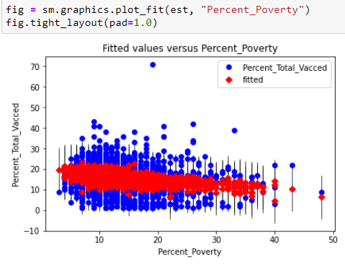
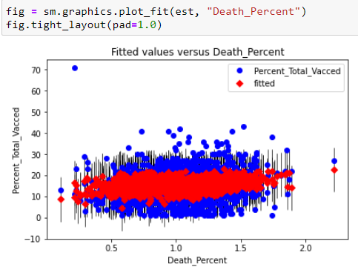
Methodology Linear Regression
Notes:
Using ordinary least squares in the statsmodels package you can see the r^2 without any performance tuning is the same around .14.
What this gives us is a summary view similar to what you would get if you ran this using R programming. What is important is to look at the P values. This shows us if our features are actually good predictors for our model and helps us know now that we can reject the null hypothesis and our model is better than not having a model at all. The fit is bad, but the P values are very small, they are not zero but very small.
You can see visually that some are fit, but have a lot of variation that was not fit if you look at the plots.

Slide 10
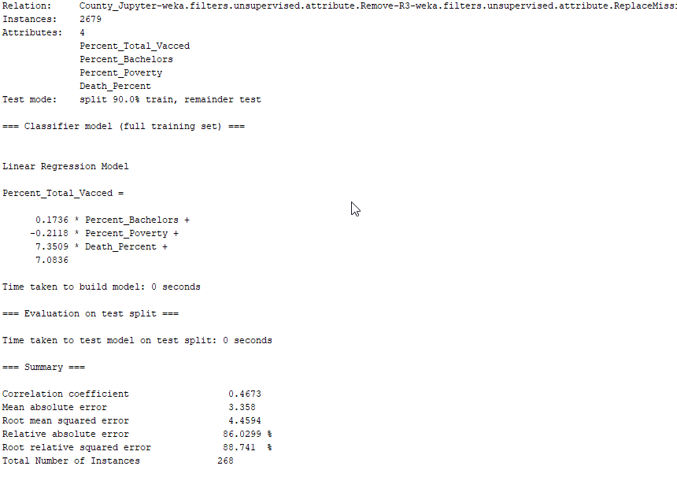
Methodology Linear Regression
Notes:
Using WEKA from class we loaded the same dataset that was used in the Jupyter Notebook. Instead of dropping null values we used the replacemissingvalues filter that uses the mean to assign the missing values. We ran the same tests/cross validations steps to see if we could improve the model. Using WEKA the R value is in the summary rather than R^2.
R is the correlation of predicted values while R² indicates percentage of variation of our model that we explained above as not a good fit. Root mean squared error (RMSE) was also used a performance measure because it assists how close the data are to the model predicted values. Lower values indicate a better fit. In every test case there was a high RMSE, which in turn shows that not only is the model not a good fit, but each point was far away from the actual value. This model is not a good performer.

Slide 11
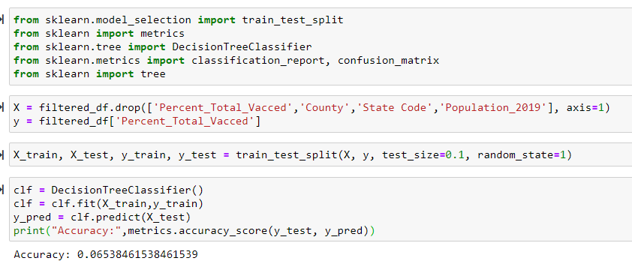
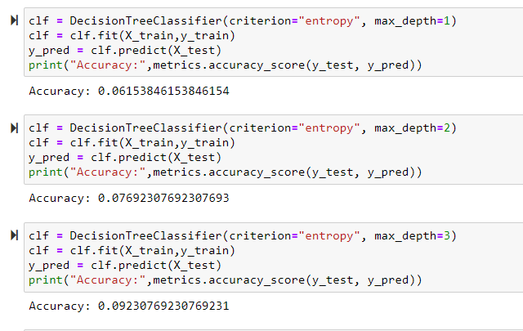
Decision Tree
Notes:
The next algorithm we used to test was a decision tree. Sklearn tree package allows you to use similar syntax as the linear regression where you can test train split/random state. You can print to see how accurate the prediction is. You can see here the accuracy with no tuning is 6.5%, relatively bad prediction. Not surprising based on the poor fit we saw in the previous linear regression model.
The next steps we took to increase accuracy was to use entropy to limit the max depth of the tree. You can see the best accuracy was with the depth of 3 where we increased to 9%.

Slide 12
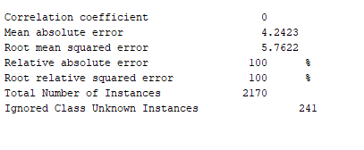
Regression Tree
Notes:
Using WEKA there is a tree REPTree which is a linear regression tree. The same test cases were used with this algorithm, test 10%10%/20%/30%/40% as well as cross validation with different number of folds. The highest performance was using 7 folds with R of .3 and RMSE of 5.5,This is still a very poor model and has shown the predictability is not high in every test we performed.

Slide 13
Logic of Problem
Key question and purpose stayed align in do socioeconomic factors increase the number of people vaccinated but using these steps we could refocus with more information and proceed through our analysis.
Pros
Straight forward problem solving with analytical thinking.
Allows us to think about bias and motivation
Recommendation
In information, look at what has been solved for this issue already.
Add measurability to see if our goal can be measured.
Notes:
Working through this analysis while using the logic of the problem toolset has been a positive experience. Before any data was collected, we identified a problem that is the COVID-10 pandemic. At the time of this class vaccine rollout was ramping up and sparked interest to see if there as an even distribution of vaccinations worldwide. Starting with a problem so large our first data checkpoint contained too many variables that were redundant. We sifted through those but were still running into issues come checkpoint three. It was apparent that our logic of problem needed to be updated with a larger dataset than countries which put us back at the information element of thought. We collected United State County data and were able to get right back on track. Key question and purpose stayed align in do socioeconomic factors increase the number of people vaccinated but using these steps we could refocus with more information and proceed through our analysis.
Pros of using the logic of problem framework is that is straight-forward in the process of solving a problem. For example, you start with a key question, purpose or motivation, information, then touch on what point of view or bias are you adding in. If you go back to gathering information you move down through the same question again and can use this framework to keep your goal in mind while solving a problem.
Two recommendations to be added to the logic of problem are what has been done regarding this problem already and to add measurability. Many issues are being tackled by many different people and it would be interesting as a step to gather information that others have analyzed already toward the question and purpose. It would also help justify writing the question in the first place to study something slightly different that what has already been produced. Measurability would assist during this framework to see if our goals of solving the problem are measurable or not.

Slide 14
Conclusions
Patterns
Accuracy/fit was low and increased minor with different test/train/split or folds
Larger the test size, poorer performance
Linear regression performed better than a tree with this dataset
Do socioeconomic indicators increase the number of vaccinations?
Using education, poverty levels, and mortality turned out to not be the best indicators to predict vaccination numbers.
If we continued…
Different datasets that were at an individual level, not aggregated.
Notes:
While running through both linear regression and decision trees the same issues were apparent with the features that we have selected to use to predict vaccinations. Those issues are that we had a high variance of predicted outcomes that lead to a very poor fitting and low accuracy model. A pattern that showed up was the larger the test group we tested, the higher the variability on a large scale. This is expected but with a poor fitting model it was more apparent.
The Python models worked better in particular because they can be controlled and touch on more statistics that what WEKA outputs as a summary. Between the actual model’s, multiple linear regression using the sklearn package had the highest R² values. This is not a surprised because all our data was numeric and linear regression is a good choice to help predict a numeric outcome.
At a United States county level, using education (% of pop that obtained a bachelor’s degree), poverty (% of poverty for that county), and mortality (% death per year), used to predict the total number of vaccinations per hundred turned to not show high predictability. The model had poor fitting using linear regression and less than 10% accuracy while using decision trees. That said, we still must reject the null hypothesis because the p values assigned to each of these three variables were very low. They still showed statistical significance as features in our model. Using this model with a poor fit is still better than no model at all.
If we were to continue this project, it would be exciting to find more rich datasets that included non-aggregated data and an individual level. Knowing socioeconomic variables at an individual level comparing their socioeconomic status to where they live could help truly answer the question of, “do socioeconomic factors increase the number of people getting vaccinated?” Even more interesting would have data of a specific home state and create a decision tree of who got vaccinated Y/N. Many questions and answers can be used to help us as we navigate towards ending this pandemic the next year and these studies would be very interesting with the data mining techniques we have learned in this course.

Slide 15
Works Cited
1. Preda, Gabriel. “COVID-19 World Vaccination Progress.” Kaggle, 14 Mar. 2021, www.kaggle.com/gpreda/covid-world-vaccination-progress.
2. “Education .” World Bank, World Bank, data.worldbank.org/topic/4.
3. GDP per Capita (Current US$).” World Bank, World Bank, data.worldbank.org/indicator/NY.GDP.PCAP.CD.
4. “Mortality Rate, Neonatal (per 1,000 Live Births).” World Bank, World Bank, data.worldbank.org/indicator/SH.DYN.NMRT.
5. “CDC COVID Data Tracker.” Centers for Disease Control and Prevention, Centers for Disease Control and Prevention, covid.cdc.gov/covid-data-tracker/#vaccinations.
6. “Download Data.” USDA ERS - Download Data, www.ers.usda.gov/data-products/county-level-data-sets/download- data/.

