Slide 1
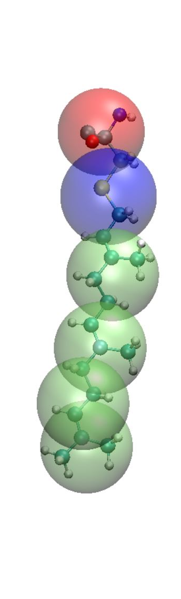
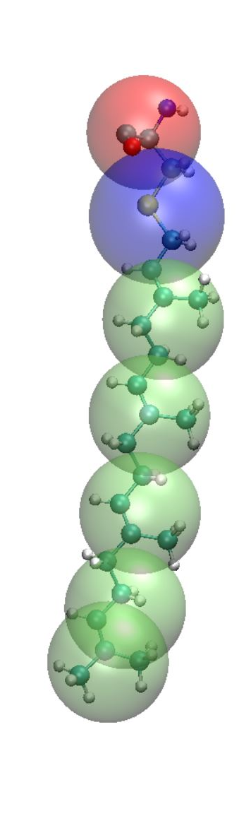
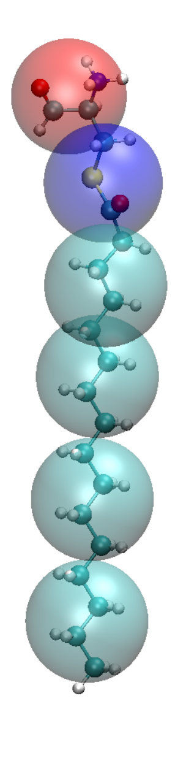
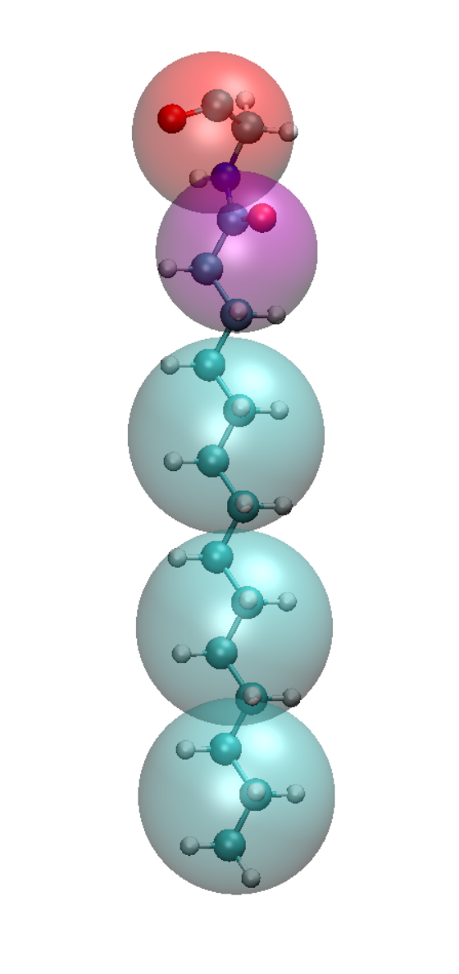
Mapping Schemes
CYSP CYSF CYSG GLYM
P5
P5
P5
Nda
Na
C5
C5
C5
C1
C3
C3
C1
C1
C3
C3
C1
C1
C3
C3
C1
C3
C1
C3
C3

