Slide 1

AI-Based Campus Navigation and Indoor Location Assistance System
For Academic Buildings and Laboratories
Helping students, faculty, and visitors locate destinations and navigate large academic campuses efficiently.
NANDIKI SAI PARDHU REDDY 324129510040

Slide 2
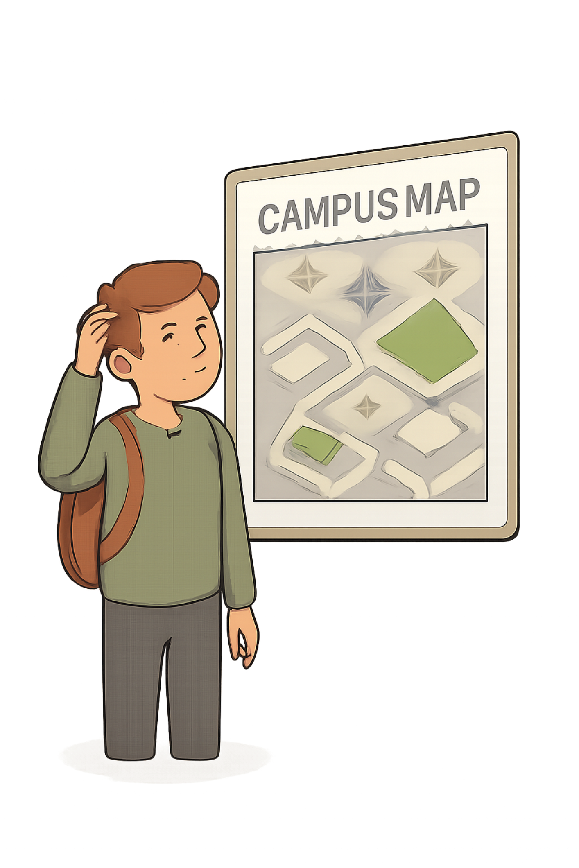

Introduction: Campus Navigation Challenges
What Is Campus Navigation?
The process of locating and moving between academic buildings, classrooms, laboratories, offices, and facilities within an educational institution.
New Students
Difficulty identifying correct buildings, locating classrooms and laboratories, and understanding campus layout.
Why It Matters
Multiple buildings, complex layouts, and interconnected facilities make navigation difficult for unfamiliar users — costing time and reducing productivity.
Faculty Members
May struggle to locate new facilities, laboratories, and offices, especially in expanding campuses.
Visitors
Lack familiarity with campus structure and require assistance to find specific destinations.
Traditional printed maps and static signboards provide limited real-time guidance and cannot offer personalized navigation — AI and location technologies change this.

Slide 3
Problem Identification
Complex Campus Layouts
Indoor Navigation Gap
Multiple academic buildings make destination identification difficult, especially for first-time visitors and new students.
Indoor navigation is significantly more difficult than outdoor navigation — conventional GPS is unreliable inside buildings.
Static Guidance Limitations
Accessibility Gaps
Traditional maps and signboards cannot adapt to user needs, offer personalized routes, or provide real-time guidance.
Accessibility routes may not be easily available or clearly marked, creating barriers for users with mobility requirements.
Users spend unnecessary time searching for destinations, affecting productivity. Educational institutions require intelligent, scalable navigation solutions to address these challenges comprehensively.

Slide 4
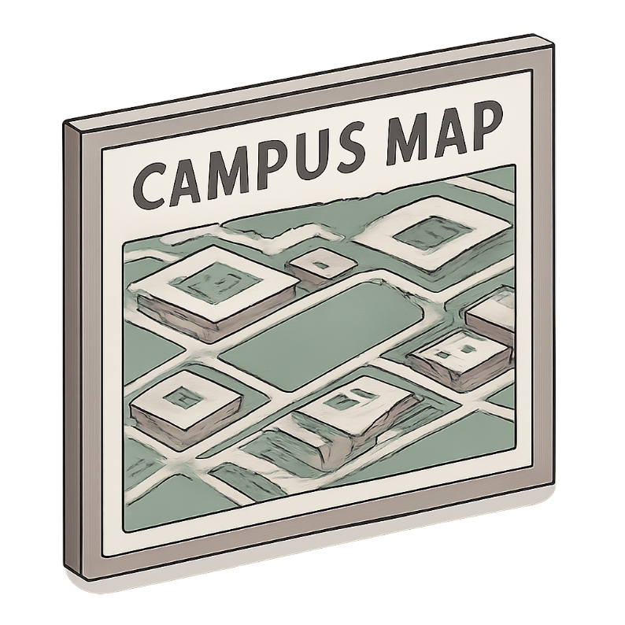
Existing System: Traditional Campus Navigation
Current Methods
Printed campus maps, static digital maps, directional signboards, asking staff for directions, and manual building identification.
Key Limitations
No dynamic route updates or real-time guidance
No personalized route calculation based on user location
Unreliable indoor navigation where GPS fails
No integrated destination search or route optimization
Challenging for visitors unfamiliar with campus structure

Slide 5

Proposed System: AI-Based Campus Navigation
Core Features
System Architecture
Centralized navigation platform with destination search functionality
User location identification using location-based technologies
Indoor mapping representing building layouts, floors, and rooms
Interactive campus maps displaying buildings, laboratories, and classrooms
Shortest-route calculation using path optimization algorithms
Real-time navigation assistance with turn-by-turn guidance
Accessibility routes for users with mobility requirements
Estimated travel time calculation
Integrates four core pillars to deliver intelligent navigation:
Python-Based Data Analysis
AI Algorithms
Indoor Mapping
Path Optimization

Slide 6
System Objectives
Locate Destinations
Identify User Location
Help users find academic buildings, classrooms, laboratories, offices, and campus facilities.
Accurately determine the user's current position within the campus, including indoors.
Calculate Optimal Routes
Deliver Real-Time Guidance
Compute the shortest or most suitable route, including accessible paths for users with mobility requirements.
Provide live navigation assistance, estimated travel time, and building information to reduce navigation time.
Together, these objectives support smart campus management and centralized location services across the entire institution.

Slide 7



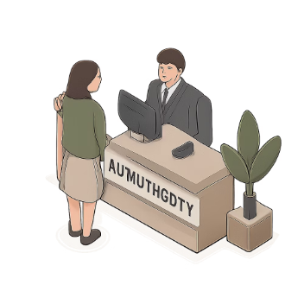

Target Users and Benefits
New Students
Faculty Members
Administrative Staff
Campus Visitors
Quickly locate classrooms, laboratories, and facilities without prior campus knowledge.
Locate offices, laboratories, and meeting spaces across campus with ease.
Navigate to administrative buildings and support facilities efficiently.
Receive guided assistance to reach specific destinations without prior familiarity.
Overall Impact: Improved campus experience, reduced navigation time, and better accessibility for all authorized campus users.

Slide 8

System Architecture and Data Flow
Key System Components
Data Management
Campus map and building data collection and processing.
Location Services
User location identification and indoor positioning.
Route Optimization Engine
Map Collection
Location Processing
Destination Input
User Position
Indoor Mapping
Path analysis and shortest route calculation.
Interactive Interface
Campus map display and destination search.
Real-Time Guidance
Navigation instructions and travel time delivery.

Slide 9
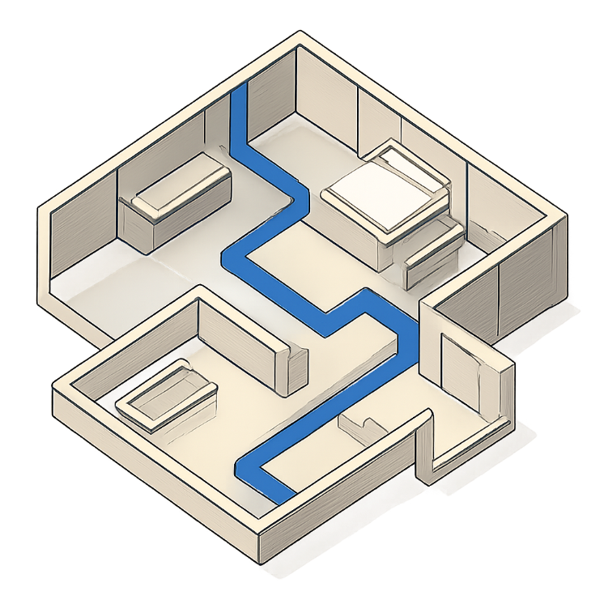
Location Identification, Destination Search, and Indoor Mapping
User Location Identification
Determines current position, establishes starting point, and matches location with campus map to support indoor navigation.
Possible Location Technologies
Indoor Mapping
Represents building layouts including floors, rooms, laboratories, corridors, and navigation paths. Identifies accessible paths and connections between indoor and outdoor areas — supporting navigation where conventional GPS is insufficient.
Destination Search
Enables search for buildings, classrooms, laboratories, offices, and facilities. Displays destination information and allows selection for navigation.
GPS (Outdoor)
Wi-Fi Positioning
Bluetooth / BLE Beacons
QR-Code Confirmation

Slide 10
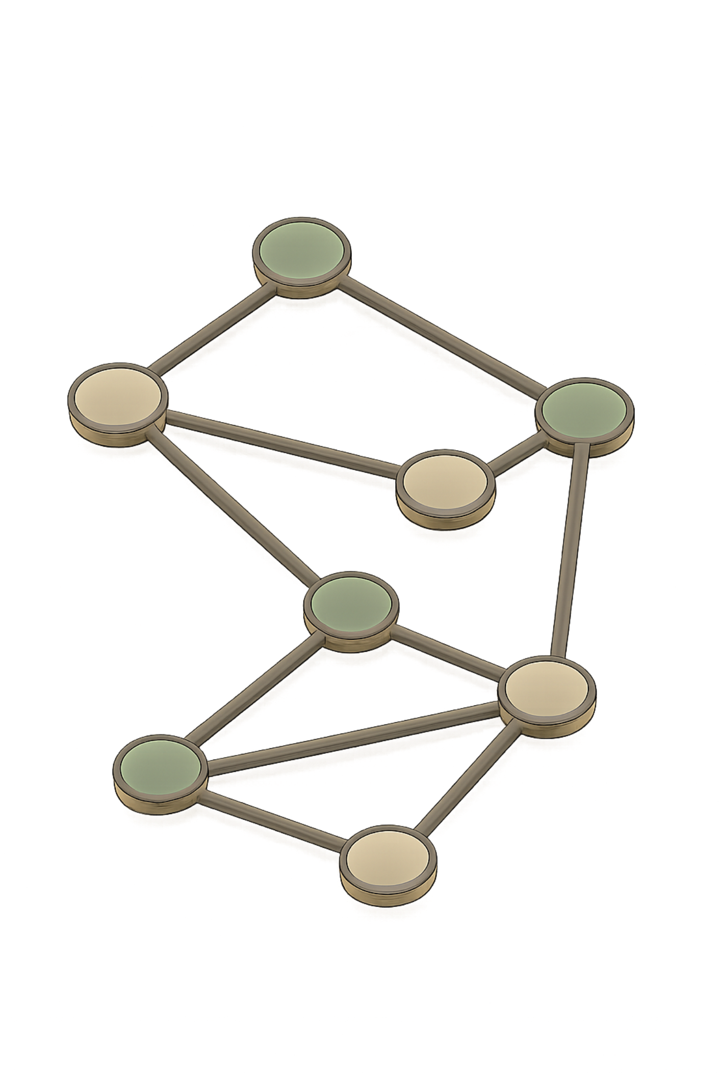

Route Optimization, Calculation, and Real-Time Navigation
Path Optimization
Route Calculation Process
Identifies available navigation paths, represents the campus as connected nodes, calculates possible routes, and determines the shortest or most suitable route.
User Location
Destination Selection
Map Representation
Route Analysis
Path Optimization
Accessibility and Travel Time
Identifies accessible routes, avoids unsuitable paths, and estimates time required to reach the destination based on route distance and navigation information.
Possible Algorithms
Dijkstra's Algorithm
A* Algorithm
Breadth-First Search
Heuristic-guided optimal pathfinding
Shortest path in weighted graphs
Unweighted shortest path traversal

Slide 11

Conclusion: Intelligent Campus Navigation Solution
System Overview
Impact
The AI-Based Campus Navigation and Indoor Location Assistance System combines AI algorithms, Python-based data analysis, indoor mapping, location-based technologies, and path optimization techniques to provide intelligent navigation across large educational campuses.
Improves campus accessibility, reduces navigation time, enhances user convenience, and supports smart campus management.
Outcome
A modern, secure, scalable, and intelligent navigation solution that transforms how students, faculty, and visitors navigate educational institutions.
Key Capabilities
Identifies user locations and locates academic buildings and laboratories
Calculates suitable routes and provides real-time navigation
Displays building information and supports accessibility
Estimates travel time for efficient route planning
Modern
Scalable
Intelligent

