Slide 1
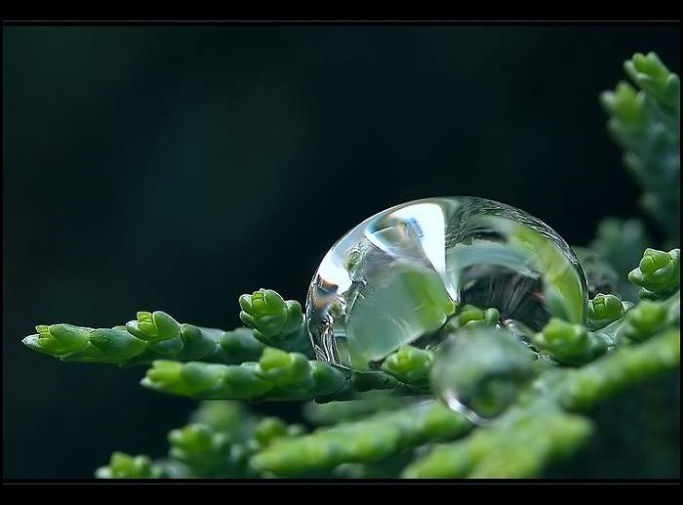
We convince ourselves that life will be better once we are married, have a baby, then another.
Then we get frustrated because our children are not old enough, and that all will be well when they are older.
Then we are frustrated because they reach adolescence and we must deal with them. Surely we’ll be happier when they grow out of the teen years.
We tell ourselves our life will be better when our spouse gets his/her act together, when we have a nicer car, when we can take a vacation, when we finally retire.
The truth is that there is no better time to be happy than right now.
If not, then when?
Your life will always be full of challenges. It is better to admit as much and to decide to be happy in spite of it all.

Slide 2
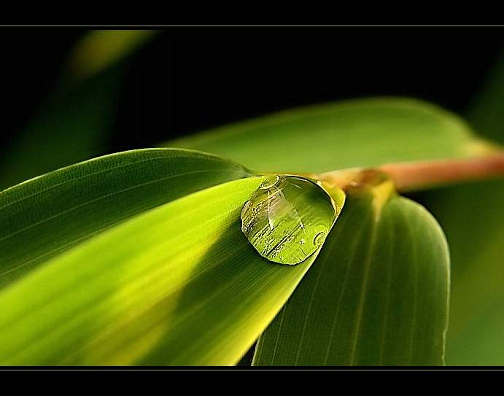
For the longest time, it seemed that life was about to start. Real life.
But there was always some obstacle along the way, an ordeal to get through, some work to be finished, some time to be given, a bill to be paid. Then life would start.
I finally came to understand that those obstacles were life.
That point of view helped me see that there isn’t any road to happiness.
Happiness IS the road.
So, enjoy every moment.
Stop waiting for school to end, for a return to school, to lose ten pounds, to gain ten pounds, for work to begin, to get married, for Friday evening, for Sunday morning, waiting for a new car, for your mortgage to be paid off, for spring, for summer, for fall, for winter, for the first or the fifteenth of the month, for your song to be played on the radio, to die, to be reborn… before deciding to be happy.

Slide 3
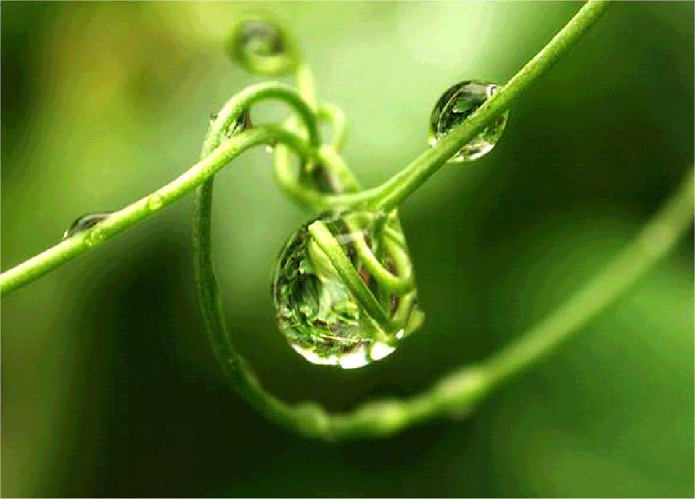
Happiness is a voyage, not a destination.
There is no better time to be happy than… NOW!
Live and enjoy the moment.
-Author unknown
Now, think and try to answer these questions:
1 – Name the 5 richest people in the world.
2 – Name the last 5 Miss Universe winners.
3 – Name the last 10 Nobel Prize winners.
4 – Name the last 10 winners of the Best Actor Oscar.

Slide 4

Can’t do it? Rather difficult, isn’t it?
Don’t worry, nobody remembers that.
Applause dies away!
Trophies gather dust!
Winners are soon forgotten.
Now answer these questions:
1 – Name 3 teachers who contributed to your education.
2 – Name 3 friends who helped you in your hour of need.
3 – Think of a few people who made you feel special.
4 – Name 5 people that you like to spend time with.
More manageable? It’s easier, isn’t it?
The people who mean something to your life are not rated “the best”, don’t have the most money, haven’t won the greatest prizes…
They are the ones who care about you, take care of you, those who, no matter what, stay close by.
Think about it for a moment.
Life is very short!
And you, in which list are you? Don’t know?

Slide 5

Let me give you a hand.
You are not among the most “famous”, but among those to whom I remember to send this message…
Some time ago, at the Seattle Olympics, nine athletes, all mentally or physically challenged, were standing on the start line for the 100 m race.
The gun fired and the race began. Not everyone was running, but everyone wanted to participate and win.
They ran in threes, a boy tripped and fell, did a few somersaults and started crying.
The other eight heard him crying.
They slowed down and looked behind them.
They stopped and came back… All of them…
A girl with Down’s Syndrome sat down next to him, hugged him and asked, “Feeling better now?”
Then, all nine walked shoulder to shoulder to the finish line.
The whole crowd stood up and applauded. And the applause lasted a very long time…

Slide 6
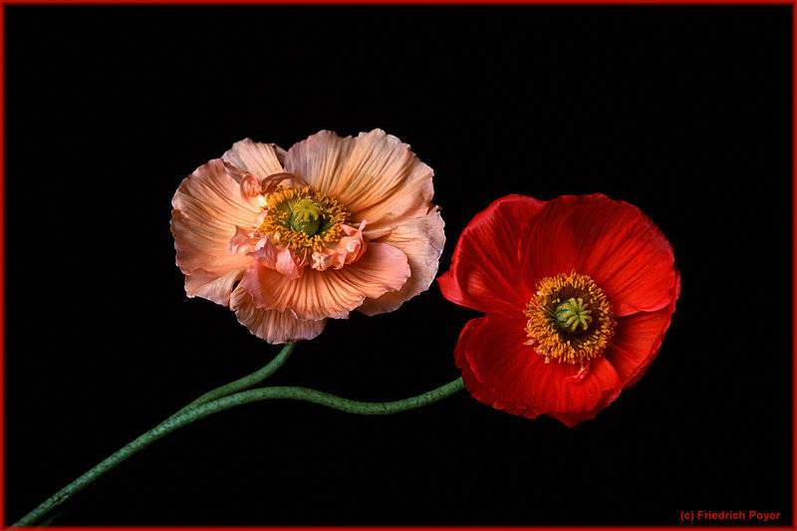
People who witnessed this still talk about it.
Why?
Because deep down inside us, we all know that the most important thing in life is much more than winning for ourselves.
The most important thing in this life is to help others to win. Even if that means slowing down and changing our own race.
If you send this email, perhaps we will succeed in changing our heart, perhaps someone else’s heart, as well…
A candle loses nothing if it is used to light another one.”
So, what have you decided? Trash this or send it?

