Slide 1


UBER USING BIG DATA
Madhuben and Bhanubhai Patel Institute of Technology (A CHARUTAR VIDYA MANDAL INSTITUTION) 3161607 – BIG DATA ANALYTICS
Guided by: Prof. Pooja Bhatt
Presented by: Nandini Patel - 180630116015
Netra Patel - 180630116016
Nidhi Patel - 180630116017

Slide 2
OUTLINE
Introduction
Uber success timeline
Features of Uber
Flow chart
Process behind scenes
Datasets
Value propositions
Challenges faced by Uber
Conclusion
Future proofing
References

Slide 3
INTRODUCTION
Uber is the first choice for people around the world when they think of moving people and making deliveries.
It uses the personal data of the user to closely monitor which features of the service are mostly used, to analyze usage patterns and to determine where the services should be more focused.
Uber focuses on the supply and demand of the services due to which the prices of the services provided changes.
Therefore one of Uber’s biggest uses of data is surge pricing. For instance, if you are running late for an appointment and you book a cab in a crowded place then you must be ready to pay twice the amount.
Uber’s business is built on data, with user data on both drivers and passengers fed into algorithms to find suitable and cost-effective matches and set fare rates.

Slide 4
FEATURES OF UBER
A user can tap his smartphone and call a cab at his location.
The driver has the option to accept or reject a ride. If the driver accepts the ride, driver details are sent to the customer along with ETA(Expected Time of Arrival).
The customer can track the driver as he arrives at his location.
The driver can also track the exact location of the customer and reach his exact location.
The payment procedure is handled by them.
This business model had a rating system in place for drivers right from the beginning, where a customer can rate the driver after his ride.

Slide 5
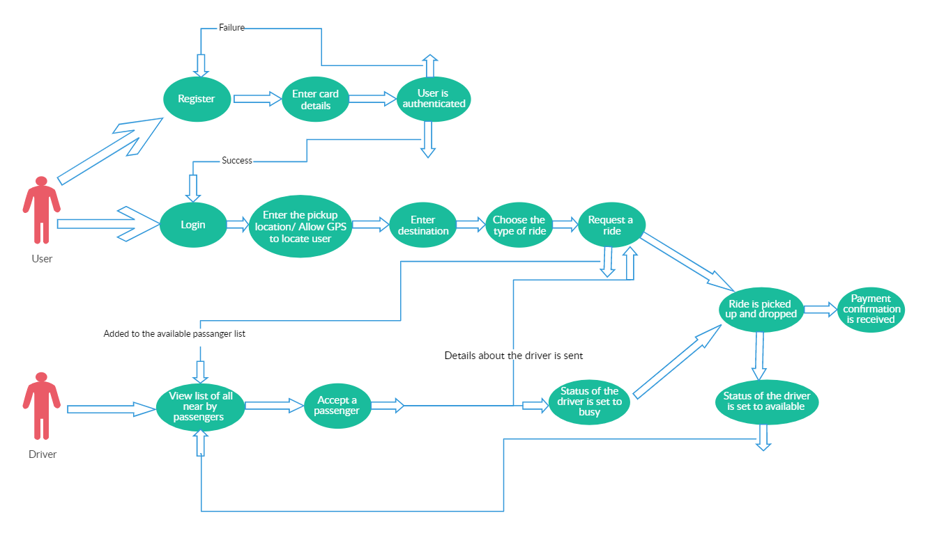
WORKING FLOW

Slide 6
PROCESS BEHIND THE SCENE
The 4 step model about how Uber works
Step 1 (Request a cab): The first step in the business model is about creating a demand. People have a smartphone app which lets them request a cab instantly or schedule it for some time later.
Step 2 (Matching): As soon as the request is made, a notification about your details are sent to the nearest driver. The cab driver has the option to accept or reject the ride. In case he rejects, notification is sent to another driver in that area.
Step 3 (Ride): Customer can track the cab when it is arriving and the ETA is also shown to the customer. The meter starts as soon as the customer sits in the cab which can be tracked through the customer side app as well. Friendly drivers make sure that the ride is comfortable for the passenger.

Slide 7
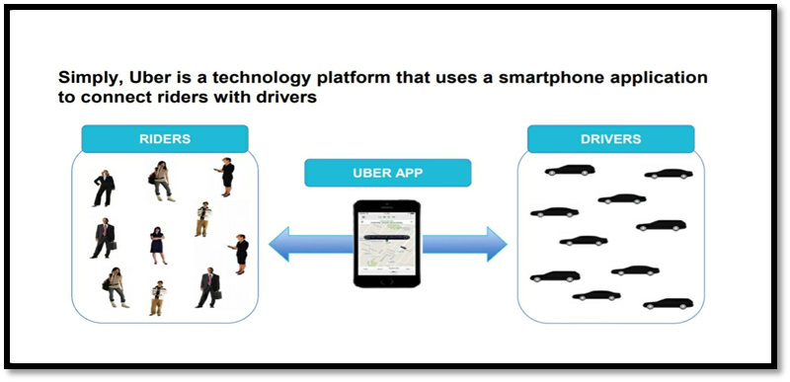
Step 4 (Payment & Rating): Once the ride is over, the customer gets an option to rate the driver. The rating system is an important part of the business model as it lets a person know about the driver before booking a ride and helps him trust the driver.

Slide 8
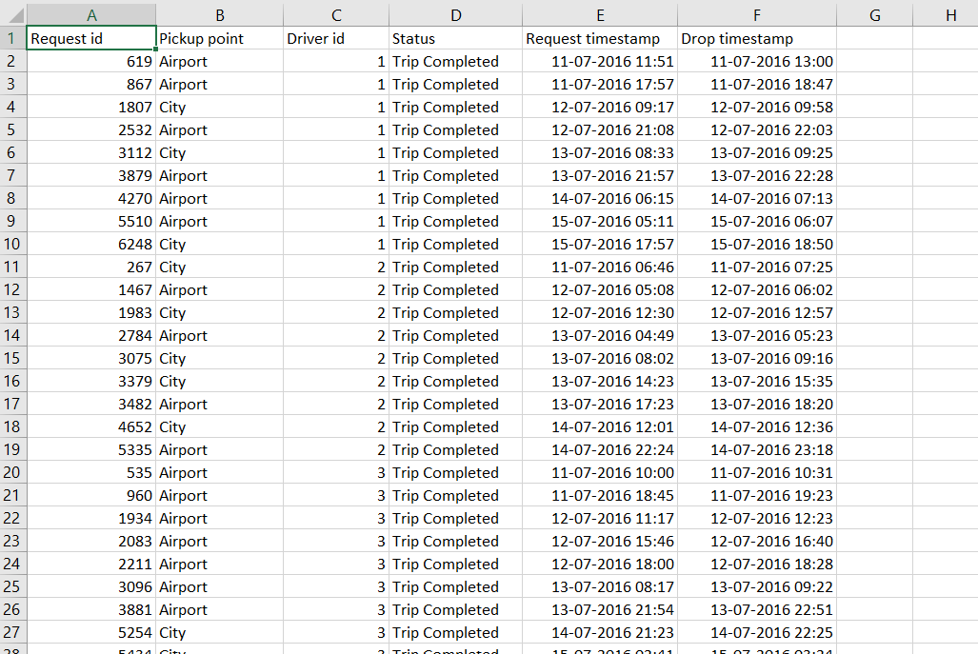
DATASETS
Reference : https://www.kaggle.com/suhasvs/uber-case-study-an-eda-based-on-cab-request-data

Slide 9
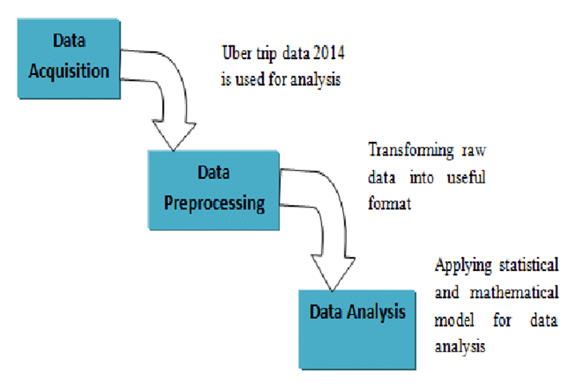
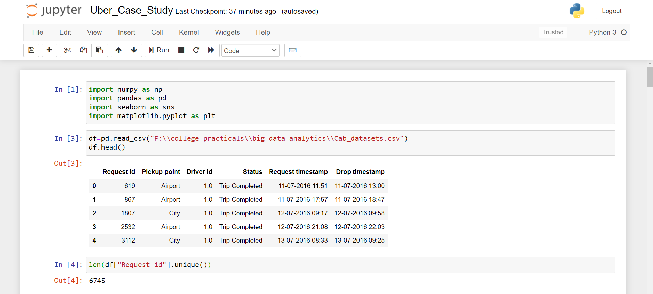

Slide 10
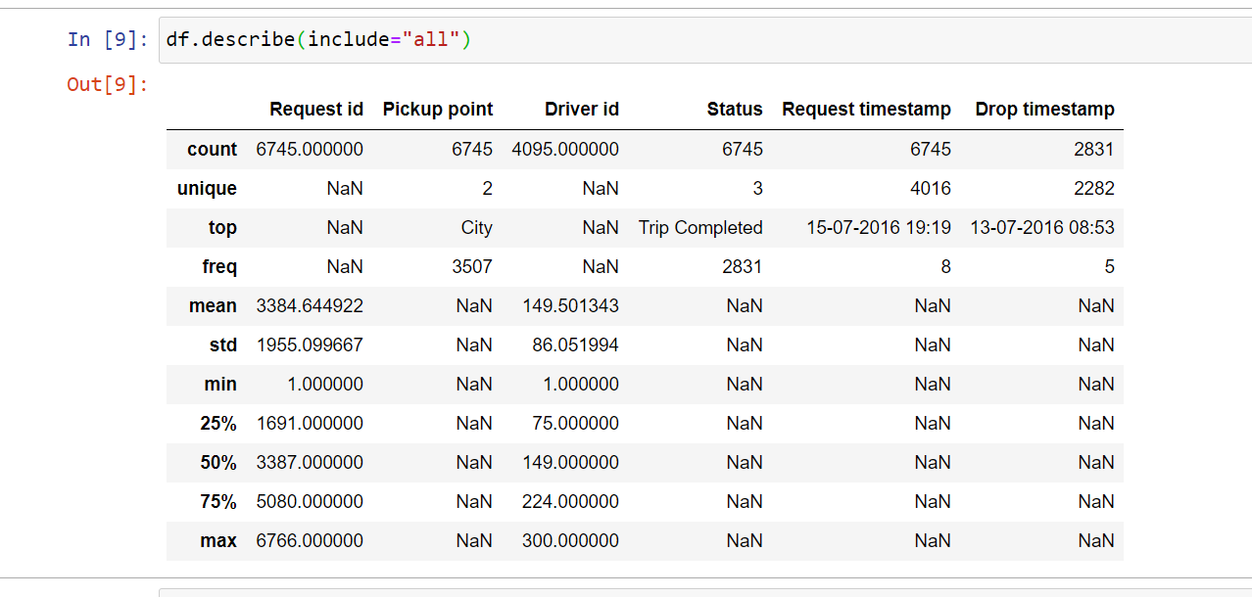
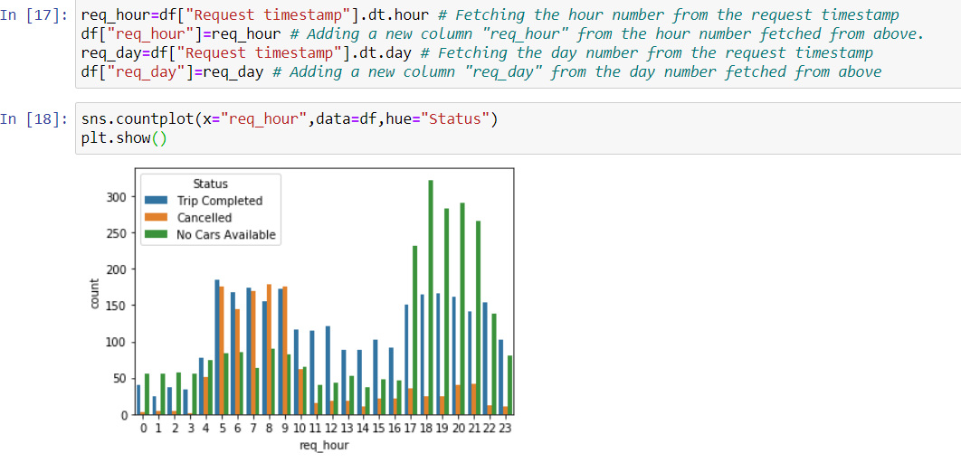

Slide 11
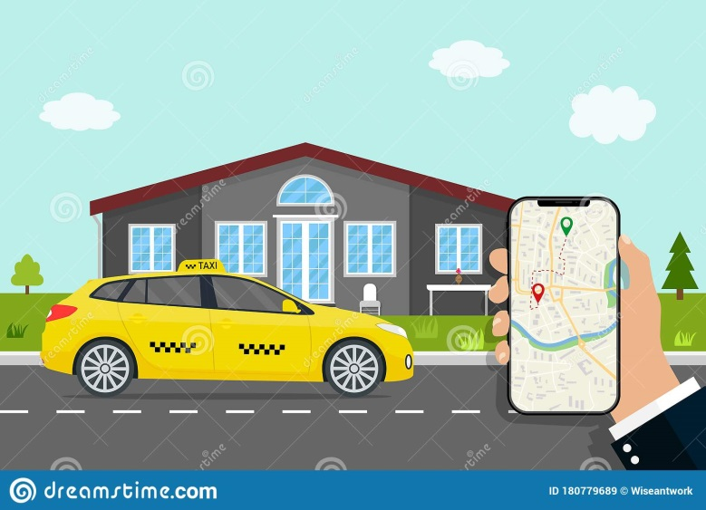
VALUE PROPOSITIONS
Customers:
Provides professional service
No need to wait for a taxi for long times.
Free rides on certain occasions and discounts from time to time.
Prices lesser than the normal taxi fares.
Uber’s tagline says – Your personal driver. It lets customers travel in style.
Fixed prices for common places like Airport etc.
Convenient and Cashless

Slide 12
Drivers:
An additional source of income.
Flexible working schedules. Can work part-time or simply whenever they like.
Easy payment procedure.
Those who love to drive can earn money while pursuing their hobby.
Uber pays drivers to be online, even if they don’t get any request.
Safer and More Flexible for Drivers

Slide 13
CHALLENGES STILL FACED BY UBER
Lawsuits:
Uber has pending lawsuits in courts of New York and San Francisco. According to Uber, all drivers working for it are its partners while the court says that they are employees. Uber is not the only company facing such a problem but in fact, almost all companies who hire 1099 workforce are under the scanner.
Chicken & Egg problem (New city launch):
Uber faces the chicken and egg problem whenever it launches in a new city. Acquisition of customers as well as partnering with new drivers is not an easy task. To solve this problem, a marketing team starts working in a new city by reaching out to professional drivers. Soon, online and offline marketing is initiated. Discounts are always the main USP to woo customers in the starting stage.

Slide 14

Trust and Safety Issues:
There have been cases where Uber drivers have acted rude to passengers. Some cases where Uber drivers have outraged the modesty of female passengers have come to the limelight. This is a big challenge for Uber. Although the company takes all steps such as police verification of drivers and their ID details but still such cases cannot be ruled out completely.

Slide 15
CONCLUSION
Go for less ownership model. Uber does not own any cab but still provides over 1 million rides a day through its partner network.
Choose an industry. Think about the most common problem it has. Find a solution and disrupt the existing model through technological infrastructure. That is what Uber did in the cab industry.
Treat your initial users as kings. They are really important for the growth of your business.
Expand step by step. Do not add everything in your business model in the first go. Uber started with cabs but now even has boats, helicopters, bikes and other means.

Slide 16
Opportunity won’t come to you. You have to look for them. Uber created an opportunity by offering discounted rides for particular event venues and hence got its first customers.
Treat your workforce an important part of your business. Uber calls its drivers as partners and gives them a decent 80% of the total fare.
There’s no doubt in the fact that Uber has brought a revolution not just as a taxi company but as a business model where businesses reach out to serve customers at their location. A lot of startups have already made their app like Uber and many others have made small iterations to launch startups in various industry verticals.

Slide 17
FUTURE-PROOFING
In addition to the core supply-and-demand dispatch systems, Uber does have a third system: Disco.
Ranney said, "Disco is the dispatch optimization system. Disco's main function is to match supply with demand. Disco, however, allows Uber to look into the future. We can match predictive supply and demand, whereas our old system could only match what we knew then.“
The advantage Disco provides Uber is clear: reduce extra driving, reduce waiting time
and lowest overall ETA(Estimated Time of Arrival).

Slide 18
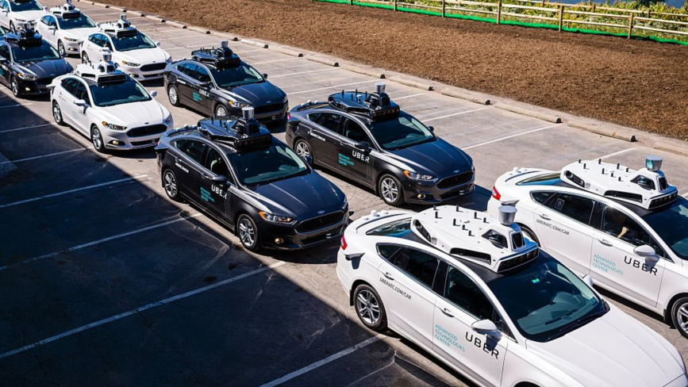
Another new approach to autonomous driving can be taken as- Uber’s self-driving car division.
That is to launch its self-driving cars in pockets of cities where weather, demand and other conditions are most favourable.
Ultimately, the new strategy can be designed to help Uber drive down costs as it seeks to show investors it has a clear path to profitability.

Slide 19
REFERENCES
GoI. (2000). THE INFORMATION TECHNOLOGY ACT, 2000 (India, MINISTRY OF LAW, JUSTICE AND COMPANY AFFAIRS, Legislative Department). New Delhi, Delhi: (Legislative Department). Retrieved July 20, 2019, from http://dot.gov.in/sites/default/files/itbill2000_0.pdf
UBER TECHNOLOGIES, INC. (2019). Uber S-1/A filing, U.S. Securities and Exchange Commission. Retrieved from https://www.sec.gov/Archives/edgar/data/1543151/000119312519120759/d647752ds1a.htm
Goitom, H. (2016, July 11). India’s Regulatory Approach To Uber. Retrieved July 21, 2019, from https://blogs.loc.gov/law/2016/07/indias-regulatory-approach-to-uber/
https://www.kaggle.com/suhasvs/uber-case-study-an-eda-based-on-cab-request-data

Slide 20
THANK YOU!

