Slide 1


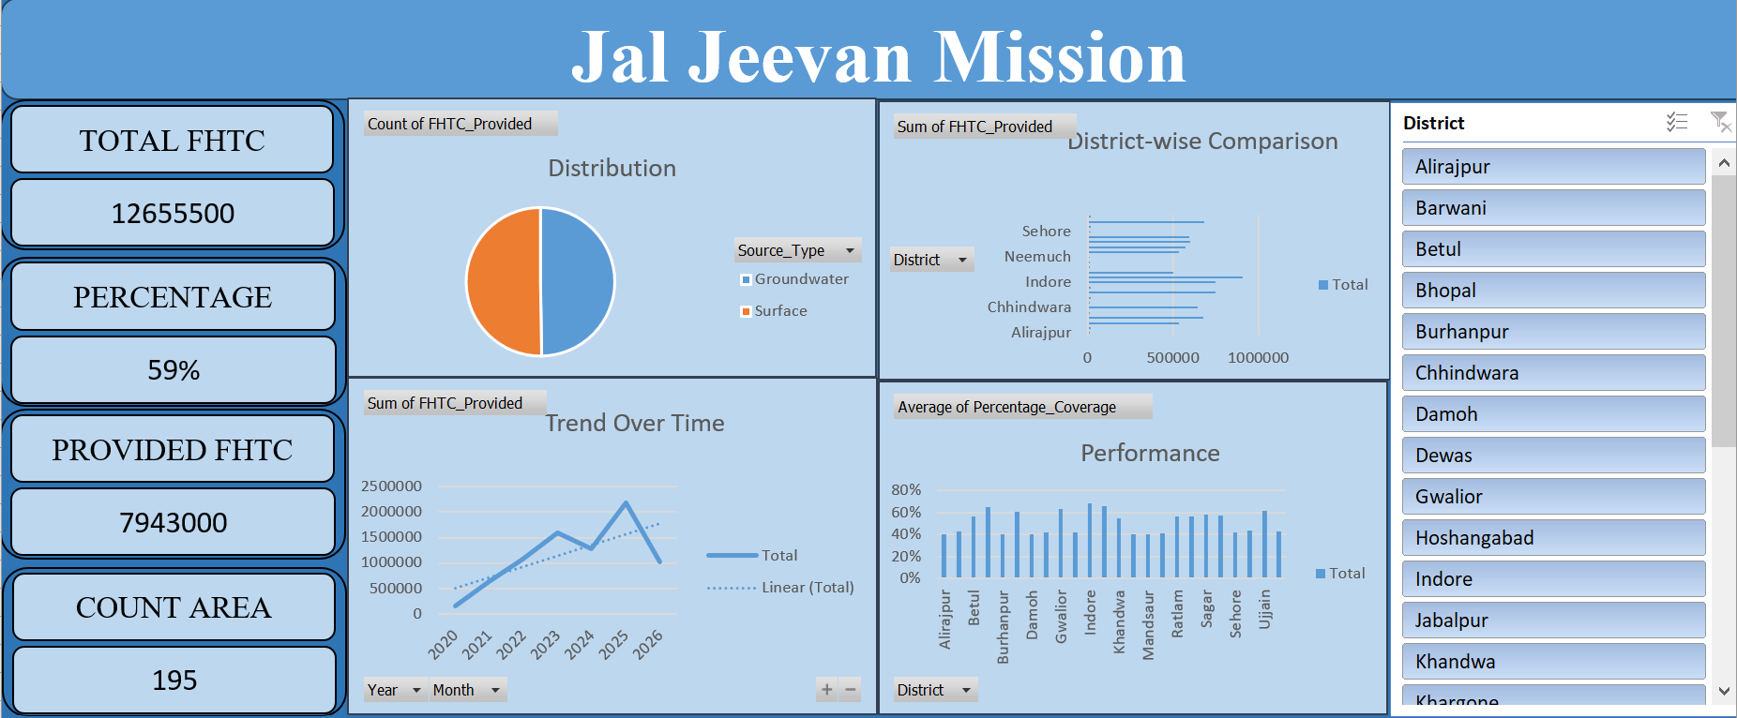


JAL JEEVAN MISSION · PUBLIC INFRASTRUCTURE ANALYTICS
Jal Jeevan Mission
FHTC Coverage & Performance Analysis
Interactive Data Analytics Dashboard using Microsoft Excel
NANDINI JAIN
Data Analyst Portfolio
Excel
Data Analytics
Dashboard
Visualization
Excel Dashboard Preview

Slide 2





GETTING ORIENTED
Project Introduction
The Jal Jeevan Mission focuses on improving access to Functional Household Tap Connections (FHTCs) in rural India. This project analyzes FHTC implementation data to understand where progress stands and where attention is still needed.
Coverage
FHTCs Provided
District Performance
Water-Source Distribution
Trends Over Time
Scale of FHTC implementation achieved
Volume of connections delivered
How implementation compares across districts
Groundwater vs. surface-water reliance
How provision has moved year to year
This analysis translates raw implementation records into a single interactive view of program progress.
INTRODUCTION
02

Slide 3


THE CHALLENGE
From Data → Decisions
Problem Statement
The Jal Jeevan Mission aims to provide Functional Household Tap Connections to rural households. Monitoring implementation across districts requires an analytical view of coverage, performance, and water-source dependency.
ANALYTICAL NEED
An interactive analytical dashboard can help convert implementation data into actionable insights for monitoring, comparison, and decision-making.
KEY QUESTIONS
How much FHTC coverage has been achieved?
Which districts are performing better or worse?
Raw Implementation Data
How has FHTC provision changed over time?
Structured Analysis
What is the distribution between groundwater and surface water?
Interactive Dashboard
Which districts may require additional attention?
Actionable Insight
PROBLEM STATEMENT
03

Slide 4



ROADMAP
Project Objectives
01
02
03
04
Measure FHTC coverage
Analyze FHTCs provided
Compare district performance
Analyze groundwater vs. surface water
05
06
07
08
Track FHTC trends over time
Identify performance gaps
Build an interactive Excel dashboard
Generate data-driven recommendations
OBJECTIVES
04

Slide 5








BEHIND THE SCENES
Data Cleaning & Preparation
Raw Data
Data Quality Check
Missing Value Check
Duplicate Validation
Standardization
Data Validation
Analysis-Ready Data
DATA PREPARATION ACTIVITIES
Missing-value checks
Duplicate checks
Data-type validation
Standardization of categorical values
Numerical validation
Metric validation
Preparation for pivot-table analysis
These activities reflect the data-preparation methodology followed to make the dataset analysis-ready for pivot-based reporting.
DATA PREPARATION
05

Slide 6
BEHIND THE DASHBOARD
Data Modeling & Analytical Structure
JAL JEEVAN MISSION DATA
Geography
Time
Measures
District
Area / Region
Year
Month
FHTC_Provided
Coverage %
Source Type
Pivot Analysis
Groundwater / Surface
Interactive Dashboard
This structure supports district analysis, time analysis, coverage analysis, source analysis, and dashboard reporting.
DATA MODELING
06

Slide 7





THE DATA
Dataset & Key Metrics
12.66M
7.94M
59%
195
Total FHTC
FHTC Provided
Coverage
Areas
ANALYTICAL DIMENSIONS
Geography
Time
FHTC
Coverage
Source
District / Area
Year / Month
FHTC Provided
Percentage Coverage
Groundwater / Surface
Figures sourced directly from the underlying dataset and Excel dashboard · No values altered or estimated
DATASET
07

Slide 8
FRAMING THE ANALYSIS
Business Questions
Seven analytical questions guide the deep-dive analysis on the following slides.
01
What is the overall status of FHTC coverage?
02
How are FHTCs distributed by water source?
03
Which districts have the highest FHTC provision?
04
How has FHTC provision changed over time?
05
Which districts show stronger or weaker coverage performance?
06
Does higher FHTC provision necessarily correspond to higher coverage?
07
Which districts should receive greater monitoring attention?
BUSINESS QUESTIONS
08

Slide 9
BUSINESS QUESTION 1
"What is the overall status of Functional Household Tap Connection (FHTC) coverage?"
12.66M
Total FHTC
59.3%
7.94M
FHTC Provided
AVERAGE FHTC COVERAGE
195
7,943,000 FHTCs provided out of 12,655,500 total FHTC requirement
Count Area
KEY FINDING
INSIGHT
BUSINESS IMPLICATION
59.3% Coverage
7.943 million FHTCs have been provided against 12.656 million total FHTCs, resulting in approximately 59.3% average coverage across the analyzed records.
While substantial progress has been made, approximately 40.7% of the total FHTC requirement remains uncovered, indicating scope for further expansion.
09
BQ 1

Slide 10
BUSINESS QUESTION 2
"How are FHTC records distributed between Groundwater and Surface Water sources?"
50.3% vs 49.7%
SURFACE WATER vs GROUNDWATER
Surface Water
98 records
Groundwater
97 records
Total
195 records
KEY FINDING
INSIGHT
BUSINESS IMPLICATION
50.3% Surface vs 49.7% Groundwater
The source distribution is almost evenly split, with 98 Surface Water records and 97 Groundwater records.
The near-balanced source mix indicates that implementation is utilizing both groundwater and surface-water sources rather than relying predominantly on one source category.
10
BQ 2

Slide 11

BUSINESS QUESTION 3
"Which districts have the highest FHTC provision, and how significant is the variation across districts?"
Jabalpur
908K FHTCs Provided
Highest FHTC provision across all districts
KEY FINDING
INSIGHT
BUSINESS IMPLICATION
Jabalpur — 908K FHTCs Provided
Jabalpur has the highest FHTC provision at 908,000, followed by Indore at 750,000 and Gwalior at 748,500.
District-level variation highlights the need for differentiated monitoring and resource planning rather than applying a uniform implementation strategy across all districts.
11
BQ 3

Slide 12

BUSINESS QUESTION 4
"How has FHTC provision changed over the years?"
2.183M
PEAK YEAR: 2025
Highest displayed FHTC provision in a single year
KEY FINDING
INSIGHT
BUSINESS IMPLICATION
2025 — Peak at 2.183M
FHTC provision increased substantially from 146K in 2020 to 1.599M in 2023, declined in 2024, reached the highest displayed value of 2.183M in 2025, and then decreased to 1.025M in 2026.
The fluctuations suggest that implementation progress should be monitored periodically to identify changes in the pace of FHTC provision.
12
BQ 4

Slide 13
BUSINESS QUESTION 5
"Which districts demonstrate stronger and weaker average coverage performance?"
HIGHER-PERFORMING DISTRICTS
LOWER-PERFORMING DISTRICTS
Indore — Highest Average Coverage: 68.1%
KEY FINDING
INSIGHT
BUSINESS IMPLICATION
Indore — 68.1% Coverage
Indore has the highest average coverage at approximately 68.1%, while several districts remain around the 40–43% range.
Lower-coverage districts can be prioritized for closer monitoring, while high-performing districts can provide useful benchmarks for implementation practices.
13
BQ 5

Slide 14

BUSINESS QUESTION 6
"Does higher FHTC provision necessarily correspond to higher coverage performance across districts?"
VOLUME ≠ COVERAGE
Jabalpur
Indore
Higher Volume
Higher Coverage
FHTC Provided
Avg. Coverage
FHTC Provided
Avg. Coverage
908,000
65.7%
750,000
68.1%
INSIGHT
BUSINESS IMPLICATION
Absolute FHTC provision and percentage coverage do not necessarily tell the same story. Jabalpur has a higher FHTC provision than Indore, while Indore has a higher average coverage.
Performance monitoring should consider both the scale of implementation and coverage efficiency rather than relying on FHTC volume alone.
BQ 6
14

Slide 15
BUSINESS QUESTION 7
"Which districts should receive greater monitoring attention based on coverage performance?"
Burhanpur
40.0%
Alirajpur
40.3%
Khargone
40.3%
Damoh
40.5%
Priority Group
Lower Coverage Districts
Mandsaur
40.5%
Neemuch
41.3%
Substantially below the overall average coverage of approximately 59.3%
Hoshangabad
42.1%
Sehore
42.1%
KEY FINDING
INSIGHT
BUSINESS IMPLICATION
Priority Group Identified
Several districts have average coverage around 40–43%, substantially below the overall average coverage of approximately 59.3%.
These districts can be considered priority areas for deeper investigation, targeted implementation monitoring, and resource planning.
BQ 7
15

Slide 16
THE DELIVERABLE
Interactive Excel Dashboard
One dashboard. Multiple analytical perspectives.
KPI Cards
Source Distribution
District Comparison
Trend Analysis
Coverage Performance
District Slicer
16
DASHBOARD

Slide 17
KEY RESULTS
Executive Summary
01
02
03
04
59.3%
7.943M
908K
68.1%
Average coverage
FHTCs provided
Jabalpur — highest displayed FHTC provision
Indore — highest average coverage
05
06
07
2.183M
40–43%
≈50/50
2025 — highest displayed FHTC provision
Several districts remain in this coverage range
Groundwater and surface water nearly evenly split
EXECUTIVE SUMMARY
17

Slide 18

INSIGHT → ACTION
Data-Driven Recommendations
01
02
Prioritize Lower-Coverage Districts
Monitor Regional Performance Gaps
Focus monitoring and intervention on districts with comparatively lower coverage.
Investigate differences in implementation performance across districts.
03
04
Learn from High-Performing Districts
Monitor Water-Source Mix
Study high-performing districts and identify practices that may be adapted elsewhere.
Track groundwater and surface-water utilization as part of implementation monitoring.
05
06
Strengthen Trend Monitoring
Use Dashboard for Periodic Reviews
Review monthly / yearly changes to identify fluctuations in implementation.
Use the dashboard for recurring district-level performance monitoring and decision-making.
RECOMMENDATIONS
18

Slide 19


WRAPPING UP
Conclusion
The Jal Jeevan Mission dashboard transforms FHTC implementation data into a consolidated view of coverage, district performance, source distribution, and trends over time.
Overall progress monitoring
From Raw Data → Analysis → Dashboard → Insights → Action
District comparison
Coverage performance analysis
Trend analysis
Source distribution monitoring
Data-driven prioritization
CONCLUSION
19

Slide 20


CAPABILITIES
Skills Demonstrated
Data Analytics
Excel
Business Intelligence
Domain
Data Cleaning
Pivot Tables
Data Visualization
Government Analytics
Exploratory Data Analysis
Pivot Charts
Insight Generation
Public Infrastructure
KPI Analysis
Slicers
Data Storytelling
Water & Rural Development
Trend Analysis
Calculations
Performance Monitoring
Comparative Analysis
Dashboard Development
Recommendations
Turning Data into Decisions.
SKILLS
20

