Slide 1
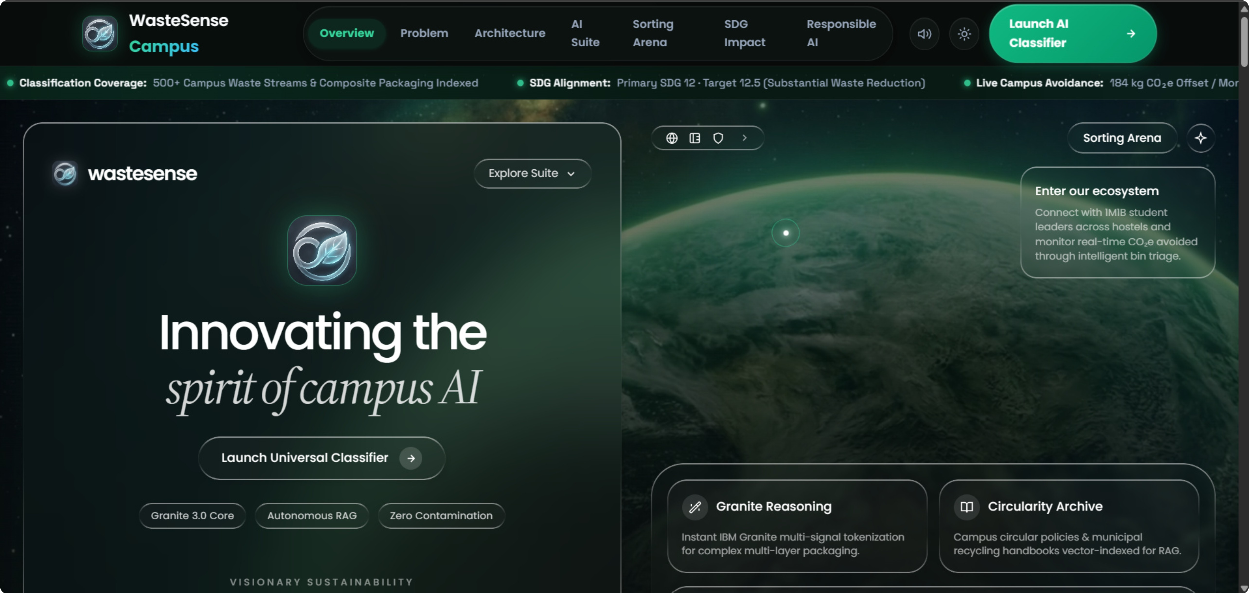

WasteSense Campus
Responsible AI decision support for campus waste segregation — a lightweight, explainable prototype to guide instant disposal choices and measure sustainability impact.
SDG 12
SDG 11
SDG 13

Slide 2
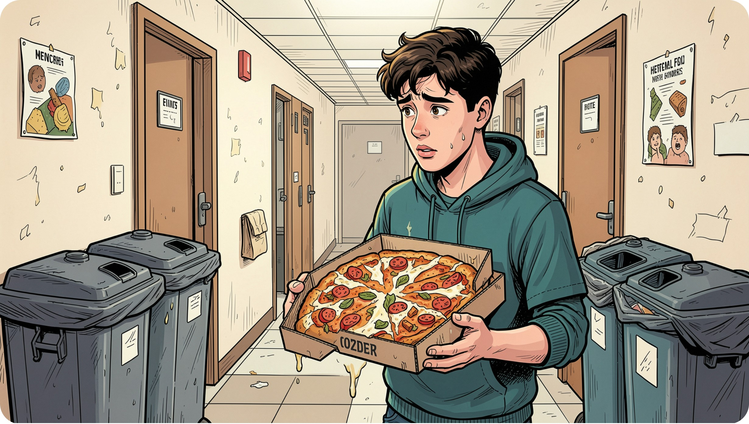
Problem & Opportunity
Problem Statement
"How might we use AI to help campus community members identify common waste items and choose the correct disposal route so that hostel and classroom waste can become more sustainable?"
Opportunity
Replace guesswork with instant, explainable guidance at the moment of decision to reduce contamination and support SDG 12 compliance.

Slide 3
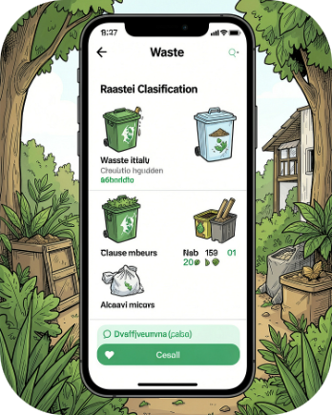
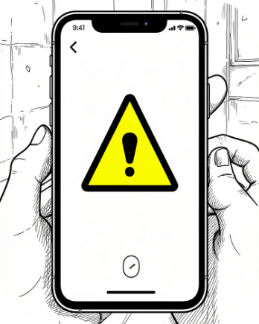

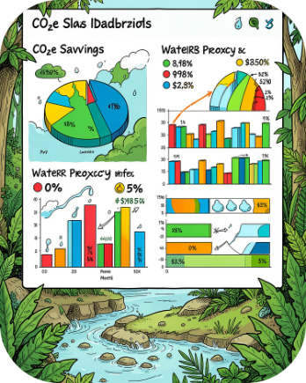
AI Solution Overview
Item Classification
Confidence & Guardrails
RAG Policy Q&A
Impact Estimator
Calculates confidence, flags contamination or ambiguity, and recommends safe fallback routes.
Retrieval-augmented responses grounded in campus policy with verifiable citations for local rules.
Quantifies diverted CO2e and water proxies based on correct routing actions.
Accepts text or image filenames (e.g., "greasy pizza box") and maps items to streams: Recyclable, Organic, Hazardous, E‑Waste, General.

Slide 4

Decision Flow (How it Works)
Contamination Check
Category Score
RAG & Impact
User Input
Normalize
High-confidence results show recommended bin and explanation; low-confidence returns a caution and safer general route with escalation to facilities staff when needed.

Slide 5
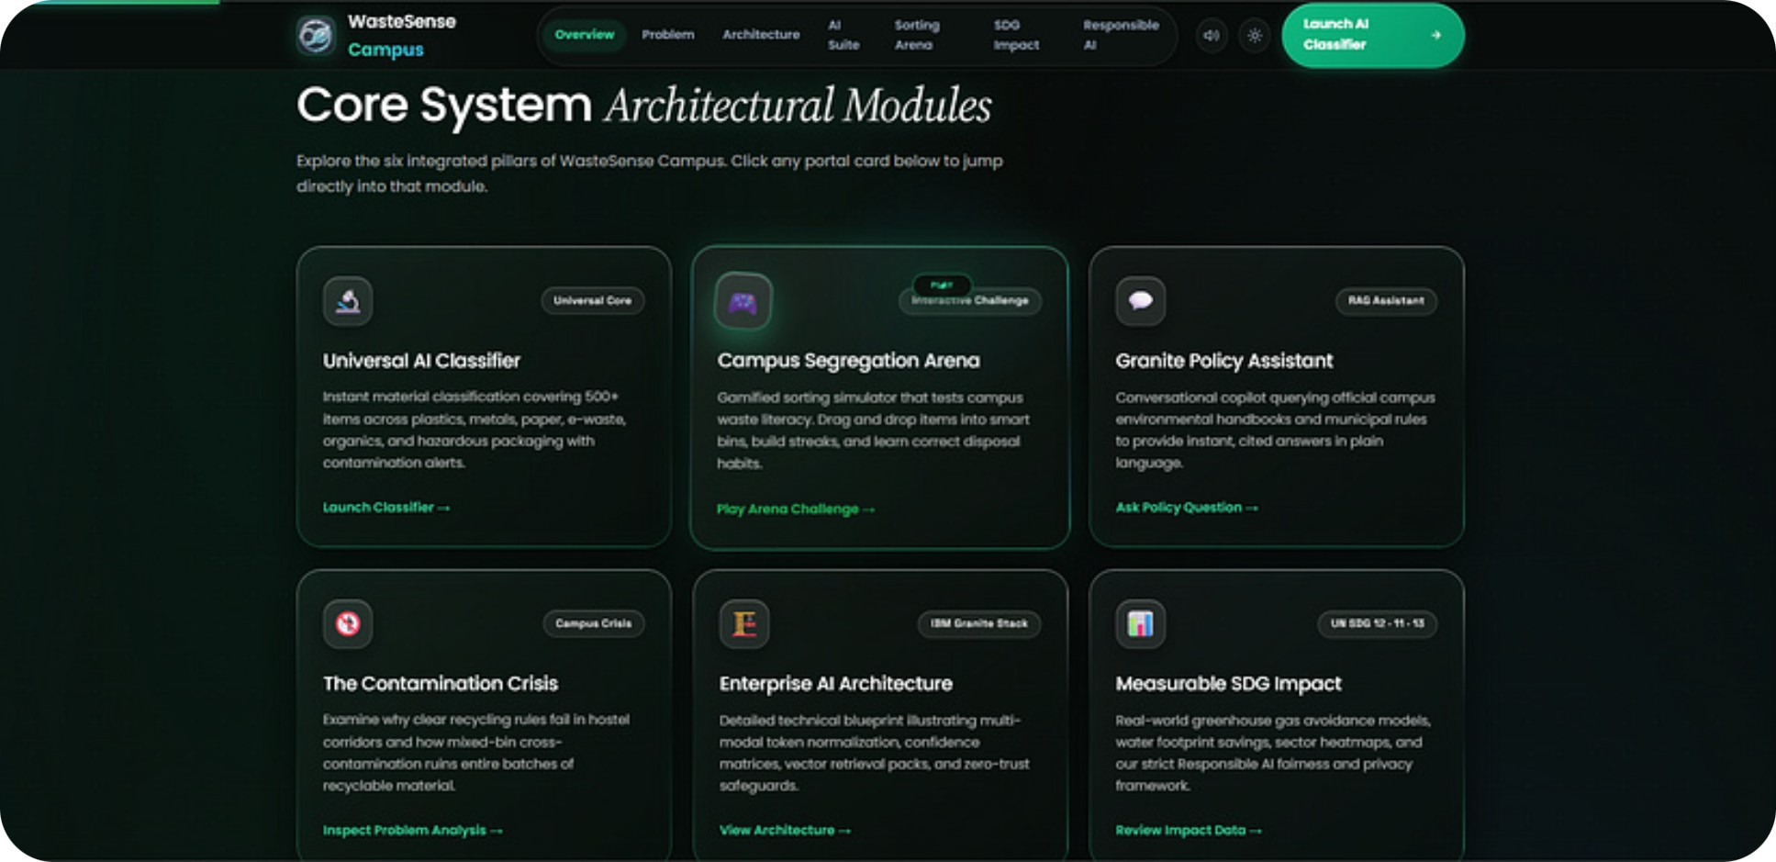
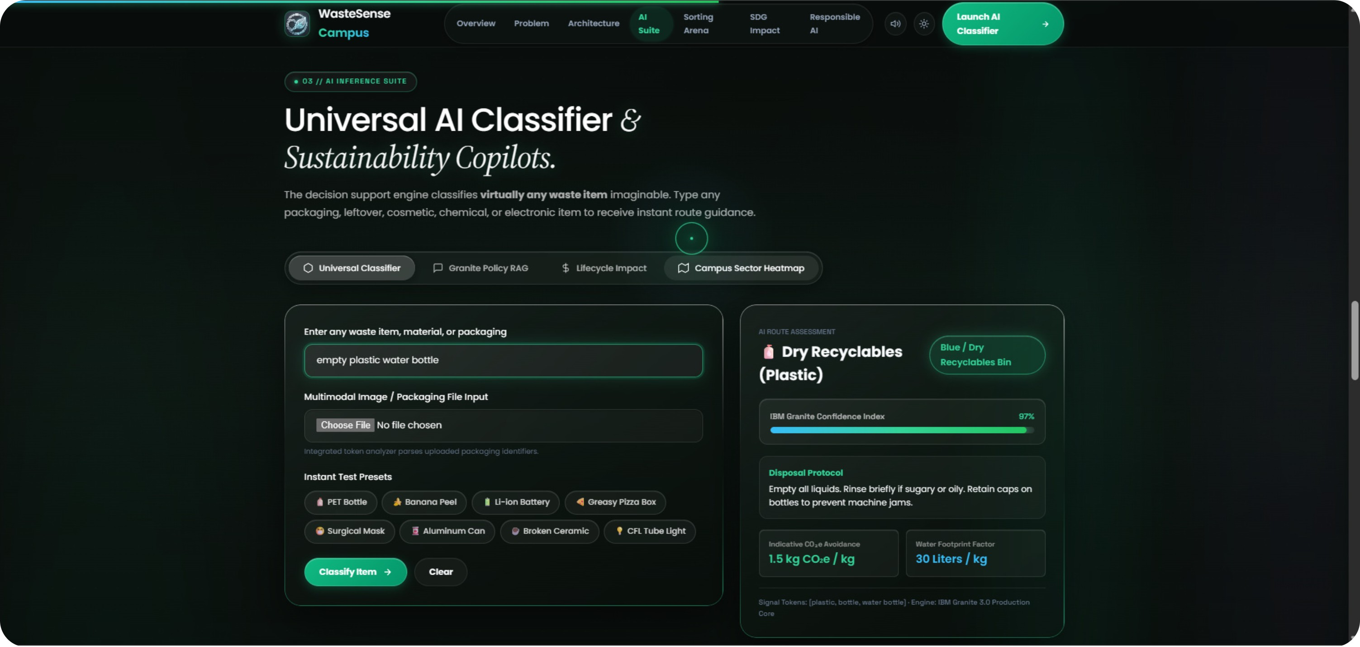
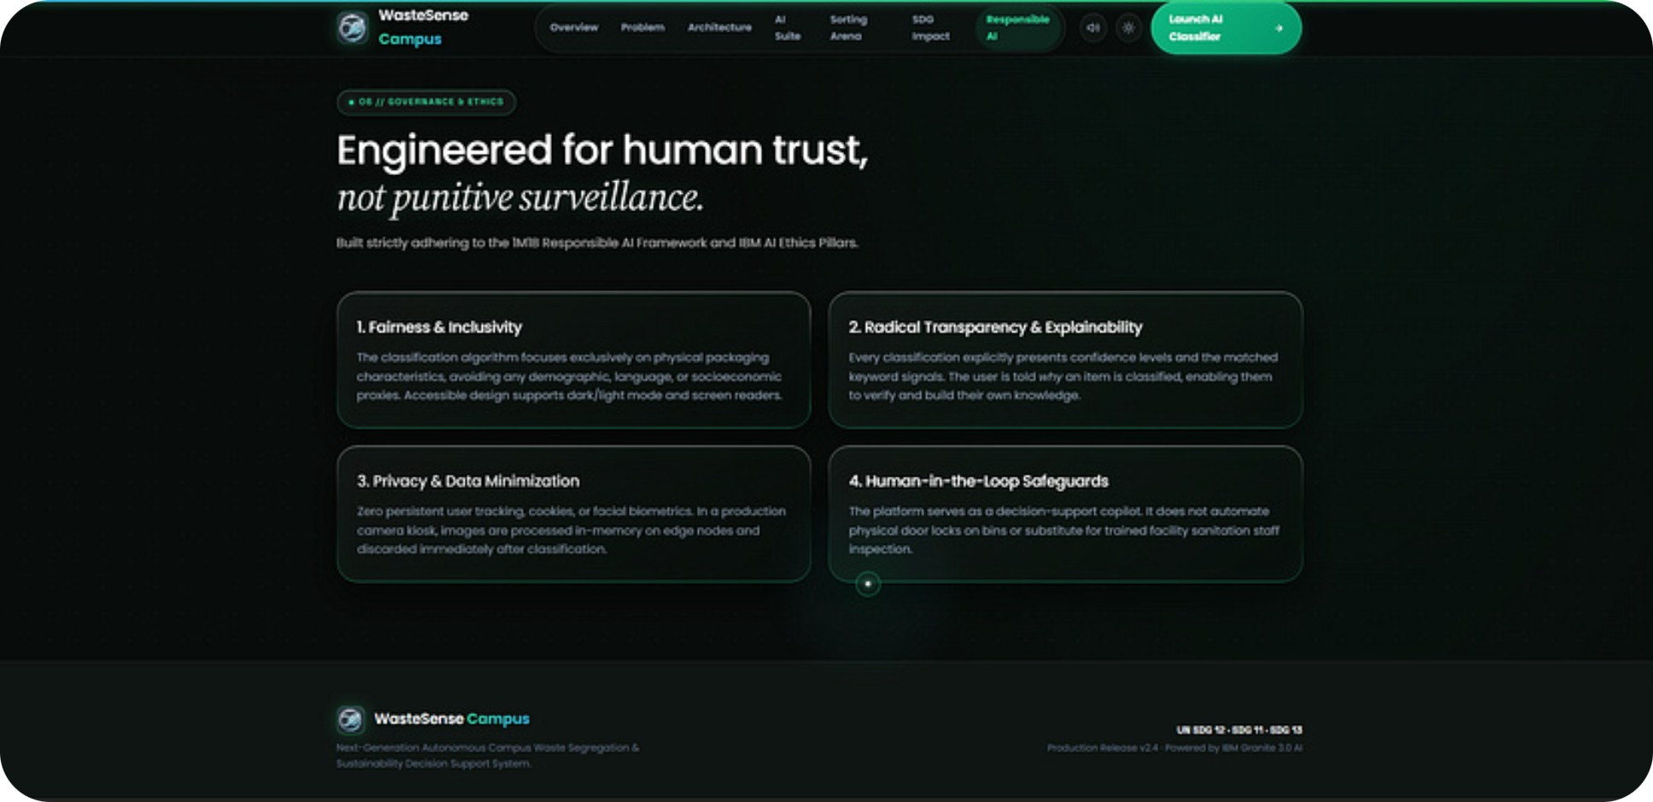

Prototype — Prompt & Demo
System Prompt (summary)
Be concise, objective, transparent. Flag food-soiled or ambiguous items and suggest safer non-recyclable routes. Align strictly with official campus guidelines. Never profile or prescribe punishments.
Sample I/O

Slide 6
Impact & Beneficiaries
Students
Cleaning & Hostel Staff
Campus Admin
Eliminates disposal confusion, builds sustainable habits, provides zero-friction mobile guidance.
Reduces manual re-sorting, lowers health hazards, yields cleaner waste streams.
Automated data for SDG 12 reporting, lower disposal costs, actionable campus metrics.
Expected pilot outcomes: 35–50% reduction in recyclable bin contamination; instant (<3s) disposal advice; targeted signage informed by query analytics; verifiable SDG 12 metrics.

Slide 7
Pilot Metrics & Responsible AI
35–50%
<3s
Contamination Reduction
Query Resolution Speed
Projected drop in recyclable bin contamination across pilot hostel blocks.
Average time to receive disposal advice.
Top 5
CO2
Confusion Index
Estimated Monthly Carbon Offset
Identify most frequently queried items (e.g., tetra paks, coffee cups).
Aggregate kg CO2e avoided through correct routing.
Responsible AI Measures
Fairness: Material-based recommendations only; no profiling.
Transparency: Confidence scores, explanations, and citations for policy answers.
Privacy: No personal or facial data stored; logs aggregated and anonymized.
Human-in-the-Loop: Escalates complex/hazardous cases to facilities staff.
Ethics: Non-punitive — avoids surveillance or shaming mechanisms.

