Slide 1
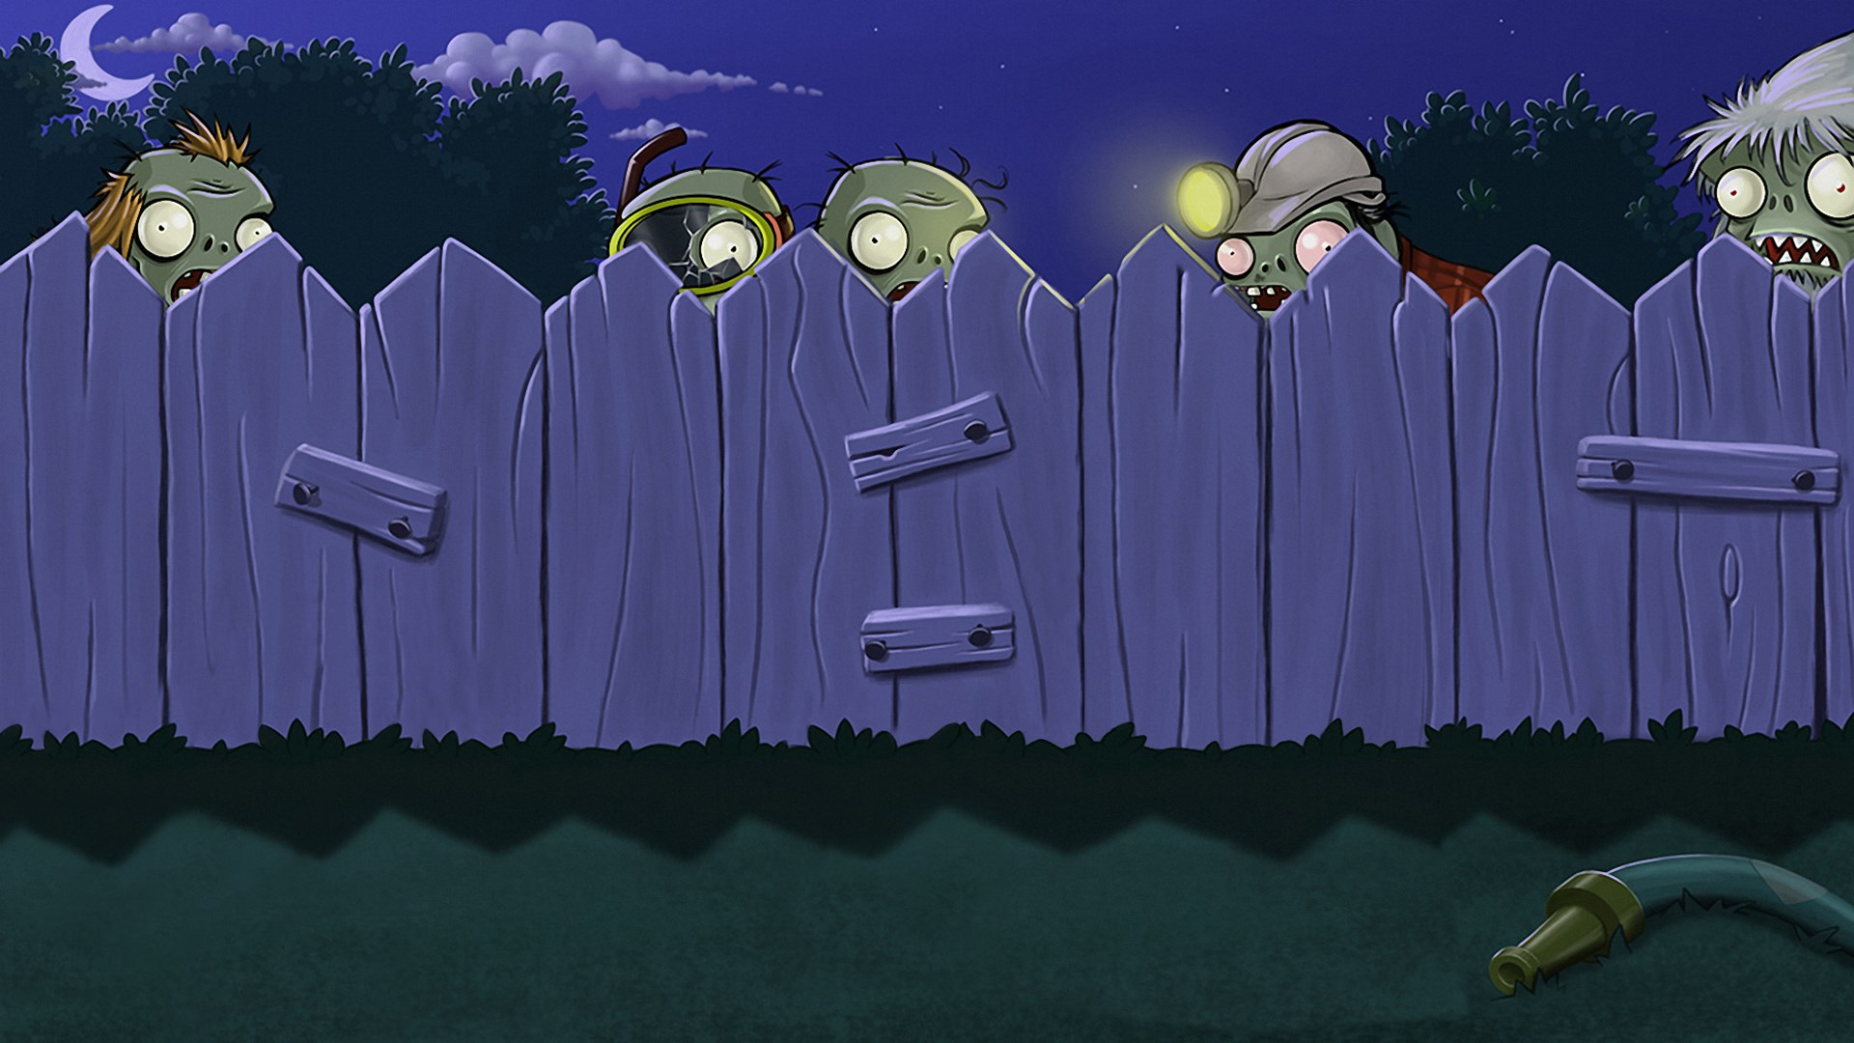
PLANTS VS ZOMBIES
Nandini |2018056
Dibya |2018282

Slide 2
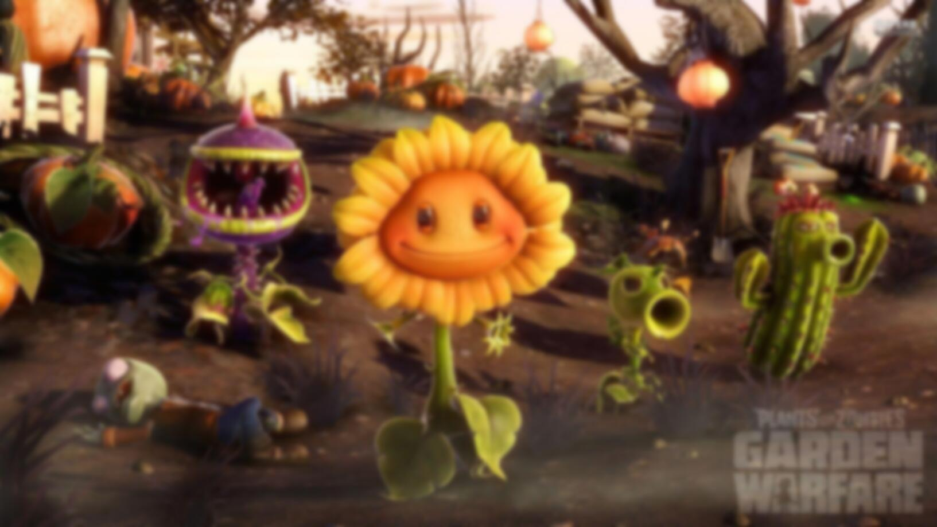
DEVELOPMENT PROCESS
ANALYSIS
Thoroughly discussed about and analyzed the features of the game. Created the UML and use case diagrams.
Finalized the classes to be used and the static and non-static components of the game. Created the non-static components using Javafx and scene builder.
Used the initial stage plans to give functionalities to the static graphical components created during the second stage.
Tested the program to ensure it is bug free.
DESIGN
IMPLEMENTATION
TESTING

Slide 3
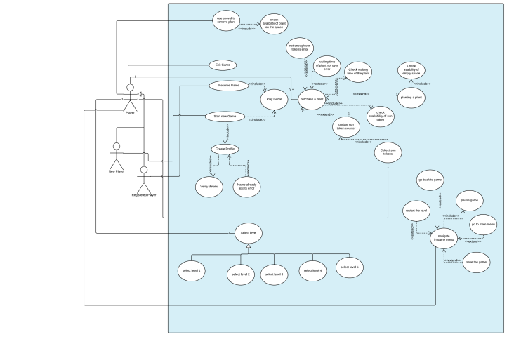
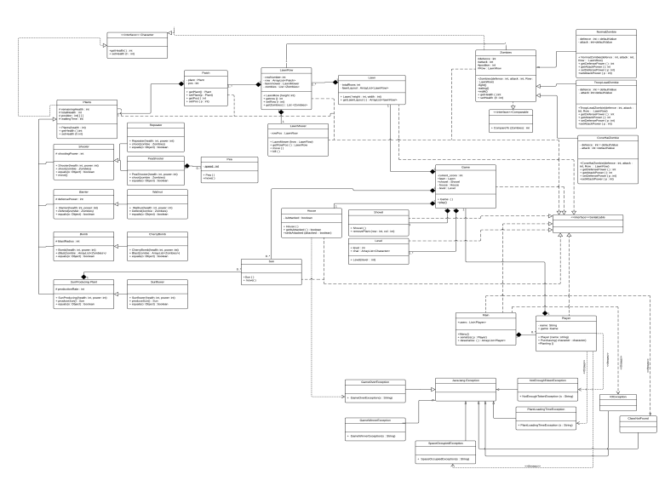
DESIGN AND IMPLEMENTATION
Followed OOP concepts with proper usage of polymorphism, encapsulation.
Implemented design pattern like singleton, façade, factory, wherever applicable.
Used Scene Builder to create the visual part using the graphics that are used in the game and created a program to link them all together.
The images on the left show the initial thought processes.

Slide 4
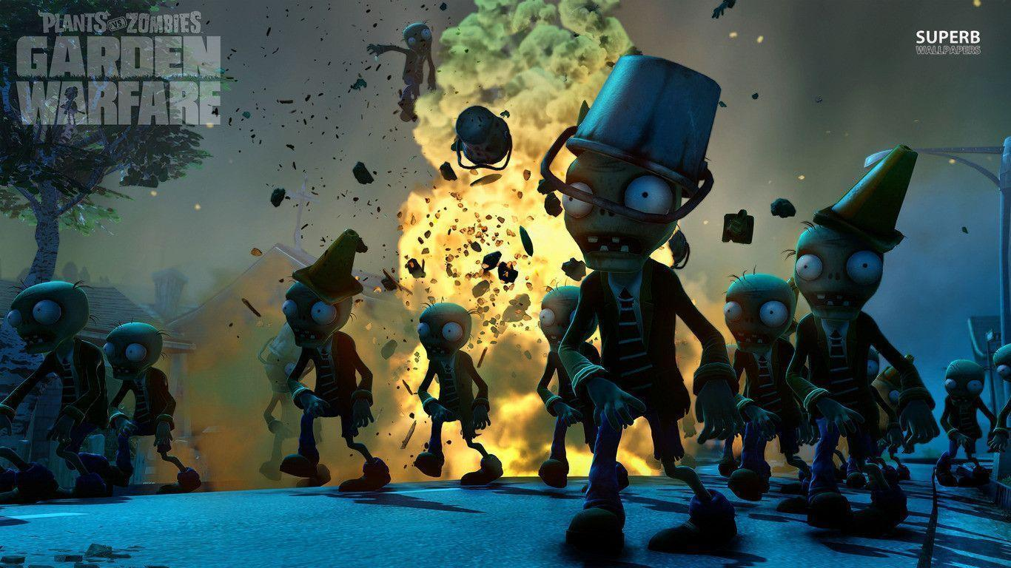
INDIVIDUAL CONTRIBUTIONS
DIBYA GAUTAM .
NANDINI BANSAL
Serialization and Deserialization.
Event handlers for mouse events on buttons.
Counters and clocks
Graphics planning and organization.
Ensured that the code has proper classes and follow OOP conceprs
Handled collisions
Plants’ and zombies’ movements
Graphics collection and organization.
Handled main logic of the code.
Event handlers for interactions between objects.

Slide 5
BONUS
BONUS
The game is properly detailed and we tried to incorporate as many features as we could in out game.
We also added some additional features like moving walnut plant, cherry bomb blast effects, etc.

