Slide 1



Slide 2


Slide 3
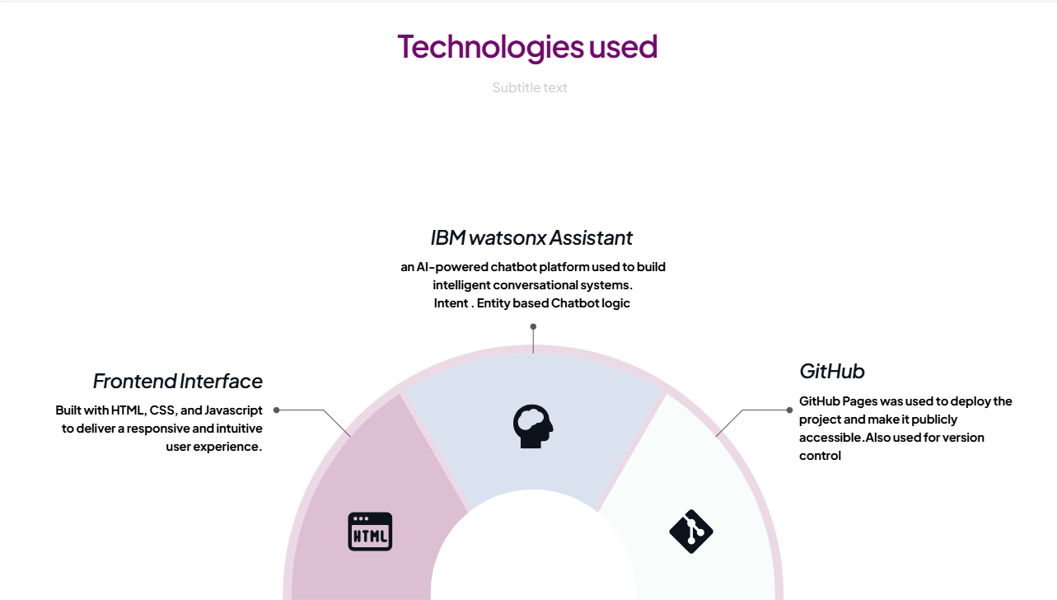

Slide 4
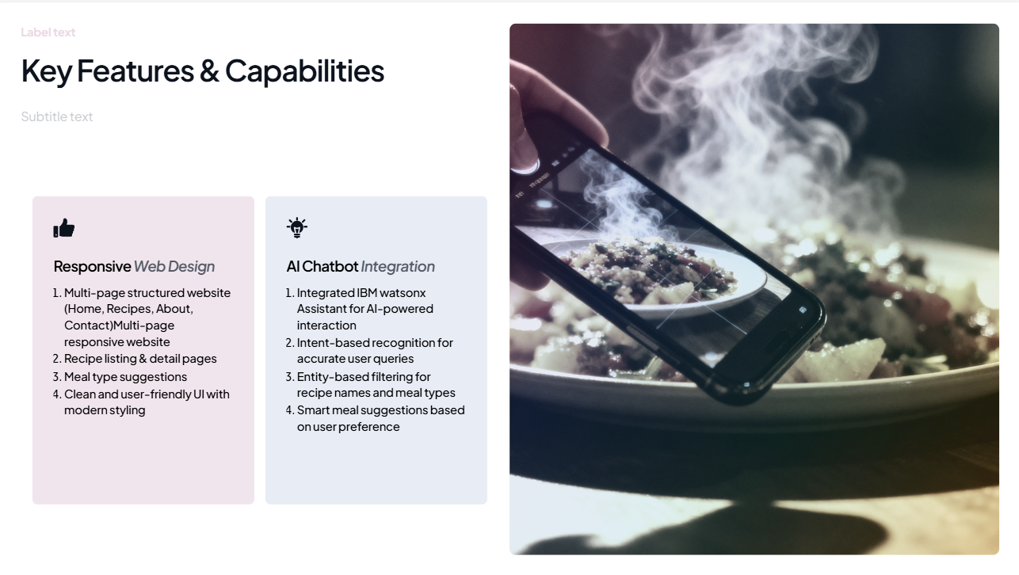

Slide 5
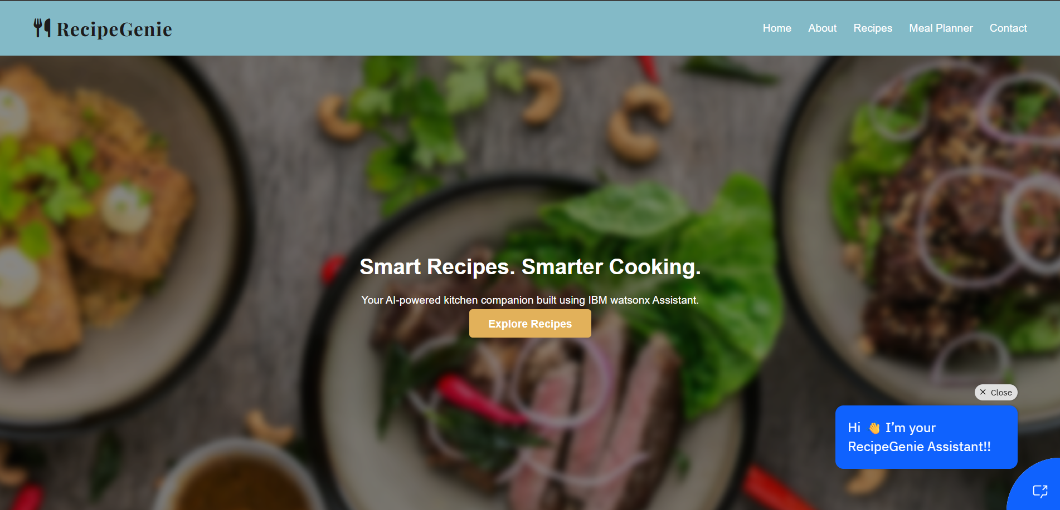
Screen Shot of website

Slide 6
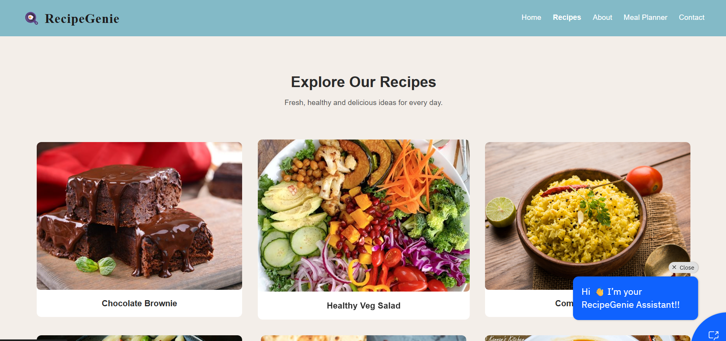

Slide 7
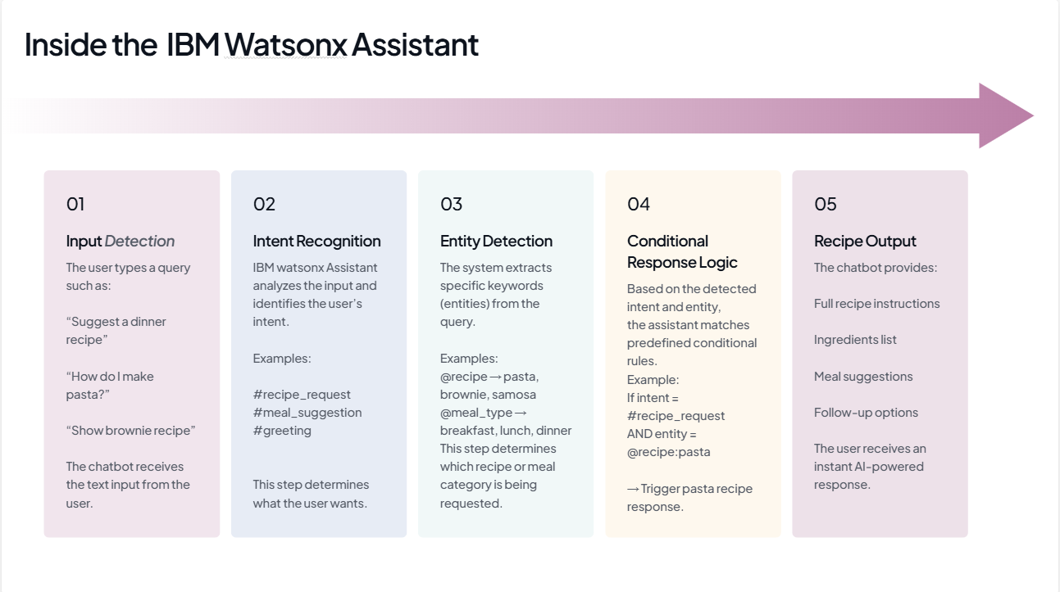

Slide 8
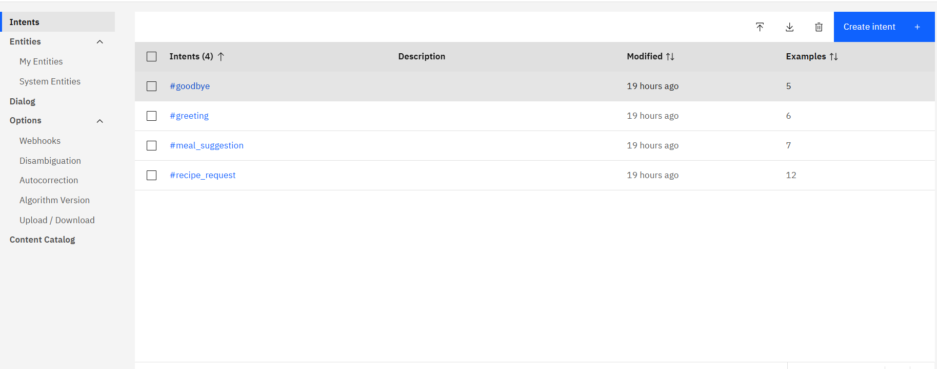
Screenshot of intent of watsonx assistant

Slide 9
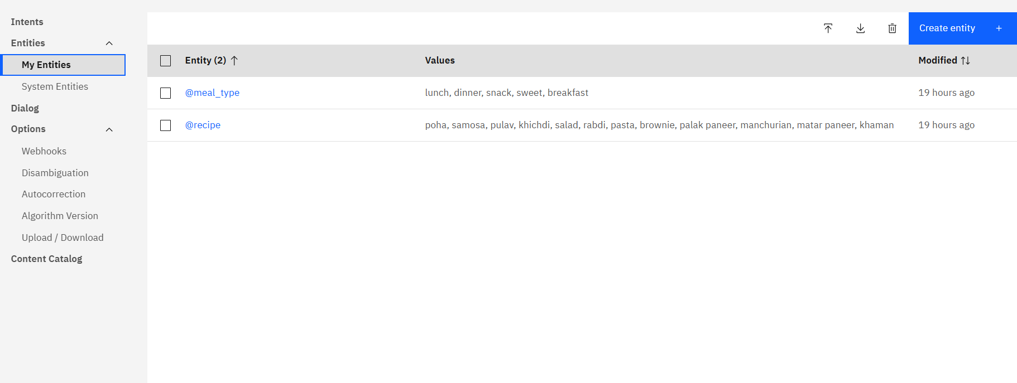
Screenshot of Entities of watsonx assistant

Slide 10
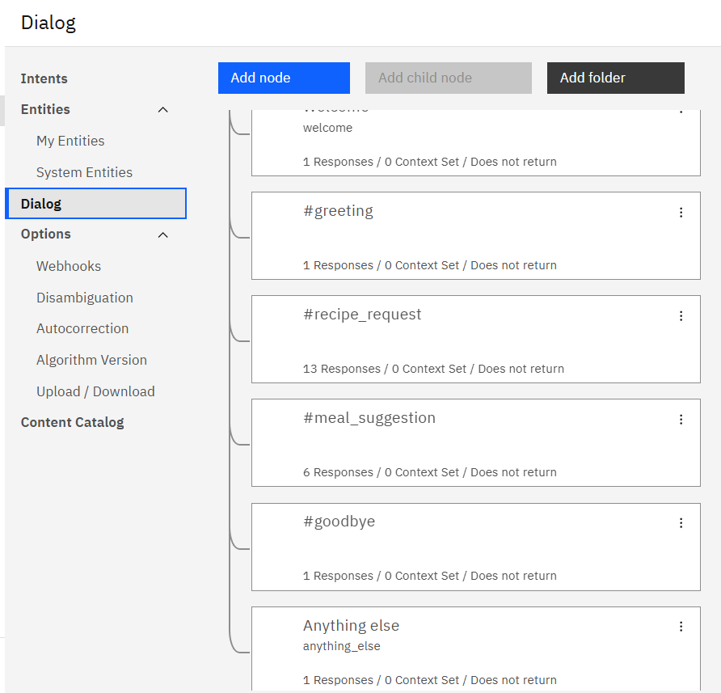
Screenshot of Dialog of watsonx assistant

Slide 11
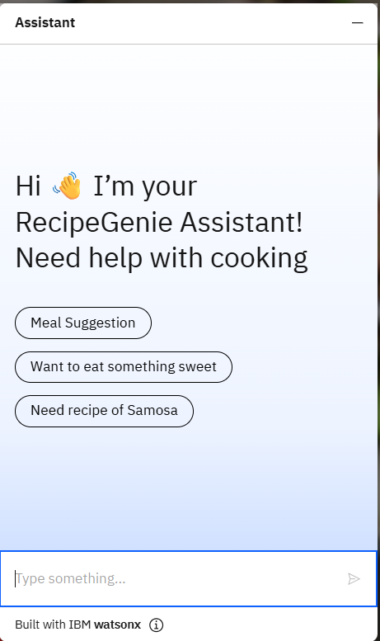
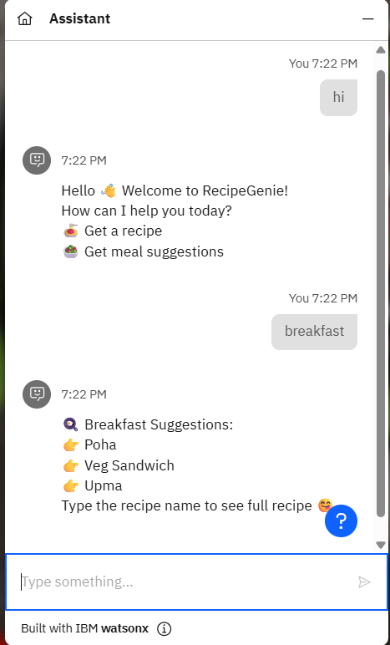
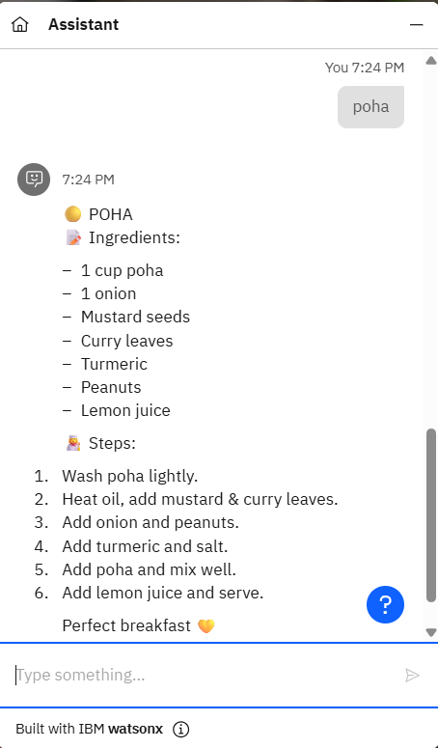

Slide 12
GitHub Repository
https://github.com/nandinichoudhary25/RecipeGenie
Live Website
https://nandinichoudhary25.github.io/RecipeGenie/

Slide 13
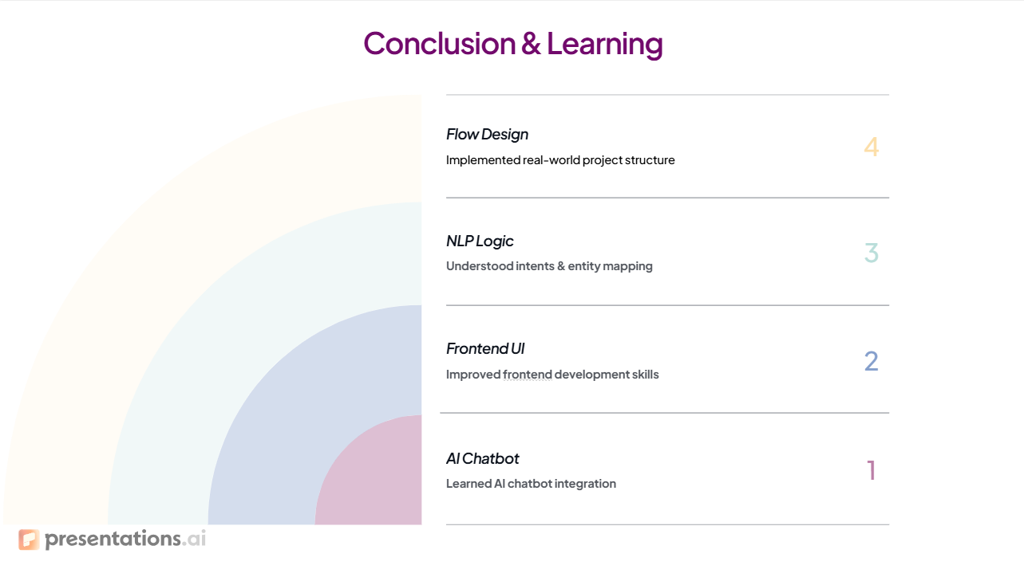

Slide 14


