Slide 1

What is ReactJS
It is a JavaScript Library(Free and Open Source)
Developed by Facebook
Used to create Single Page applications (Load Only Once)
Web and Mobile Applications
Latest version is 19.0.0

Slide 2

ReactJS is a JavaScript library used for building user interfaces (UIs), primarily for single-page applications (SPAs). It allows developers to create fast, scalable, and interactive web applications by using a component-based architecture.
Component Based Architecture
Reusability is possible
Uses Virtual DOM(Document Object Model)
Fast Rendering(Displaying the content in the webpage)
Easy to Learn

Slide 3
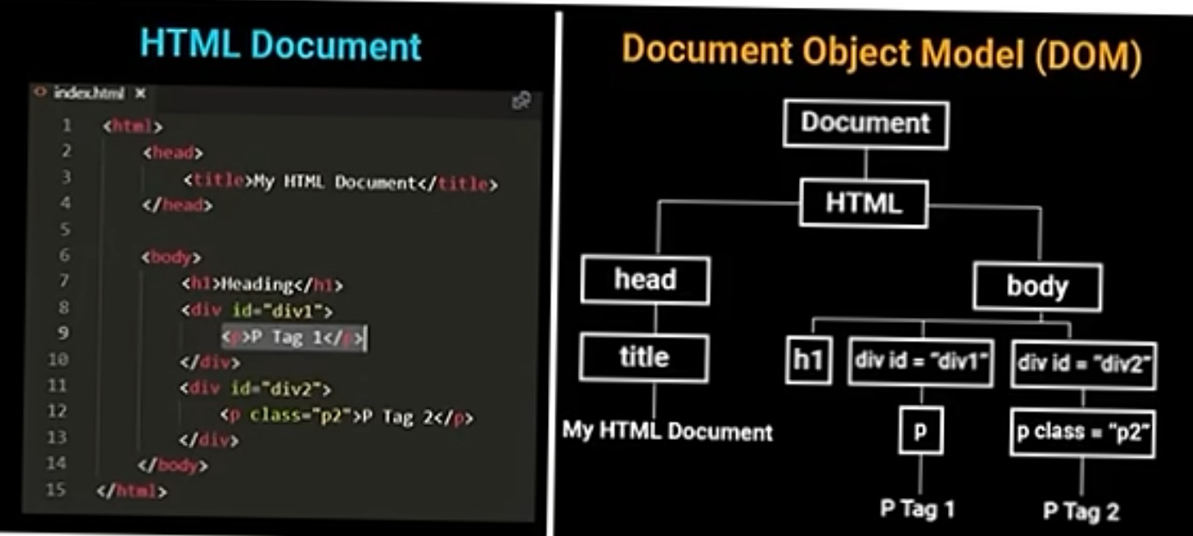

Slide 4
Components
React apps are built using components.
A component is a reusable and independent UI element (like a button, header, or form).
There are two types of components:
Functional Components (Recommended)
Simple JavaScript functions that return JSX.
Class Components (Older approach, uses this.state)
The state is a built-in React object that is used to contain data or information about the component.

Slide 5
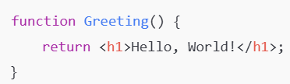
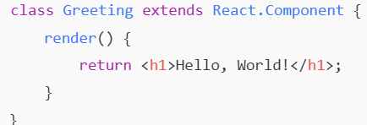

Functional Component Class Component
JSX (JavaScript XML)
JSX allows you to write HTML-like code inside JavaScript.

Slide 6
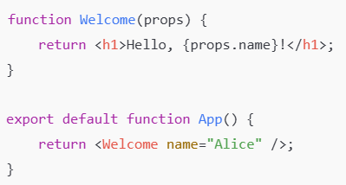
Props (Properties) Passing Data to Components
Props are inputs to components that make them dynamic.
Props allow data passing from a parent component to a child.

Slide 7
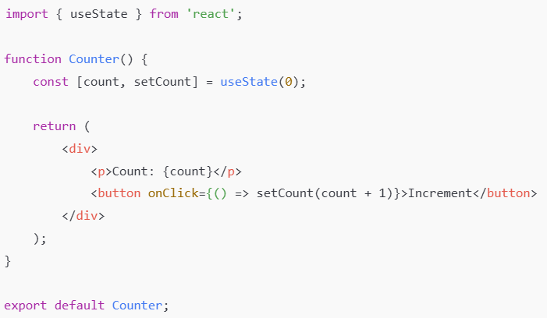
State (Component Memory) - Managing component data
State is used to store
component-specific data.
Unlike props, state is
mutable (can change).

Slide 8
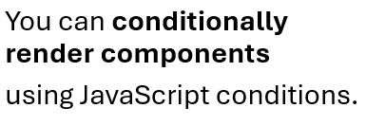
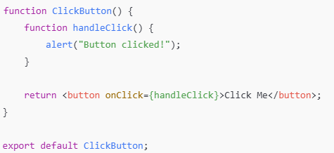
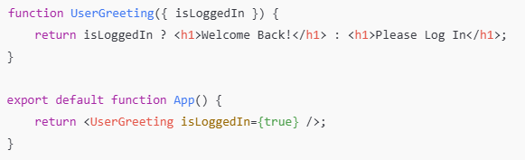
Event Handling in Components Conditional Rendering
Handling events in React is similar
to HTML but uses camelCase syntax.

Slide 9
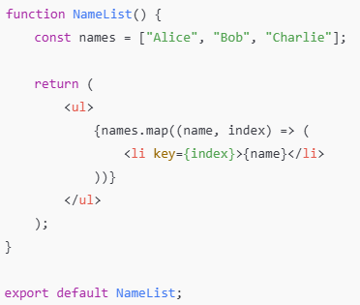
Lists & Keys (Rendering Dynamic Lists)
Keys help React identify which items have changed, added, or removed, making the rendering more efficient.

Slide 10
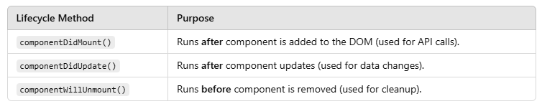
Component Lifecycle
In class components, React provides lifecycle methods to manage component behavior.
React components go through three main phases in their lifecycle:
Mounting (Component is created and added to the DOM)
Updating (Component is re-rendered due to state or prop changes)
Unmounting (Component is removed from the DOM)
Each phase has specific lifecycle methods that allow you to control what happens at each step.

Slide 11
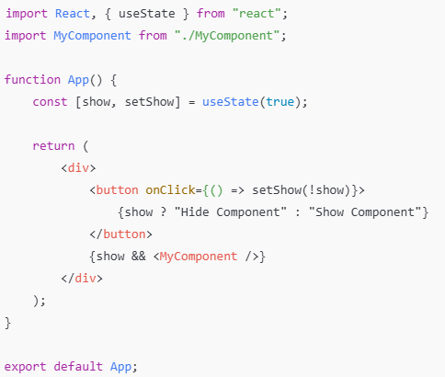
Initially, MyComponent mounts (componentDidMount() runs).
Clicking the button toggles show, which removes the component (componentWillUnmount() runs).
Clicking the button again adds the component back (componentDidMount() runs again).

Slide 12
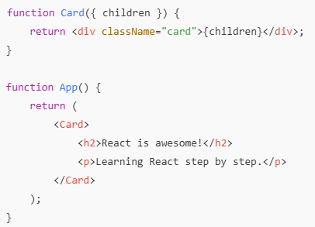
Composition (Preferred in React)
Instead of using inheritance, React composes components inside each other.
More flexible than inheritance , Encourages code reuse, Keeps components modular

Slide 13
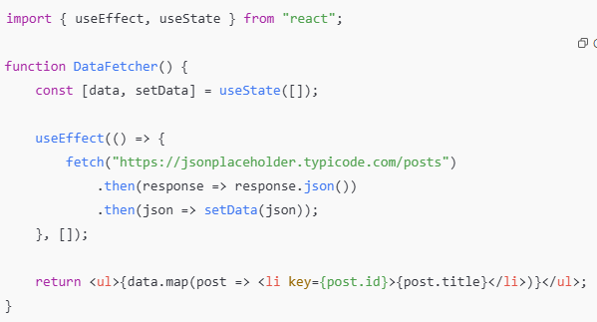
Hooks: Hooks allow functional components to manage state and side effects. Common hooks: useState(): Manages component state. useEffect(): Runs side effects (e.g., fetching data). useContext(): Shares global state.

Slide 14
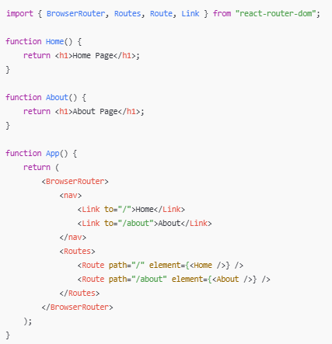
Routing (React Router)
React Router helps in navigation.
npm install react-router-dom

Slide 15
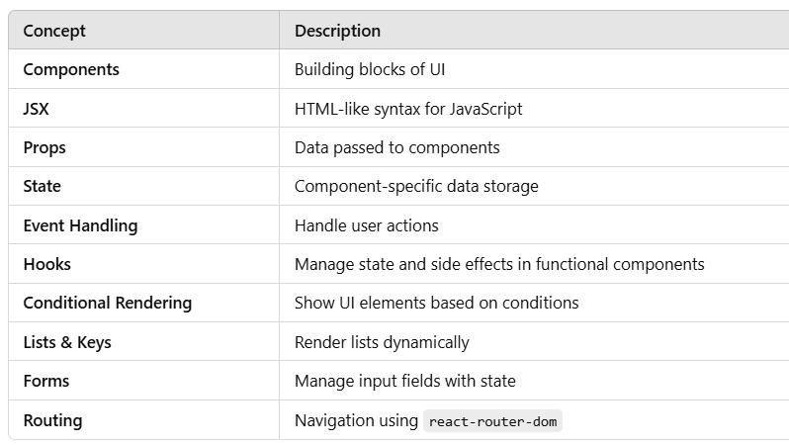

Slide 16
reflow/repaint
A Reflow happens when the browser recalculates the positions and sizes of elements in the document. This occurs whenever a change affects an element’s geometry (position, size, or layout).
Causes of Repaint
Adding/removing elements from the DOM
Changing an element’s size, position, margin, padding, borders, etc.
Changing window size (resizing the browser)
Using JavaScript to modify styles that affect layout (e.g., width, height, display)
A Repaint occurs when an element’s visual properties (like color, background, or visibility) change, but its layout remains unchanged.
Causes of Repaint
Changing color, background-color, visibility, box-shadow, etc.
Applying CSS effects like opacity, border-color, outline, etc.
Changing text color using color: red;

Slide 17
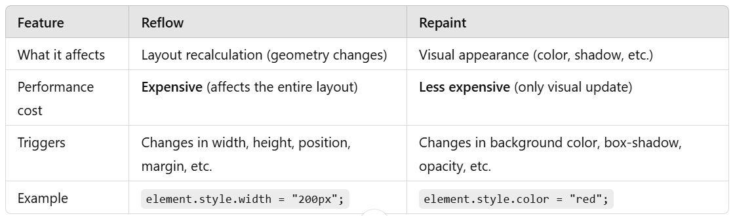
How to Optimize and Reduce Reflows & Repaints?
Minimize Layout Changes
Use visibility hidden Instead of display: none
Use transform and opacity for Animations

Slide 18
Virtual DOM
The Virtual DOM (VDOM) is a lightweight, in-memory representation of the real DOM.
React creates and updates this Virtual DOM instead of directly modifying the real DOM.
It helps improve performance by reducing unnecessary DOM updates
Faster Performance → Only updates necessary parts of the UI.
Efficient Rendering → Uses "diffing" to detect changes.
Better User Experience → Smooth updates without flickering.

Slide 19
How Does the Virtual DOM Work?
Step 1: Create a Virtual DOM:
Whenever a React component is rendered, React creates a Virtual DOM tree that mirrors the actual DOM.
Step 2: Compare with Previous Virtual DOM (Diffing)
When the component's state or props change, React:
Creates a new Virtual DOM (updated state).
Compares the new Virtual DOM with the previous Virtual DOM using a process called Reconciliation.
Identifies the changes (diffs) between the two Virtual DOMs.
Step 3: Update the Real DOM (Efficiently)
React then updates only the changed parts of the real DOM instead of re-rendering the entire page.

Slide 20
React Fiber
It is a complete reimplementation of React's reconciliation algorithm.
It makes UI updates faster, smoother, and more efficient, especially for complex applications.
It allows asynchronous rendering, improving performance for large applications.
It helps React pause, prioritize, and reuse work instead of blocking the UI.
Before Fiber: React used a synchronous, blocking rendering process. Once rendering started, it couldn't be interrupted.
With Fiber: React can split work into smaller chunks, pause rendering, and resume when needed.

Slide 21
Key Features of React Fiber
1. Interruptible & Asynchronous Rendering
React can pause rendering to keep the UI responsive.
Useful for animations, transitions, and large data updates.
2. Priority-Based Rendering
Different tasks are assigned different priorities:
High Priority: User interactions (e.g., button clicks, typing).
Low Priority: Background tasks (e.g., loading data, logs).
React processes urgent tasks first.
3. Concurrent Mode (Time-Slicing)
React can split tasks into chunks and process them over multiple frames.
Helps create a smooth user experience even with large updates.

