Slide 1


Data Analytics

Slide 2


Today's agenda
Project recap
Problem
The Analytics team
Process
Insights &
Summary
1.We will recap the overall project to give a high-level understanding of the business problem we're tackling and the specific requirements.
2. We will dive into the specific problem that we, the Data Analytics team, have been focusing on and will give some background as to why this is such a big problem.
3. After introducing the problem, I will go over the team responsible from our side in tackling this task.
4. I will then go over the high-level process that we followed to complete this task, so that you have complete clarity in how we tackle these kinds of tasks.
5. Finally, I will go over all important results and I will present them as a series of insights and visualizations from our analysis.

Slide 3

Social Buzz is a fast growing technology
unicorn that need to adapt quickly to it's
global scale. Accenture has begun a 3 month
POC focusing on these tasks:
•An audit of Social Buzz's big data practice
•Recommendations for a successful IPO
•Analysis to (nd Social Buzz's top 5 most
popular categories of content
“Social Buzz” is a fast growing technology
unicorn that need to adapt quickly to it's
global scale. Accenture has begun a 3 month
POC focusing on these tasks:
•An audit of Social Buzz's big data practice
•Recommendations for a successful IPO
•Analysis to find Social Buzz's top 5 most popular categories of content
Project Recap

Slide 4

Problem
The client has reached a massive scale within recent years and does not have the resources internally to handle it.
Social Buzz receives over 100000 posts per day which amounts 36,500,000 posts every year, of which this all unstructured data making it very hard to make a sense.
Identify the requirements that need to be delivered for this project.
Merging of sample data set tables
An analysis of their content categories that highlights the top 5 categories with the largest aggregate popularity

Slide 5



Jissele
Chief Technology Architect
The Analytics team
Marcus Rompton
Senior Principal
Nandini
Data Analyst

Slide 6
Data Understanding
Process
1
MICROSOFT EXCEL
Data Cleaning
2
Data Modelling
3
Data Analysis
4
POWER BI
Uncover Insights
5

Slide 7

Insights
16
75K
January
Animals
UNIQUE CATEGORIES
Category With Highest Score
MONTH WITH
MOST POSTS

Slide 8
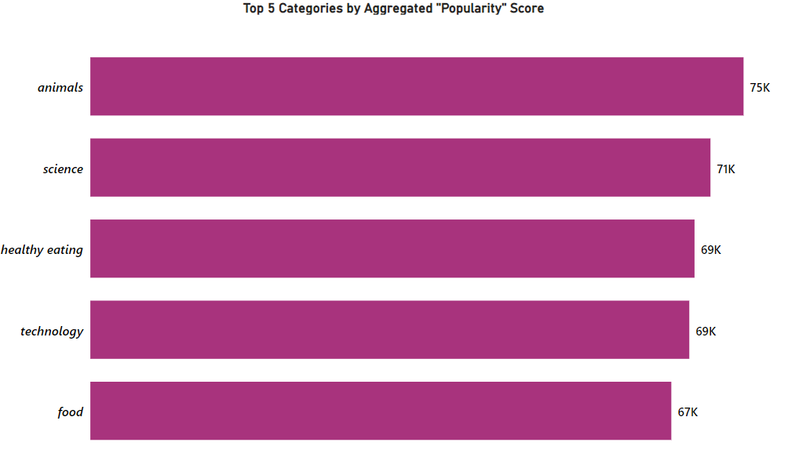

Slide 9
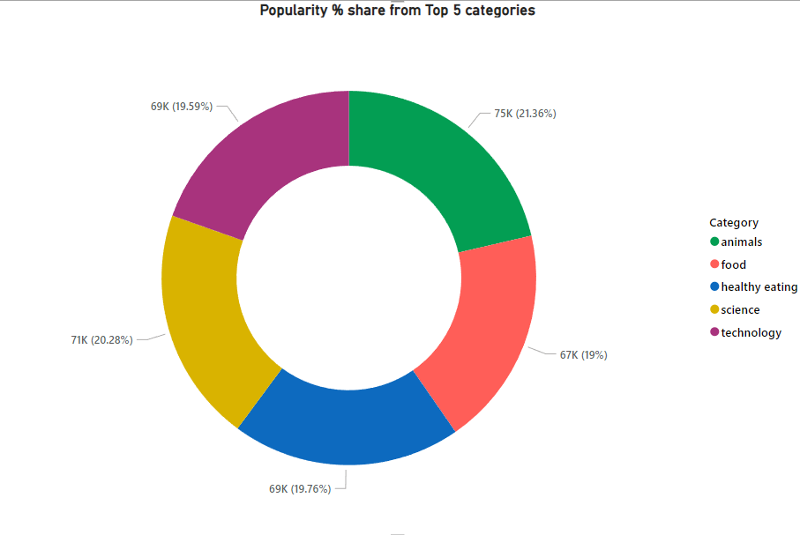

Slide 10
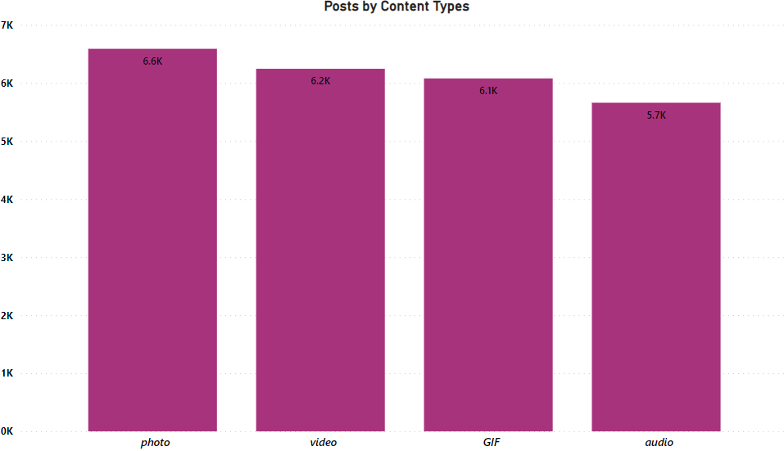
Looking at the total number of posts by content type, photos have the highest posts with a total of 6.6K posts, followed by videos with a total of 6.2K posts, in third place is GIFs with a total of 6.1K posts, and lastly audio with a total of 5.7K posts.

Slide 11

Animals and science are two of the most popular content categories, this shows that people enjoy “real-life” and “factual” content the most. So I would recommend that you keep creating more contents relating to these two categories.
Food is a common theme with the top 5 categories with “Healthy Eating” ranking as one of the highest. This may give an indication to the audience within your user base. You could use this insight to create a campaign and work with healthy eating brands to boost user engagement.
Summary
With rise in technology it is no surprise to see contents related to technology right up with the top categories. It show users enjoy your technology contents. I would recommend collaborating with some of the world’s tech giants as this would definitely make user engagement skyrocket.

Slide 12
Thank you!

