Slide 1

JAVA PROJECT

Slide 2

introduction
A Hospital Management System (HMS) is a software application designed to manage various aspects of a hospital's operations. These systems streamline administrative tasks, improve the efficiency of medical care, and facilitate better patient management. In Java, building an HMS involves creating modules for patient registration, appointment scheduling, billing, medical records, and more.

Slide 3
Key Features of a Hospital Management System
Patient Management: Register new patients, manage patient details, and maintain medical histories.
Appointment Scheduling: Schedule and manage appointments for doctors and patients.
Billing and Invoicing: Generate bills, manage payments, and handle insurance claims.
Medical Records: Store and retrieve patient medical records securely.
Inventory Management: Manage hospital inventory, including medicines and supplies.
Staff Management: Manage hospital staff, including doctors, nurses, and administrative personnel.
Reporting and Analytics: Generate reports for various metrics and analyze hospital performance.

Slide 4
Building a Hospital Management System in Java
1. Setting Up the Development Environment:
IDE: Use an Integrated Development Environment (IDE) like IntelliJ IDEA, Eclipse, or NetBeans.
JDK: Ensure you have the Java Development Kit (JDK) installed.
Database: Choose a relational database like MySQL, PostgreSQL, or Oracle.
Frameworks: Use frameworks like Spring Boot for backend development and Hibernate for ORM (Object-Relational Mapping).

Slide 5
Project Structure:
src/main/java: Contains the main Java source code.
Login class: contains login source code.
Connecting to Java database: Connect with my SQL data base
Reception Class: Contains reception details
NEW_PATIENT Class:
Room Class:
Department Class:
All_Patient_Info Class:
Patient Discharge Class:
Update Details Class:
Search Room Class:

Slide 6
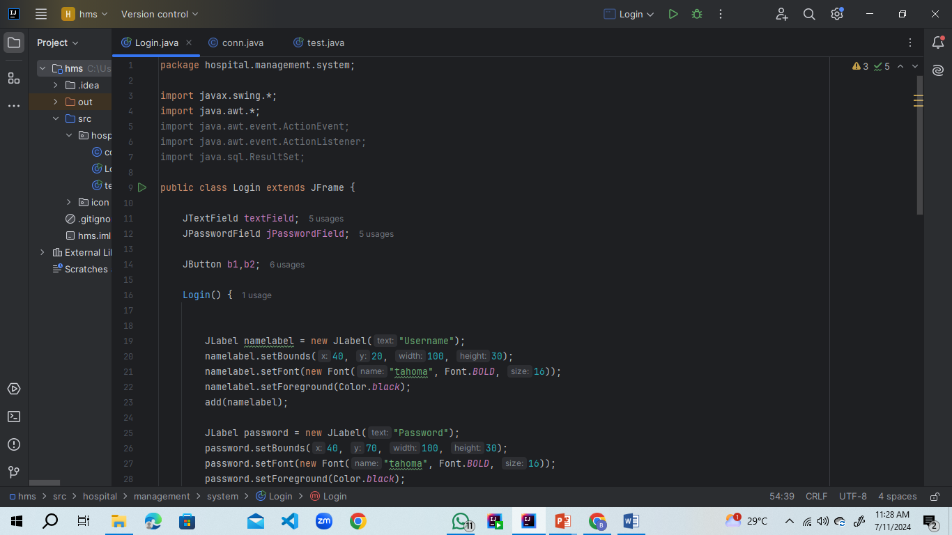
LOGIN CLASS:

Slide 7
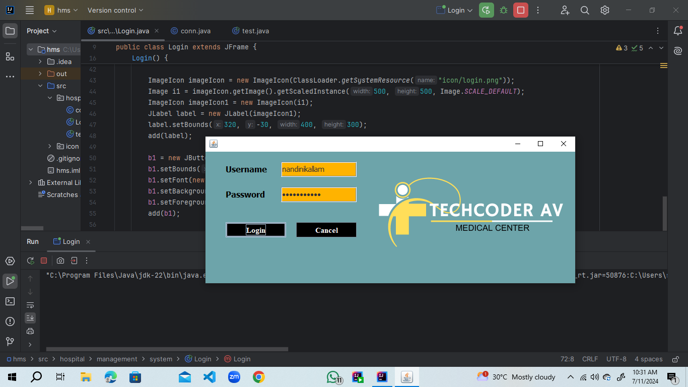
Output:

Slide 8
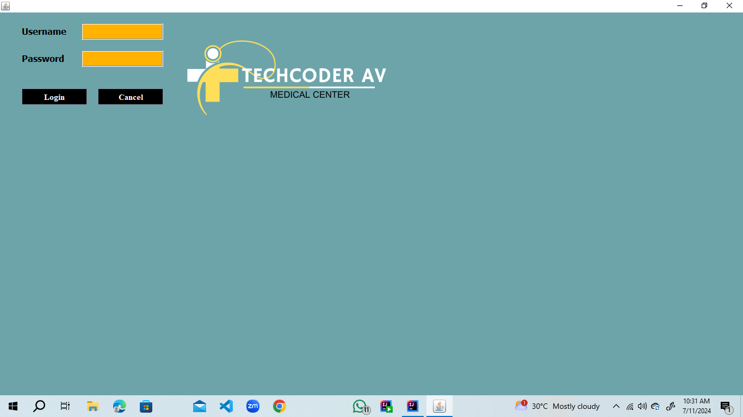

Slide 9
CODE:
LOGIN CLASS :
RECEPTION CLASS:
NEW_PATIENT Class:

Slide 10






ICONS:

Slide 11
THANK YOU
DONE BY:
K. Naga NANDINI & T. UMA DEVI
B D1 SECTION
ROLL NO: 19 , 25

