Slide 1
AI-Based Dynamic Difficulty & Retention Engine
Presented by
Nandini K.
1

Slide 2
Problem Statement
Gaming platforms generate large volumes of player activity data, but raw metrics alone do not provide actionable player-level insights.
Players differ in engagement, progression and activity patterns, so a single retention strategy is not effective for everyone.
The project aims to convert these raw data into actionable insights using machine learning and rule based recommendations so that the gaming team can implement the intervention for the player.
2

Slide 3
Project Objectives
Player Classification
Churn Prediction
Classify players based on weekly playtime and activity patterns.
Identify players with higher risk of becoming inactive.
Action Recommendation
Business Intelligence
Generate a suitable retention/engagement action from prediction results.
Turn gameplay metrics into actionable insights for gaming companies.
3

Slide 4
Dataset & Input Features
Player Profile
Gameplay Metrics
Engagement & Behaviour
Age Gender Location Game Genre Current Game Difficulty
Play Time Hours Per Week Sessions Per Week Average Session Duration Player Level Achievements Unlocked
In-Game Purchases Engagement Level Progression Speed Reports Received Match Abandonment
The application presents a simplified prediction form while the backend supplies the model-required features.
4

Slide 5
Data Preprocessing & Feature Engineering
Validated data types, missing values, duplicates and inconsistent records.
Handled extreme values using clipping/capping where appropriate.
Created derived behavioural features such as ProgressionSpeed and other engagement indicators.
Encoded categorical variables using OneHotEncoder with handle_unknown='ignore'.
Separated input features (X) from target variables (Y) before model training.
5

Slide 6
Target Variables (Y Variables)
Y1 — PlayerCategory
Y2 — ChurnRisk
Y3 — RecommendedAction
Casual / Moderate / Expert Based on weekly playtime.
High Risk / Low Risk Based on activity and engagement indicators.
Rule-based action generated from PlayerCategory and ChurnRisk.
7

Slide 7
Machine Learning Approach
1. PlayerCategory
2. ChurnRisk
3. RecommendedAction
Classification model XG Boost selected as the preferred model for the player category prediction.
Classification model Logistic Regression used for identifying player churn risk.
Rule-based decision layer Combines PlayerCategory and ChurnRisk to select an appropriate action.
8

Slide 8
Prediction Workflow
PlayerCategory Model
User Input
Preprocessing
RecommendedAction Rules
Results
ChurnRisk Model
Flow: User Input → Preprocessing → ML Predictions → Rule-Based Recommendation → Displayed Results
9

Slide 9
Application Architecture
Frontend — Streamlit
Backend — FastAPI
Data — Supabase
Interactive prediction interface • Player input form • Prediction button • Results display • Project overview and ML approach
Prediction API • Receives input data • Loads saved ML models • Performs preprocessing • Returns predictions
Cloud database layer • Stores project/player data • Supports data access • Separates application and database responsibilities
10

Slide 10
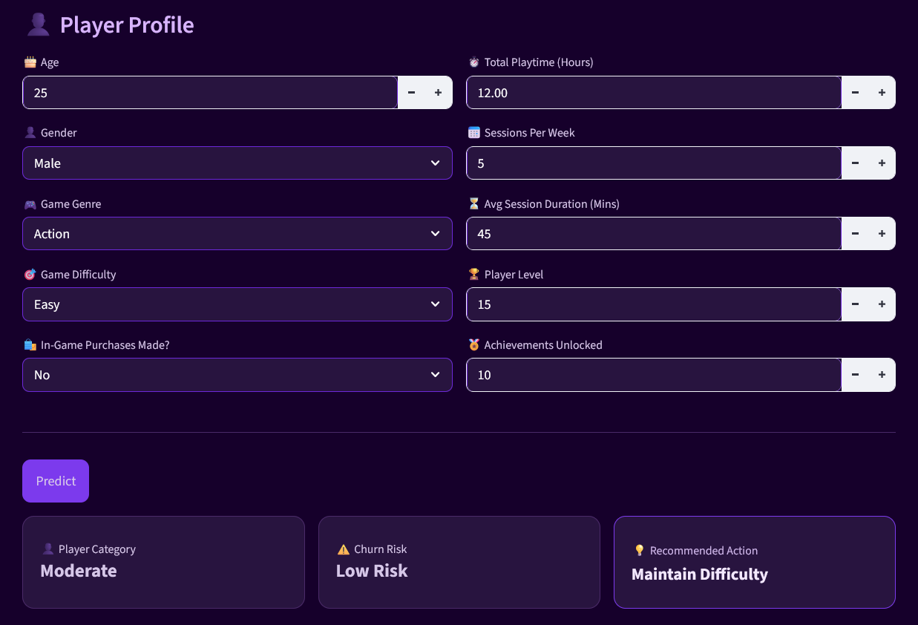
User Interface & Prediction Outputs
11

Slide 11
Business Value
Personalized Player Engagement: Different player groups receive tailored interventions.
Churn risk prediction: Identifies players at risk of churn and require attention.
Actionable Decision-Making: Converts model predictions into practical actions.
Operational Efficiency: Automates player segmentation and intervention selection.
12

