Slide 1
ApexPlanet Data Analytics Internship
Task 4: Hypothesis Testing
Presented by: Nandini Nitturi
Tools: Python | Pandas | SciPy | Matplotlib

Slide 2
Objective
• Analyze the sales dataset using statistical hypothesis testing
• Determine whether average Total Sales differs significantly from ₹100,000
• Examine the relationship between Quantity and Total Sales
• Use statistical evidence to support business decisions
• Interpret the results using a 5% significance level

Slide 3
Dataset Overview
• Dataset: Cleaned Sales Dataset
• Total Records: 1,000
• Numerical Variables:
- Age
- Quantity
- Unit Price
- Total Sales
•Data was cleaned and prepared before analysis
• Python and Pandas were used for data analysis
Variable | Description
Age | Customer age
Quantity | Number of units purchased
Unit Price | Price per unit
Total Sales | Total value of the sale

Slide 4
Hypothesis Test 1 — Average Total Sales
• Test Used: One-Sample t-Test
• Significance Level (α): 0.05
• H₀: Mean Total Sales = ₹100,000
• H₁: Mean Total Sales ≠ ₹100,000
• Sample Mean: ₹139,399.44
• t-statistic: 10.92
• p-value: 2.66 × 10⁻²⁶
• Decision: Reject H₀
Conclusion:
There is statistically significant evidence that the average Total Sales is different from ₹100,000. The sample average is approximately ₹139,399.

Slide 5
Hypothesis Test 2 — Quantity vs Total Sales
• Test Used: Pearson Correlation
• Variables: Quantity and Total Sales
• Significance Level (α): 0.05
• H₀: There is no significant relationship between Quantity and Total Sales
• H₁: There is a significant relationship between Quantity and Total Sales
• Correlation Coefficient: 0.647
• P-value: 1.71 × 10⁻¹¹⁹
• Decision: Reject H₀
Conclusion:
There is a statistically significant positive relationship between Quantity and Total Sales. As Quantity increases, Total Sales tends to increase.

Slide 6
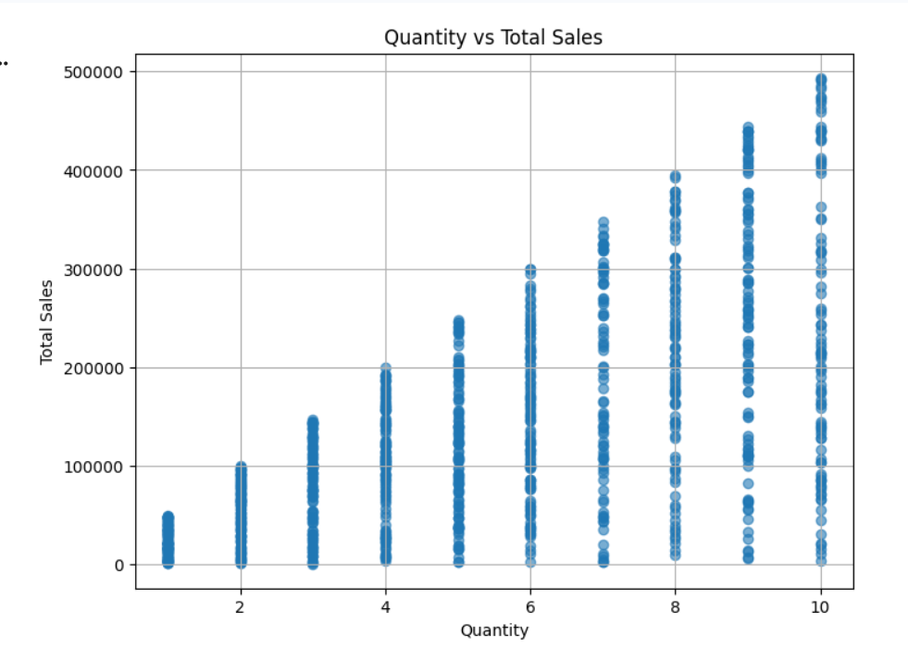
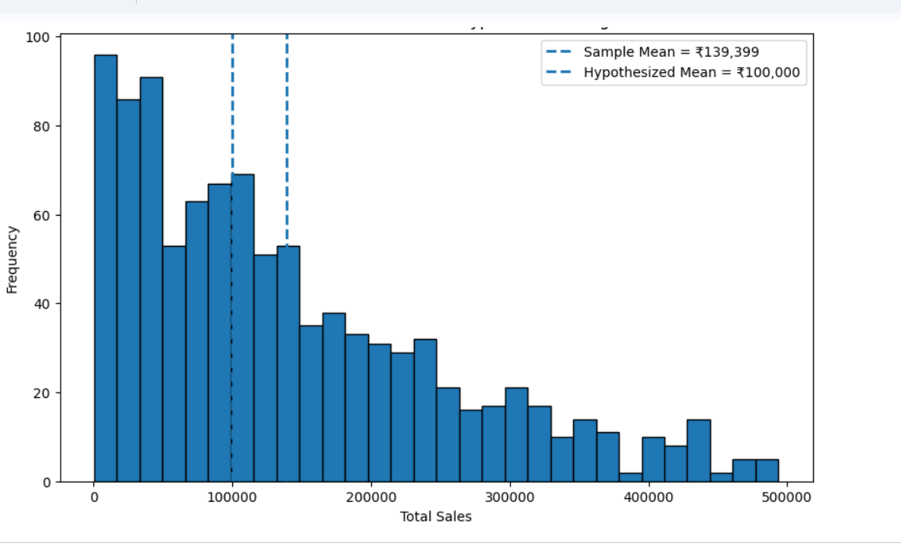
Visualizations

Slide 7
Conclusion & Business Insights
• The average Total Sales was ₹139,399.44, which is significantly different from the hypothesized value of ₹100,000.
• The one-sample t-test produced a p-value of 2.66 × 10⁻²⁶, leading to rejection of the null hypothesis.
• Quantity and Total Sales showed a positive correlation of 0.647.
• The Pearson correlation test produced a p-value of 1.71 × 10⁻¹¹⁹, indicating a statistically significant relationship.
• Hypothesis testing helped identify meaningful patterns that can support data-driven business decisions.
Key Takeaway:
Statistical analysis shows that sales performance is significantly different from the benchmark, and higher quantities are associated with higher Total Sales.

